Slide 1
QR Code Implement
Zxing Code on Raspberry Pi4
Speaker : Yi Tse Wu

Slide 2
More Simple Code
Use Dynamic Memory Allocation
Delete Redundant Library or Code
Notes:
sudo g++ "%f" -o %e `pkg-config --cflags --libs zxing`

Slide 3
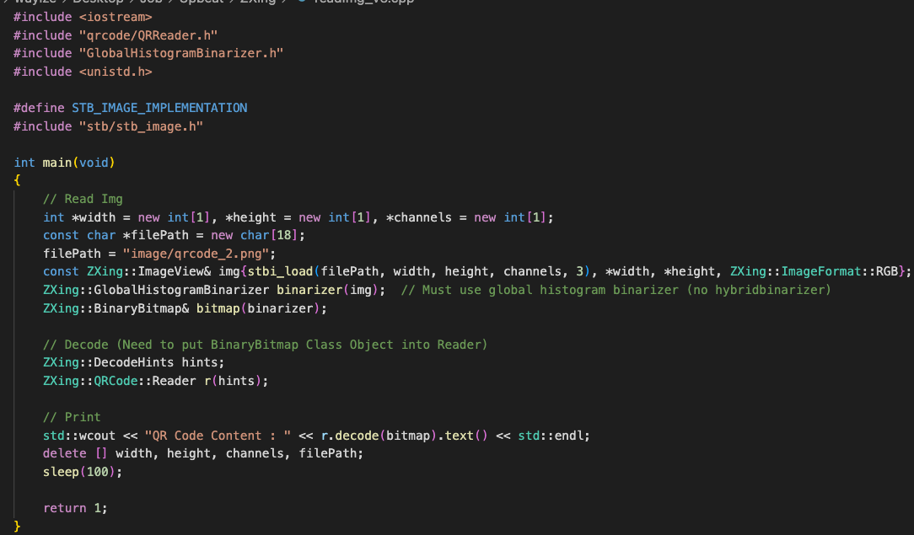
Source Code
Notes:
sudo g++ "%f" -o %e `pkg-config --cflags --libs zxing`

Slide 4
Program Resource Usage
Use C++ Function, “sleep”
Use Linux command, “pmap”
Notes:
sudo g++ "%f" -o %e `pkg-config --cflags --libs zxing`

Slide 5
Comparison Table, Read a 328 * 328 QR Code
Code | Memory Usage | EXE File Size
V1 : General | 6052 KB | 150.6 KB
V2 : Just QR Code | 5844 KB | 168.1 KB
V3 : Optimize | 5840 KB | 164.3 KB
Hello World | 5384 KB | 12 KB
sudo g++ "%f" -o %e `pkg-config --cflags --libs zxing`
Notes:
sudo g++ "%f" -o %e `pkg-config --cflags --libs zxing`

Slide 6
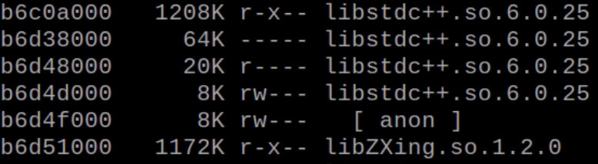
Pmap Command Result
1248 + 1208 + 1172 = 3628 KB
sudo g++ "%f" -o %e `pkg-config --cflags --libs zxing`
Notes:
sudo g++ "%f" -o %e `pkg-config --cflags --libs zxing`

