Slide 1

Daddy Wrestler
This is a film that makes one's blood boil

Slide 2
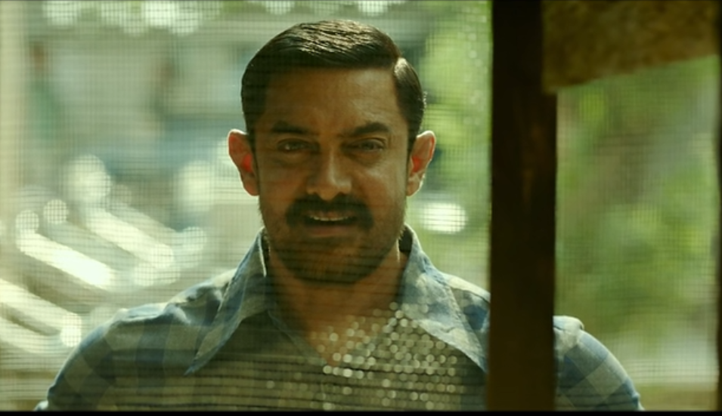
The father smiled when he saw his daughters' athletic talent

Slide 3
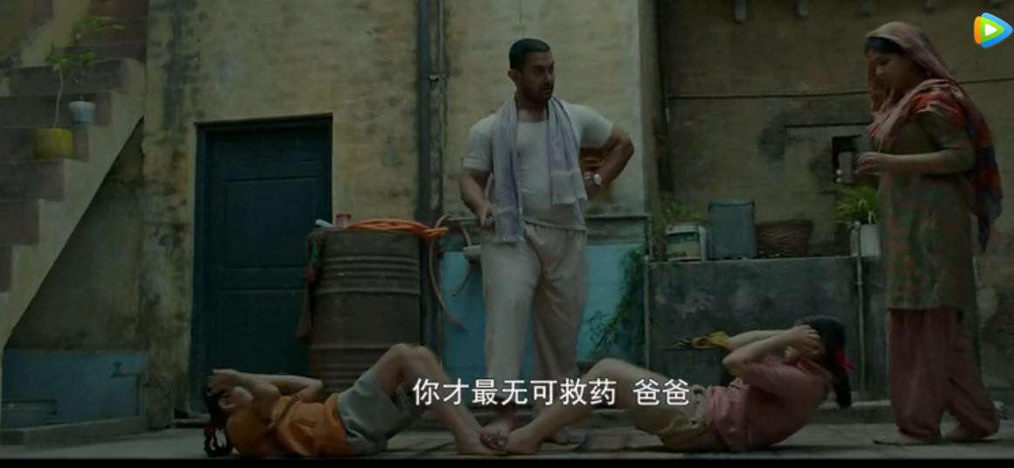
He picked out two of his most talented daughters and began to train them

Slide 4
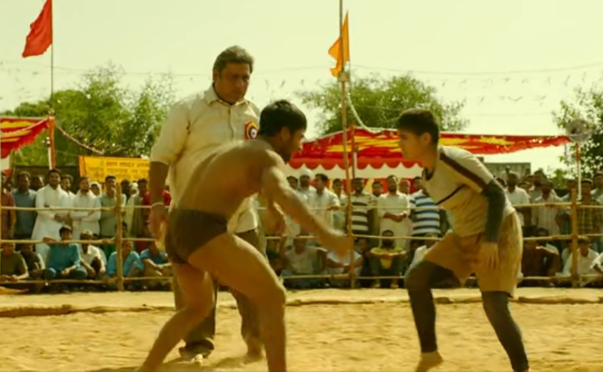
Geeta won. She once beat a boy in a her hometown

Slide 5
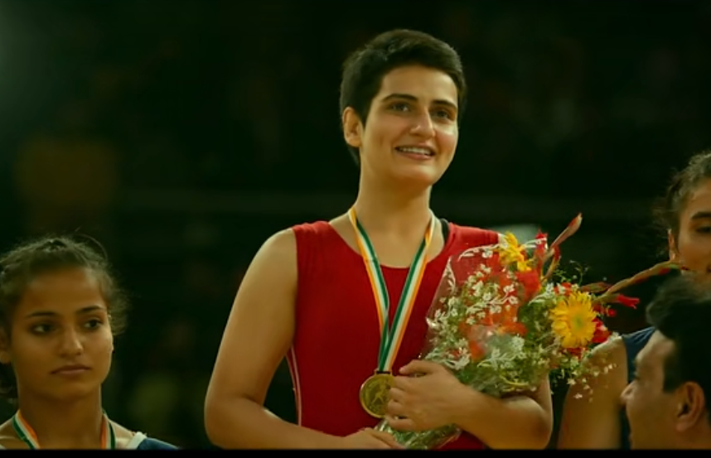
Under the guidance of her father, Geeta has won all kinds of domestic competitions, and now she wants to go for the gold medal in world competitions

Slide 6
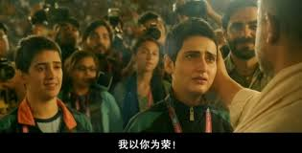
Finally geeta got the world champion, from the beginning to fulfill her father's ideal and gradually become to fight for her own ideal

