Slide 1
BEFORE · raw python-pptx
Atoms compose into Units
VOCAB
UNIT
perro
Ordering food
composes into
(dog)
a real-world ability
Drop shadows are offset-rect ghosts. The connector arrow has no arrowhead in Keynote.

Slide 2
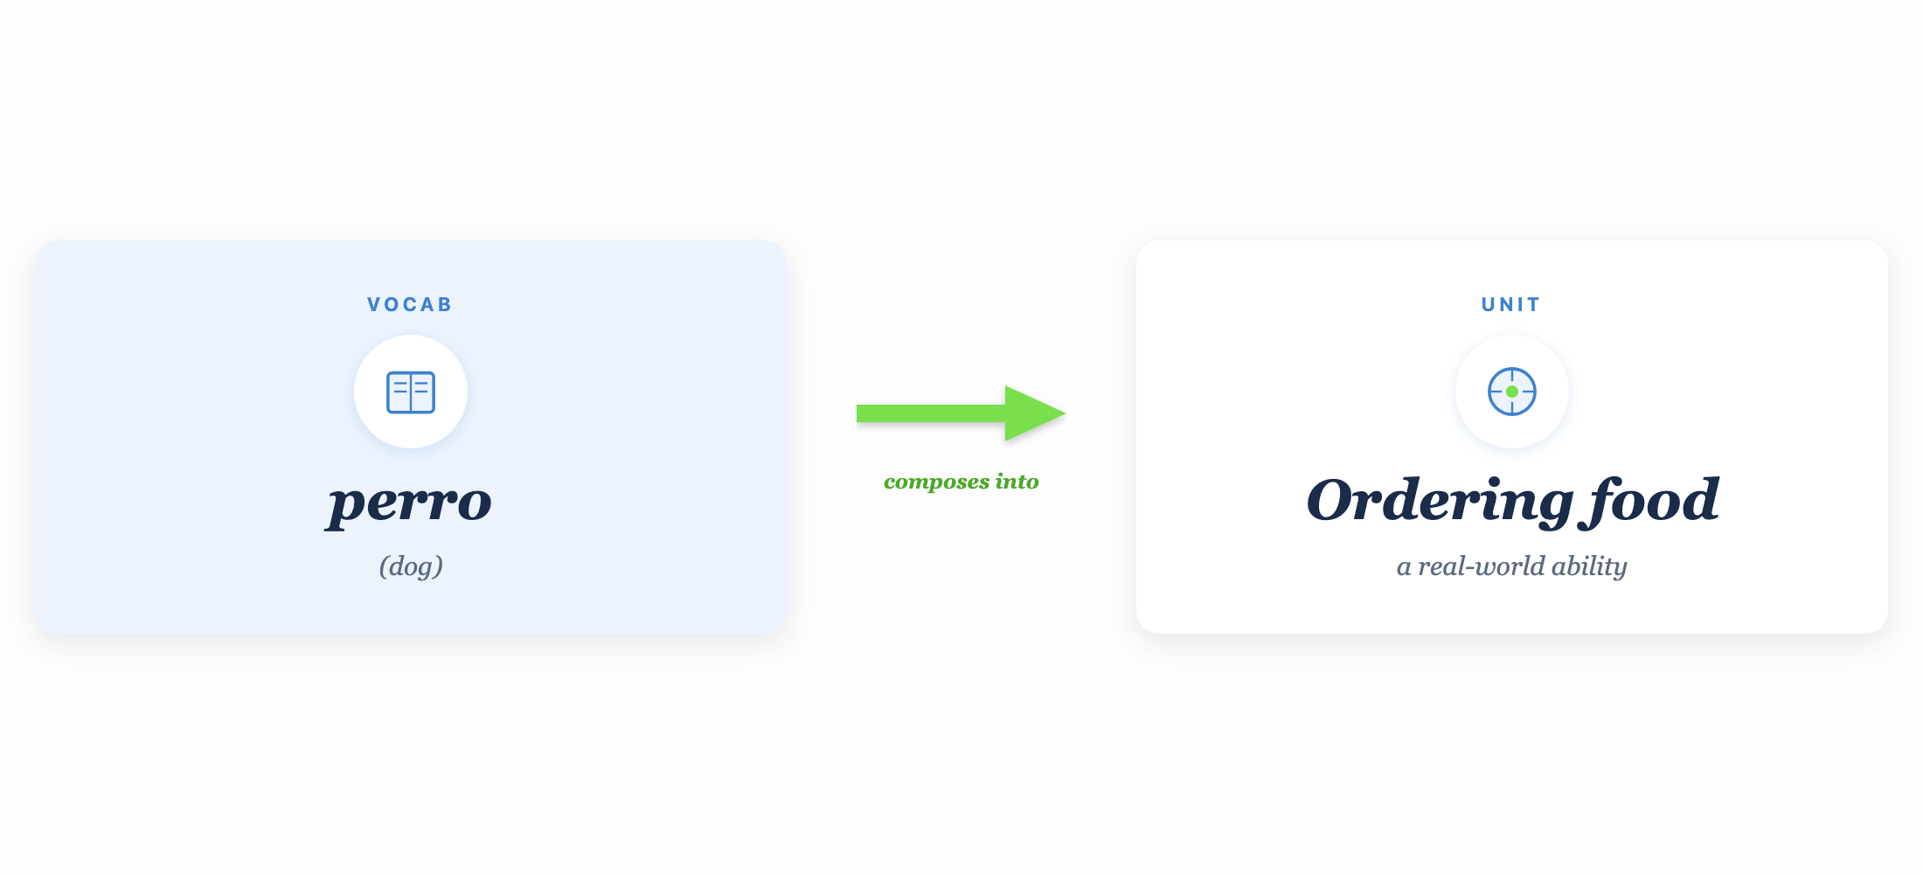
AFTER · HTML/SVG → PNG → embed
Atoms compose into Units

