Slide 1


Slide 2
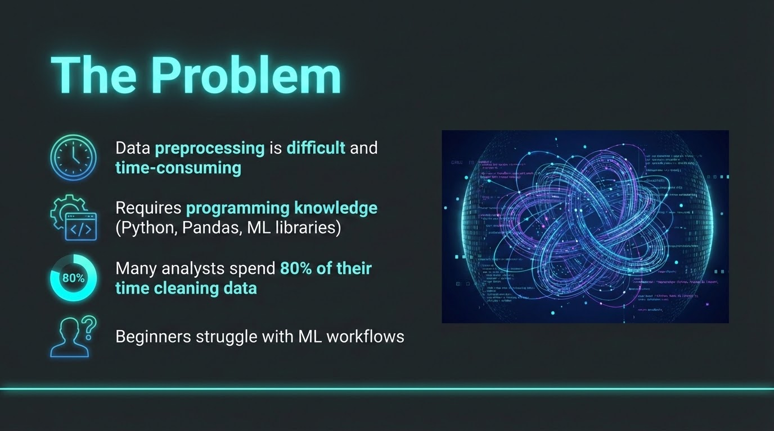

Slide 3
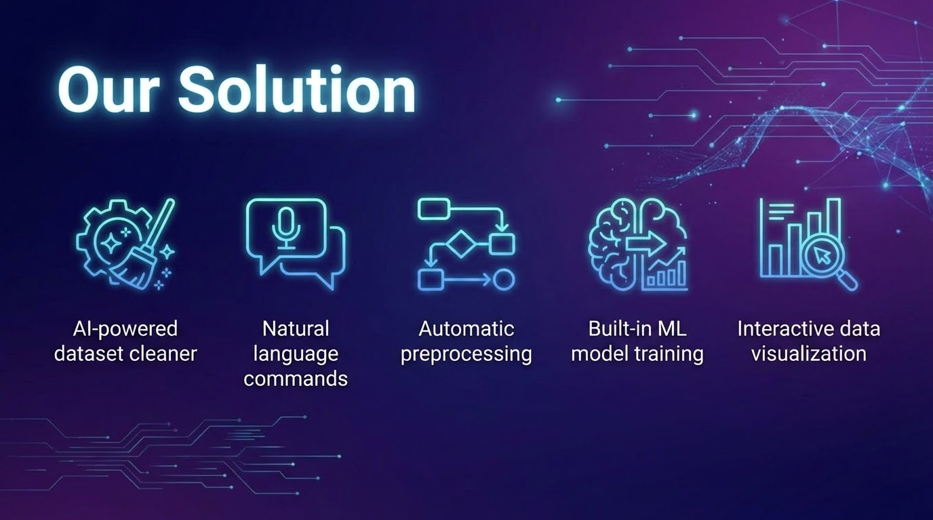

Slide 4
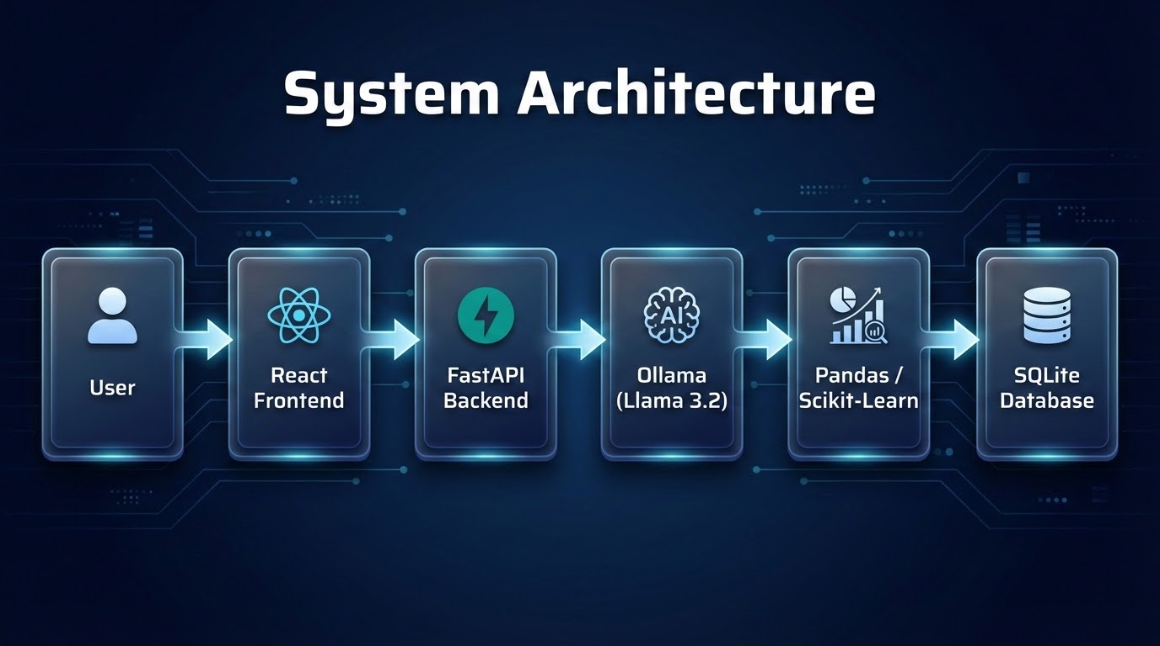
Notes:
Explain components:
React UI
FastAPI backend
Ollama running Llama locally
Pandas data processing
ML models
SQLite logging

Slide 5
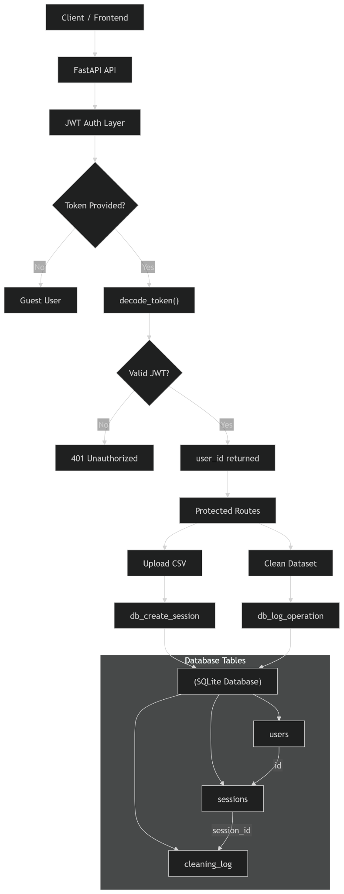
The Database

Slide 6
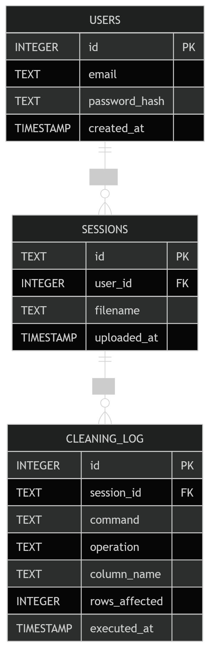
The Database

Slide 7
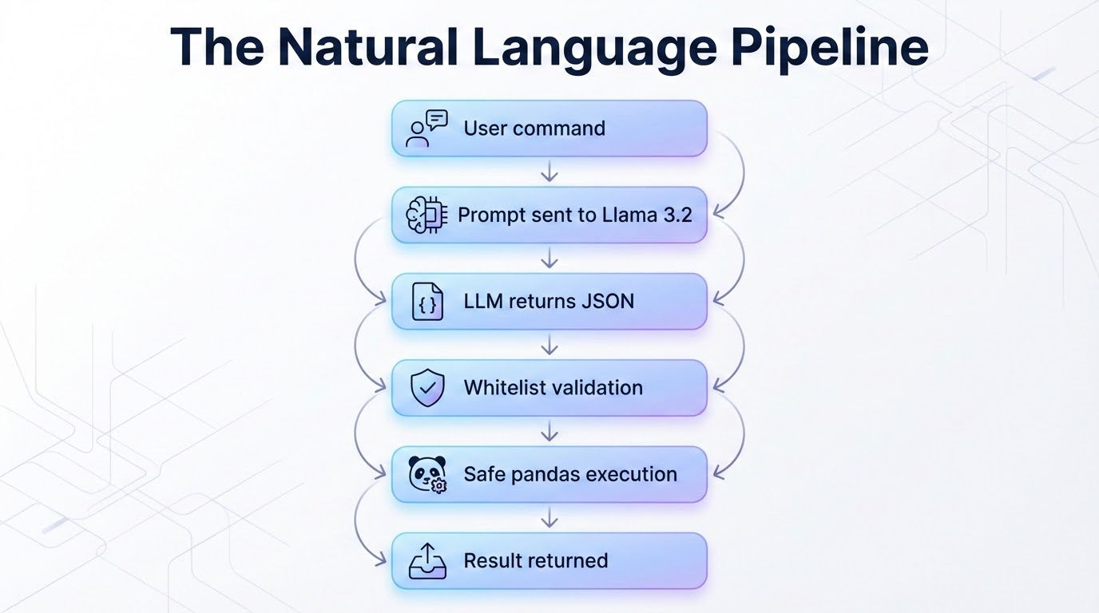
Notes:
{ "operation": "remove_outliers", "column": "cholesterol" }

Slide 8
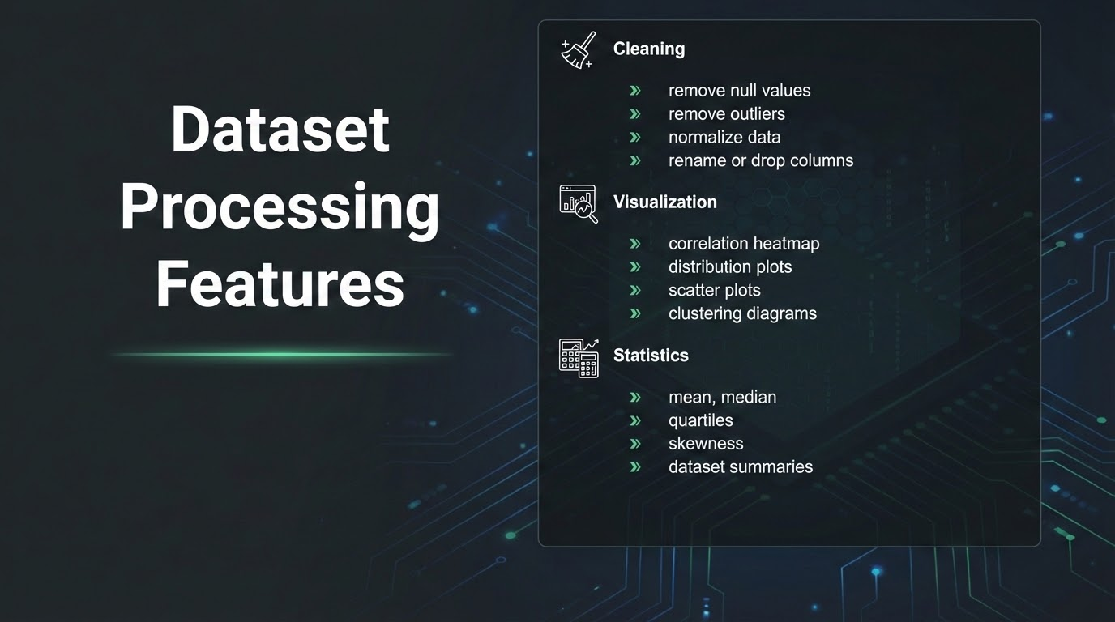

Slide 9
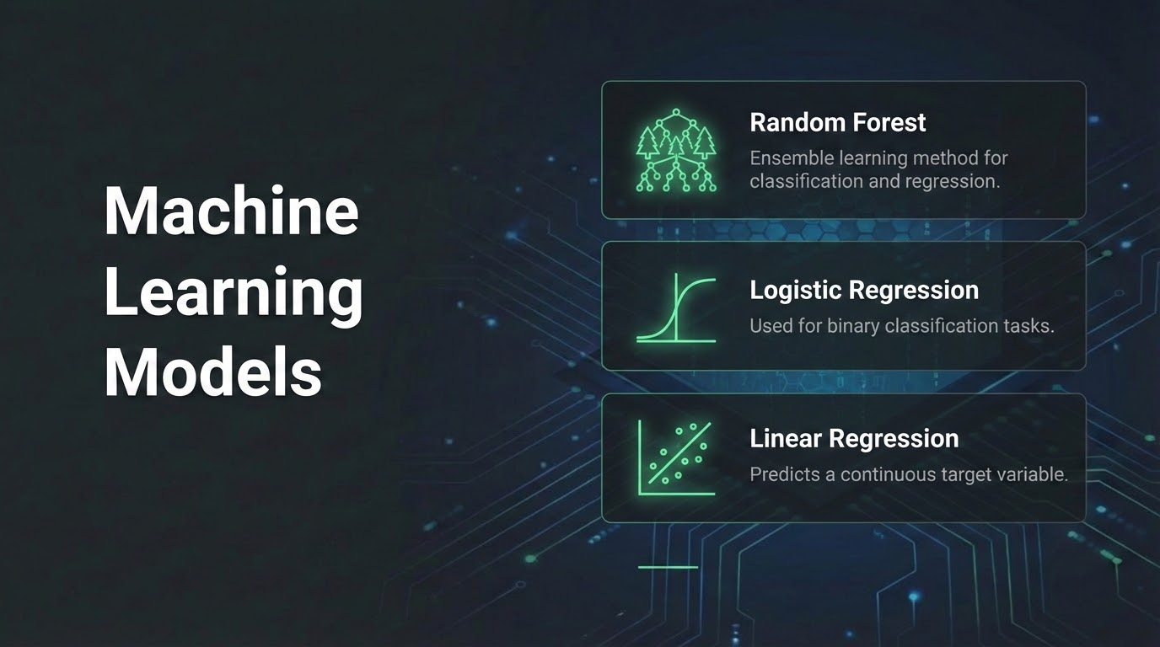

Slide 10
The Application

Slide 11
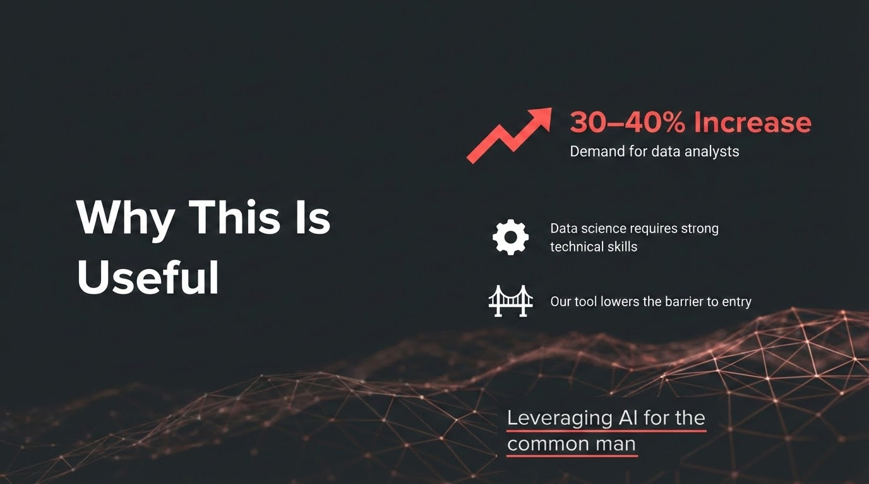

Slide 12
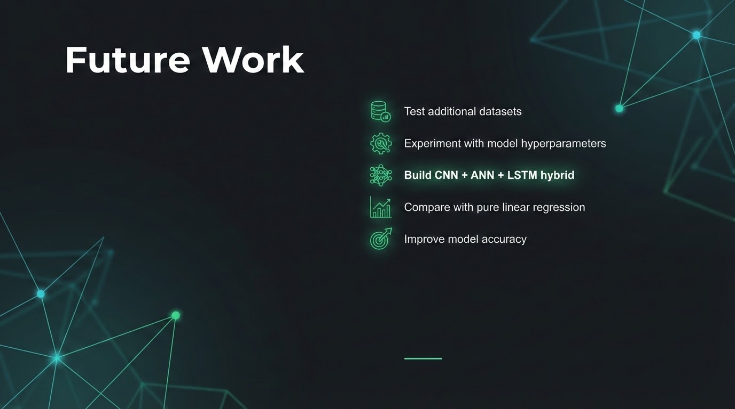

Slide 13
References
IsraelTheAnalyst. “Should You Become a Data Analyst in 2026?” Medium, Mar. 2026,
https://medium.com/@israeltheanalyst01/should-you-become-a-data-analyst-in-2026-bc0473eed805.
Bureau of Labor Statistics, U.S. Department of Labor. (2025, August 28). Data scientists. Occupational Outlook Handbook.
https://www.bls.gov/ooh/math/data-scientists.htm

