Slide 1

Welcome to the Presentation
PATIENT MANAGEMENT SYSTEM FOR DOCTORS

Slide 2


Introduction
ETHIC- 16301200

Slide 3
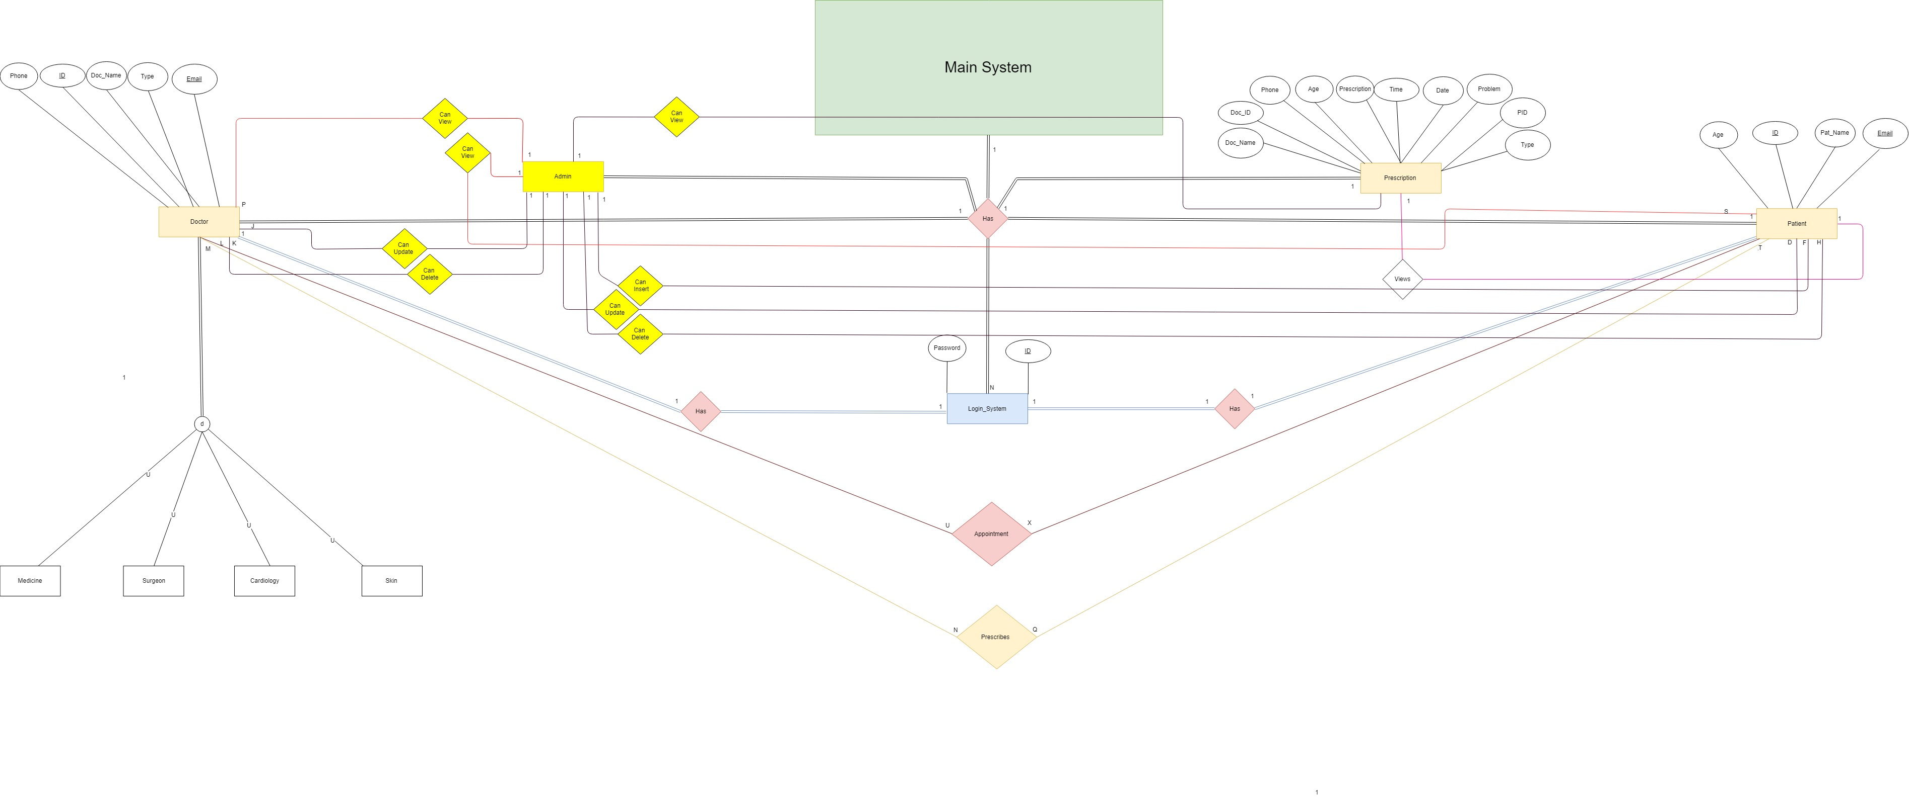
EER Diagram

Slide 4
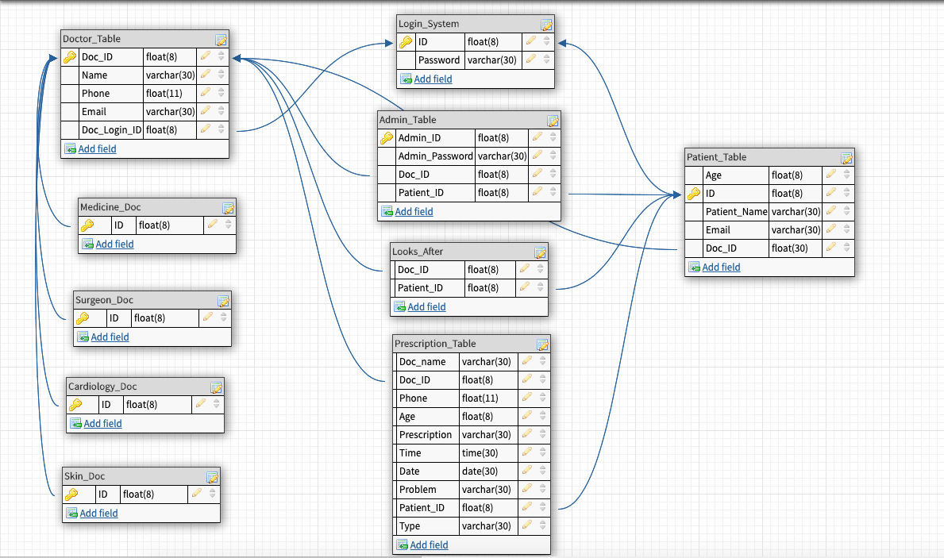
RELATION SCHEMA

Slide 5
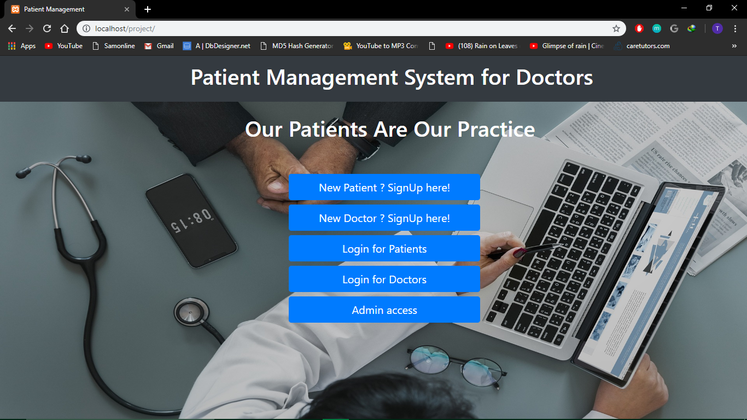

Slide 6
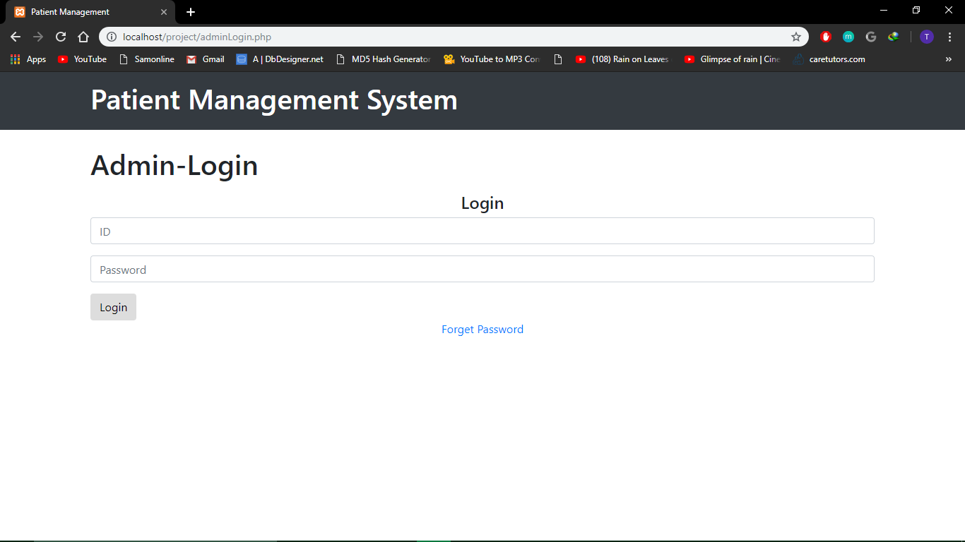

Slide 7
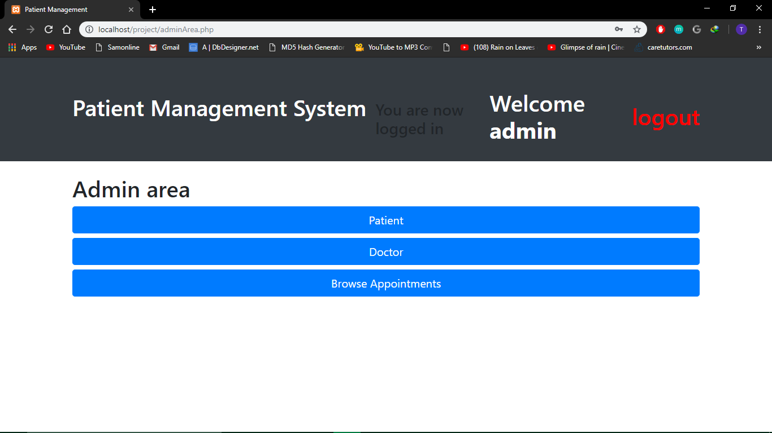

Slide 8



Slide 9


Slide 10


