Slide 1

Infosys Summer Of Ideas 2020
Team: FlyPhishers
Captain: Benjamin goh

Slide 2

Phishing
Phishing sites are a threat to everyone as they try to steal confidential data. Measures to help identify and avoid Phishing attacks are:
Knowledge of known phishing techniques
Random popups
Type URL of known site instead of clicking a picture of link claiming it will bring you there
Properly closing
Site security
HTTP vs. HTTPS
Avoid sharing personal information

Slide 3

Problem Proposal
Create a Chrome extension capable of:
Alerting users if they are visiting an insecure site
Identify if a website is a known phishing website
Use machine learning to identify malicious websites
Checking emails as possible phishing attempt

Slide 4
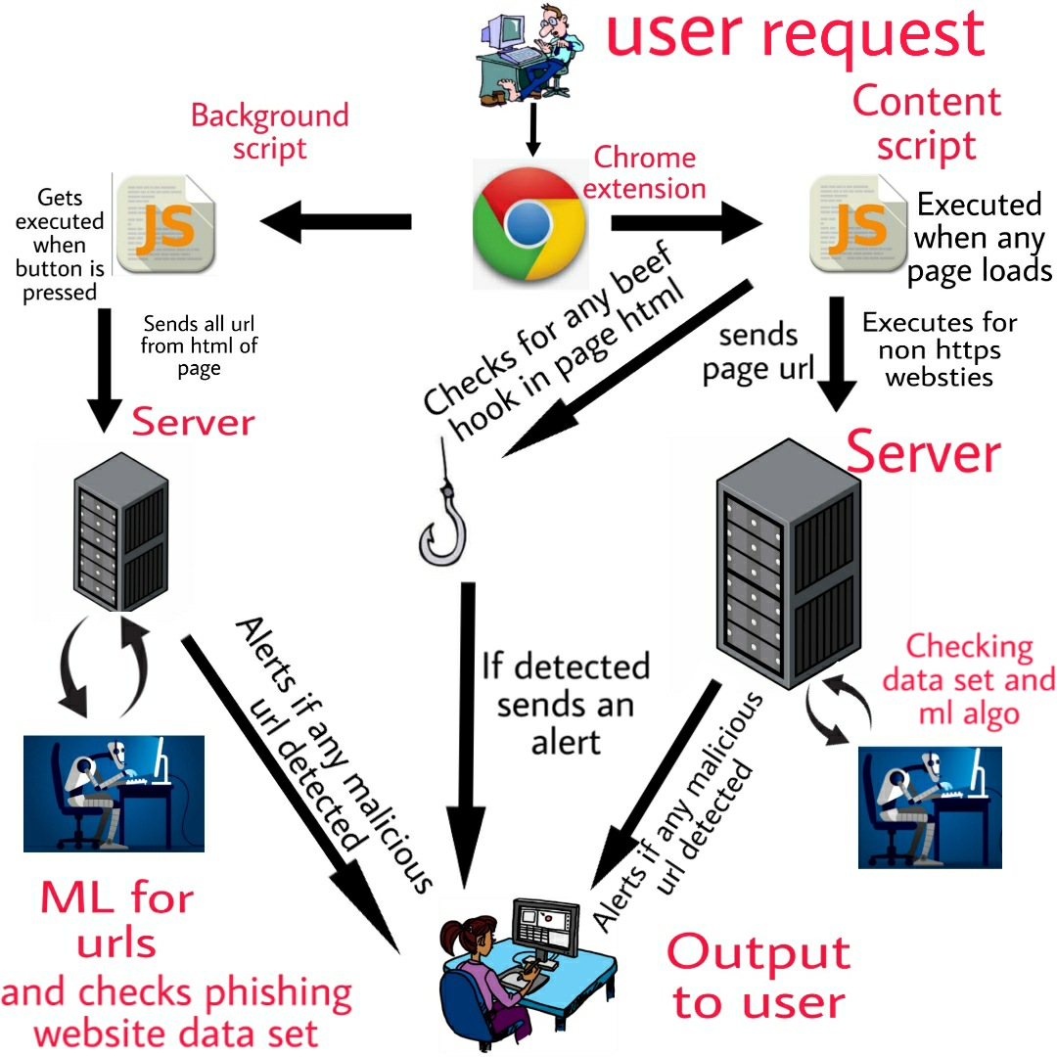
Solution: Phishing Detector
Three checks
Site URL scan
HTML page scan for BeEF hooks
HTML page scan for malicious URLs
Three methods for checking
HTTPS vs. HTTP
Index database of known phishing sites
Machine learning

Slide 5
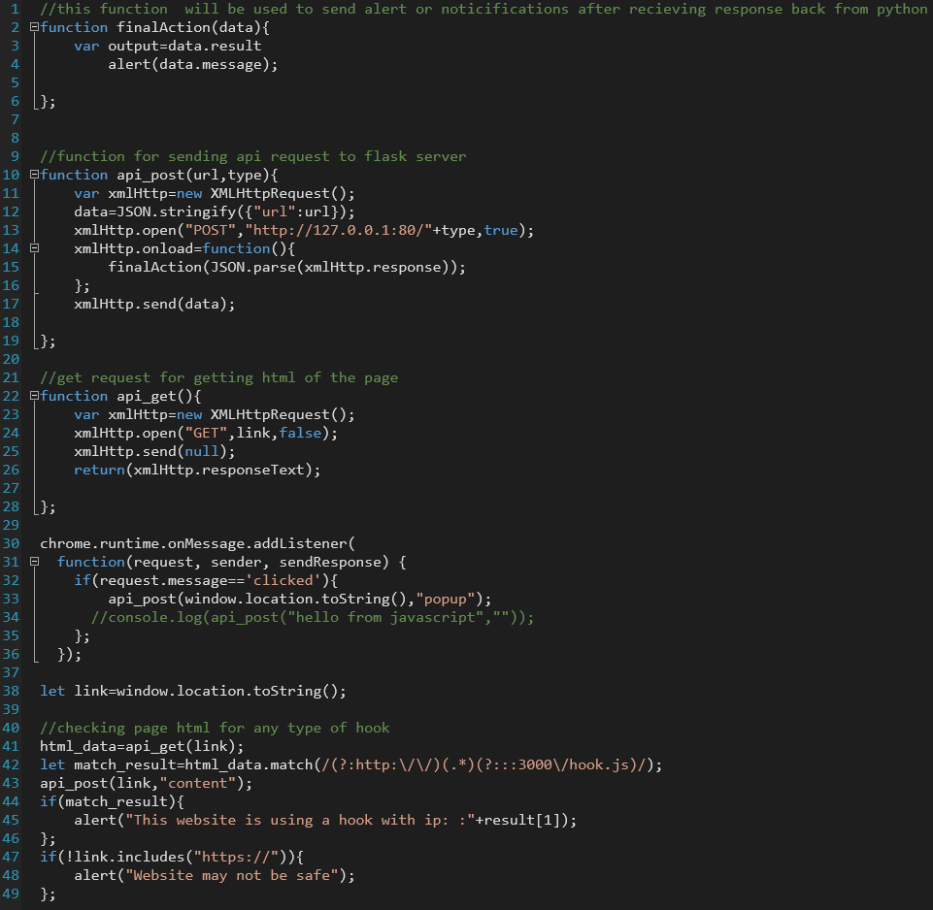
Content Script
Runs in background
Triggered when new page is loaded
Sends page URL and HTML code of page to backend server
Server checks URL

Slide 6
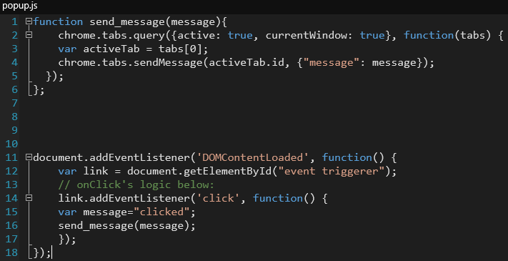
PopUP Script
Executes when user presses a button
Extracts all embedded URLs from HTML of page
Machine Learning algorithm checks URLs
URLs compared to known phishing URL database
Can detect phishing emails

Slide 7
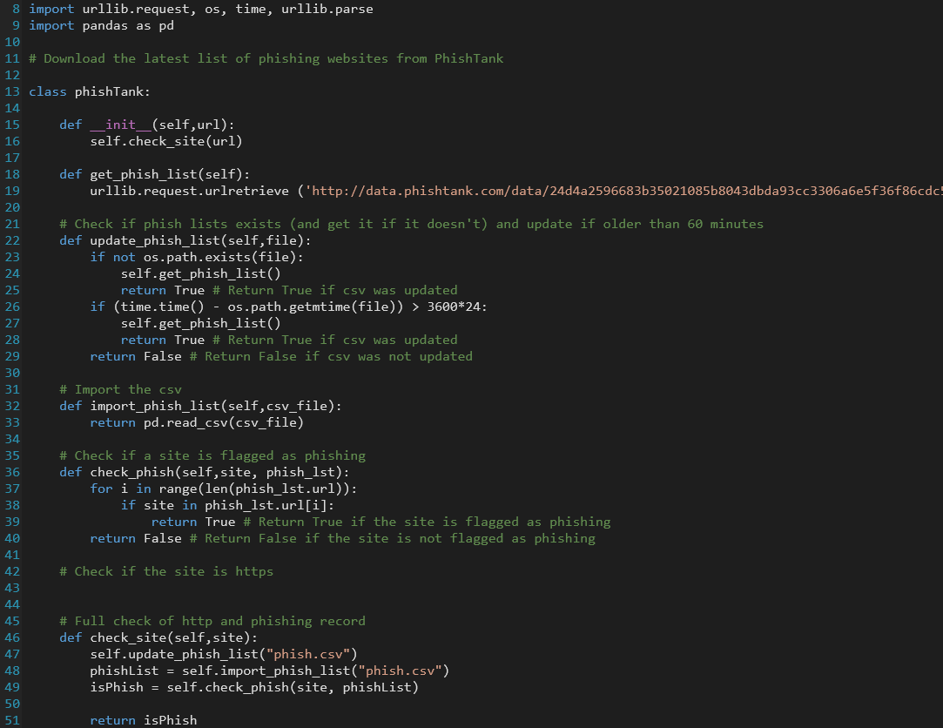
Phish Database
PhishTank is a website that receives and verifies phishing websites
Pull list from website to compare links to

Slide 8
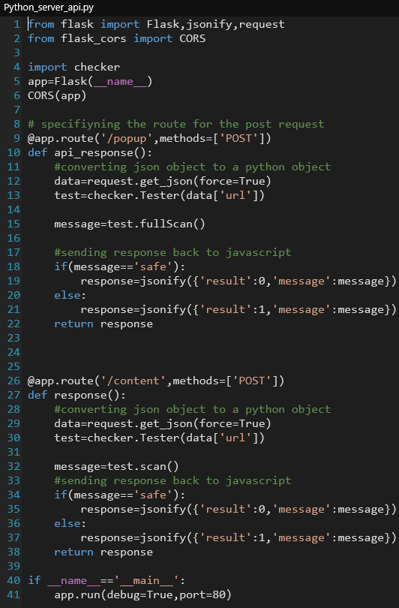
Client Server Communication
Server: Flask server
Client: chrome extension
Client sends URLs to server
Server runs checks
Server returns results to client
Client sends results to user

Slide 9
Thank You

