Slide 1






International Hackathon 5.0
Organized by Kalaignar Karunanidhi Institute Of Technology, Coimbatore & ECLearnix EdTech LLC, Wyoming, USA.
Round 1
Your College or Organization Logo
Choose Your Hackathon Domain :
✔ Domain 1 - Open Challenge Solutions [ SELECTED ]
(Tracks: AI & Data Science | Healthcare & Life Sciences | Software)
Domain 2 - SaaS Product Solutions
Domain 3 - Business Solutions
Domain 4 - AI & Student Collaboration Solutions
Team Details :
Team Name : OJAS (AI Fitness Battle Arena)
Domain Name : Domain 1 - Open Challenge Solutions
Single Point of Contact (SPOC) : Ayush Sharma
SPOC Email ID : sankhyahricks@gmail.com
SPOC Mobile Number : +91 9600888519

Slide 2
Your College or Organization Logo
TEAM MEMBER’S NAMES & CONTACT DETAILS
S.no | Hackathon ID* | Team Member Name (*) | WhatsApp Contact Number | Role in the Hackathon (#) | Designation(Employee/ UG/ PG Student / etc) | College / Organization Name and Department State & Country
1. | ECLIH5O0001 | Ayush Sharma | +91 8667877491 | Project Lead & AI/ML Engineer | UG Student | Dept. of Computer Science & Engineering
2. | ECLIH5O0002 | Sankhyahrick Swami | +91 9600888519 | System Architect & Backend Lead | UG Student | Dept. of Computer Science & Engineering
3. | ECLIH5O0003 | Aditya Barua | +91 9234567810 | Mobile & Three.js Graphics Lead | UG Student | Dept. of Computer Science & Engineering
(*) Hackathon ID: Complete registration and download the ACE App to receive your Hackathon ID. Click here to continue.
(#) Team Roles: Please assign appropriate roles to your team members, such as Project Leader, Research Analyst, Developer, Tester/Debugger, Documentation Lead, Presentation Lead, or any other relevant role.

Slide 3



Your College or Organization Logo
Website:
www.AllCollegeEvent.com

Slide 4
Your College or Organization Logo
Problem Statement: The Crisis in Home Fitness & Virtual Coaching
DOMAIN 1: OPEN CHALLENGE • TRACK: ARTIFICIAL INTELLIGENCE & HEALTHCARE
1. Silent Injury Epidemic in Solo Workouts
• Over 70% of individuals exercising at home train with incorrect biomechanical form (knee valgus in squats, hip sag in pushups, spinal hyperextension).
• Repetitive uncorrected stress causes acute joint injuries and chronic tendon/spine damage.
• 1-on-1 personal trainers are cost-prohibitive ($50–$100/hr) for the vast majority of students and working professionals.
2. Privacy Invasions & Latency of Cloud Video
• Conventional smart-coaching platforms require streaming live webcam video feeds of bedrooms or living rooms to remote cloud servers.
• Poses severe personal privacy, data security, and surveillance vulnerabilities.
• High network bandwidth demands make cloud streaming impossible on slow mobile data or in offline environments.
3. The 80% Drop-Out Cliff in Fitness Apps
• Traditional workout apps rely on boring repetition logs, passive video feeds, and monotonous countdown timers.
• Over 80% of users quit within 30 days due to lack of real-time feedback, social excitement, or competitive incentives.
• Solitary fitness lacks the dynamic adrenaline of esports and multiplayer gaming.
CORE MISSION: Deliver zero-latency biomechanical coaching and posture correction 100% on-device with zero privacy loss, while transforming solitary workouts into thrilling, competitive multiplayer esports battles.

Slide 5
Your College or Organization Logo
Abstract & Domain Alignment
    Domain: Domain 1 – Open Challenge Solutions (Tracks: AI & Data Science | Healthcare & Fitness | Software Development)
Problem Statement: Home fitness practitioners lack real-time biomechanical guidance, leading to frequent musculoskeletal injuries. Furthermore, conventional digital coaching tools demand cloud video streaming that violates personal privacy, requires heavy bandwidth, and suffers from severe user drop-off within weeks.
Objective / Aim: To develop OJAS, an edge-native AI workout coach and competitive fitness battle arena that delivers millisecond-level form validation, posture deformity screening, and esports-style gamification without transmitting a single camera frame over the network.
Proposed Solution / Approach: OJAS deploys an on-device computer vision pipeline (MediaPipe Pose 33 3D landmarks + ONNX classifiers) executing directly inside the mobile runtime at 30+ FPS. A deterministic biomechanical state machine evaluates joint angles, validates strict rep thresholds (e.g., squat knee angles ≤100° to ≥155°), and flags postural anomalies (knock knees, bow legs, scoliosis/lordosis lean) with instant visual and audio HUD cues. Simultaneously, movements drive an interactive WebGL Three.js 3D avatar with live inverse kinematics (IK) retargeting. OJAS integrates multiplayer esports mechanics: real-time 1v1 duels, 10-athlete Battle Ground lobbies, adaptive AI opponents across 10 exercises, ranked tiers (Bronze to Immortal), and modular character customization. A dynamic CDN asset delivery pipeline slashes the app binary size from 88MB to 17MB.
Expected Impact / Outcome: OJAS democratizes elite personal training at zero marginal compute cost while providing guaranteed video privacy. By transforming solitary, injury-prone home workouts into exhilarating, competitive social gameplay, OJAS dramatically boosts exercise adherence, athletic longevity, and global physical health.
Word Count: 284 Words | File Name: OJAS_Domain1_Round1.pdf | Submission: Round 1 PPT Presentation

Slide 6
Your College or Organization Logo
Novelty & Key Architectural Innovations
1. 100% On-Device Edge AI Vision
Zero Video Leakage & Zero Latency
• All 33 3D body landmarks are computed locally on the smartphone at 30+ FPS.
• Zero camera frames or user video images ever touch cloud servers or the network.
• Works completely offline; eliminates all server GPU inference and infrastructure costs.
2. Real-Time 3D Avatar Inverse Kinematics
Live Biomechanical Retargeting
• Full-body 3D AI instructor (Three.js WebGL) renders live form demonstrations.
• Real-time IK retargeting maps joint targets onto 3D humanoid rigs across all 10 exercises.
• Dynamic camera framing smoothly adapts between standing and floor exercises (pushups, cobra, child pose).
3. Biomechanical Posture Scanner
Clinical Musculoskeletal Screening
• 6-point skeletal posture check analyzing shoulder symmetry, pelvic tilt, knee valgus/varus, and head tilt.
• Classifies functional misalignments: Knock Knees, Bow Legs, Flat Feet, Rounded Shoulders, Kyphosis.
• Automatically prescribes targeted corrective strength and yoga regimens.
4. Esports Synchronous Fitness Battles
Multiplayer Duels & RAPTOR Model
• Real-time 1v1 duels and 10-player Battle Ground lobbies with sub-15ms WebSocket score sync.
• Anti-cheat visibility gating: reps voided if body visibility drops below 40%.
• RAPTOR AI pipeline: distilling Meta's 2GB SAM 3D Body into a 50MB mobile ONNX engine for occlusion resilience.

Slide 7
Your College or Organization Logo
Technical Feasibility & Full-Stack Architecture
Layer 1: Mobile Client & Game Engine
React Native 0.86.3 • Expo SDK 57 • TypeScript • Zustand
• Architecture: Modern cross-platform React Native with bare workflow Android build.
• Game Feel & Arena UI: Full landscape Arena UI with custom SVG polygon primitives, dynamic sound synthesizers (expo-audio), and haptic impact.
• Local Web Server: Embedded loopback HTTP asset server (127.0.0.1:8888) serving WebGL 3D models securely without cross-origin blocks.
Layer 2: Vision & Biomechanical Pose Engine
MediaPipe Pose (33 3D Keypoints) • ONNX Runtime • WASM
• Pose Detection: High-frequency MediaPipe Pose running in isolated WebView bridge at 30+ FPS.
• Biomechanical Rule State Machine: Mathematical joint angle trigonometrics (e.g. knee ≤100° to ≥155° for squats).
• Static Pose Hold Verification: Tree Pose & Warrior II engines verified with dynamic JSON thresholds; 51/51 automated tests passing.
Layer 3: 3D Graphics & Rigging Runtime
Three.js • WebGL • GLTF / VRM Avatars • Inverse Kinematics
• 3D Character Runtime: Three.js WebGL engine rendering rigged humanoid models (Arjun & Meera).
• Live IK Retargeting: Joint-target inverse kinematics computing hip, torso, wrist, and ankle positions on the fly.
• Dynamic Asset Optimization: 51 modular face and outfit GLBs stored on CDN, shrinking APK install from 88MB to 17MB.
Layer 4: Real-Time Backend & Cloud Data
Python FastAPI • Supabase PostgreSQL • Row Level Security • WebSockets
• Matchmaking Server: High-concurrency Python FastAPI WebSocket engine (<15ms score synchronization).
• Database: Supabase PostgreSQL with 28 migrations, strict Row-Level Security (RLS), and Realtime replication.
• Security & Production Readiness: Automated APK keystore signature verification and sandboxed guest authentication.

Slide 8
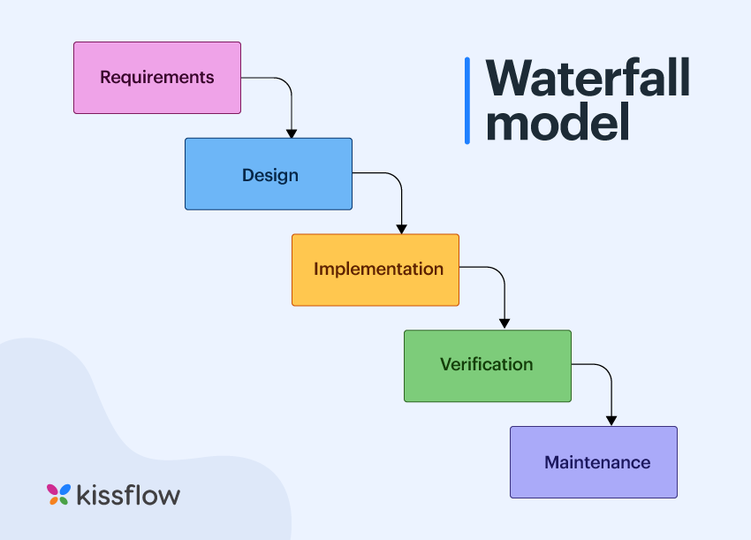
Your College or Organization Logo
System Architecture & Biomechanical Pipeline Flow
Stage 1
Camera Feed
Expo-Camera
Raw 30 FPS
RGB Sensor
On-Device Only
Stage 2
Pose Vision
MediaPipe Pose
33 3D Keypoints
Visibility Check
(Threshold ≥40%)
Stage 3
Biomechanics
Angle Engine
Trigonometrics
State Machine
(Start-Peak-End)
Stage 4
Live HUD
Rep Counters
Hold Timers
Form Alerts
Audio Synthesis
Stage 5
3D Avatar IK
Three.js WebGL
Inverse Kinematics
Bone Retargeting
Live Opponent
Stage 6
Sync & Ranks
FastAPI WSS
Supabase Realtime
XP / Ranked Tier
Shop Currency
Camera Sensor ➔ 33 Landmarks ➔ Biomechanical State Machine ➔ Real-Time HUD ➔ 3D Retargeting ➔ WebSocket Duel Sync
Biomechanical Form Validation Engine
• Squats: Knee joint angle ≤100° (bottom inflection) and ≥155° (full extension).
• Push-ups: Elbow flexion ≤90° with torso alignment check (hip dip penalty).
• Tree Pose & Warrior II: Multi-joint geometry verification with dynamic JSON configs.
• Anti-Cheat Visibility Gate: Reps voided if body visibility drops below 40%.
Real-Time Latency & Network Benchmarks
• Vision Processing: Sub-35ms frame inference time on Snapdragon 680+ phones.
• Video Privacy: 0 frames uploaded to network; 100% offline edge capability.
• Multiplayer Duel Sync: <15ms WebSocket round-trip score packet broadcast.
• Rendering: Solid 60 FPS WebGL 3D instructor animations with zero memory leak.

Slide 9
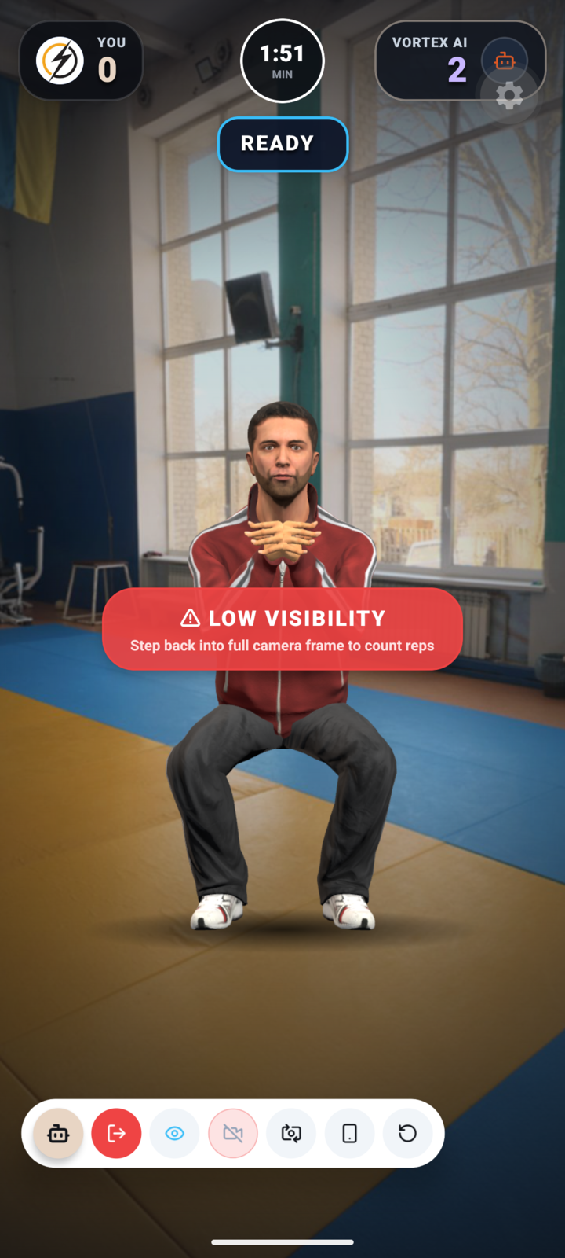
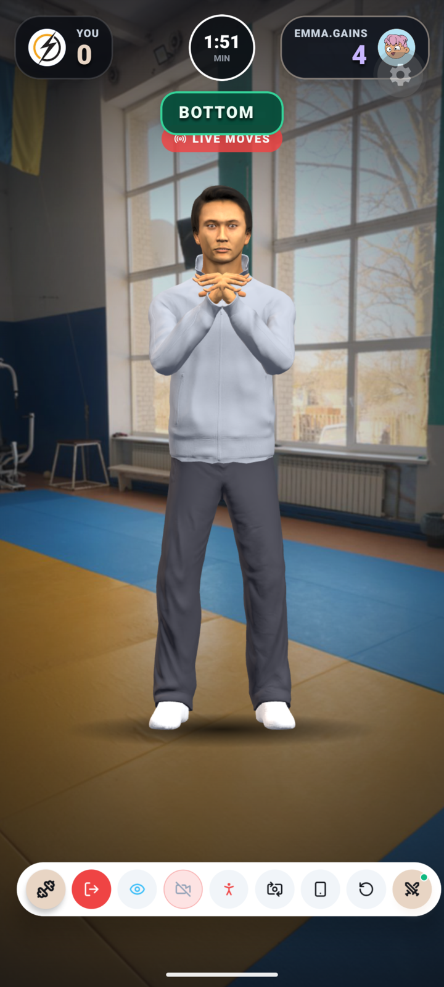
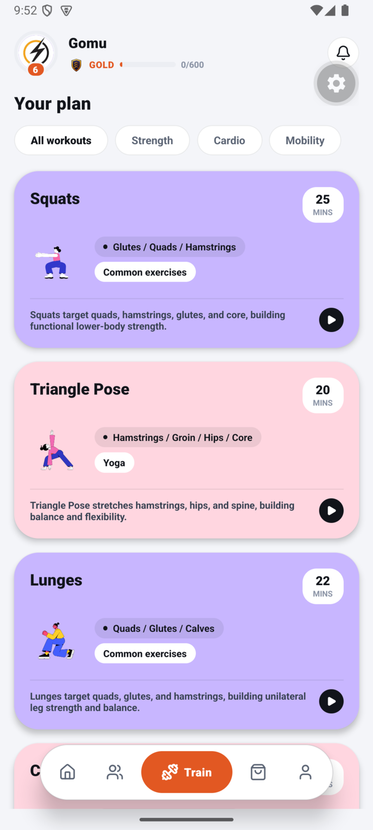
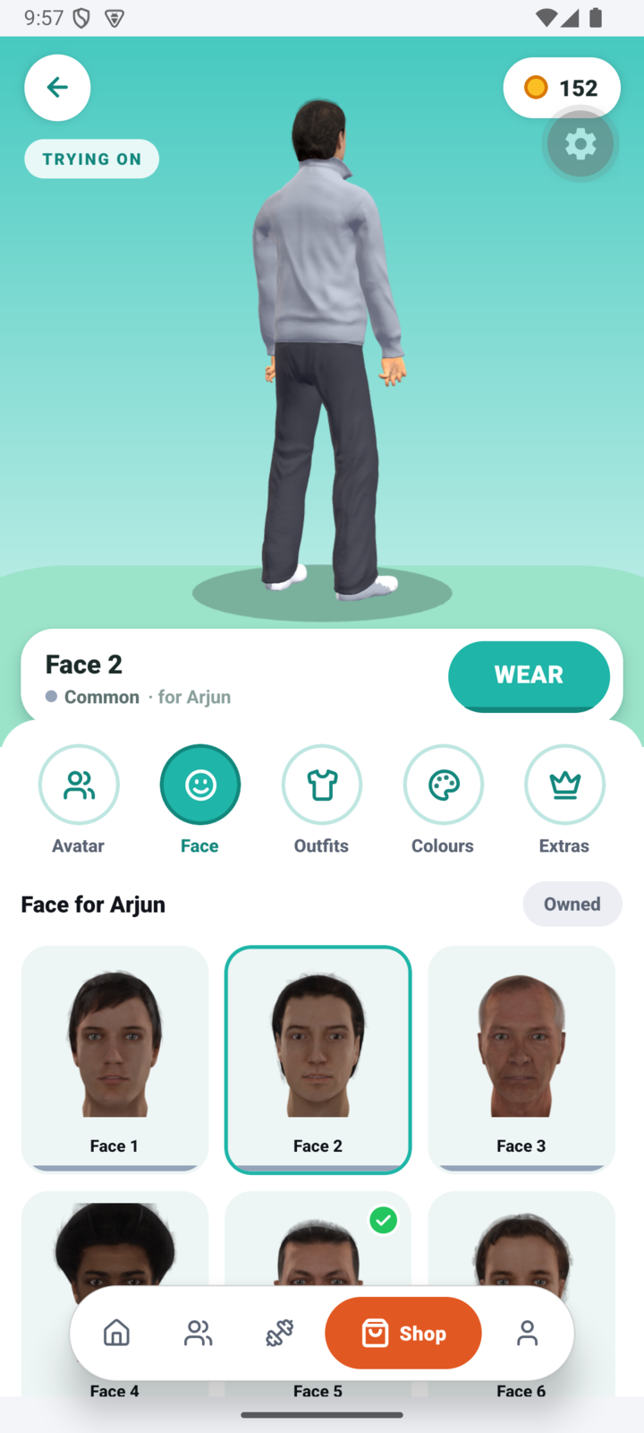


Your College or Organization Logo
Application Showcase: Real-World UI & Game Mechanics
3D Human vs AI Duel
Real-time 3D opponent
IK form retargeting
1v1 Multiplayer Duel
Live rival matchmaking
Synchronized score HUD
10 Tracked Exercises
Calisthenics & Yoga asanas
Biomechanical validation
3D Avatar Shop
Custom 3D characters
Dynamic CDN asset delivery

Slide 10
Your College or Organization Logo
Summary, Verified Results & Strategic Impact
Project Summary & Verified Results
• Sub-35ms On-Device Latency: Evaluated on mid-range Android devices with zero thermal throttling or camera frame drops.
• 100% Video Privacy Protection: Zero frames or face images leave the client device; complies with strict biometric privacy principles.
• Automated Test Verification: 51/51 automated biomechanical test suites passing (angle math, inflection thresholds, hold timers).
• Infinite Horizontal Scalability: Edge-native pose inference shifts compute burden from cloud GPUs to the client device, reducing operational costs to near zero.
• High Retention Gamification: Ranked multiplayer leagues (Bronze to Immortal), daily challenges, and social squads convert tedious exercise into competitive play.
Discussion, Market Fit & Future Roadmap
• Market Readiness & Need: Bridges the $96B global fitness market with esports gaming, solving the 80% user drop-off crisis.
• Active Phase 1 Enhancement: Finalizing full landscape Arena UI across all duel screens and camera interfaces.
• Next-Gen RAPTOR AI Rollout: Distilling Meta's 2GB SAM 3D Body into an ultra-fast 50MB mobile ONNX engine for depth tracking and occlusion recovery.
• Bluetooth LE Wearable Integration: Synchronizing live heart-rate variability (HRV), metabolic strain, and fatigue pacing.
• Clinical Orthopaedic Partnerships: Tailoring automated posture assessment protocols for physical therapy clinics and post-injury rehabilitation.

Slide 11
Your College or Organization Logo
Acknowledgements & Institutional Credits
Hackathon Organizers & Leadership
Our sincere gratitude to Kalaignar Karunanidhi Institute Of Technology (KIT), Coimbatore and ECLearnix EdTech LLC, Wyoming, USA for orchestrating International Hackathon 5.0.
Thank you for fostering global student innovation, interdisciplinary problem-solving, and providing a platform to present high-impact AI solutions.
Institutional & Faculty Mentorship
We express our deep appreciation to our department faculty advisors, computer vision researchers, and sports biomechanics consultants.
Their expert guidance in clinical joint kinematics, angle thresholds, and posture screening standards was instrumental in engineering OJAS's validation logic.
Open-Source & Research Community
We acknowledge the transformative open-source research and engineering teams whose foundational platforms made this project possible:
• Google MediaPipe & TensorFlow Teams (Edge Vision)
• Three.js & WebGL Community (3D Avatar Engine)
• React Native & Expo Core Teams (Mobile Runtime)
• Supabase Team (PostgreSQL & Realtime Sync Engine)

Slide 12
Your College or Organization Logo
Social Media
  Share your Post : Post about your Hackathon participation on LinkedIn, Instagram, and other social media platforms
  Tag: AllCollegeEvent, Eclearnix
  Use Hashtags: #ECLearnix #AllCollegeEvent
4. Share it with the world! 🌍
  Instagram :
ECLearnix : www.instagram.com/eclearnix.edtech/
AllCollegeEvent : www.instagram.com/allcollegeevent/
  LinkedIn :
ECLearnix : www.linkedin.com/company/eclearnix-edtech-private-limited/
AllCollegeEvent : www.linkedin.com/showcase/all-college-event/?viewAsMember=true
  YouTube : youtube.com/@eclearnix
  Facebook : www.facebook.com/people/ECLearnix-Education-Hub-2025/61578948513643/
  X : x.com/eclearnix_888

