Slide 1

E
DATA WRANGLING PROJECT
Predicting
Baseball Player Salary
USING PREVIOUS SALARY, PLAYER PROFILE, APPEARANCES AND TEAM INFORMATION
BY: ETHLIND LEO YEE QIAN

Slide 2

PROBLEM FORMULATION
PREDICTION QUESTION
GOAL
CAN A PLAYER’S CURRENT SALARY BE PREDICTED USING PREVIOUS SALARY, PLAYER CHARACTERISTICS, GAME APPEARANCES AND TEAM INFORMATION?
THE GOAL IS TO PREDICT A NUMERICAL SALARY, NOT TO CLASSIFY PLAYERS INTO CATEGORIES
SALARY
REGRESSION
4
TARGET VARIABLE
PROBLEM TYPE
TABLES USED

Slide 3
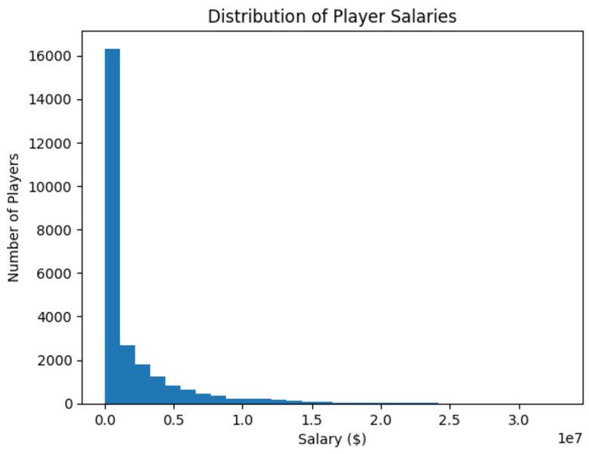
DATA EXPLORATION
CHECKED SHAPES, COLUMNS, DATA TYPES AND MISSING VALUES
SALARY DISTRIBUTION WAS STRONGLY RIGHT-SKEWED
MOST PLAYERS EARNED LOWER SALARIES, WHILE A FEW EARNED VERY HIGH SALARIES
HIGH SALARY VALUES WERE CHECKED AND KEPT BECAUSE THEY APPEARED TO BE GENUINE SALARIES
25,575
1985–2015
0
SALARY RECORDS
YEARS COVERED
FINAL DUPLICATE ROWS

Slide 4
DATA WRANGLING & FEATURE ENGINEERING
STARTED WITH THE SALARY TABLE
USED LEFT JOINS TO ADD PLAYER, APPEARANCES AND TEAM DATA
MATCHED TABLES USING PLAYER_ID, YEAR AND TEAM_ID
GROUPED SALARY BY PLAYER ID AND YEAR BEFORE CREATING PREVIOUS SALARY.
NEW FEATURES
AGE
WIN %
PREVIOUS SALARY
YEAR − BIRTH YEAR
WINS ÷ (WINS + LOSSES)
SALARY FROM IMMEDIATELY PREVIOUS SEASON

Slide 5
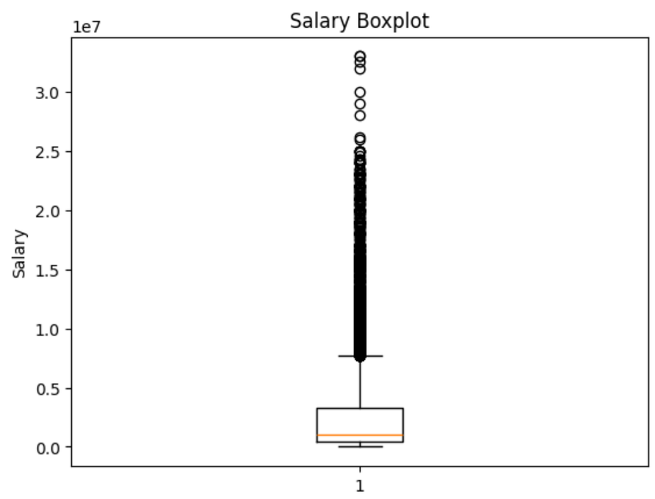
DATA CLEANSING & TRANSFORMATION
REMOVED ROWS WITH MISSING MODELLING VALUES
USED ONE-HOT ENCODING FOR CATEGORICAL VARIABLES
SPLIT DATA INTO 70% TRAINING AND 30% TESTING
STANDARDSCALER WAS USED FOR NUMERICAL PREDICTORS
SALARY OUTLIERS WERE CHECKED AND KEPT AS VALID VALUES
8,002
31.29%
ROWS REMOVED
OF ROWS REMOVED

Slide 6

MACHINE LEARNING MODELS
NAÏVE BASELINE PREDICTED THE AVERAGE TRAINING SALARY
LINEAR REGRESSION WAS USED AS A SIMPLE MODEL
RANDOM FOREST WAS USED TO CAPTURE MORE COMPLEX PATTERNS
EVALUATION USED MAE AND R²
MAE
R²
LOWER IS BETTER
HIGHER IS BETTER

Slide 7
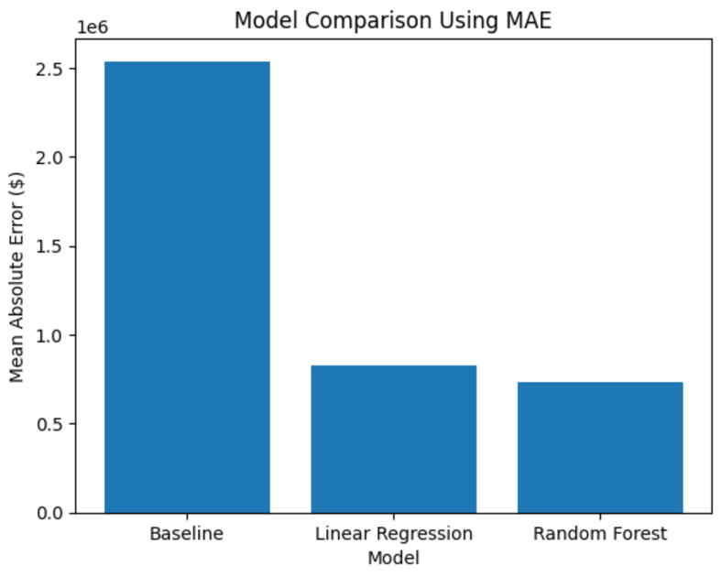
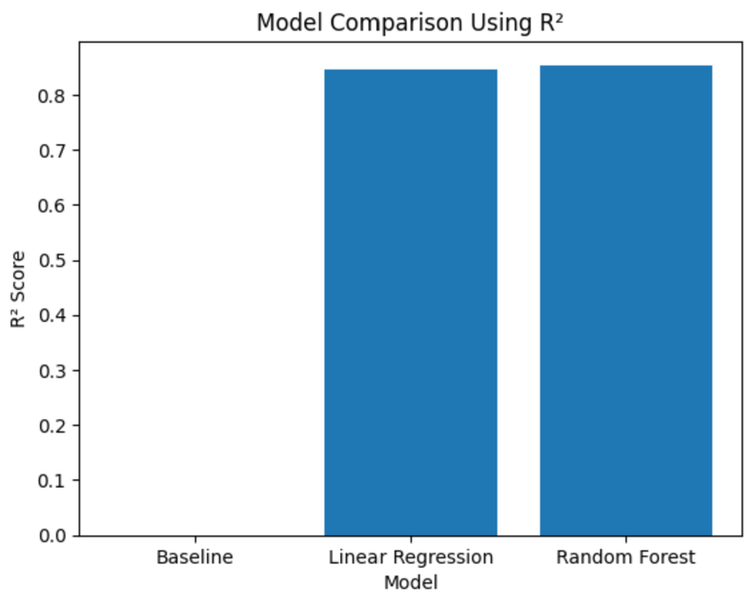
MODEL RESULTS
$736K
0.854
RANDOM FOREST
BEST MAE
BEST R²
BEST MODEL OVERALL

Slide 8
MAIN INTERPRETATION
BEST MODEL & WHY
WHAT THE RESULTS SUGGEST
RANDOM FOREST PERFORMED BEST
THE FEATURES CREATED DURING DATA WRANGLING ADDED USEFUL INFORMATION FOR PREDICTION
LINEAR REGRESSION WAS ALREADY STRONG, BUT RANDOM FOREST IMPROVED SLIGHTLY
FEATURE IMPORTANCE ANALYSIS COULD SHOW WHICH VARIABLES CONTRIBUTED MOST TO THE PREDICTIONS
IT REDUCED THE AVERAGE SALARY ERROR TO ABOUT $0.74M AND ACHIEVED AN R² OF ABOUT 0.85
PREVIOUS SALARY MAY BE IMPORTANT BECAUSE SALARY OFTEN CARRIES INFORMATION FROM ONE SEASON TO THE NEXT.

Slide 9
SUMMARY & FURTHER IMPROVEMENTS
SUMMARY
FURTHER IMPROVEMENTS
COMBINED 4 TABLES INTO ONE MODELLING DATASET
CREATED AGE, WIN PERCENTAGE AND PREVIOUS SALARY
COMPARED BASELINE, LINEAR REGRESSION AND RANDOM FOREST
RANDOM FOREST ACHIEVED THE BEST RESULTS
ADD BATTING OR PITCHING PERFORMANCE FEATURES
TRY IMPUTATION INSTEAD OF DROPPING MISSING RECORDS
TUNE RANDOM FOREST PARAMETERS
USE CHRONOLOGICAL TRAIN-TEST SPLIT FOR A MORE REALISTIC TEST

Slide 10

THANK
YOU

