Slide 1
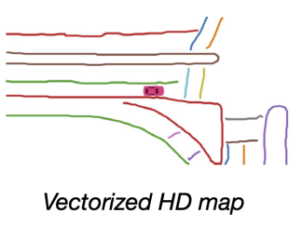
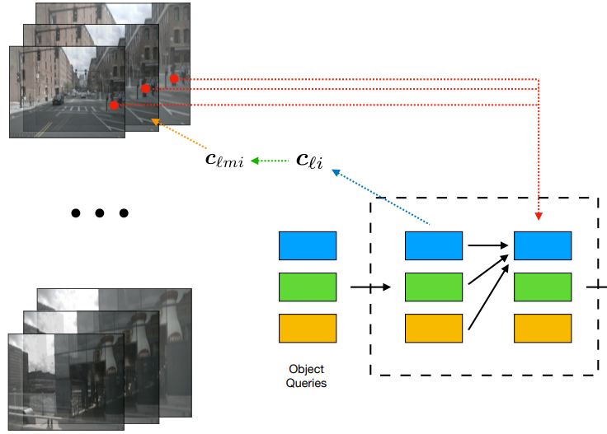
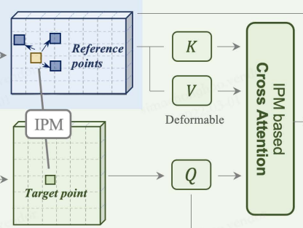
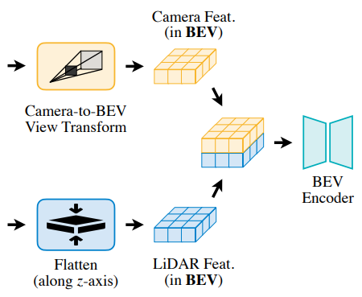
Trending in Academia: BEV Perception
2021.7
HDMapNet
Given HD map in BEV coordinates
Propose the aggregation of feature extracted from both Camera and LiDAR
2021.10-12
DETR3D
BEVDet
Fused Object Detection using omnidirectional cameras in BEV
2022.3
BEVFormer
PersFormer
Explicitly Construct BEV representation via camera parameters
UP to now
BEVFusion(Damo Academy)
BEVFusion(MIT)
FUTR3D
Multimodal feature fusion in BEV
Core Question: How to model the View Transformation from front view to BEV to obtain more effective features?
Output BEV Map
Implicitly processing BEV features100
Explicitly processing BEV features
Fusion on the dimension of BEV-feature
Notes:
按时间线简述泛bev perception的一些工作
当我们在讨论BEV的时候，我们在讨论什么：
隐式/显式？
输入/feature/输出？
基于/不基于相机内外参？
融合？
多任务？
直接支持下游任务？跳过perception这一步？
我们主要关注：
BEV view transform中，2d到3d（BEV）这种位置关系该怎么建模？
加入一些性能的比较
乔宇要看线
王泰要看点
讲重点 突出重点

Slide 2
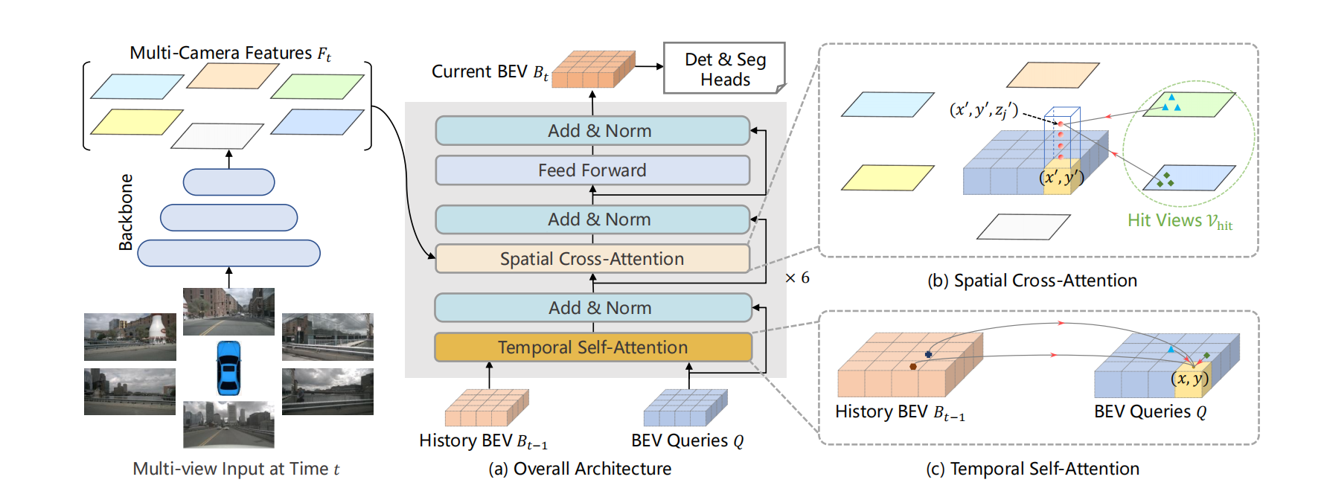
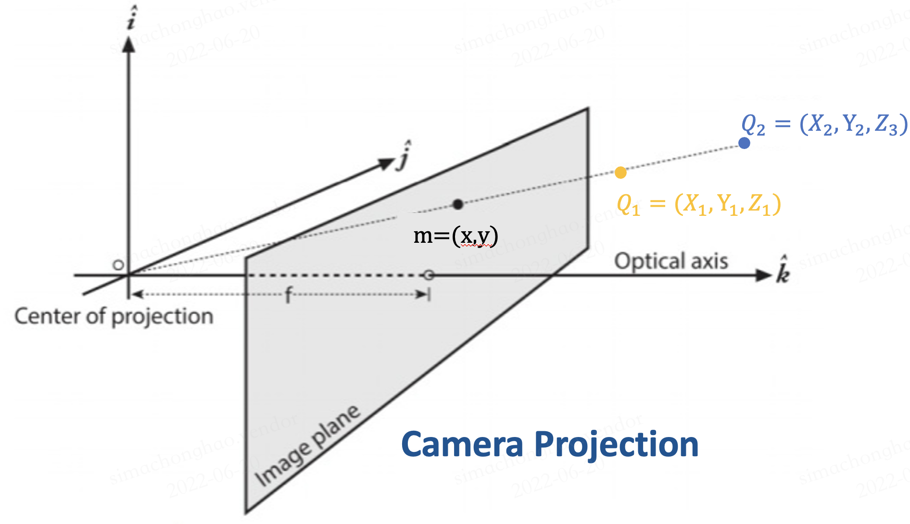
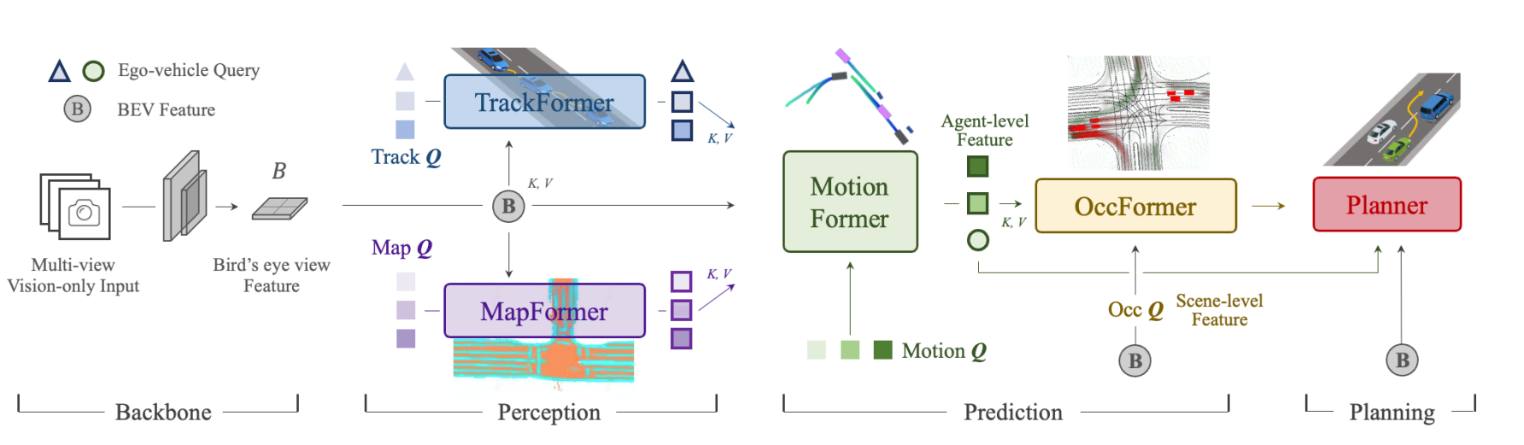
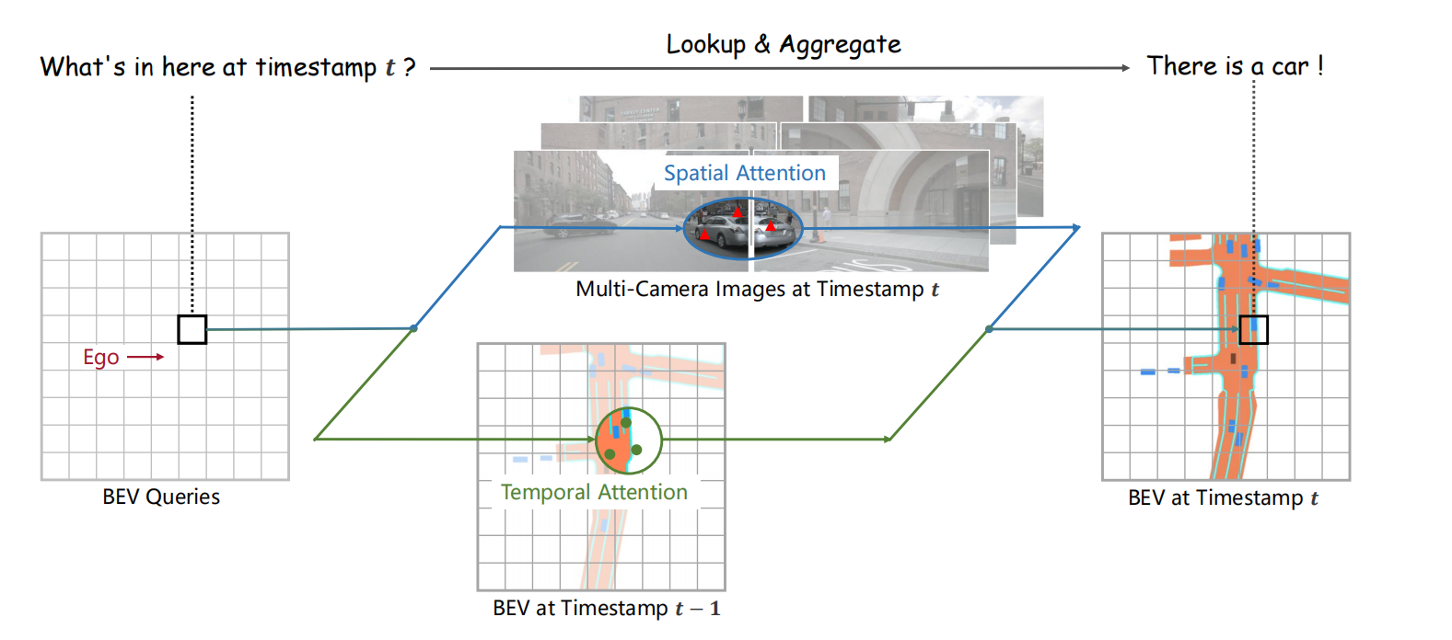
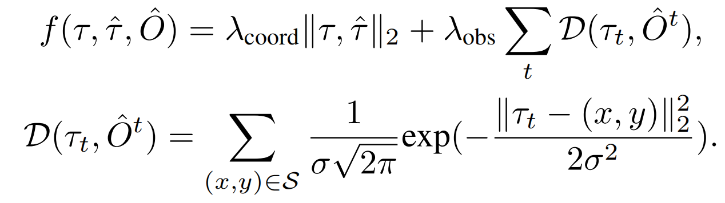
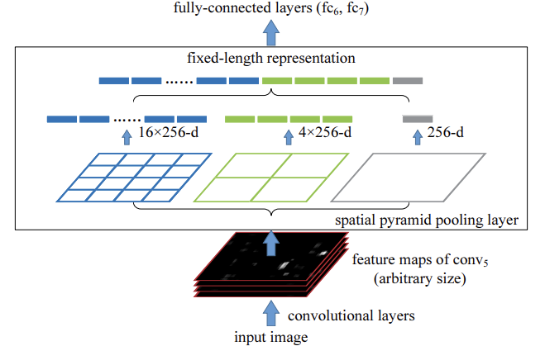
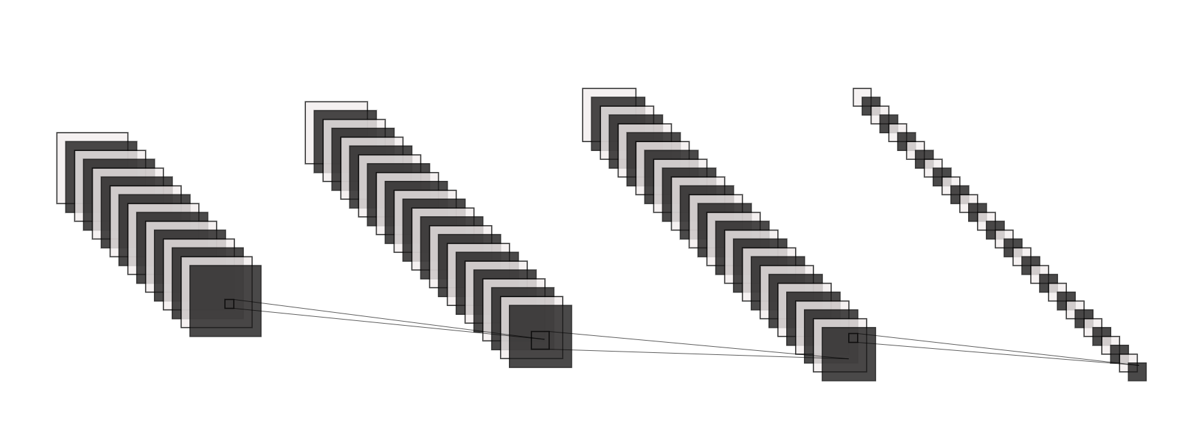
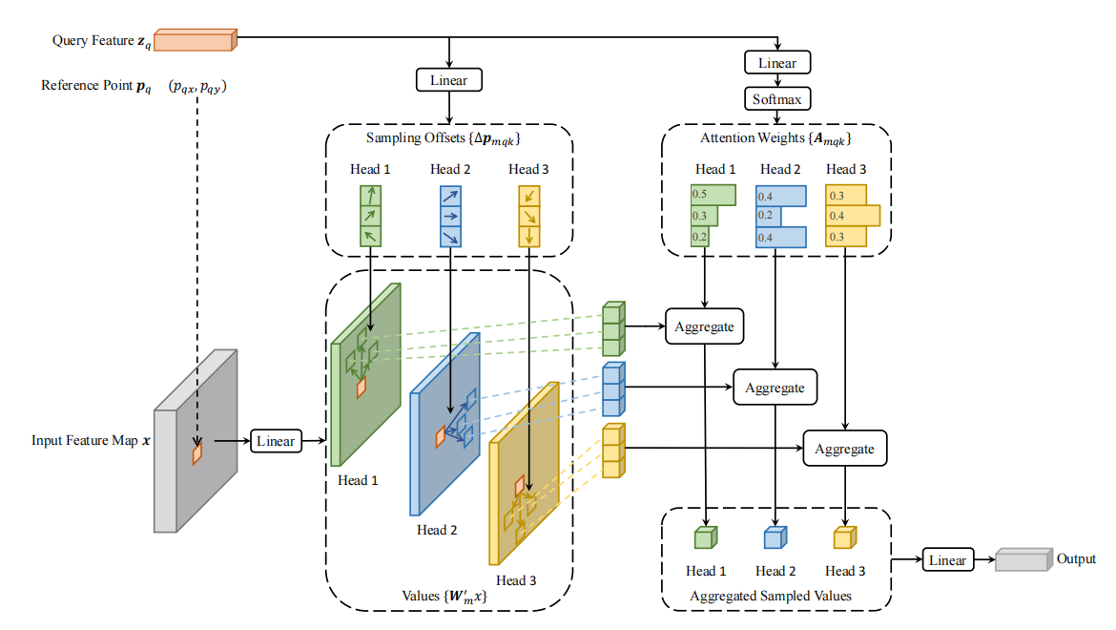
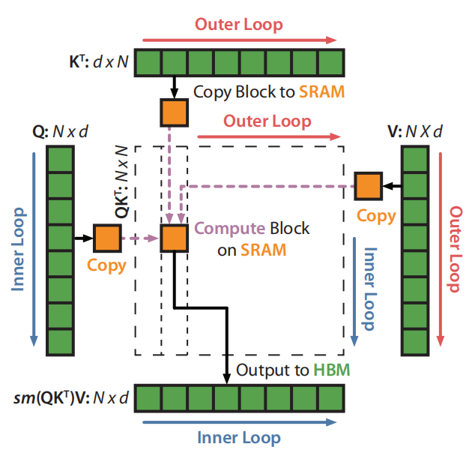
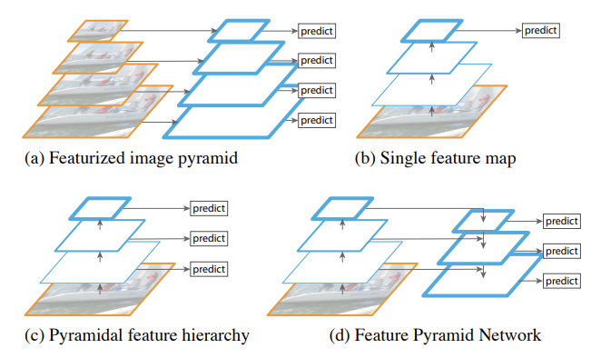
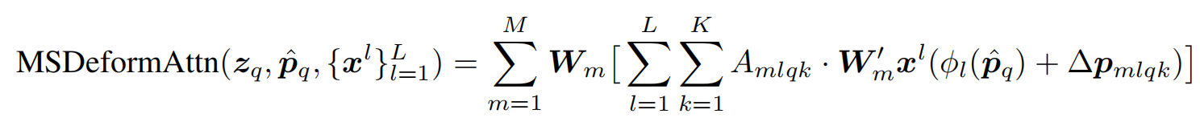
Modern Autonomous Driving Architecture
BEVFormer
The task framework for perception based on Deformable Attention, which integrates multi-camera and temporal features
Real-time prediction for temperature distribution on the cylinder head of RE011 via a deep learning framework
Bicubic interpolation
Feature Pyramid Network
Spatial Pyramid Pooling
Residual Conv
Deforamble Attention
/Swin Transform
Flash Attention

