Slide 1

By
Étienne Bérubé
Amir Osman
William Perron-Lafleur

Slide 2

What is it?
Social media
For Champlain College Students

Slide 3
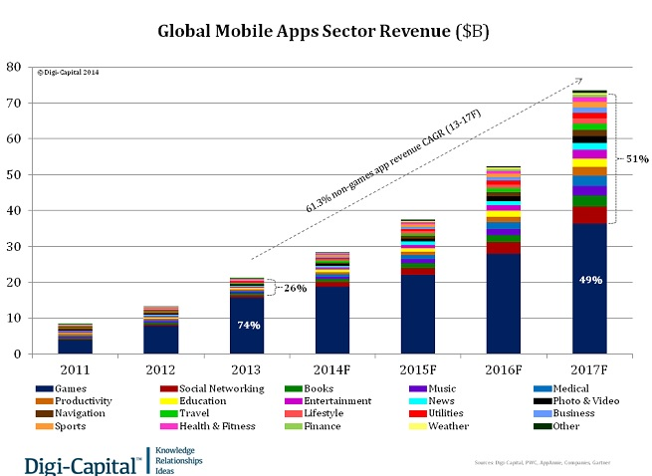
Why this project?
Increasing demand of mobile apps
Difficulty finding friends
Android uses Java
An interesting project for a couple of students

Slide 4
How it looks like

Slide 6

How it works!
Each page is an instance of “Activity”
Equivalence of “Scene” in JavaFx
Uses XML for the visual and Java for the real code
Needs to link them
A LOT of event handling

Slide 7
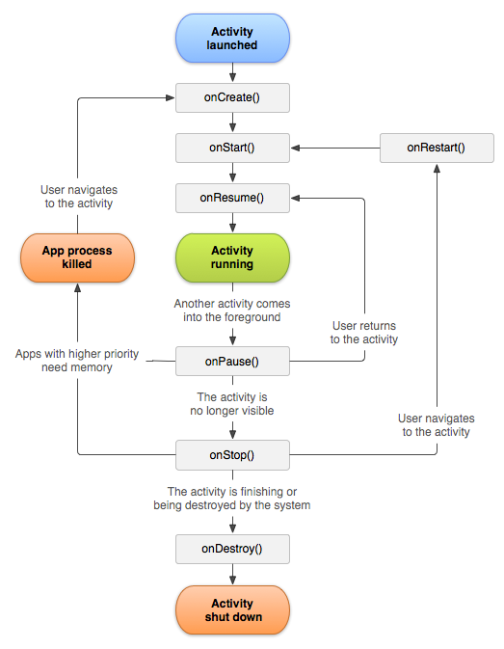

Slide 8






How Firebase works

Slide 9
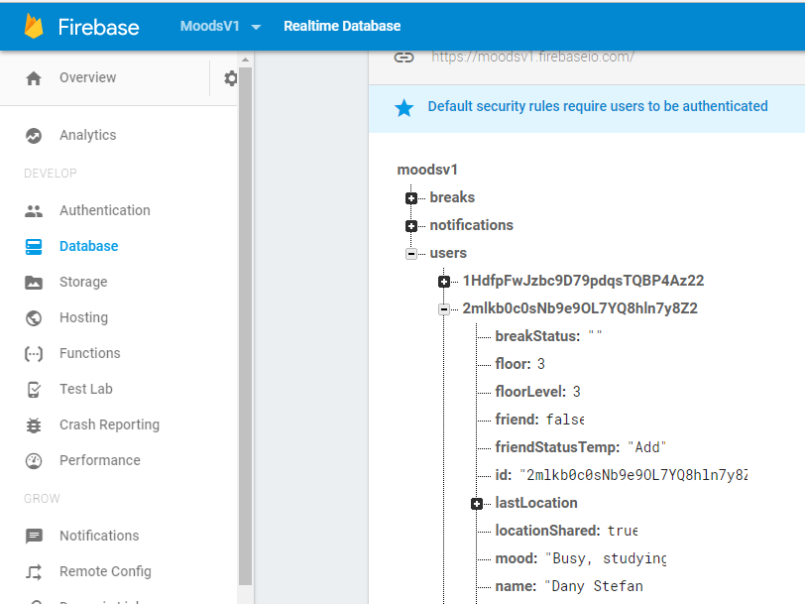
JSON Object Key Pair Values

Slide 10
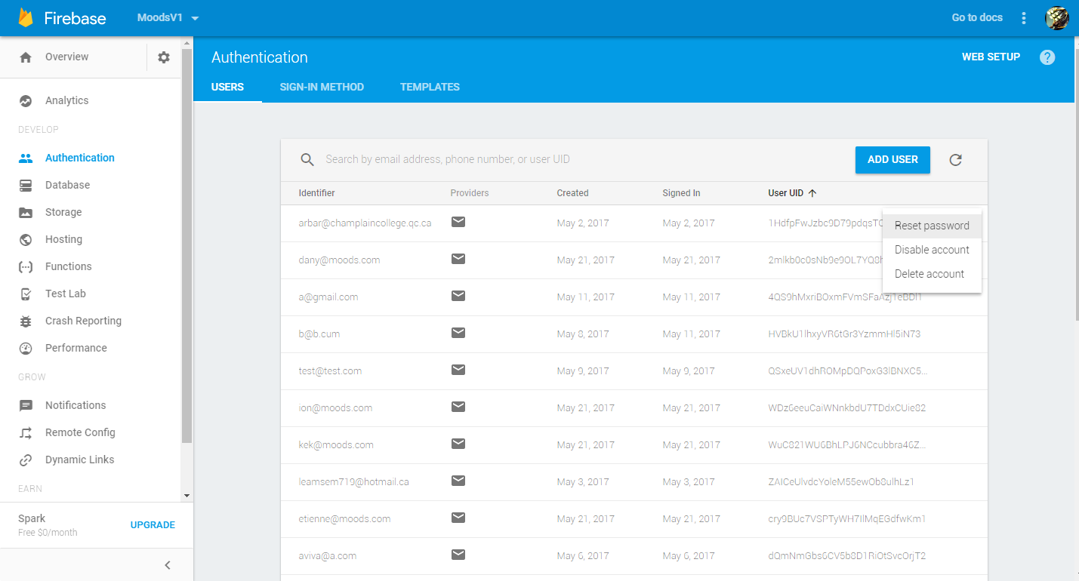
Authentication

Slide 11
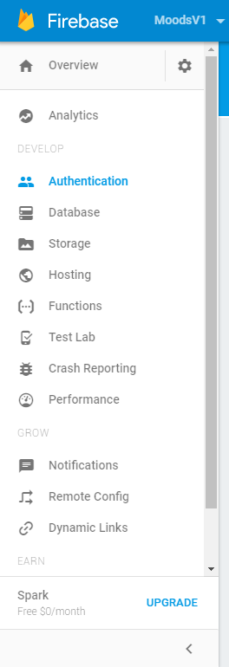
More Fire

Slide 12

Problems Solved
Localisation
Learning how it works
Interaction with Database
Gradle sync
Login / Register

Slide 13


Potential & What’s Next

Slide 14

Demo

Slide 15

Conclusion

