Slide 1

By
Étienne Bérubé
Amir Osman
William Perron-Lafleur

Slide 2
What is it?
Social media
For Champlain College Students

Slide 3
Why this project?
Increasing demand of mobile apps
Difficulty finding friends
Android uses Java
An interesting project for a couple of students

Slide 4
How it looks like

Slide 6
How it works!
Each page is an instance of “Activity”
Equivalence of “Scene” in JavaFx
Uses XML for the visual and Java for the real code
Needs to link them
A LOT of event handling

Slide 7
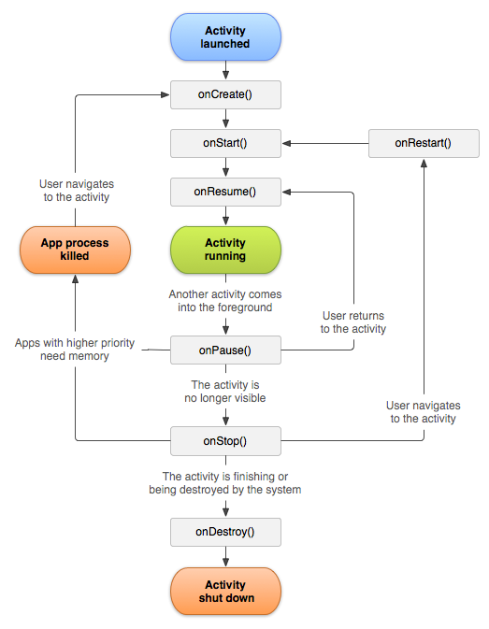

Slide 8

How Firebase works

Slide 9
Problems Solved
Localisation
Learning how it works
Interaction with Database
Gradle sync
Login / Register

Slide 10
Potential

Slide 11
Demo

