Slide 1

Communicating the right way
By
Étienne Bérubé
Amir Osman
William Perron-Lafleur

Slide 2

What is it?
Social media
For Champlain College Students

Slide 3
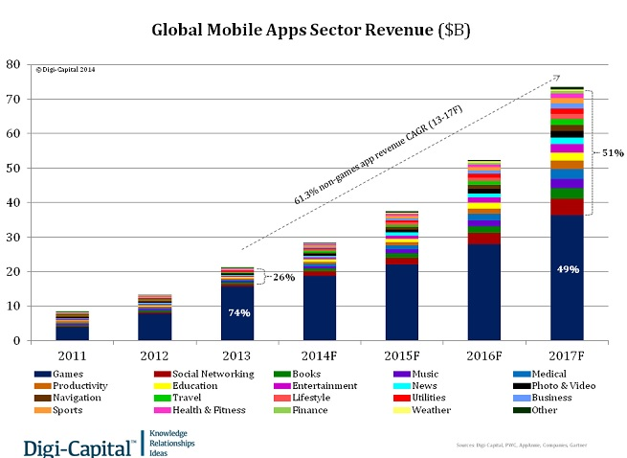
Why this project?
Increasing demand of mobile apps
Difficulty finding friends
Android uses Java
An interesting project for a couple of students

Slide 4
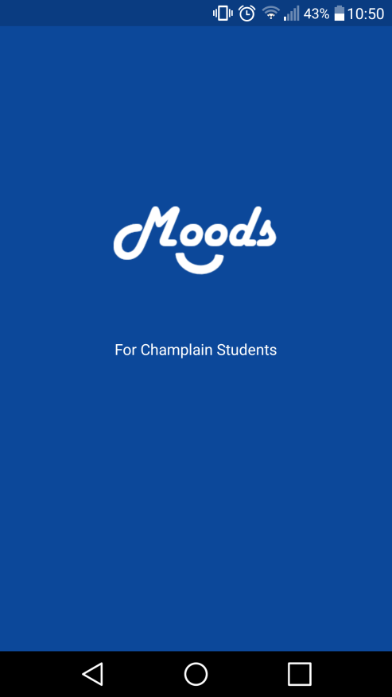
Visuals

Slide 5
Casting device…

Slide 6

How it works!
Each page is an instance of “Activity”
Equivalence of “Scene” in JavaFx
Uses XML for the visual and Java for the real code
Needs to link them
A LOT of event handling

Slide 7
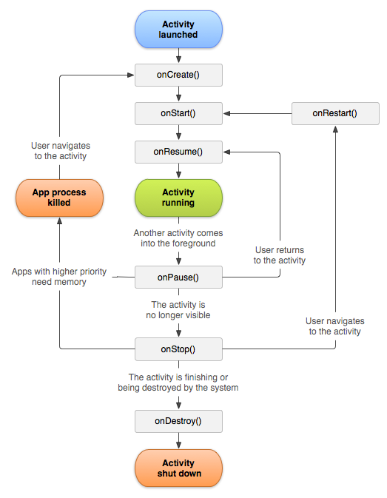

Slide 8






How Firebase works

Slide 9
Firebase
No SQL is efficient to handle real time actions from users
Database hosting from Google
Google gives a web API key with a file google-services.json, and we simply add it to mobile application’s code.

Slide 10
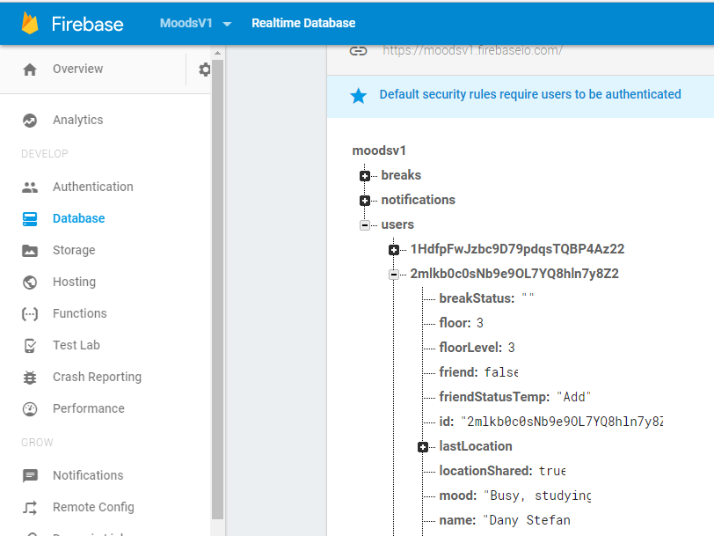
JSON Object Key Pair Values

Slide 11
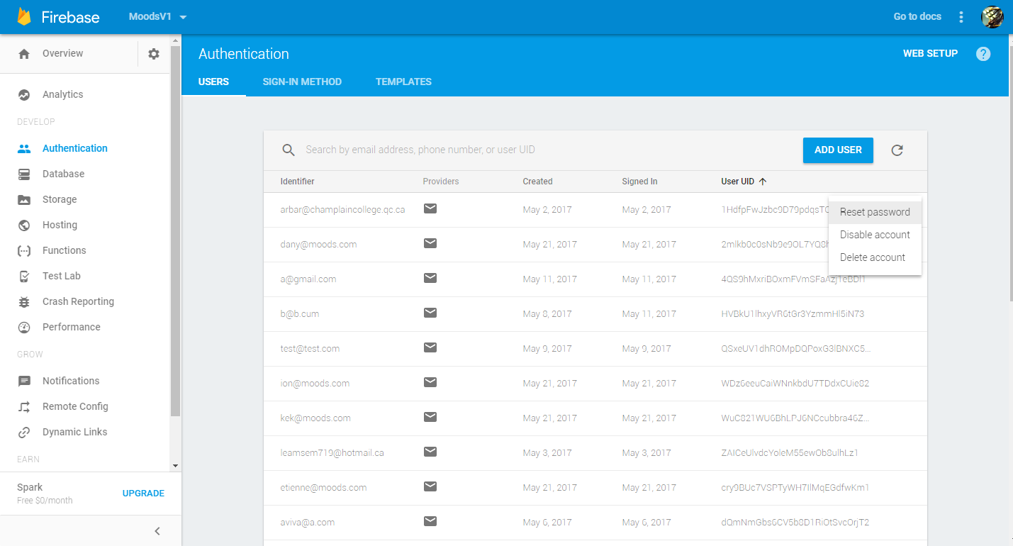
Authentication

Slide 12
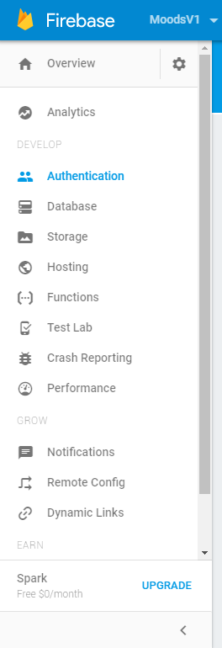
More Fire

Slide 13

Problems Solved
Localisation
Learning how it works
Interaction with Database
Gradle sync
Login / Register

Slide 14


Potential & What’s Next

Slide 15

Demo

Slide 16

Conclusion

