Slide 1
Moods
Email
Password
Log In
Create account!
Forgot Password?

Slide 2
Forgot Password?
Moods
Email
Send a New Password

Slide 3
Create your Account!
Moods
Full Name
Email
Password
Confirm password
Add Schedule Now!
Create account
Terms and Conditions

Slide 4
Schedule
When are your breaks?
Save Changes

Slide 5
Terms and Conditions
Moods
Be a Champlain Student!

Slide 6
Loading…
M

Slide 7
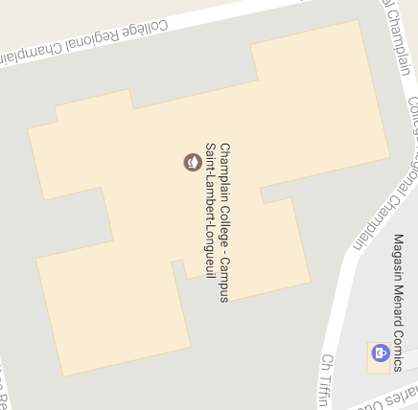
Moods
M
!
My Mood:
Current mood
FirstName LastName
Current Mood
Break in 15 min
Picture
Poke !
View 1st Floor

Slide 8
MyName MyName
M
!
Picture
Current mood
In Break !
Friend List
Share Location:
View 1st Floor

Slide 9
FirstName LastName
M
!
Picture
Current Mood
Break in 25 min
Poke !
Unfriend
Friend List
View 2nd Floor

Slide 10
Settings
M
!
Edit Profile
Modify Schedule
Notifications
Log Out
Terms and Conditions

Slide 11
Edit Profile
M
!
Picture
Full Name
Email
Password
Confirm password
Save Changes

Slide 12
Explore
Search
M
!
Picture
FirstName LastName
Poke !
Current Mood
Picture
FirstName LastName
Add
Current Mood
Picture
FirstName LastName
Add
Current Mood
Picture
FirstName LastName
Poke !
Current Mood
Picture
FirstName LastName
Poke !
Current Mood
Picture
FirstName LastName
Add
Current Mood

Slide 13
Notifications
M
!
Picture
FirstName LastName
Poked you !
Poke !
Picture
FirstName LastName
Friend request !
Add
Picture
FirstName LastName
Now friends !
Poke !
Picture
FirstName LastName
Changed his mood !
Poke !
Picture
FirstName LastName
Shares Location !
Poke !
Picture
FirstName LastName
Now in Break !
Poke !

Slide 14
My Friends
Search
M
!
Picture
FirstName LastName
Poke !
Current Mood
Picture
FirstName LastName
Poke !
Current Mood
Picture
FirstName LastName
Poke !
Current Mood
Picture
FirstName LastName
Poke !
Current Mood
Picture
FirstName LastName
Poke !
Current Mood
Picture
FirstName LastName
Poke !
Current Mood

Slide 15
Friend List
Search
M
!
Picture
FirstName LastName
Poke !
Current Mood
Picture
FirstName LastName
Add
Current Mood
Picture
FirstName LastName
Add
Current Mood
Picture
FirstName LastName
Poke !
Current Mood
Picture
FirstName LastName
Poke !
Current Mood
Picture
FirstName LastName
Add
Current Mood

