Slide 1
Docker : Introduction to containers
Etienne Deneuve

Slide 2
Docker : Pre requisite
You need some knowledge to run docker :
IT parts :
GNU Linux
Networking
Windows (if you want to run Docker on Windows Server)
« Coding » parts :
Be able to understand some code sample in Python, Javascript and others languages
Be able to understand Json files and YML files

Slide 3
Virtualization
Provide an abstraction layer between hardware and OS
Better usage of hardware
Lower the energy consumption
Add way to run different OS on the same server
Reduce the time for deploying new servers (15 min avg)

Slide 4
Containerization
Provide isolation between processes on the same operating system
Reduce the memory usage of same kernel.
Reduce the time for deploying services on servers (up to 5 sec avg)
Provide a way for Infrastructure as Code (IaaC)

Slide 5
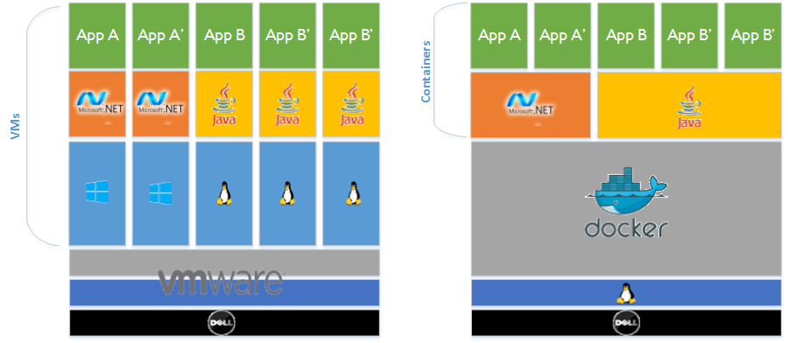
Docker : Virtualization architecture vs Containers architecture

Slide 6
Docker : Operating Systems
Docker run on :
Linux : https://docs.docker.com/engine/installation/linux/
Windows : Docker for Windows (made by French team !)
Mac Os : Docker for Mac

Slide 7
Docker in Microsoft World
In Microsoft Windows Server 2016, they added Windows Containers based on Docker (even Linux containers):
https://blog.docker.com/2016/04/docker-windows-server-tp5/

Slide 8
Docker : What is Docker
18/01/2013 : 1st commit
01/02/2013 : 1st demo online
21/03/2013 : 1st demo à Pycon US
23/03/2013 : Version 0.1
26/03/2013 : GitHub opening
23/04/2013 : Version 0.2
06/05/2013 : Version 0.3
03/06/2013 : Version 0.4
25/06/2013 : Linux Fundation
18/07/2013 : Version 0.5 (top, mount)
23/08/2013 : Version 0.6 (-privileged, LXC conf)
19/09/2013 : Red Hat partner
29/10/2013 : company renamed in Docker
26/11/2013 : Version 0.7 (standard kernel, device-mapper, name, links)
21/01/2014 : get 15M$
04/02/2014 : Version 0.8 (MacOSX, BTRFS experimental, ONBUILD)
….

Slide 9
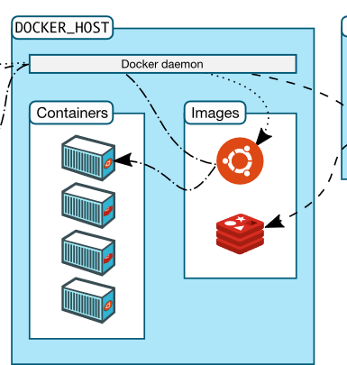
Docker : Sytem Architecture
Docker client communicate with docker daemon with RESTful API

Slide 10
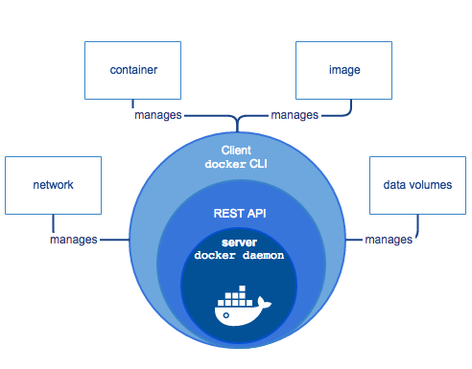
Docker : Architecture Overview
The core of docker is the deamon « dockerd »
You control docker over the client « docker »
« docker » communicate over a Rest Api to the docker daemon

Slide 11
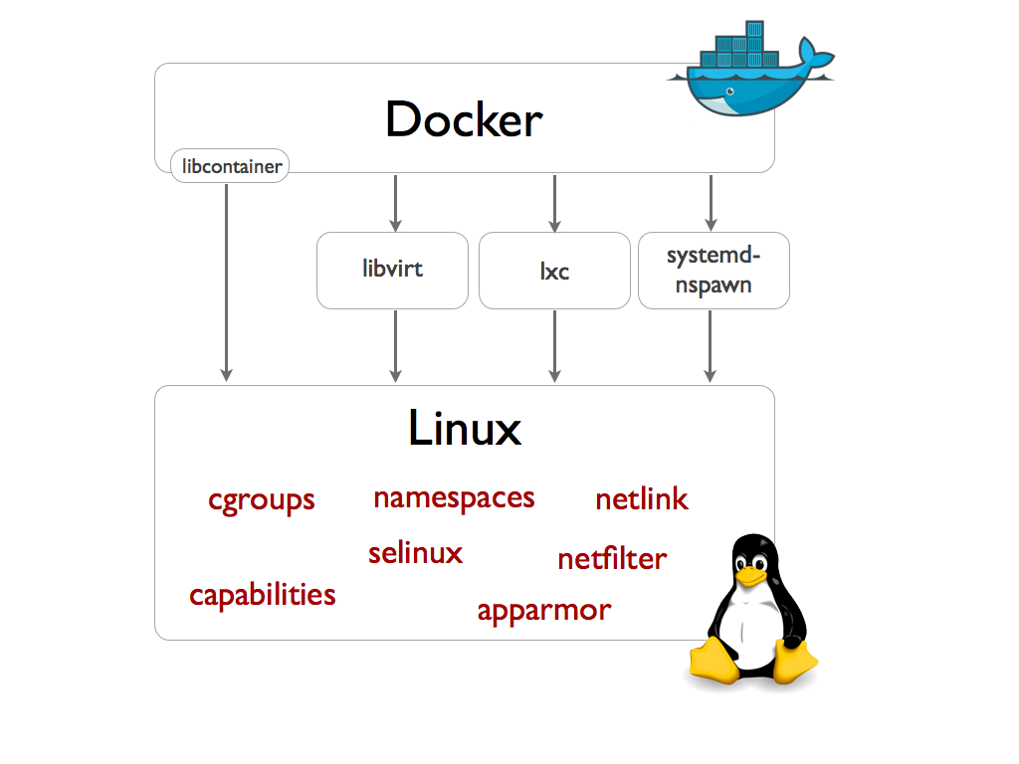
Docker : Engine Architecture
Docker Engine is based on standard technology :
Libvirt
LXC
Systemd-nspwan
Libcontainer
Docker use heavily Linux features such as Namespace, Netlink, netfilter or cgroups

Slide 12
Docker : Engine Architecture - Mount
Mount Namespace (Linux 2.4.19)
Manage the isolation between file system and process groups:
Mount point aren’t system wide but namespace specific
You can inherit mount point
New root (chroot)

Slide 13
Docker : Engine Architecture - PID
PID namespace (Linux 2.6.24)
Manage ID isolation between process :
PID 1 init-like per namespace
each namespace get it’s own PID numeration (host isolation)
process of one namespace can’t call systemcall on other process of other PID namespace
Manage pseudo-filesystem (ex : /proc) seen by PID namespace
each process onw multiple PID : one in namespace, one outside (process seen by host), more if you have imbricated namespace.

Slide 14
Docker : Engine Architecture - Net
Net namespace (Linux 2.6.19-2.6.24)
Manage network isolation. Each own :
interfaces
ports
Routing table
Firewall rules (iptables)
Folder /proc/net
INADDR_ANY (0.0.0.0)

Slide 15
Docker : Engine Architecture - User
User namespace (Linux 2.6.23-3.8)
Manage isolation of users and groups :
Split right between namspaces
Make safe namespace shareing to process without right

Slide 16
Docker : Engine Architecture - IPC
IPC namespace (Linux 2.6.19-2.6.30)
Manage isolation of IPC resources :
semaphores
message queues
shared memory segments

Slide 17
Docker : Engine Architecture - UTS
UTS namespace (Linux 2.6.19)
Manage isolation of hostname and domain.
UTS come from structure of "utsname" send by syscall uname(). UTS means "UNIX Time-sharing System".

Slide 18
Docker : Terms
Images
Images are read only template. We build images.
Registry
Registry hold images. It can be public or private. It’s the distribution part.
Docker Hub is a public registry.
Containers
Containers are similar to a folder. Containers are build from images. This is the run part of docker

Slide 19
Docker : Prepare your workstation for Docker
Linux :
Be sure to run a Docker compatible and supported Linux Kernel
3.10 today, use the uname –r command to get your running Kernel
You need to install « docker-compose » manualy
Windows :
Windows 10 64 bits in Pro, Enterprise or Education with at least the build 10586. You need to enable Hyper V
Mac :
A Mac after 2010 with Intel MMU and EPT
OS X 10.10.3 or newer
4 Gb of Ram

Slide 20
Docker installation
Linux
Windows & Mac
For Docker on Linux we need to follow the official guide depending of the linux distribution :
https://docs.docker.com/engine/installation/linux/
For our labs it’s better to install it in a virtual machine but it’s not mandatory
Take care of your selinux/apparmor configuration !
Just download Docker for Mac or for Windows and follow the installer assistant

Slide 21
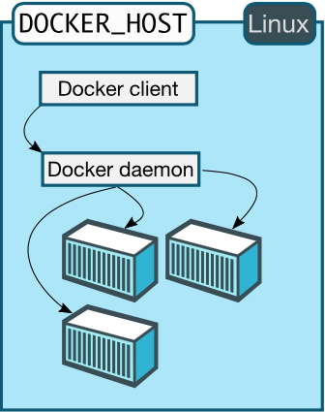
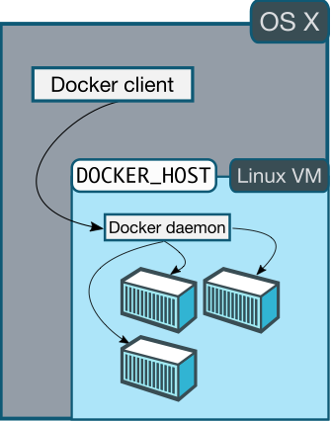
Linux Version vs Mac and Windows version
Linux :
Others :

Slide 22
Linux version vs Mac or Windows version
Linux
Windows or Mac
On linux you can run the docker engine directly
You use the same kernel in Docker and in your containers
On Mac OS :
You use the HyperKit to run a Linux virtual machine:
github.com/docker/hyperkit
On Windows :
You use the Hyper V feature to run a virtual machine

Slide 23
Docker client consideration
For testing and developping, use docker directly on your workstation is not a problem. But if you want to run docker in production, you will need to run the client on you management computer and the docker daemon on your docker host or in a Virtual Machine.

Slide 24
Configure the Docker Daemon
The daemon is standard, so you can interact with it as usual using the LSB syntax :
Service docker start/stop/…
Systemclt start docker
To configure you docker daemon, you have two options :
Edit the/etc/default/docker file
Create a docker.service.d in /etc/systemd/system/ (see it on next slide)

Slide 25
Configure the daemon for remote management
On a Red Hat system using SystemD we need to :
Create a folder like that :
mkdir /etc/systemd/system/docker.service.d
Create a docker.conf file in this folder
[Service]
ExecStart=
ExecStart=/usr/bin/dockerd -H fd:// -D --tls=true --tlscert=/var/docker/server.pem --tlskey=/var/docker/serverkey.pem -H tcp://192.168.59.3:2376
-D is for debug mode
--tls is for using tls mode and so set your cert and your key using –tlscert and –tlskey
-H tcp://192.168.59.3:2376 is needed for the deamon to listen on the 2376 port for incoming docker connection
Reload the deamon : sudo systemctl daemon-reload
Restart the deamon : sudo systemctl restart docker
By default the docker daemon listen on unix:///var/run/docker.sock so we need to open the remote connections, using sock is not really recommanded for remote !

Slide 26
Docker Engine Logs
To get the logs of the docker deamon you can use your standard logs tools.
On Red Hat you can get your log of your docker instance :
journalctl -u docker

Slide 27
How to connect docker to remote Docker
For one command it’s maybe more easier to use the –H option :
docker –H tcp://192.168.59.3:2376
Or you can configure your docker client by adding an DOCKER_HOST in your environnement :
export DOCKER_HOST=tcp://192.168.59.3:2376

Slide 28
Configure the Docker Daemon
On a Red Hat system using SystemD we need to :
Create a folder like that (if you don’t have made it before):
mkdir /etc/systemd/system/docker.service.d
Create a file http-proxy.conf in this folder
Edit this file with the following content :
[Service] Environment="HTTP_PROXY=http://proxy.example.com:80/ " "HTTPS_PROXY=https://secureproxy.example.com:80/" "NO_PROXY=http://proxy.example.com:80/"
Reload the docker deamon using « systemctl daemon-reload »
Check if your configuration is ready :
systemctl show --property=Environment docker
You should get :
Environment=HTTP_PROXY=http://proxy.example.com:80/

Slide 29
Docker Compose installation
To install docker compose on Linux it’s pretty easy :
Copy the curl line from : https://docs.docker.com/compose/install/
curl -L https://github.com/docker/compose/releases/download/1.8.0/docker-compose-`uname -s`-`uname -m` > /usr/local/bin/docker-compose
We will see what is docker-compose and why we need it more further.

Slide 30
Docker – Base command
Docker is written in Go, so we have a single keyword to interact with docker :
docker (yes ;))

Slide 31
Docker – Base commands
Docker command syntax is like systemctl command :
docker <keyword> <command> [options]
Keyword are for example :
Attach
Run
Start/Stop
Images
Command are for example
Ls

Slide 32
Docker : Exercise 1 - Installation
We seen how to install docker, now install your docker host !
https://docs.docker.com/engine/installation/linux/
https://docs.docker.com/engine/installation/mac/
https://docs.docker.com/engine/installation/windows/
Don’t forget to install docker-compose !

Slide 33
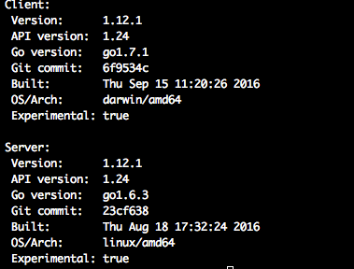
Docker : Exercise 2 – Base Command
Get your docker version
docker version
Sample output :
Notes:
https://hub.docker.com/r/nickistre/centos-lamp/~/dockerfile/
https://github.com/tkyk/docker-compose-lamp

Slide 34

Docker : Exercise 3 – Base Command
Get your docker-compose version
docker-compose version
Notes:
https://hub.docker.com/r/nickistre/centos-lamp/~/dockerfile/
https://github.com/tkyk/docker-compose-lamp

Slide 35

Docker : Exercise 4 and 5 – Base Command
Get a base image of your choice (just download it !)
docker pull centos
To get the list of the « tag » avaibles you can use curl :
Docker : Exercise 4
You may notice the centos:latest
You can get a full list of availables tag on the docker hub
Try to get an older version like the 5.11 :
docker pull centos:5.11
This can be useful for older binaries and testing

Slide 36
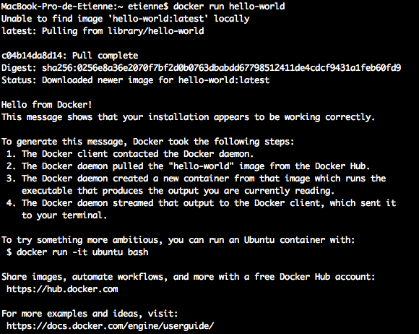
Docker : Exercise 6 – Base Command
Run a Hello World
docker run hello-world
As you see, we can use run without pulling the images first, it’s not recommanded for big images

Slide 37
Docker : Exercise 7 – Base Command
Run a base image interactive and get information in the container
docker run –it centos /bin/bash
The –i stand for interactive and –t for assign a virtual tty
Using yum install the net-tools package
yum update && yum install net-tools
Now net-tools is installed get your container IP
Yes, your container have it’s own ip on another network, we will see this point later…

Slide 38
Docker : Exercise 8 – Base command
Now we have downloaded images and launched containers it’s time to clean it up:
docker ps –a
docker rm $(docker ps -a -q)
(or one by one ;))
docker images
docker rmi $(docker images -a -q)

Slide 39
Docker : Images
In docker we used images but images are more complex than you think.
Docker images are build on UnionFS (AUFS, BTRFS..)
Images are the assembly of multiple layer

Slide 40
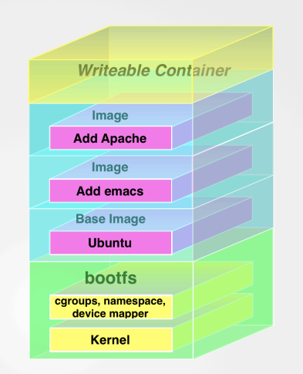
Docker : Images

Slide 41
Docker : Images
Images in multiple layer provide advantage :
You can update layer and rebuild the layer without rebuild the whole images.
You can put only the delta layer into your images

Slide 42
Docker : Images - Exercise
Pull the ubuntu layer :
Docker pull ubuntu:15.04
Create a file named Dockerfile
Write :
FROM: ubuntu:15.04
RUN echo "Hello world" > /tmp/newfile
Save and Exit
Type :
docker build -t changed-ubuntu .

Slide 43
Docker : Images – Exercise
At the build time we can see :
Sending build context to Docker daemon 2.048 kB
Step 1 : FROM ubuntu:15.04 ---> d1b55fd07600
Step 2 : RUN echo "Hello world" > /tmp/newfile
---> Running in a74b0ffafa39
---> 45e5e22e1161
Removing intermediate container a74b0ffafa39
Successfully built 45e5e22e1161
As you can see, we created a R/W layer execute the command and then created a snapshot of the delta layer based on ubuntu

Slide 44
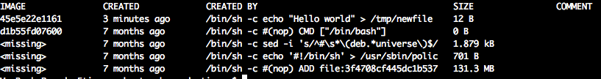
Docker : Images – Exercise
Running the docker images command you can see your new image :
REPOSITORY TAG IMAGE ID CREATED SIZE
ubuntu-changed latest 45e5e22e1161 2 minutes ago 131.3 MB
ubuntu 15.04 d1b55fd07600 7 months ago 131.3 MB
Running the docker history ubuntu-changed command :
You can see all the layer of your new image !

Slide 45
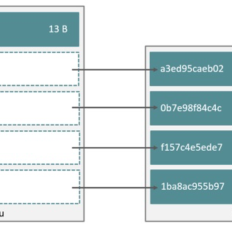
Docker : Images – Exercice
In reality, we only linked the existing layer of the Ubuntu image and our layer.
Using the UnionFS we don’t need to copy the whole layer multiple time to get a good image.

Slide 46
Docker : Networking
Docker provide networking to containers by using a default network. This network is a bridge and let containers communicate each others.
The official doc is here : https://docs.docker.com/engine/tutorials/networkingcontainers/

Slide 47
Docker : Networking – Exercise 1
Let‘s try to create a new network for our containers :
docker network create -d bridge ournewbridge
docker network ls will show us our new bridge

Slide 48
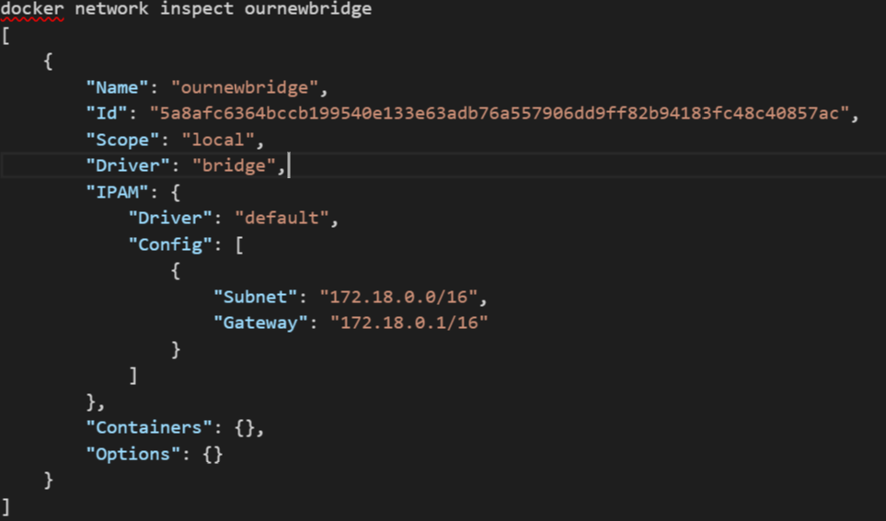
Docker : Networking
Using docker network inspect you can have more information about your new network

Slide 49
Docker : Networking – Exercise 2
Let’s create two containers :
docker run -itd --name=container1 busybox
docker run -itd --name=container2 busybox
Create a new network :
docker network create -d bridge --subnet 172.25.0.0/16 isolated_nw
Connect container2 :
docker network connect isolated_nw container2

Slide 50
Docker : Networking – Exercise 2
Using the inspect command we can find the container2 IP address :
docker network inspect isolated_nw
Create a third container :
docker run --network=isolated_nw --ip=172.25.3.3 -itd --name=container3 busybox
Using the attach command connect in container2 :
docker attach container2
Using ifconfig you can see container2 is connected to 2 network on eth0 and eth1

Slide 51
Docker : Networking – Exercise 2
Try to ping container1 and container3 using container name
You can use the name on the isolated network we create but not in the defaut one. That’s by design, the service discovery isn’t enabled on the default bridge.

Slide 52
Docker : Networking
To go deeper in more complex networking in Docker you can go to :
https://docs.docker.com/engine/userguide/networking/

Slide 53
Docker Volume
For persistent storage we need docker volumes
Docker volume are mount point between your docker host and your containers
On the docker documentation we can go to :
https://docs.docker.com/engine/tutorials/dockervolumes/
As you see there’s multiples way to add storage for our containers

Slide 54
Docker Volumes
Data volumes :
Using a create or run command we can create a persistent storage for containers :
docker run -d -P --name container -v /<YourVolumeName> <images> <command>
Using this way the mount point is controlled by the docker engine
You can see where your files are stored with :
docker inspect containers | more
You will get a JSON output, search for « Mounts » node :
"Name": "fac362...80535", "Source": "/var/lib/docker/volumes/fac362...80535/_data", "Destination": "/YourVolumeName", "Driver": "local", "Mode": "", "RW": true, "Propagation": ""

Slide 55
Docker Volumes
Data Volumes can also be « named », in our last command we used the –v /YourVolumeName but we can also use :
docker run -d -P --name container -v /YourVolumeNameonHost:/<YourVolumeName> <images> <command>
Then you can push file from your host in the container directly

Slide 56
Docker Volumes
You can also use a container to store your data.
Docker recommand to use the same image as your « application » container to lower the impact on your host.
If you want a Mysql Container you can do the following :
docker create -v /dbdata --name dbstore mariadb /bin/true
docker run -d --volumes-from dbstore --name db1 mariadb
And then launch another one :
docker run -d --volumes-from dbstore --name db2 mariadb
Docker also advise us :
“However, multiple containers writing to a single shared volume can cause data corruption. Make sure your applications are designed to write to shared data stores.”

Slide 57
Docker Volumes
In our previous ssh sample we could add something in our Dockerfile to persist data in our containers
Just before the CMD line add the following :
VOLUME /data/ourfiles
Rebuild your image and launch the container like :
docker create -v /data/ourfiles --name sshdata eg_sshd
Then :
docker run -d --volumes-from sshdata --name ssh1 –p 2221:22 eg_sshd
docker run -d --volumes-from sshdata --name ssh2 -p 2222:22 eg_sshd
Try to create a file in ssh1 and get it from ssh2

Slide 58
Dockerfiles
Get the dockerfile of a LAMP Stack :
https://hub.docker.com/r/nickistre/centos-lamp/~/dockerfile/
A Dockerfile is an YML file with all the information for create an image using the « docker build » command.
In the dockerfile you get you can see :
FROM keyword, used for images selection
RUN keyword, used for execute command in the build process
ADD keyword, used for copying file from your computer in the image
You can get the whole keyword from the Docker website here :
https://docs.docker.com/engine/reference/builder/

Slide 59
Dockerize an Application
On the official docker page we have samples to understand how we can dockerize app.
Get the sample here :
https://docs.docker.com/engine/examples/running_ssh_service/
Copy the Dockerfile example in a new folder and then :
docker build -t eg_sshd .

Slide 60
Dockerize an Application
After the build process we could run our image in a container :
docker run -d -P --name test_sshd eg_sshd
Let’s find where we can interact with our ssh services :
docker port test_sshd 22
Connect in your container :
ssh root@192.168.1.2 –p <theportfromcommand>

Slide 61
Dockerize an Application
Create a file in your new ssh container:
Touch myfile.txt
Exit your ssh container and then change the root password in the line 10 « RUN echo 'root:screencast' | chpasswd » and rebuild your image.
Reconnect in your container, what do you see ?
Containers aren’t able to store data, every time you rebuild a container, you will loose your data !

Slide 62
Docker Compose
For running complex architecture, Dockerfiles are not very handy. With Docker you can also use the docker-compose
First install docker-compose command from here :
https://docs.docker.com/compose/install/
Compose is a three step process :
Define your app’s environment with a Dockerfile so it can be reproduced anywhere.
Define the services that make up your app in docker-compose.yml so they can be run together in an isolated environment.
Lastly, run docker-compose up and Compose will start and run your entire app.

Slide 63
Docker Compose
To better understand the docker compose way, go here :
https://docs.docker.com/compose/gettingstarted/
We will copy a simple python application and create a redis database
After that we can create a Wordpress stack following this :
https://docs.docker.com/compose/wordpress/

Slide 64
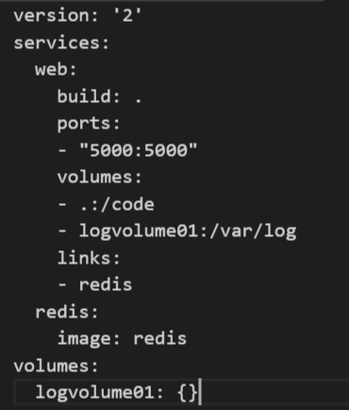
Docker Compose
A docker-compose.yml looks like :
You need the keyword « Services » to declare your web services and redis
As in a dockerfile you can add information like links between containers

Slide 65
Docker Registry
Docker store image in a registry
When we used docker pull or docker run command we get the image in the docker hub. This registry is public and contains images from official company like Canonical, Red Hat, Oracle, Microsoft and also from external contributor
We can create our shared registry easily :
https://docs.docker.com/registry/deploying/
First we need to create a container :
docker run -d -p 5000:5000 --restart=always --name registry registry:2
Then add the first image in our registry :
docker pull ubuntu && docker tag ubuntu localhost:5000/ubuntu

Slide 66
Docker Registry
To add the image in our registry we need to push it :
docker push localhost:5000/ubuntu
As the registry is a container, we can access it remotely as other container on the specified port
For production registry, you must add encryption like mentionned here :
https://docs.docker.com/registry/deploying/#/running-a-domain-registry

Slide 67
Docker Clustering
Running a standalone host is like creating a virtualisation with one host.
Using Docker Swarm, we can clusterize our server and achieve a high available docker solution
https://docs.docker.com/swarm/install-manual/
For now you need a linux machine to test swarm with virtualbox installed

Slide 68
Docker Orchestration
Running Docker without orchestration in production isn’t really recommended.
You can try Kubernetes, Rancher, Mesos, Swarm
Kubernetes is from Google, with all the Google experience
http://kubernetes.io/
Rancher is a new company (Rancher Labs) who provides the Rancher server to achieve a really fast installation using containers
http://rancher.com/
Mesos from Apache
http://mesos.apache.org/
Swarm mode from Docker
https://docs.docker.com/engine/swarm/

