Slide 1

Solving a Sudoku in Parallel
by:
Alton Chiu, Ehsan Nasiri, Rafat Rashid
“Sudoku is a denial of service attack on human intellect” -- Ben Laurie

Slide 2
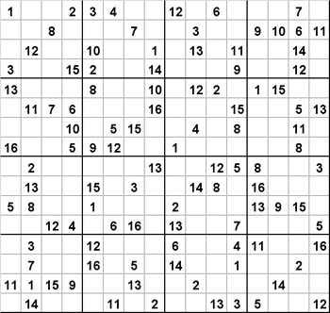
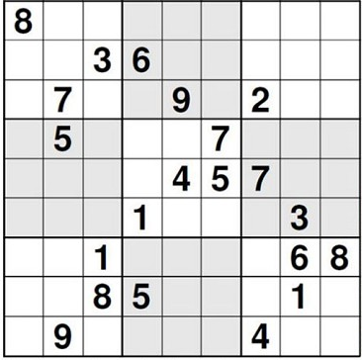
Sudoku
9x9 Puzzle
16x16 Puzzle

Slide 3
Sudoku Singleton
Singleton
CELL
9x9 Puzzle
16x16 Puzzle

Slide 4
Sudoku Peers
CELL
PEERS
9x9 Puzzle
16x16 Puzzle

Slide 5

Brute Force You Say?
$4×5×3$ $×…$ $×5=4.6×{10}^{38}$
$\frac{10 GHz ×1024×1,000,000 ×13 Billion Years}{4.6×{10}^{38}}=0.9 \%$
4 |  |  |  |  |  | 8 |  | 5
 | 3
 |  |  | 7
 | 2 |  |  |  |  |  | 6
 |  |  |  | 8 |  | 4
 |  |  |  | 1
 |  |  | 6 |  | 3 |  | 7
5 |  |  | 2
1 |  | 4

Slide 6
Constraint Propagation (CP)
If a cell has one value x, remove x from its peers’ possibility list
If none of your peers have value x in their possibility list, you are x
4 |  |  |  |  |  | 8 |  | 5
 | 3
 |  |  | 7
 | 2 |  |  |  |  |  | 6
 |  |  |  | 8 |  | 4
 |  |  |  | 1
 |  |  | 6 |  | 3 |  | 7
5 |  |  | 2
1 |  | 4
Possibility list = {4}
4
Possibility list = {2,6,7,8,9}
.
.
.

Slide 7
Constraint Propagation (CP)
If a cell has one value x, remove x from its peers’ possibility list
If none of your peers have value x in their possibility list, you are x

Slide 8
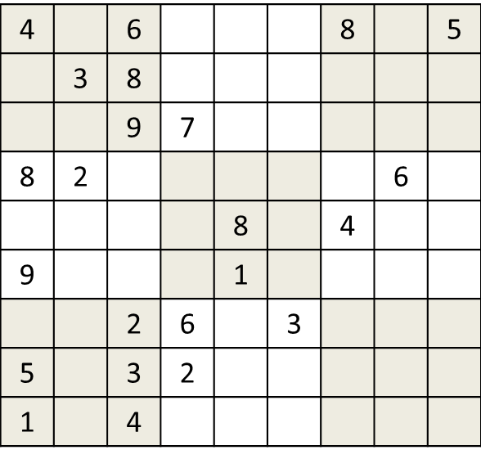
Search
Try all possibilities until you hit one that works
Possibility list = {7,2}

Slide 9
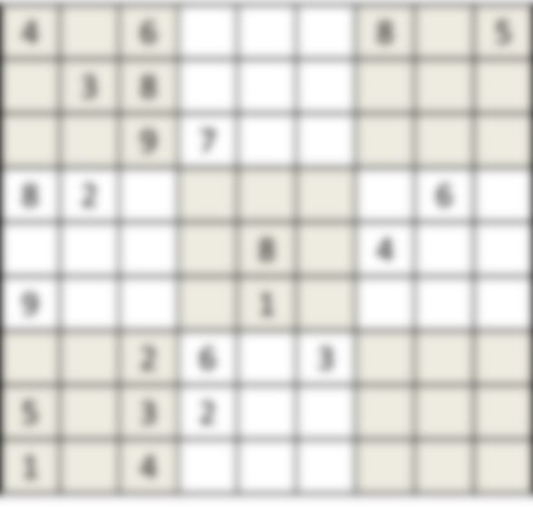
Search
Try all possibilities until you hit one that works
Possibility list = {7,2}
7
2

Slide 10
Decision Tree
Algorithm: CP → Search → CP → Search …
Possibility list = {7,2}
7
2

Slide 11
Decision Tree
7/2
1/3/4
5/6/7

Slide 12
Decision Tree
7/2
1/3/4
5/6/7
Search Picked: 7
Search Picked: 2
Do CP()
Do CP()
7
1/3/4
6/7
2
1/3/4
5/6/7

Slide 13
Decision Tree
7/2
1/3/4
5/6/7
Search Picked: 7
Search Picked: 2
Do CP()
Do CP()
7
1/3/4
6/7
2
1/3/4
5/6/7
Pick: 7
Pick: 6
Do CP()
Do CP()
7
4
7
7
1
7
7
3
7

Slide 14
Decision Tree – Search Candidate
. . .
. . .
.
.
.
.
.
.

Slide 15
Decision Tree – Search Candidate
. . .
. . .
.
.
.
.
.
.

Slide 16
Serial Algorithm: DFS
. . .
✔

Slide 17
Parallel Algorithm: DFS
. . .
✔

Slide 18
Improving the Parallel Algorithm: Message Passing
2
3
4
. . .
1
5
Thread#1 List= {}
Thread#2 List= {5,2,3,4}
Thread#2 List= {5,2,4}
Thread#1 List= {3}

Slide 19
Improving the Parallel Algorithm: Message Passing
Private Puzzle List
Thread #1
Thread #2
Thread #3
Thread #4
Ask for work
Ask for work
Ask for work
Ask for work

Slide 20
Improving the Parallel Algorithm: Locking
Global Puzzle List (shared memory)
POP()
✔
Broadcast
lock_acquire();
List.pop_front();
lock_release();
lock_acquire();
List.push_back(new_node);
lock_release();

Slide 21
Evaluation Methodology
Used pthreads library for parallelism
Amortized results:
100 ‘evil’ puzzles, 10 runs for each algorithm
Evil = the puzzle can’t be solved if one more cell is removed
Measured on UG machines
Intel Core 2 Quad (2.66 GHz)
4 GB RAM

Slide 22
Results - Runtime

Slide 23
Results - Yielding
pthread_yield() can save you a large number of CPU cycles

Slide 24
Results – Conditional Signaling
pthread_cond_signal() is expensive!
Can’t always avoid it. Our application was simple enough to avoid it.

Slide 25
Conclusions
Solving a Sudoku is fun… until you try to parallelize it!
Strongly connected dependencies make it extremely difficult to parallelize constraint propagation
Traversing the solution space tree in parallel is the best way to reach a solution faster.
We achieved an average of 4.6X speedup using 4 threads (using locking and yielding)

