Slide 1
High Resolution
Sparse Voxel DAGs
Etienne Ferrier and Nikolai Morin

Slide 2
Presentation plan
Paper summary (demo result)
Storage and traversal
  Voxel grid
  Octree (demo color & memory ideal/actual on slide)
  DAG (demo color & memory ideal/actual on slide)
Conversion algorithm
Comparison

Slide 3
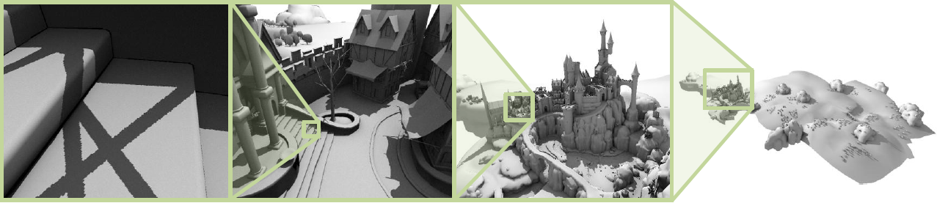
Paper summary
Context : Alternative scene representation.
Objective : Encode and manipulate huge voxel scenes.
Scene encoded and rendered with a DAG
Resolution : 128K³ | Voxel Octree mem. size : 5.1GB | DAG mem. size : 945 MB

Slide 4
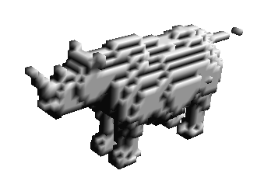
Voxel grid
A 3D voxel matrix
Mem. size : side³ bits.
Used to convert a mesh to
a voxel scene
64³ voxel grid rhino
32 kB

Slide 5
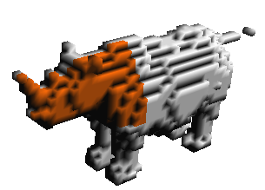
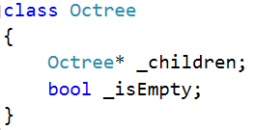
Sparse Voxel Octree (SVO)
8 children per node :
Mem. Size :
  32 + 8 = 40 bits per leaf
  32*8 + 8 = 264 bits per internal node
64³ octree rhino
45 kB

Slide 6

SVO Breadth First Encoding
One child mask per internal node
  Listed in breadth first order
  Ex :
Mem. Size :
  8 bits per internal node
  0 bit per leaf
Only good for storage
64³ octree rhino
670 B

Slide 7
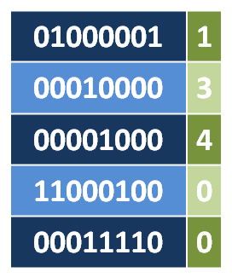
SVO Mask-pointer encoding
Per internal node :
  One pointer to the first non-empty child
  One child mask
  Ex :
Mem. size : 32 + 8 = 40 bits per internal node
64³ octree rhino
3 kB

Slide 8
DAG

Slide 9
Conversion algorithm

Slide 10
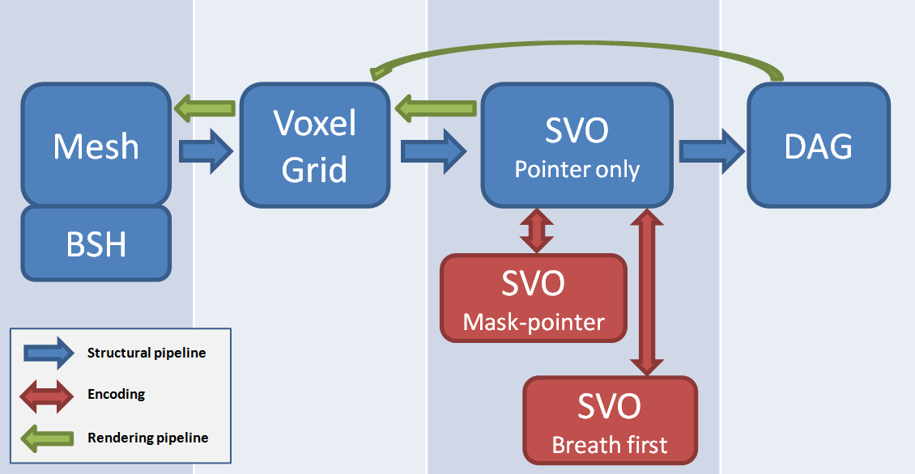
Implementation
Our pipeline

Slide 11
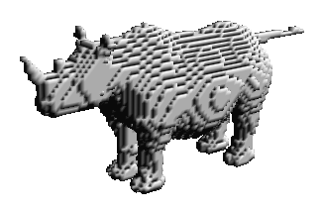
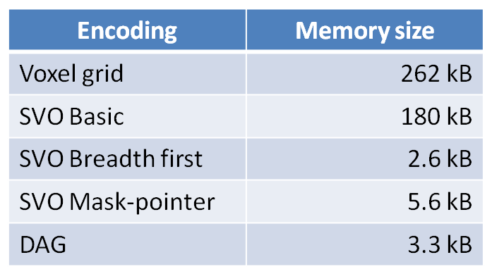
Memory Comparison
For 128³ rhino :

