Slide 1
High Resolution Sparse Voxel DAGs
Etienne Ferrier and Nikolai Morin

Slide 2
Presentation plan
Paper summary (demo result)
Storage and traversal
Voxel grid
Octree (demo color & memory ideal/actual on slide)
DAG (demo color & memory ideal/actual on slide)
Conversion algorithm
Comparison

Slide 3
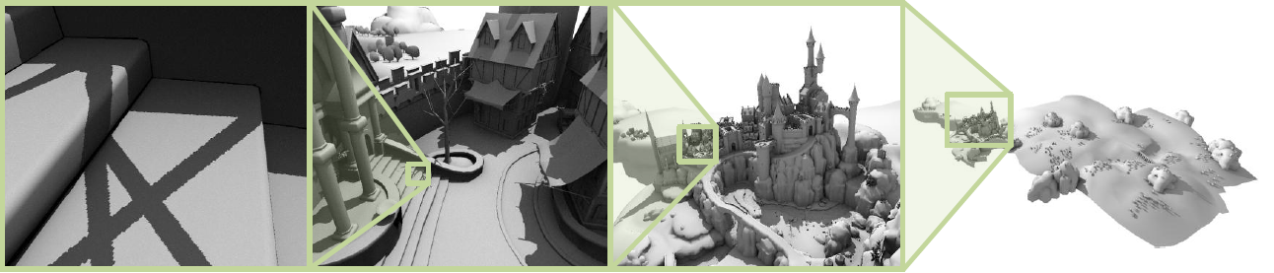
Paper summary
Context : Alternative scene representation.
Objective : Encode and manipulate huge voxel scenes.
Scene encoded and rendered with a DAG
Resolution : 128K³ | Voxel Octree mem. size : 5.1GB | DAG mem. size : 945 MB

Slide 4
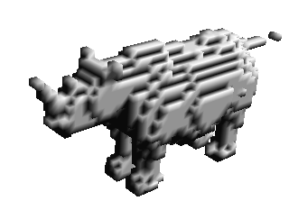
Voxel grid
A 3D voxel matrix
Mem. size : side³ bits.
Used to convert a mesh to
a voxel scene
64³ voxel grid rhino
32 kB

Slide 5
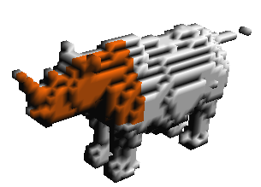
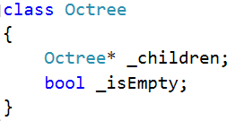
Sparse Voxel Octree (SVO)
8 children per node :
Mem. Size :
32 + 8 = 40 bits per leaf
32*8 + 8 = 264 bits per internal node
64³ octree rhino
45 kB

Slide 6
SVO Breadth First Encoding
One child mask per internal node
Listed in breadth first order
Ex :
Mem. Size :
8 bits per internal node
0 bit per leaf
Only good for storage
01000001 | 10100100 | 00000100
64³ octree rhino
670 B

Slide 7
SVO Mask-pointer encoding
Per internal node :
One pointer to the first non-empty child
One child mask
Ex :
Mem. size : 32 + 8 = 40 bits per internal node
01000001 | 1
00010000 | 3
00001000 | 4
11000100 | 0
00011110 | 0
64³ octree rhino
3 kB

Slide 8
DAG

Slide 9
Conversion algorithm

Slide 10
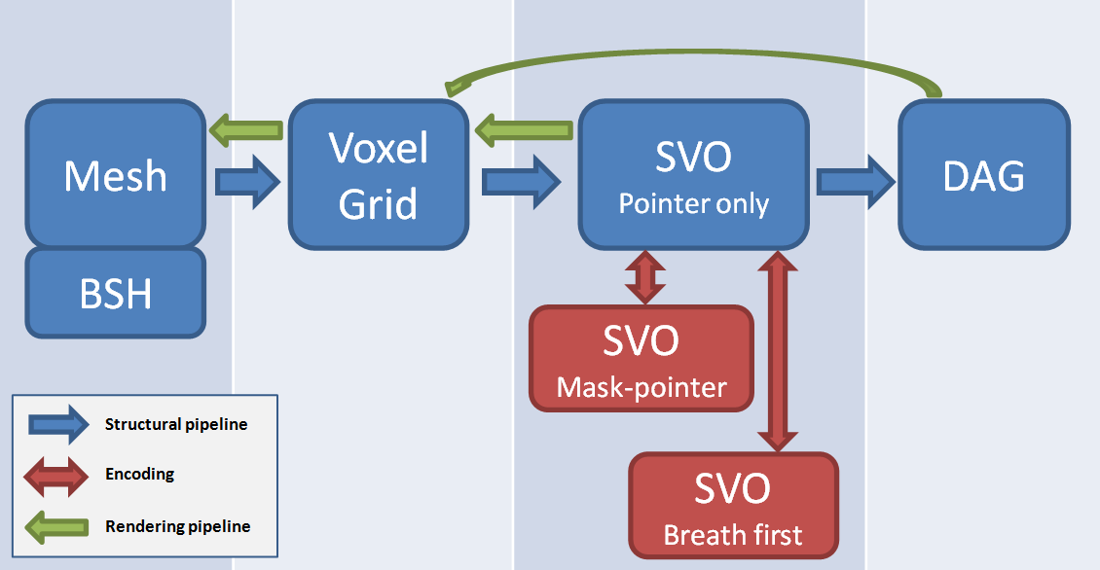
Implementation
Our pipeline

Slide 11
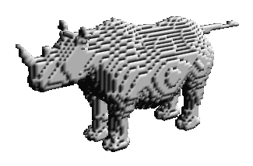
Memory Comparison
For 128³ rhino :
Encoding | Memory size
Voxel grid | 262 kB
SVO Basic | 180 kB
SVO Breadth first | 2.6 kB
SVO Mask-pointer | 5.6 kB
DAG | 3.3 kB

