Slide 1
What Developers Want
An Introduction to PaaS and 12-Factor Apps
Etienne Koekemoer
Twitter: @EtienneK
Github: https://github.com/EtienneK

Slide 2
Introduction
Platform as a Service (PaaS)
12-Factor Apps
Spring Boot
Heroku

Slide 3
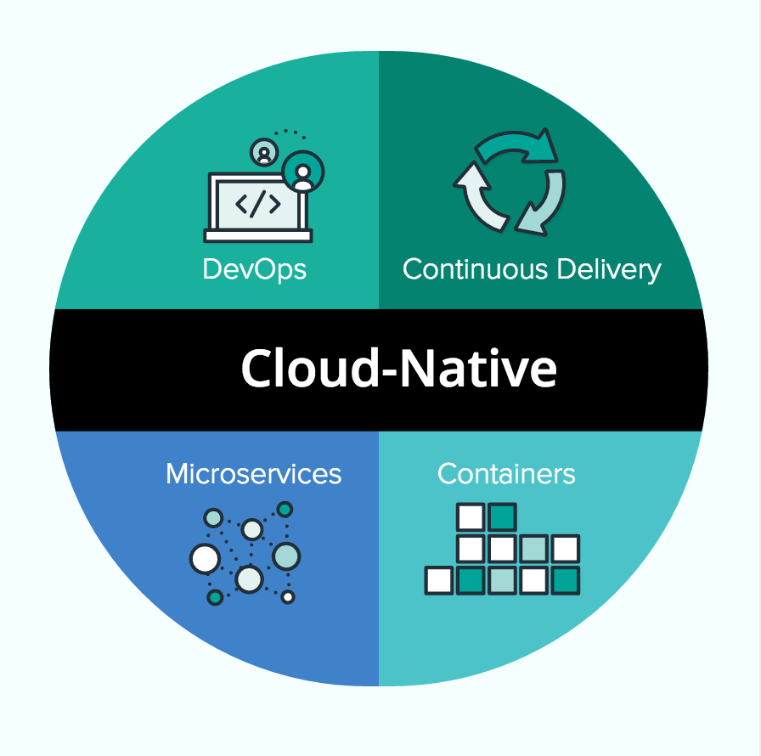
We Want to Build Cloud Native Apps

Slide 4
We Need a Platform
“Nobody has ever built cloud-native apps without a platform. They either build one themselves or they use Cloud Foundry.” Joshua McKenty, Field CTO of Pivotal Cloud Foundry

Slide 5
“You build it, you run it”
Developers HATE this!

Slide 6
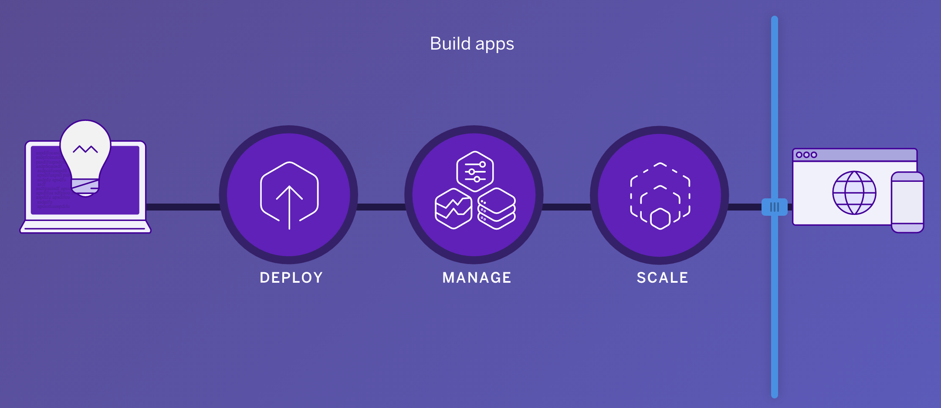

Slide 7
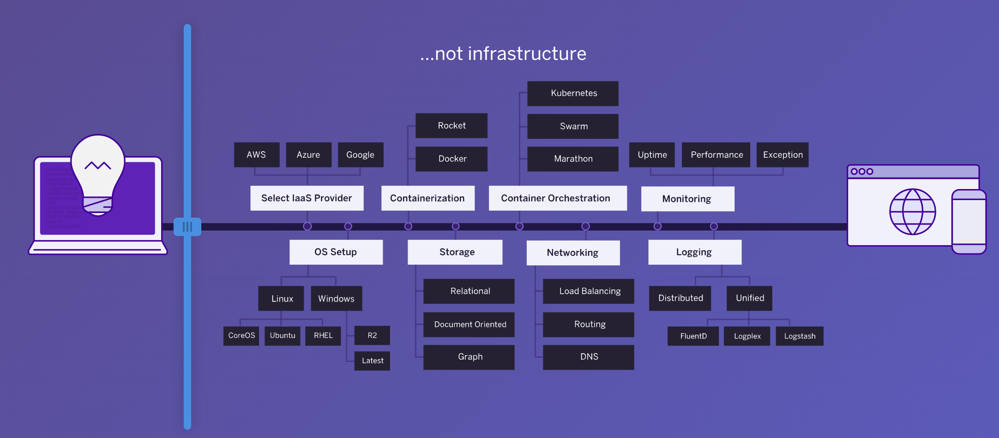

Slide 8
PaaS systems hide the Infrastructure
Let Developers focus on what they are good at: delivering business functionality

Slide 9
How to Build a Cloud-Native Application
12 Factor Apps
https://12factor.net/

Slide 10
The 12-Factor Application
I. Codebase One codebase tracked in revision control, many deploys II. Dependencies Explicitly declare and isolate dependencies III. Config Store config in the environment IV. Backing services Treat backing services as attached resources V. Build, release, run Strictly separate build and run stages VI. Processes Execute the app as one or more stateless processes
VII. Port binding
Export services via port binding
VIII. Concurrency
Scale out via the process model
IX. Disposability
Maximize robustness with fast startup and graceful shutdown
X. Dev/prod parity
Keep development, staging, and production as similar as possible
XI. Logs
Treat logs as event streams
XII. Admin processes
Run admin/management tasks as one-off processes

Slide 11
12-Factor App Summarized
“12-Factor apps are apps that decouple themselves from the environment.” Kelsey Hightower, Engineer at Google (Currently working on Kubernetes)

Slide 12
Spring Boot makes Writing 12-Factor Apps Easy!
Demo Time!
https://github.com/EtienneK/arch-f2f-2017-03/blob/master/README-spring-boot-demo.md
Customer Micro Service
PostgreSQL DB

Slide 13
Matching Back to 12-Factor
I. Codebase ✅ One codebase managed in git for all environments II. Dependencies ✅ Declared in pom.xml file III. Config ✅ DB string configured in ENV variable IV. Backing services ✅ Treating PostgreSQL as just another service V. Build, release, run ❌ Will be handles by the PaaS VI. Processes ✅ App runs as its own STATELESS process – does not require any other processes to run it (like an App Server)
VII. Port binding ✅
Exposes port 8080 by default so we can connect to it
VIII. Concurrency ✅
Scaling our app is as easy as just spinning up new instances of it
IX. Disposability ✅
Starting up and stopping our application is pretty fast (seconds, not minutes)
X. Dev/prod parity ❌
Will be handled by the PaaS and its tools
XI. Logs ✅
Logs get written to standard out/err by default
XII. Admin processes ❌
No admin processes for this demo

Slide 14
Deploy to Heroku
https://id.heroku.com/login
https://github.com/EtienneK/arch-f2f-2017-03/blob/master/README-heroku-demo.md
https://elements.heroku.com/addons

Slide 15
Questions?
???
Presentation + Working demo available at: https://github.com/EtienneK/arch-f2f-2017-03

