Slide 1

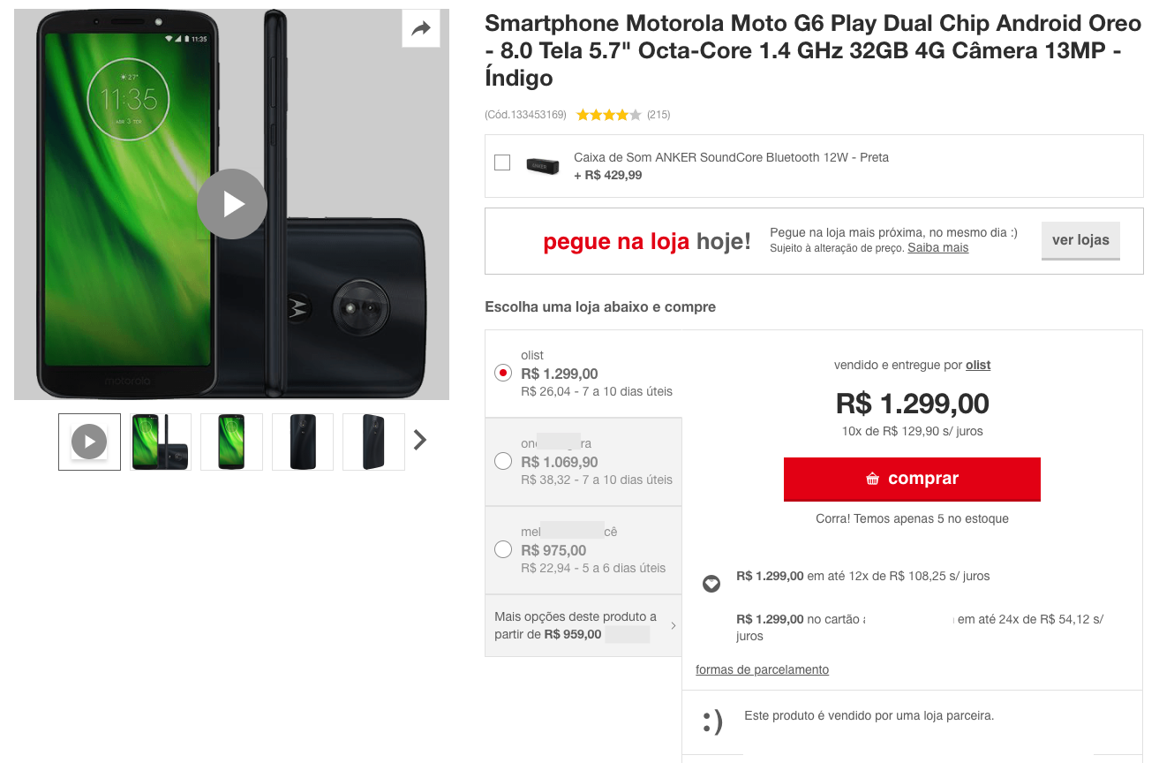

Olist Marketplace: Customer Segmentation  Rely on Olist datasets shared through Kaggle*,  Help marketing teams to understand customers,  Through a usable segmentation,  Identify the right update interval
3 steps :
Perform EDA & Feature Engineering to enhance data
Try a variety of modelling approaches
Select the best model and its improvements
* https://www.kaggle.com/olistbr/brazilian-ecommerce

Slide 3
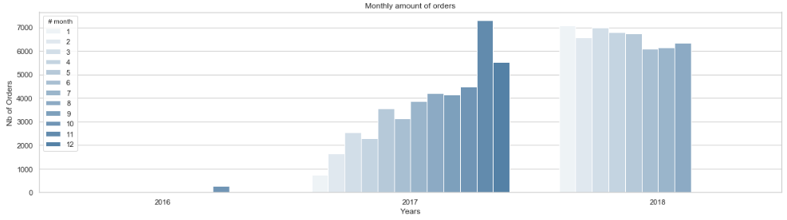
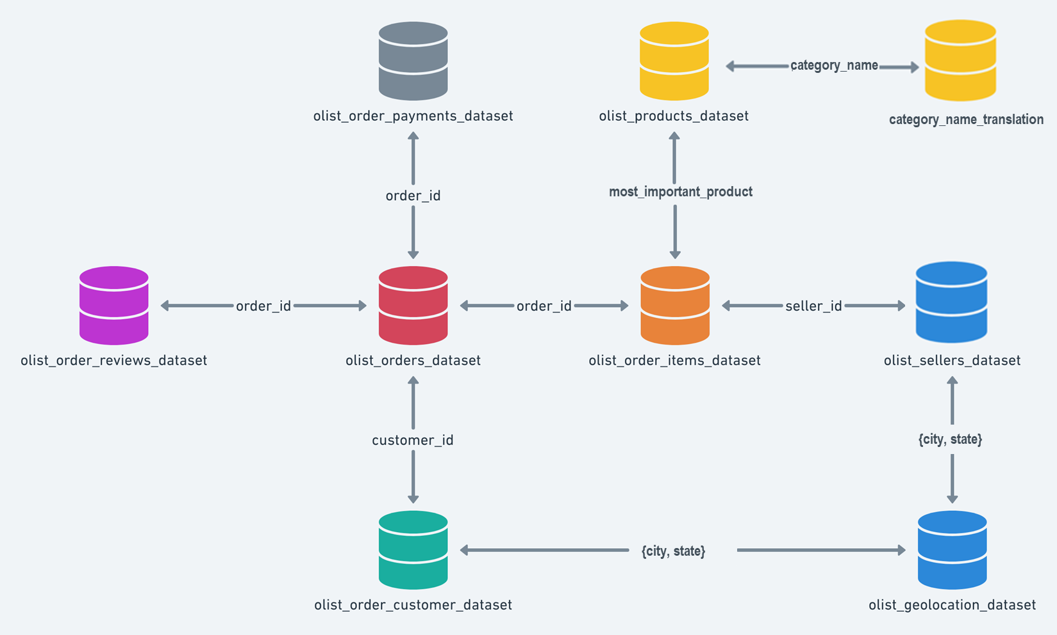
Merge a Customer-Centric Dataset
Data Truncature
Orders number rise from end 2016 and is stable in 2018
Only 3 % of Customers made more than a Single Order !
RFM* techniques are not valid
Only 3 % of Orders are not single_product & 10% multi-item in shopping carts
Simplified 1:1 cardinality for {Customer_unique – Order – Product – Review} is valid
* Recency and Frequency would require the knowledge of multiple timestamped orders and senseful anteriority.
2
1
From Order-Centric to Customer-Centric data:
1. Focused on the most_important_product (of highest value)
2. Attached a category to the product
3. Keeping for any customer_unique_id, the « single_product » & last delivered Orders
3.
Let’s browse some Customer-Centric features !
Notes:
Why such data troncature statement :
Identification of unexpectedly poor quantities of a given type of order (multi_orders, multi_products)
Consequence for the study :
Rebuild a balanced dataset would imply to adjust with an additionnal sample of original datas. For instance : how many single_orders should we keep, on which basis ?
We would rather get to a clearly biased dataset.

Slide 4

Build Customer-Centric Features
Order-Centric datasets enable to gather :
costs of detailed shopping cart, paiement details,
accurate description (but of unnamed products), attached to a product category,
review score, attached to an order,
customer and seller geolocation.
We build Client-Centric features to detail « Who : Customers Groups », by studying :
What : the product, its value and price (the M criteria of RFM)
The total_price (& supported freight_percentage)
The « charm price » (price with a « 9, 99 or x90 » termination)
The product category and its caracteristics : size, weight
When : the purchase_time_zone (as a clustering of purchase_dayofweek & purchase hour)
Why :
the Review Scores and especially the review_gap, as well as the « popularity » of the product or its seller.
the quality of product’s description may be part of the customer purchase behavior
Where : despite web purchase, Customer-Seller distance, with impact on Delivery time and Freight cost.
Note that each item has the freight calculated accordingly to its measures & freight value is splitted between items
How : the (main_)payment_type, the payment installement size

Slide 5
customers
Native a | Native b | … | New : | New : | New :
orders
Native x | Native y | … | New : Sum (a) | New : Mean (b)
items
Native a | Native b | …

Slide 6





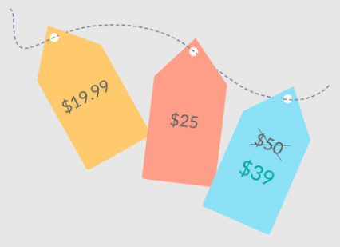



Customer-Centric features
How : main_payment_type(_cat)
payment_installments_size(_cat)
payment_sequence_size(_cat)
What : payment_total*
main_payment_value
What : product_cat
product_weight_g
product_size
product_density
Why : product_photos_qty product_description_length
product_name_length
product_sales_count
product_revenue
payments
freight related
products
product_qlty_idx*
When : purchase_time_zone_cat
order_purchase_dayofweek
order_purchase_hour
delivery_vs_estimated*
estimated_delivery_time effective_delivery_time
orders
product_popularity
freight related
customer
What : total_price*
charmed_price(_cat)
freight_percentage*
total_freight
items_qty
product_price
product_freight
items
freight related
Why : product_review_mean*
product_review_count
customer_review_count
How : review_gap*
review_answer_delay*
customer_review_mean
reviews
Sellers &
geoloc
of a single product !
Where : cust_sell_dist*
seller_city &state
customer_city & state
Why : seller_sales_count
seller_revenue
seller_main_product_cat
freight related
seller_popularity
* : can also be described as an ordinal « level » feature

Slide 7
K-Modes Features
How : main_payment_type_cat
payment_installments_size_cat
payment_sequence_size_cat
What : payment_lvl
payments
What : product_cat
Why : product_qlty_idx_lvl
products
When : purchase_time_zone_cat
delivery_vs_estimated_lvl
orders
customer
items
What : product_price_lvl
charmed_price_cat
freight_percentage_lvl
reviews
Why : product_review_mean_lvl
How : review_gap_lvl
review_answer_delay_lvl
Sellers &
geoloc
Where : cust_sell_dist_lvl
seller_main_product_cat

Slide 8
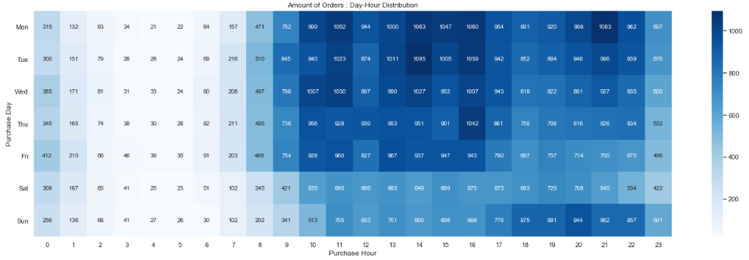
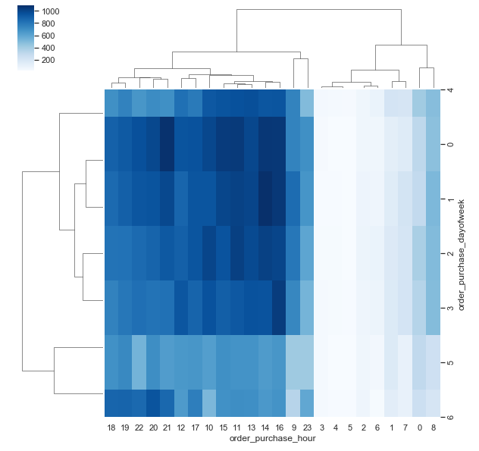
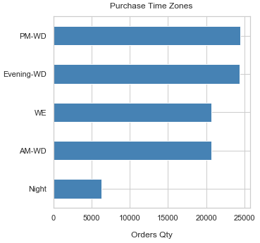
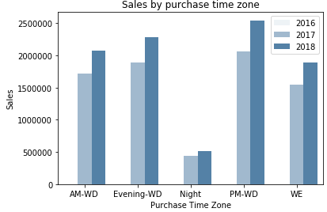
Feature engineering insights :
purchase_time_zone_cat : order_purchase_dayofweek & _hour from original purchase_timestamp
product_cat : rationalized from 71 to 15 categories, should map with customer’s search & navigation
review_gap : value the gap between product and customer review
A few features are available about “freight”, linked together :
cust_sell_dist : the distance computed from geolocation
product_size / _weight_g / _density : used to compute a freight class
freight_percentage : freight value / total paiement

Slide 9
Correlated features & pre-processing
Heatmap with Spearman rank correlation : help to select among correlated features the most significant ones.
A forward selector that calculates how « good » a feature is in order to obtain a better clustering.
Although Silhouette Score is the best for accurate comparison (same value relevance in any context),
Silhouette Score is costly to computes even with samples,
Davies-Bouldin Index is fastest to compute and offers same trends than Silhouette Score.
We used Davies-Bouldin index first and refine our work with Silhouette Score
Model sensitivity (to a feature type) is obviously critical here :
Once we put a discrete or even non-normal distributed feature, this takes the lead on other features.
According to marketing insights :
We could target such emerging categorization
Or we must try to remedy this effect (e.g. tends to normal-distributed features, build new features such as « indexes »).

Slide 10
Use an alternate approach
Idea is to perform K-Modes technique, dedicated to categorical features, on level features.
Pros : get clear centroïd details and cluster description
Cons : consider ordinal as categorical features, losing the « real » distance between levels
Method : starting with an initial centroids seed, refine clusters by minimizing dissimilarity (Hamming distance from cluster mode).
! Currently a research topic, to find the most efficient technique.
Basics : many seeds, few clusters, and of course few features and especially few categories (prevent having too small populated categories)
Evaluation : the lowest cost gives the best clustering.

Slide 11
Funnel : issue synthesis & strategy
Data Science approach relies on facts an maths, rather than usual marketing practices.
Such approach needs could help to find disruptive recipe.
Which features as input of clustering algorithm ?
Reduced number of features better actionability
Haw many clusters should we target ?
Is there a « marketing » optimal cluster number ?

Slide 12
(Fast) Forward Selector
Aim is to get an idea of the most valuable features to perform segmentation.
Unfortunately, neither feature combination technique seems embedded in pipeline, nor features selection’s algorithms in such unsupervized context (unlike feature’s importance or coef. weights).
An idea to assess each feature for further clustering, is to proceed by :
1. Performing K-means with each feature individually, targetting a given k clusters number.
2. Get clustering performance
3. Keep the feature that gives the best result.
Proceed the same loop 1 to 3 with remaining features, until n « most valuable » features seems found.
Implementation made on 2 scoring methods : max of silhouette score, min of Davies-Bouldin Index,
We are able to submit to marketing departement alternate subsets of features, based on our observations :
The « model sensitivity » according to the feature’s distribution.
A small number of features generaly leads to high clustering scores. This trend explains why dimensionality reduction techniques are so valuable in clustering.

Slide 13
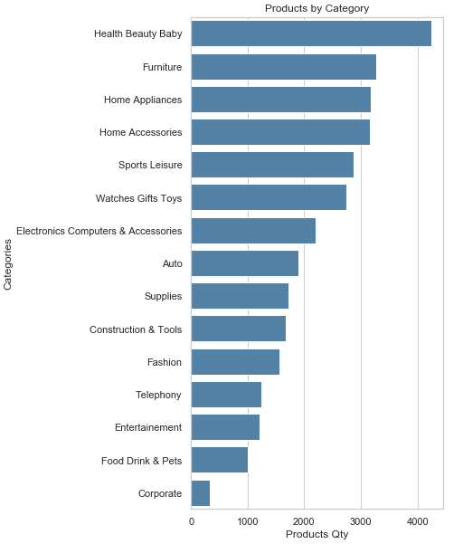
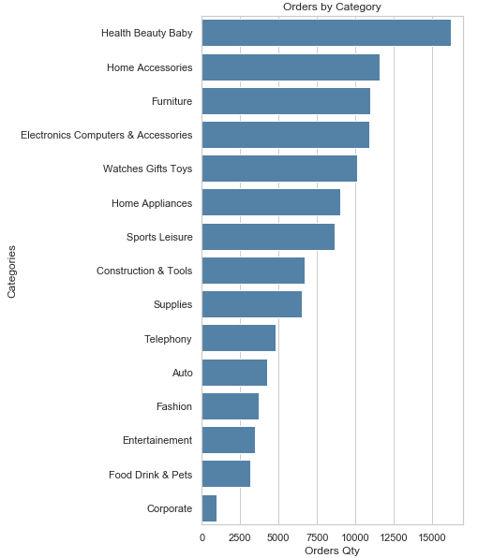
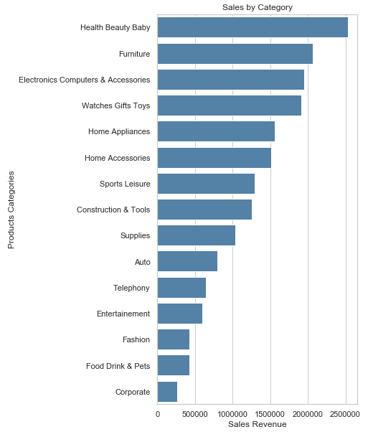

Slide 14
Pipeline
EDA with clean dtypes
Co*
Numerical
Categorical
Ordinal ?
Mutual exclusion?
Numerical : order_purchase_dayofweek, order_purchase_hour
Categorical : Purchase_Time_Zone
Combine
1 x
preprocessor = make_column_transformer(
(numerical_pipeline, numerical_features),
(categorical_pipeline, categorical_features),
? Ordinal_pipeline : - 3, +3)
Transform
Search space :
C : Features Combination?
Transformer
S : {'selector__k': [5, 10, 20, 30]}
R : {‘PCA’: , …}
M : {‘Nb_cluster’
S*
Select
Kbest ?
Visualize
R*
Reduce
PCA, T-sne ?, no reduction, both
Cluster
Cl*
K-Means, Agglomerative Clustering, DBSCAN, K-Modes? K-Prototypes ?
CV -> persp.
ARI
Reval?
Stability
Assess
Quality
Assess
Silhouette vs Davies-bouldin, (elbow is visual),

Slide 15
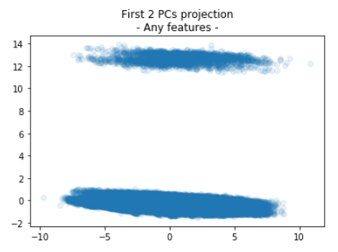
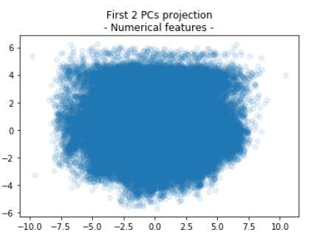
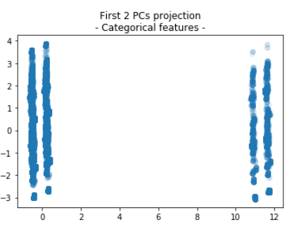
PCA : feature type sensitivity

Slide 16
Customer-Centric features
payment_total
main_payment_type(_cat)
payment_sequence_size
payment_installments_size
payments
rational_category
product_density
product_name_length
product_description_length
product_photos_qty
product_weight_g
product_size
products
orders
purchase_time_zone
delivery_vs_estimated
order_purchase_dayofweek
order_purchase_hour
customer
items
charm_price
freight_percentage
product_price
product_freight
total_price
total_freight
items_qty
product_review_mean
review_gap
review_answer_delay
customer_review_mean
product_review_count
customer_review_count
Nb. the score is for the Order
reviews
geoloc
cust_sell_dist
seller_state
customer_state

Slide 17
Learn about Clients
« naturally » correlated features
Freight value or percentage* versus density, because freight cost is usually calculated with weight and volume.
Category typical values : i.e. Furnitures are high vol. products, basic goods for health and beautye are not has expensive has perfumery, etc.
Customer’s behavior could offer actions, let’s try to see which actions could increase the selling power through Olist.
Total price is not that easy to handle by Olist, but a “charm pricing” strategy is affordable and could be assessed to be applied to most relevant products in order to increase the sales performance.
Get a better knowledge of what kind of customers is about to by a product at what time is another valuable intel : for categories recommendation such as kart and additional item.
Customer’s behaviour can as well be determined by the product review, and this could also affect its own review score, if correlated each other.

Slide 18
* Customer shall surely not pay delivery costs for any items of its order and we assume that for a given price, the costs are adjusted in case of far distance delivery.
From Payments-Centric
A customer can already select the payment means and its potential installements, although this reveal the purchase behavior,
We could try to improve sales or favor highest expenses for customers, by analysing payment total.
From Products/Items-Centric
Product sales comparisons based on their detailed descriptions would be valuable to take actions to enhance seller’s products database.
Charm pricing could affect Customer behavior.
Freight value beeing usually determined by product Weight and Volume, those features may have an hidden impact on Customer’s behavior
From Geoloc-Centric:
A marketplace offers a virtualization of Seller-Customer relations, a deeper look on this hidden aspect and its impact to the customer behavior could be valuable to understand how the real cust-seller distance influence the sales.
From Order-Centric
delivery_vs_estimated would be valuable to remedy unsatisfaction consequences, and its consequence on Review scores.
From Review-Centric
Is the review score given by the customer correlated with the average score? Does the score affects the sales of a product?
Client review would be valuable to remedy unsatisfaction consequences. Does the client follow the crowd?
Customer-Centric selection :
Payment Total
Freight Percentage
Customer – Seller Distance
Charm Price
Review Score Gap
If we want to get to new customers, an idea is to get a picture of When and What they buy, by catching their favorite Time Purchase Zone and Product Category.

Slide 19
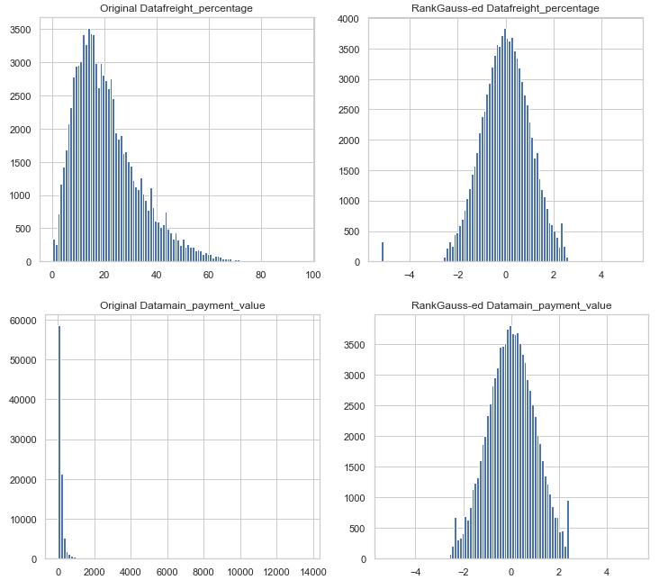
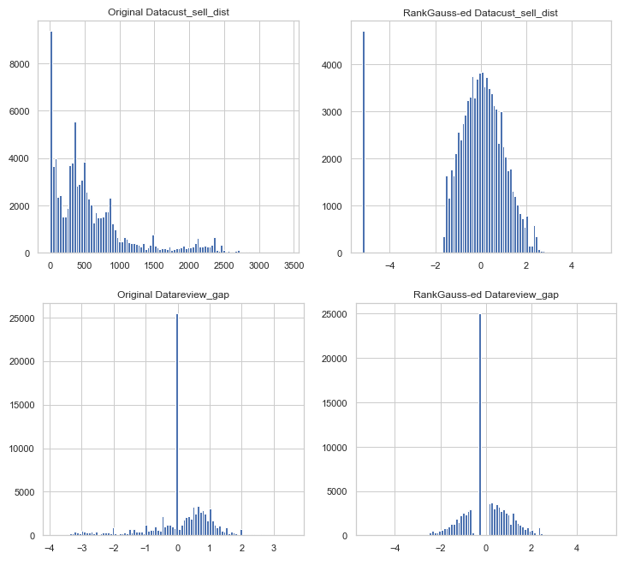
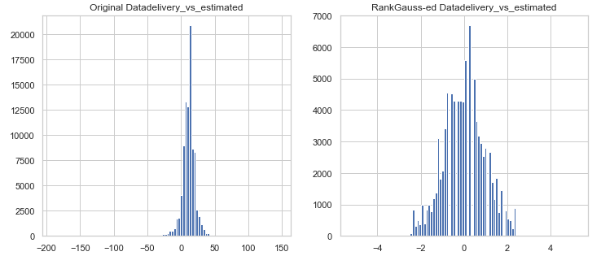
davies_bouldin_score : 0.8377774761211887

Slide 20
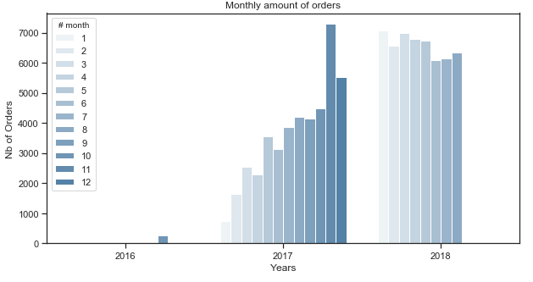

Slide 21
['AroundMed_Paiement' 'OnTime_Delivery' 'BelowMed_FreightCost'
'Near_Dist' 'AroundMed_Review' '1']
['AroundMed_Paiement' 'Late_Delivery' 'OverMed_FreightCost'
'AroundMed_Dist' 'LowerMed_Review' '1’]
['Light_Paiement' 'OnTime_Delivery' 'OverMed_FreightCost'
'AroundMed_Dist' 'AroundMed_Review' '1']
['AroundMed_Paiement' 'OnTime_Delivery' 'AroundMed_FreightCost'
'AroundMed_Dist' 'AroundMed_Review' '1']
['Light_Paiement' 'Late_Delivery' 'AroundMed_FreightCost' 'Near_Dist'
'UpperMed_Review' '0']
['AroundMed_Paiement' 'Late_Delivery' 'BelowMed_FreightCost' 'Near_Dist'
'AroundMed_Review' '1']
['Light_Paiement' 'OnTime_Delivery' 'OverMed_FreightCost' 'Far_Dist'
'AroundMed_Review' '1']
['Light_Paiement' 'OnTime_Delivery' 'OverMed_FreightCost'
'AroundMed_Dist' 'AroundMed_Review' '0']
['AroundMed_Paiement' 'OnTime_Delivery' 'AroundMed_FreightCost'
'AroundMed_Dist' 'AroundMed_Review' '1']
['AroundMed_Paiement' 'Soon_Delivery' 'AroundMed_FreightCost'
'Near_Dist' 'UpperMed_Review' '1']

Slide 22
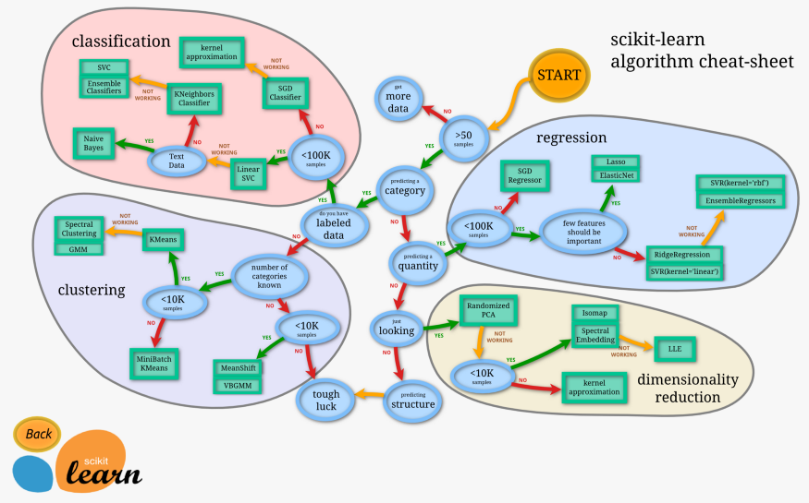
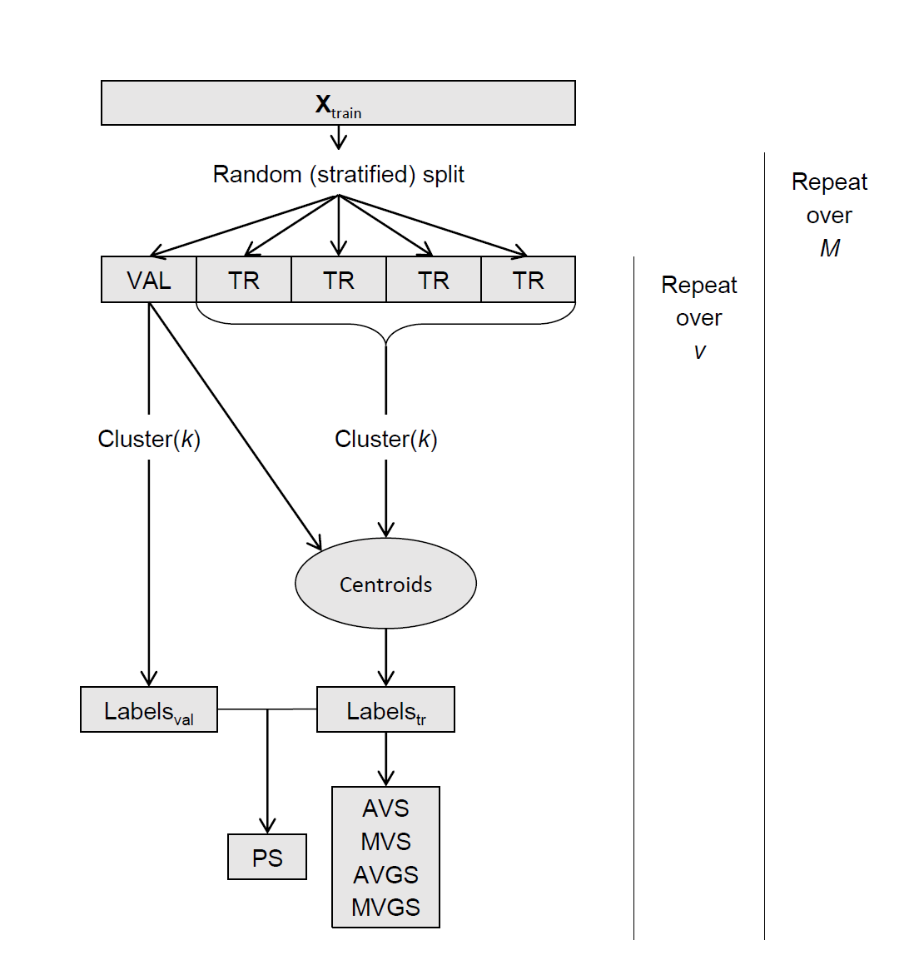

Slide 23


Merge a Client-Centric Dataset
category_name
category_name_translation
most_important_product
{city, state}
{city, state}

