Slide 1
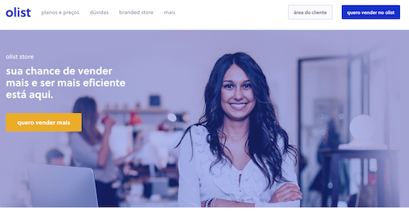
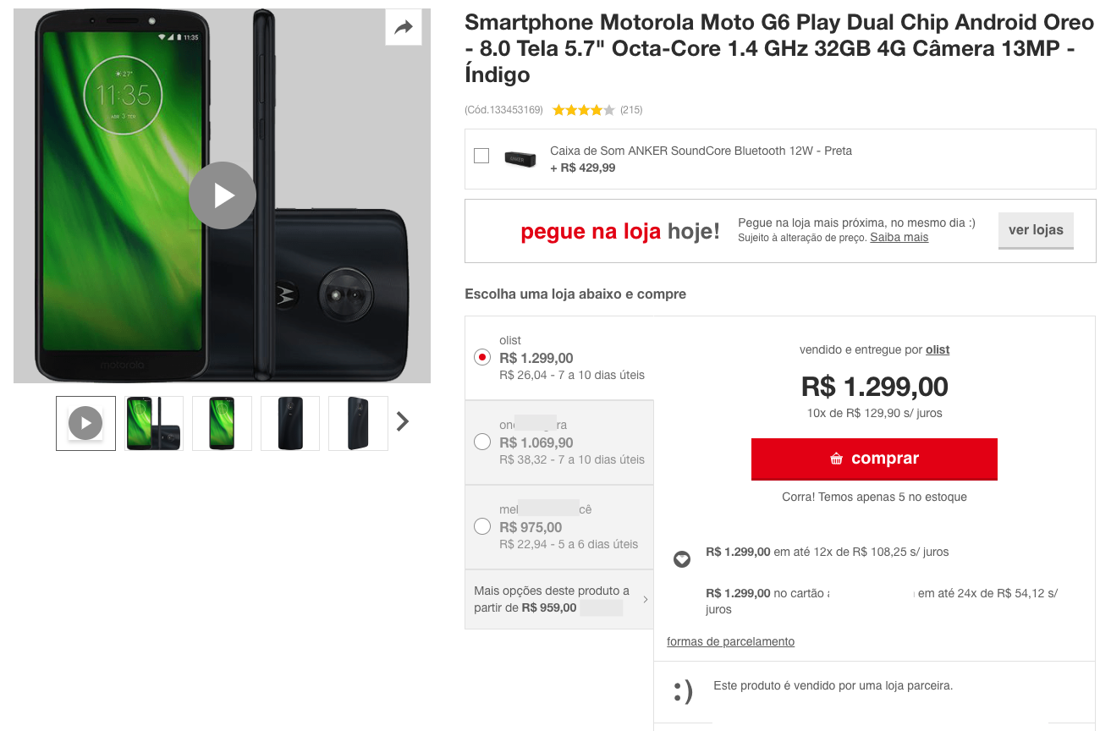

Olist Marketplace: Customer Segmentation  We rely on Olist datasets shared through Kaggle*,  To improve marketing team’s customer understanding,  Through a usable segmentation,  Identifying a right update interval
3 steps :
1. Perform EDA & Feature Engineering to enhance data
2. Combine a variety of modelling approaches
3. Choose the best approach and its improvements
* https://www.kaggle.com/olistbr/brazilian-ecommerce

Slide 2

Data Science : your best Support
What can emerge out of data ?
Exploratory Data Analysis, toward valuable Customer-Centric data
Feature Engineering: You Set the Limits, Pick Your Favourite !
Refine your target : refine Use Cases
Once the right targets are selected : what is a good segmentation ?
The most usefull Features, i.e. with adequate type and shape
The most efficient Models, i.e. with adequate sensitivity
The most relevant Metrics, i.e. with meaningfull results
Once the « right » approach is selected : how to achieve Olist business goals ?
Stability
Further proceedings

Slide 3
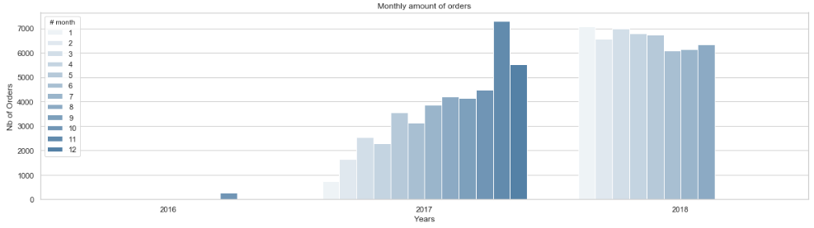
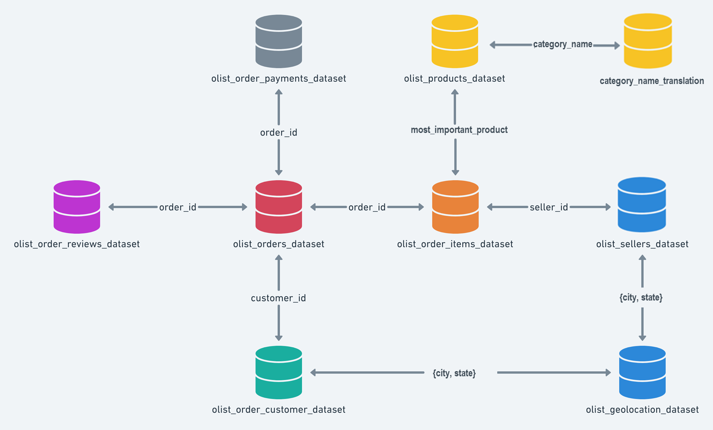
1.a. Merge a Customer-Centric Dataset
Data Truncature
Orders number rise from end 2016 and is stable in 2018
Only 3 % of Customers made more than a Single Order !
RFM* techniques are not valid
Only 3 % of Orders are not single_product & 10% multi-item in shopping carts
Simplified 1:1 cardinality for {Customer_unique – Order – Product – Review} is valid
* Recency and Frequency would require the knowledge of multiple timestamped orders and senseful anteriority.
2
1
From Order-Centric to Customer-Centric data:
1. Focused on the most_important_product (of highest value)
2. Attached a category to the product
3. Keeping for any customer_unique_id, the « single_product » & last delivered Orders
3.
Let’s browse some Customer-Centric features !
Notes:
Why such data troncature statement :
Identification of unexpectedly poor quantities of a given type of order (multi_orders, multi_products)
Consequence for the study :
Rebuild a balanced dataset would imply to adjust with an additionnal sample of original datas. For instance : how many single_orders should we keep, on which basis ?
We would rather get to a clearly biased dataset.

Slide 4

1.b. Engineer Customer-Centric Features
While Order-Centric datasets enable many calculation with groupby and consolidation by merge,
Client-Centric features can be engineered to get the « Who » : Customers Groups, e.g. by studying :
What : the product, its value and price (the « M » criteria of RFM)
The « charm price » (price with a « 9, 99 or x90 » termination)
The product category, and its caracteristics : size, weight
When : the purchase_time_zone (as a clustering of purchase_dayofweek & purchase hour)
Why :
the Review Scores interest and behaviour, as well as the « popularity » of the product or its seller.
the quality of product’s description.
Where : the Customer-Seller distance, linked to the delivery time and freight cost.
each item has the freight calculated accordingly to its measures & freight value is splitted between items
How :
The kind of payment, with payment_type, installements size, …
the review score given by the customer

Slide 5






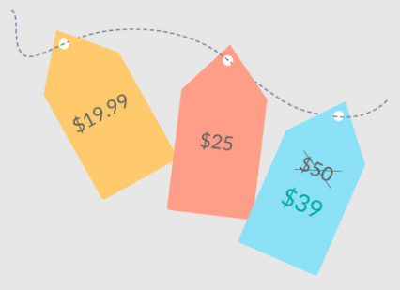



1.b. Overview : the unlimited Feature Engineering field
How : main_payment_type(_cat)
payment_installments_size(_cat)
payment_sequence_size(_cat)
What : payment_total*
main_payment_value
What : product_cat
product_weight_g
product_size
product_density
Why : product_photos_qty product_description_length
product_name_length
product_sales_count
product_revenue
payments
freight related
products
product_qlty_idx*
When : purchase_time_zone_cat
order_purchase_dayofweek
order_purchase_hour
delivery_vs_estimated*
estimated_delivery_time effective_delivery_time
orders
product_popularity
freight related
customer
What : total_price*
charmed_price(_cat)
freight_percentage*
total_freight
items_qty
product_price
product_freight
items
freight related
Why : product_review_mean*
product_review_count
customer_review_count
How : review_gap*
review_answer_delay*
customer_review_mean
reviews
Sellers &
geoloc
of a single product !
Where : cust_sell_dist*
seller_city &state
customer_city & state
Why : seller_sales_count
seller_revenue
seller_main_product_cat
freight related
nb *: Most features can also be derived as an ordinal « level », according to your rules or targets
seller_popularity

Slide 6

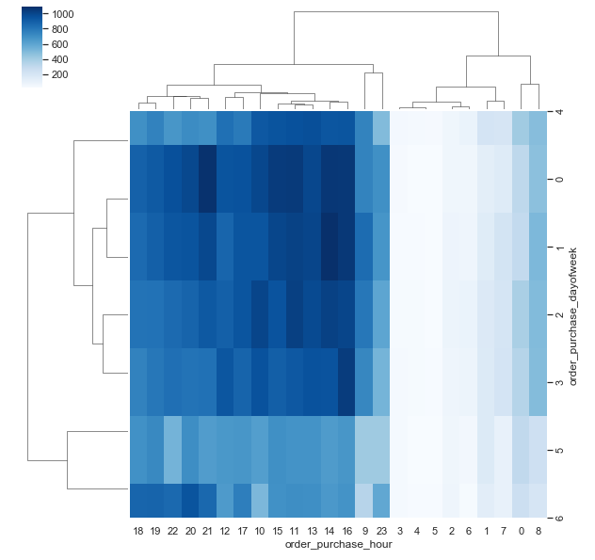
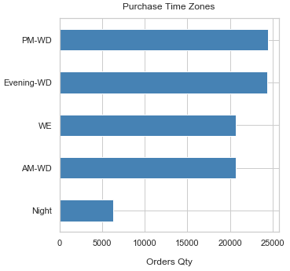
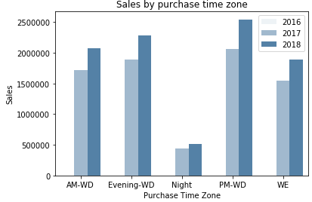
1.c. Refine your Goals, Find the Right Target
RFM easy actionability has emerged during years of practices, is now enhanced by Machine Learning.
You shall not « put » customers in a frozen matrix any more, but drive your ability to « learn » from data.
Let’s see practical examples :
The « Right » features
The right product :
Product_review_mean : « stars » influence
The right time :
purchase_time_zone_cat : build purchase time zone (through hierarchical clustering technique out of day & hour timestamp)
The right product description :
product_qlty_idx : e.g. build a product description index
The right pricing and its attractivity :
Total_price & charmed_price : « charmed » by 0,99 termination
The right satisfaction level :
review_gap : value the gap between product and customer review, to define who’s a worst, same or better scorer.
The right location :
cust_sell_distance : so far so close thanks to a virtual marketplace
The most powerfull & efficient Customer’s segmentation shall first suits to Your Goals

Slide 7
Use Case : building a « Right » communication campaign
payments
Why : product_qlty_idx_lvl
products
When : purchase_time_zone_cat
orders
customer
items
What : product_price_lvl
charmed_price_cat
reviews
Why : product_review_mean_lvl
How : review_gap_lvl
Sellers &
geoloc
Where : cust_sell_dist_lvl
We’ll use this shorlist of 7 features, incl. 2 of type Categories, and 5 Numerical (with their derivation as Ordinal)

Slide 8
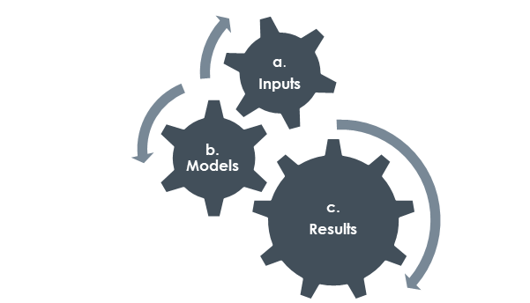
Data Science : your best Support
What can emerge out of data ?
Exploratory Data Analysis, toward valuable Customer-Centric data
Feature Engineering: You Set the Limits, Pick Your Favourite !
Refine your target : refine Use Cases
Once the right targets are selected : what is a good segmentation ?
The most usefull Features, i.e. with adequate type and shape
The most efficient Models, i.e. with adequate sensitivity
The most relevant Metrics, i.e. with meaningfull results
Once the « right » approach is selected : how to achieve Olist business goals ?
Stability
Further proceedings
Any approach is made of 3 interacting steps,
with a resulting « Sensitivity »
Transform inputs
Reduce dimension
Initialize &
« feed »
clusters
Find the
optimal solution

Slide 9
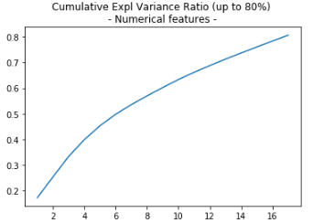
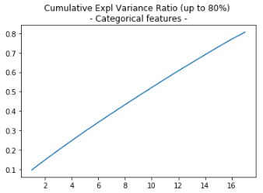
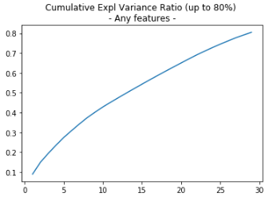
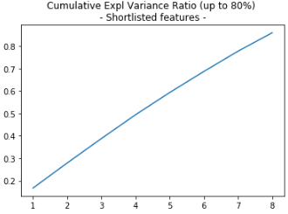
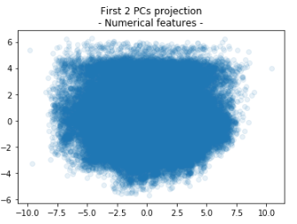
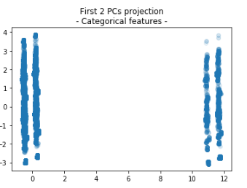
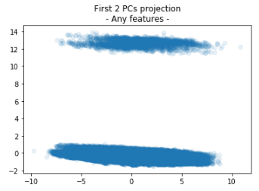
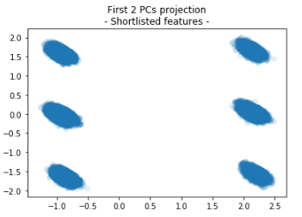
2.a. Inputs : select the most usefull features
Despite transformer that enables to deal equaly with any feature types
With reducer PCA’s cumulative explained variance showing an unbiased profile,
Resulting projections remains highly affected by discrete features
Only numerical
Only categorical
Any
Use Case
Same issue with :
distance computation,
or metrics used to assess results
ex. Silhouette Score decrease while increasing the number of Principal Component
We assume covering a mixed of numerical, categorical and even ordinal features
Notes:
Heatmaps (with Spearman rank correlation) : help to catch correlated features (& drop redundancies)
Pairplots : help to catch trends or pattern between a features and a Goal (e.g. inscrease sales)
Once we put discrete or even non-normally distributed features, this takes the lead on other features
.e.g. Charm price binary (0, 1) or discrete Review Scores (1 to 5) introduce bias, even on optimal number of segments.
we may try to remedy this effect and tends to normal-distributed features, build new features such as « indexes »
Or we could target this effect, consider this as an emerging categorization and refine it.

Slide 10
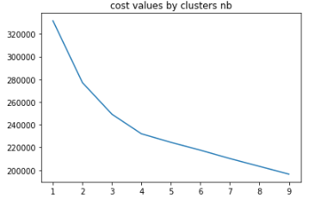
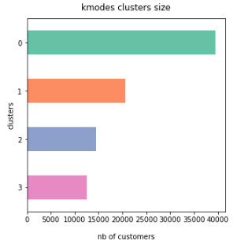
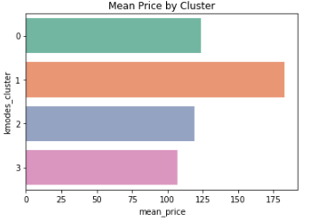
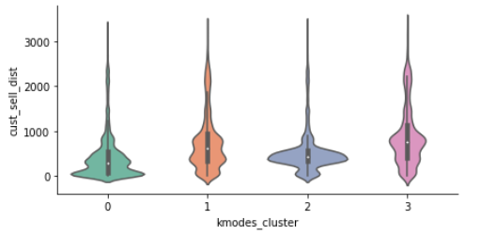
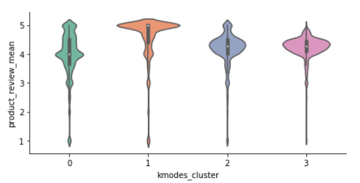
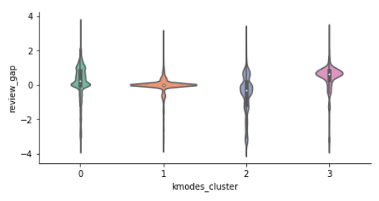
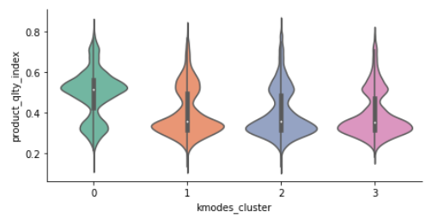
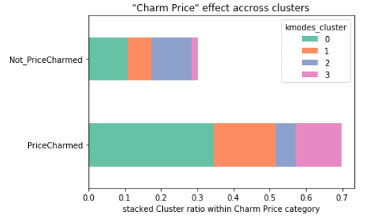
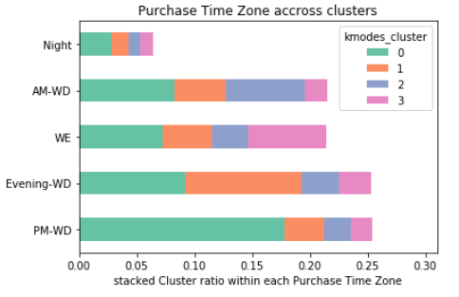
Starter : K-Modes
What : k-Modes extends k-Means algorithm for categorical features, minimizing a cost function measuring matching dissimilarity
Pros :
« raw » data (turned to categorical)
clear cluster description
deterministic (with « Cao » init)
Cons :
would consider ordinal as categorical (losing the « real » distance between levels)
reward same k optimal clusters than feature discretization
K-Modes gets a direct « cluster Zero » description : feature’s most frequent values
K-Modes build clusters iteratively until cost slows its decrease
Watch the resulting cluster’s balance
Refine your Goal : Mean Price
Find your target
Watch for an unbalanced between products categories. (they buy the same).
Notes:
k-Modes intend to extend the k-Means algorithm, dedicated to categorical features : with discrete data as input (even with labels), it performs clustering that minimize a cost-function that measures a "matching dissimilarity". A cost unit is spent on any category switch.
Pros :
raw data (unpreprocessed) can be considered as inputs (even labels),
it provides a clear cluster description, based on centroïd values,
among the various init techniques (with pretty high dependency to init), 'Cao' research offers a deterministic approach introducing density of the data to their Modes (i.e. most frequent values).
Cons : this depends on the feature discretization in the first place, with
cost approximation is wrong for ordinal features, i.e. cost is the same for any switch, even when passing from below_median to over_median (e.g. 1 to 3).
while trying to find the best "k", the algorithm may reward the features with a 'k' corresponding discretization : e.g. the 5 levels of review scores would obviously lead to split into 5 clusters.

Slide 11
Cluster 0 :
['Near_Dist', 'Light_Price', 'High_QltyIdx', 'Low_Score’, 'Better_Review', 'Charmed_Price', 'PM-WD’],
Customer of the largest segment, they claim a good product description of below mean priced products. They seem satisfied by low review score while giving a better score. They live the closest to commercial areas and seems not sensitive to charm pricing. They spread across any purchase time zone.
Cluster 1 :
['Far_Dist', 'Medium_Price', 'Low_QltyIdx', 'Top_Score', 'Same_Review', 'Charmed_Price', 'Evening-WD’]
Customers of the interesting second largest segment, buy more expensive products, no matter their description’s quality and are not sensitive to charm pricing. They live far from the sellers, meaning they could not get to stores. Top review score seems mandatory to them while they score the same. Their favorite purchase time zone is the evening of a working day.
Cluster 2 :
['AroundMed_Dist', 'Light_Price', 'Low_QltyIdx', 'Medium_Score’, 'Worst_Review', 'Uncharmed_Price', 'AM-WD’]
Customers of the second smallest segment are the worst reviewers while purchasing medium scored products, not matter their description’s quality. They are located around the median distance to sellers, but live already two far to get those shops other than virtually. These customer seems to reject charm pricing. Their favourite purchase time zone is the morning of a working day. They buy more often products of Electronics, Computers & Accessories.
Cluster 3 :
'Far_Dist', 'Light_Price', 'Low_QltyIdx', 'Medium_Score’, 'Better_Review', 'Charmed_Price', 'WE’]
Customers of the smallest segment are the best reviewers while purchasing medium scored products, not matter their description’s quality. They are the farthest customers. They have the highest sensitivity to charm pricing. Their favourite purchase time zone is the week-end. They buy more often products of Telephony, Supplies and Health Beauty Baby Caterogies.
With basic goal of sales increase :
Action 1 : improve scoring, targetting cluster 3 customers, i.e. mainly during the week-end, catching them on the charm price sensitivity, arguing that they can afford any products thanks to the marketplace, no matter the live far from the original commercial areas (action about freight fares to study). Additionnal action targetting cluster 2 could be, mainly during the morning, to fasten regular cart
Action 2 : improve sales, targetting cluster 1 customers, i.e. mainly during the evening of a working-day, catching them on the top review scores and arguing that those selected products are now available thanks to the market place (new sellers joigned, top ratings).

Slide 12
K-Mode
Idea is to perform K-Modes technique, dedicated to categorical features, on level features.
Pros : get clear centroïd details and cluster description
Cons : consider ordinal as categorical features, losing the « real » distance between levels
Method : starting with an initial centroids seed, refine clusters by minimizing dissimilarity (Hamming distance from cluster mode).
! Currently a research topic, to find the most efficient technique.
Basics : many seeds, few clusters, and of course few features and especially few categories (prevent having too small populated categories)
Evaluation : the lowest cost gives the best clustering.

Slide 14
Funnel : issue synthesis & strategy
Data Science approach relies on facts an maths, rather than usual marketing practices.
Such approach needs could help to find disruptive recipe.
Which features as input of clustering algorithm ?
Reduced number of features better actionability
Haw many clusters should we target ?
Is there a « marketing » optimal cluster number ?

Slide 15
(Fast) Forward Selector
Aim is to get an idea of the most valuable features to perform segmentation.
Unfortunately, neither feature combination technique seems embedded in pipeline, nor features selection’s algorithms in such unsupervized context (unlike feature’s importance or coef. weights).
An idea to assess each feature for further clustering, is to proceed by :
1. Performing K-means with each feature individually, targetting a given k clusters number.
2. Get clustering performance
3. Keep the feature that gives the best result.
Proceed the same loop 1 to 3 with remaining features, until n « most valuable » features seems found.
Implementation made on 2 scoring methods : max of silhouette score, min of Davies-Bouldin Index,
We are able to submit to marketing departement alternate subsets of features, based on our observations :
The « model sensitivity » according to the feature’s distribution.
A small number of features generaly leads to high clustering scores. This trend explains why dimensionality reduction techniques are so valuable in clustering.

Slide 16
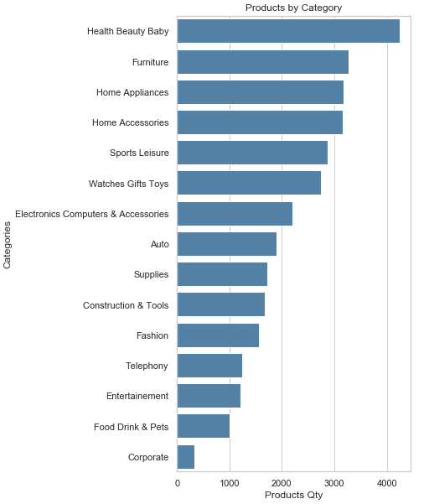
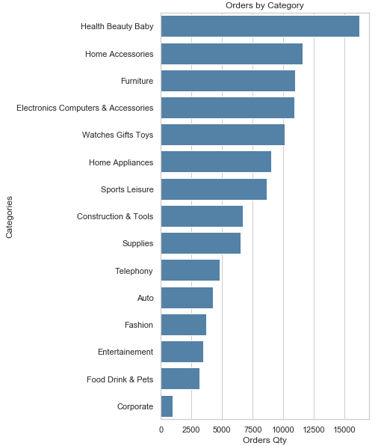
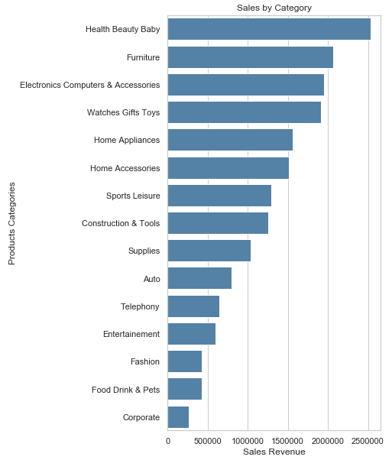

Slide 17
Pipeline
EDA with clean dtypes
Co*
Numerical
Categorical
Ordinal ?
Mutual exclusion?
Numerical : order_purchase_dayofweek, order_purchase_hour
Categorical : Purchase_Time_Zone
Combine
1 x
preprocessor = make_column_transformer(
(numerical_pipeline, numerical_features),
(categorical_pipeline, categorical_features),
? Ordinal_pipeline : - 3, +3)
Transform
Search space :
C : Features Combination?
Transformer
S : {'selector__k': [5, 10, 20, 30]}
R : {‘PCA’: , …}
M : {‘Nb_cluster’
S*
Select
Kbest ?
Visualize
R*
Reduce
PCA, T-sne ?, no reduction, both
Cluster
Cl*
K-Means, Agglomerative Clustering, DBSCAN, K-Modes? K-Prototypes ?
CV -> persp.
ARI
Reval?
Stability
Assess
Quality
Assess
Silhouette vs Davies-bouldin, (elbow is visual),

Slide 18
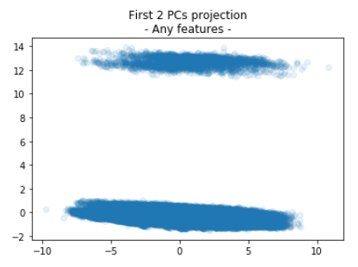
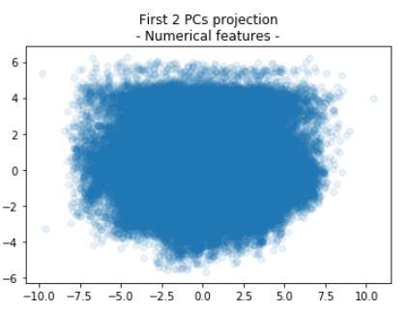
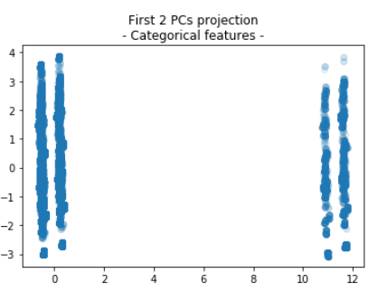
PCA : feature type sensitivity

Slide 19
Customer-Centric features
payment_total
main_payment_type(_cat)
payment_sequence_size
payment_installments_size
payments
rational_category
product_density
product_name_length
product_description_length
product_photos_qty
product_weight_g
product_size
products
orders
purchase_time_zone
delivery_vs_estimated
order_purchase_dayofweek
order_purchase_hour
customer
items
charm_price
freight_percentage
product_price
product_freight
total_price
total_freight
items_qty
product_review_mean
review_gap
review_answer_delay
customer_review_mean
product_review_count
customer_review_count
Nb. the score is for the Order
reviews
geoloc
cust_sell_dist
seller_state
customer_state

Slide 20
Learn about Clients
« naturally » correlated features
Freight value or percentage* versus density, because freight cost is usually calculated with weight and volume.
Category typical values : i.e. Furnitures are high vol. products, basic goods for health and beautye are not has expensive has perfumery, etc.
Customer’s behavior could offer actions, let’s try to see which actions could increase the selling power through Olist.
Total price is not that easy to handle by Olist, but a “charm pricing” strategy is affordable and could be assessed to be applied to most relevant products in order to increase the sales performance.
Get a better knowledge of what kind of customers is about to by a product at what time is another valuable intel : for categories recommendation such as kart and additional item.
Customer’s behaviour can as well be determined by the product review, and this could also affect its own review score, if correlated each other.

Slide 21
* Customer shall surely not pay delivery costs for any items of its order and we assume that for a given price, the costs are adjusted in case of far distance delivery.
From Payments-Centric
A customer can already select the payment means and its potential installements, although this reveal the purchase behavior,
We could try to improve sales or favor highest expenses for customers, by analysing payment total.
From Products/Items-Centric
Product sales comparisons based on their detailed descriptions would be valuable to take actions to enhance seller’s products database.
Charm pricing could affect Customer behavior.
Freight value beeing usually determined by product Weight and Volume, those features may have an hidden impact on Customer’s behavior
From Geoloc-Centric:
A marketplace offers a virtualization of Seller-Customer relations, a deeper look on this hidden aspect and its impact to the customer behavior could be valuable to understand how the real cust-seller distance influence the sales.
From Order-Centric
delivery_vs_estimated would be valuable to remedy unsatisfaction consequences, and its consequence on Review scores.
From Review-Centric
Is the review score given by the customer correlated with the average score? Does the score affects the sales of a product?
Client review would be valuable to remedy unsatisfaction consequences. Does the client follow the crowd?
Customer-Centric selection :
Payment Total
Freight Percentage
Customer – Seller Distance
Charm Price
Review Score Gap
If we want to get to new customers, an idea is to get a picture of When and What they buy, by catching their favorite Time Purchase Zone and Product Category.

Slide 22
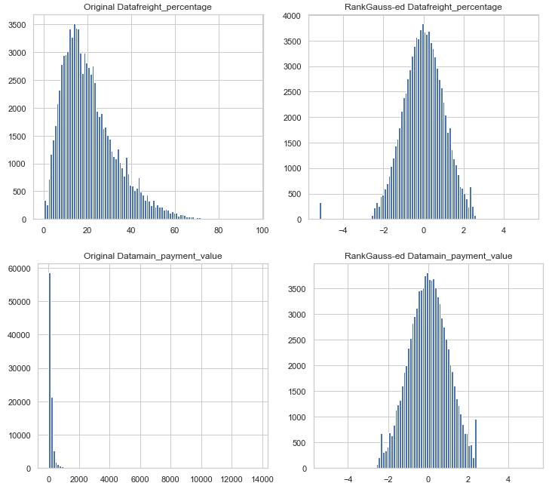
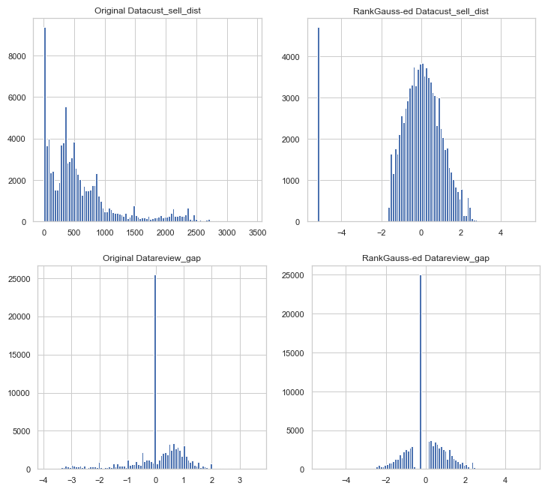
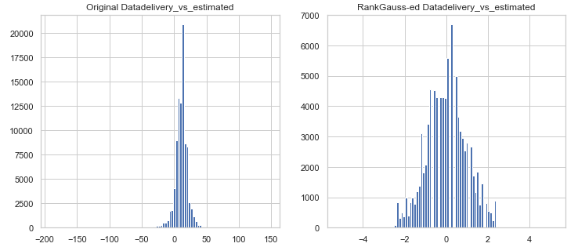
davies_bouldin_score : 0.8377774761211887

Slide 23
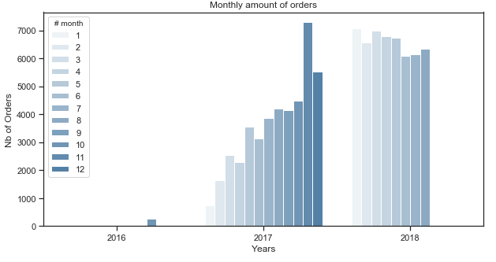

Slide 24
['AroundMed_Paiement' 'OnTime_Delivery' 'BelowMed_FreightCost'
'Near_Dist' 'AroundMed_Review' '1']
['AroundMed_Paiement' 'Late_Delivery' 'OverMed_FreightCost'
'AroundMed_Dist' 'LowerMed_Review' '1’]
['Light_Paiement' 'OnTime_Delivery' 'OverMed_FreightCost'
'AroundMed_Dist' 'AroundMed_Review' '1']
['AroundMed_Paiement' 'OnTime_Delivery' 'AroundMed_FreightCost'
'AroundMed_Dist' 'AroundMed_Review' '1']
['Light_Paiement' 'Late_Delivery' 'AroundMed_FreightCost' 'Near_Dist'
'UpperMed_Review' '0']
['AroundMed_Paiement' 'Late_Delivery' 'BelowMed_FreightCost' 'Near_Dist'
'AroundMed_Review' '1']
['Light_Paiement' 'OnTime_Delivery' 'OverMed_FreightCost' 'Far_Dist'
'AroundMed_Review' '1']
['Light_Paiement' 'OnTime_Delivery' 'OverMed_FreightCost'
'AroundMed_Dist' 'AroundMed_Review' '0']
['AroundMed_Paiement' 'OnTime_Delivery' 'AroundMed_FreightCost'
'AroundMed_Dist' 'AroundMed_Review' '1']
['AroundMed_Paiement' 'Soon_Delivery' 'AroundMed_FreightCost'
'Near_Dist' 'UpperMed_Review' '1']

Slide 25
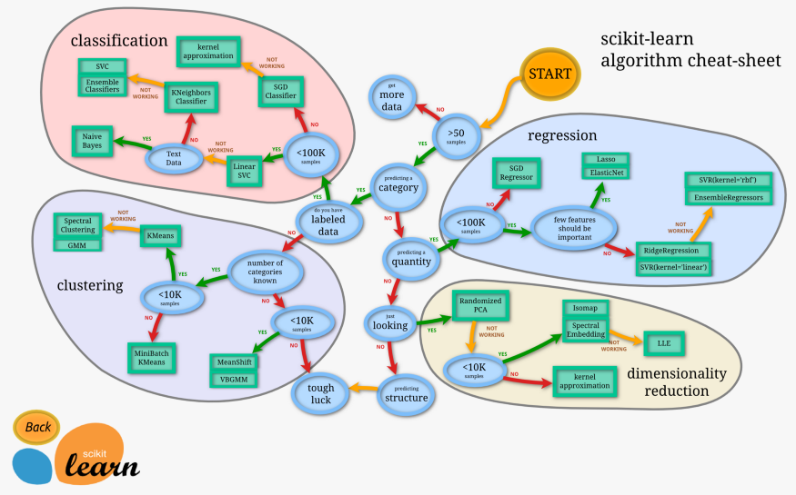
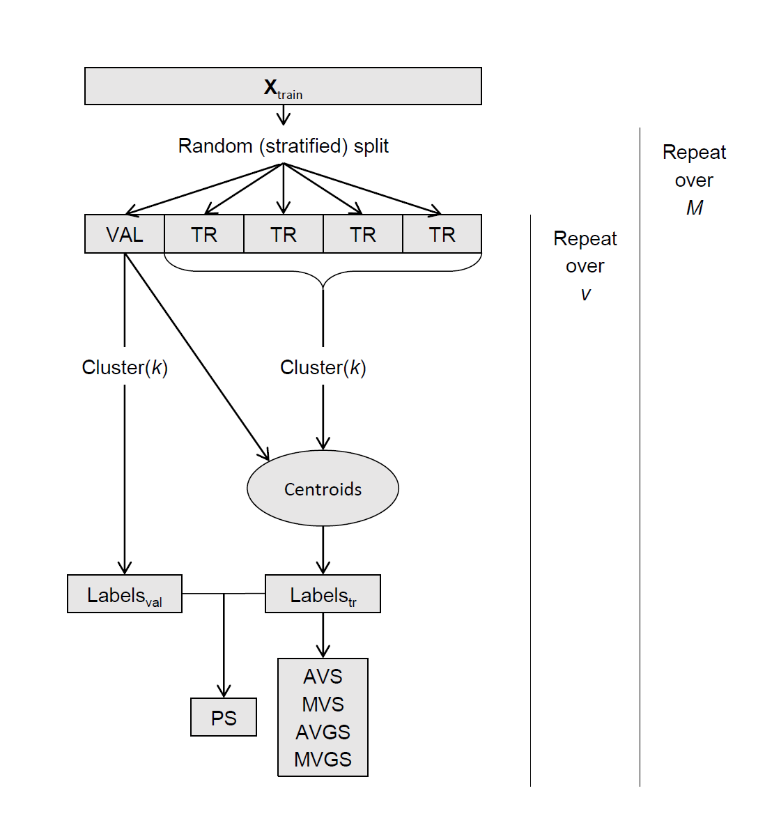

Slide 26


Merge a Client-Centric Dataset
category_name
category_name_translation
most_important_product
{city, state}
{city, state}

