Slide 1

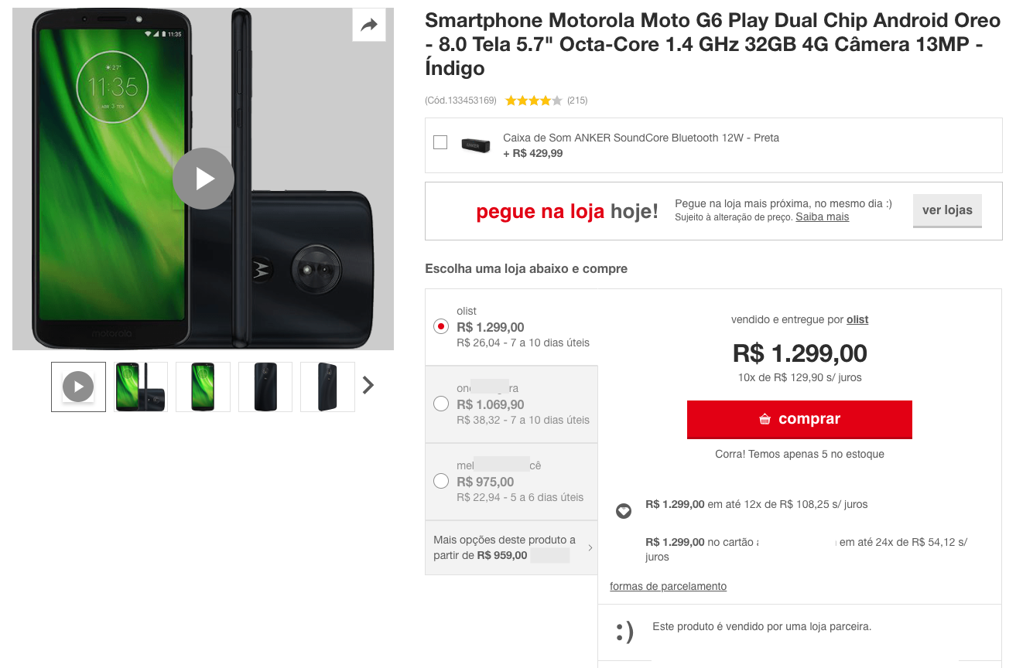

Olist Marketplace: Customer Segmentation  Rely on Olist datasets shared through Kaggle*,  Help marketing teams to understand customers,  Through a usable segmentation,  Identify the right update interval
3 steps :
Perform EDA & Feature Engineering to enhance data
Try a variety of modelling approaches
Select the best model and its improvements
* https://www.kaggle.com/olistbr/brazilian-ecommerce

Slide 2
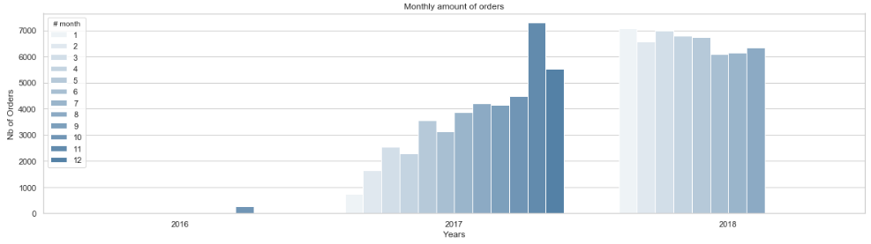
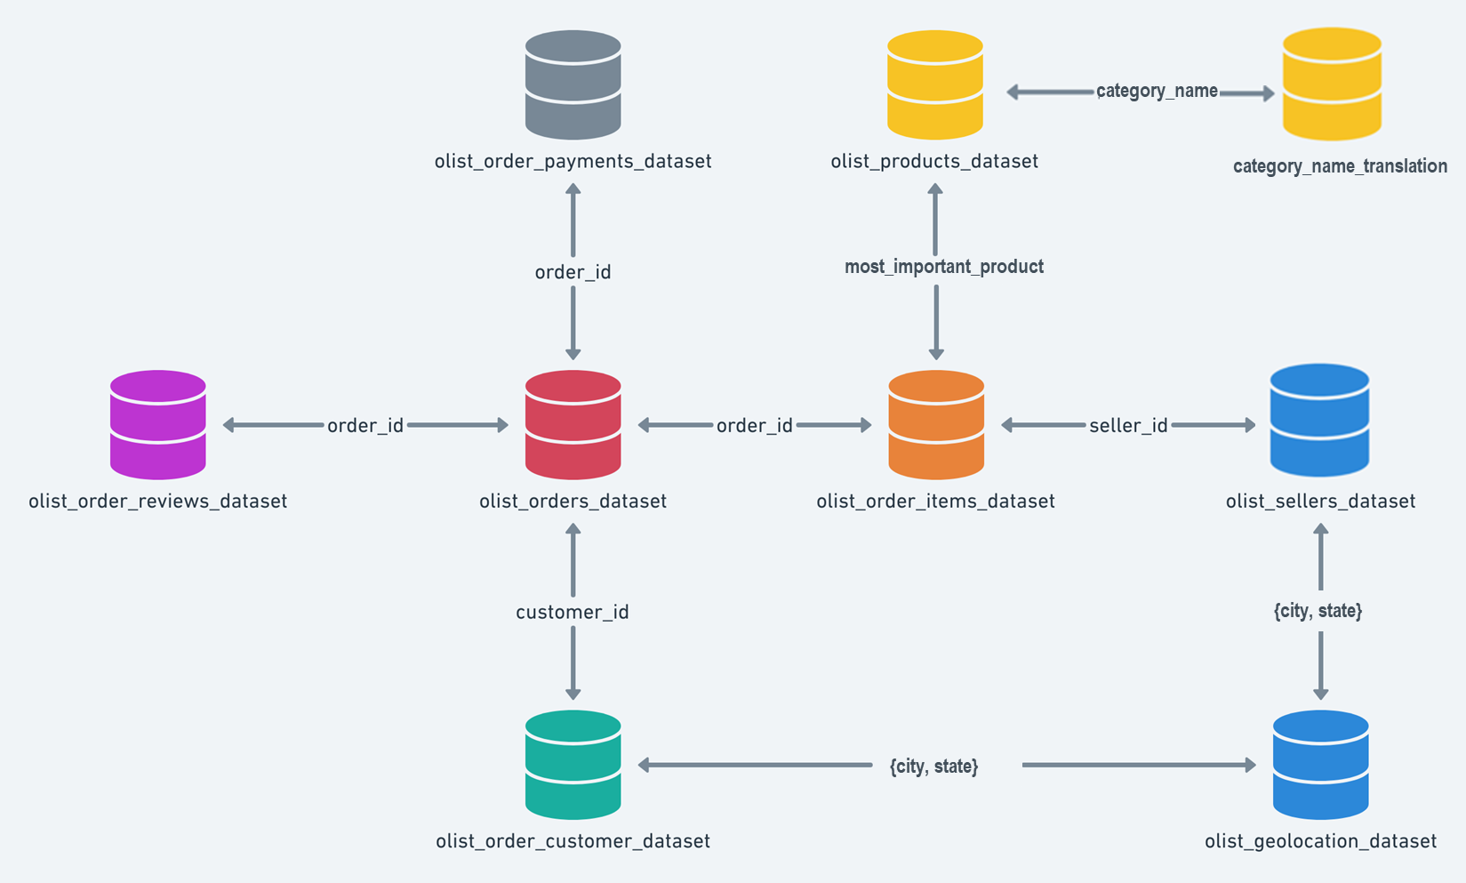
Merge a Customer-Centric Dataset
Data Truncature
Orders number rise from end 2016 and is stable in 2018
Only 3 % of Customers made more than a Single Order !
RFM* techniques are not valid
Only 3 % of Orders are not single_product & 10% multi-item in shopping carts
Simplified 1:1 cardinality for {Customer_unique – Order – Product – Review} is valid
* Recency and Frequency would require the knowledge of multiple timestamped orders and senseful anteriority.
2
1
From Order-Centric to Customer-Centric data:
1. Focused on the most_important_product (of highest value)
2. Attached a category to the product
3. Keeping for any customer_unique_id, the « single_product » & last delivered Orders
3.
Let’s browse some Customer-Centric features !
Notes:
Why such data troncature statement :
Identification of unexpectedly poor quantities of a given type of order (multi_orders, multi_products)
Consequence for the study :
Rebuild a balanced dataset would imply to adjust with an additionnal sample of original datas. For instance : how many single_orders should we keep, on which basis ?
We would rather get to a clearly biased dataset.

Slide 3

Build Customer-Centric Features
Order-Centric datasets enable to gather :
costs of detailed shopping cart, paiement details,
accurate description (but of unnamed products), attached to a product category,
review score, attached to an order,
customer and seller geolocation.
Client-Centric features could provide to detail the « Who : Customers Groups », by studying :
What : the product, its value and price (the M criteria of RFM)
The total_price (& supported freight_percentage)
The « charm price » (price with a « 9, 99 or x90 » termination)
The product category (and its caracteristics : size, weight)
When : the purchase_time_zone (as a clustering of purchase_dayofweek & purchase hour)
Why : the « product » average Review Score, and the review gap build according to the customer’s review,
Where : in spite of web purchase, Customer-Seller distance impacts on Delivery time and Freight cost.
Note that each item has the freight calculated accordingly to its measures & freight value is splitted between items
How : the (main_)payment_type, the payment installement size

Slide 4
customers
Native a | Native b | … | New : | New : | New :
orders
Native x | Native y | … | New : Sum (a) | New : Mean (b)
items
Native a | Native b | …

Slide 5





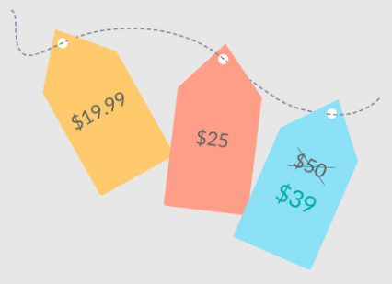



Customer-Centric features
How : main_payment_type(_cat)
payment_installments_size(_cat)
payment_sequence_size(_cat)
What : payment_total*
main_payment_value
payments
What : product_cat
product_description_length
product_name_length
product_photos_qty*
product_weight_g
product_size
product_density
products
qlty_desc_index
When : purchase_time_zone_cat
order_purchase_dayofweek
order_purchase_hour
delivery_vs_estimated*
estimated_delivery_time effective_delivery_time
orders
freight related
freight related
customer
What : total_price*
charmed_price(_cat)
freight_percentage*
total_freight
items_qty
product_price
product_freight
items
freight related
Why : product_review_mean*
product_review_count
customer_review_count
How : review_gap*
review_answer_delay*
customer_review_mean
reviews
Sellers &
geoloc
of a single product !
Where : cust_sell_dist*
seller_city &state
customer_city & state
freight related
* : can also be described as an ordinal « level » feature

Slide 6
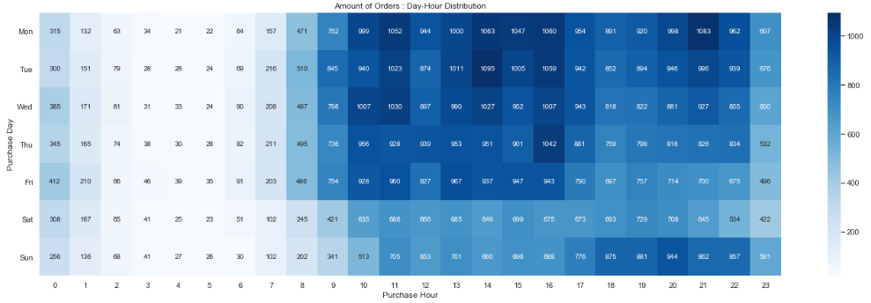
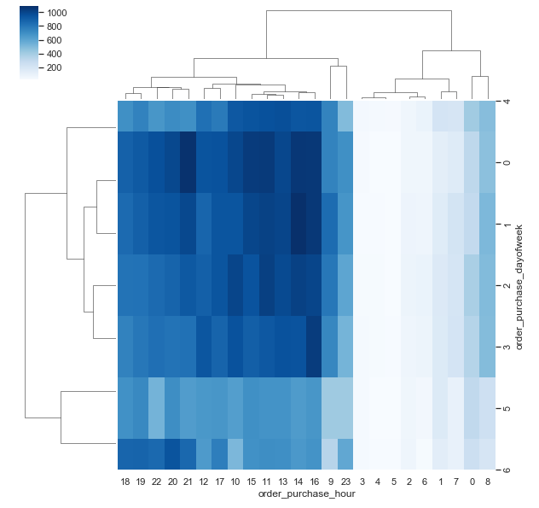
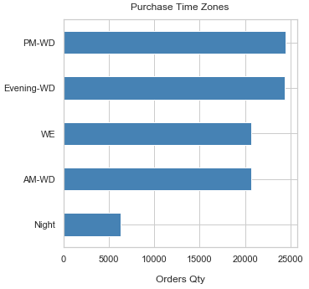
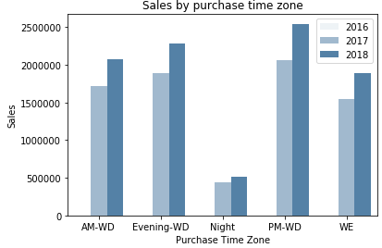
Feature engineering :
purchase_time_zone_cat : order_purchase_dayofweek & order_purchase_hour from native “order_purchase_timestamp”
product_cat : should map with customer’s search & navigation, rationalized from 71 to 15 categories
A few features are available about “freight”, linked together :
cust_sell_dist : the distance computed from geolocation
product_size / product_weight_g (density) : use to compute a freight class
freight_percentage : freight value / total paiement
review_gap : value the gap between product and customer review
_lvl are qcut of numerical : valuable for cluster descripton, for Kmode technique or in case of highly unbalanced values

Slide 7
Correlated features & pre-processing
Heatmap with Spearman rank coorelation : help to define subsets of features in order to select the most significant feature among correlated ones.
A forward selector : enhance the futur clustering by calculating how « good » a feature is in order to obtain a better clustering.
Model sensitivity (to a feature type) is obviously critical here :
Once we put a non-normal distributed feature, this takes the lead on the others.
Either we target an emerging categorization (marketing rational) or we should try to remedy this effect (e.g. tends to normal-distributed features).

Slide 8
Customer-Centric features
payment_total
main_payment_type(_cat)
payment_sequence_size
payment_installments_size
payments
rational_category
product_density
product_name_length
product_description_length
product_photos_qty
product_weight_g
product_size
products
orders
purchase_time_zone
delivery_vs_estimated
order_purchase_dayofweek
order_purchase_hour
customer
items
charm_price
freight_percentage
product_price
product_freight
total_price
total_freight
items_qty
product_review_mean
review_gap
review_answer_delay
customer_review_mean
product_review_count
customer_review_count
Nb. the score is for the Order
reviews
geoloc
cust_sell_dist
seller_state
customer_state

Slide 9
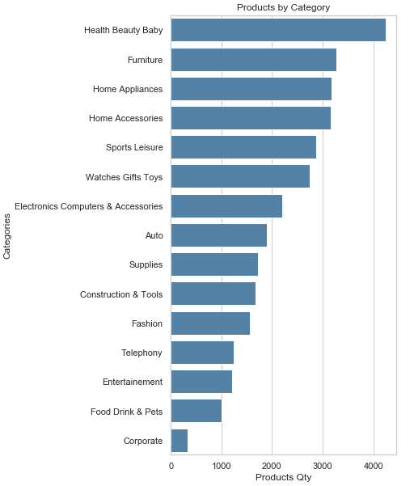
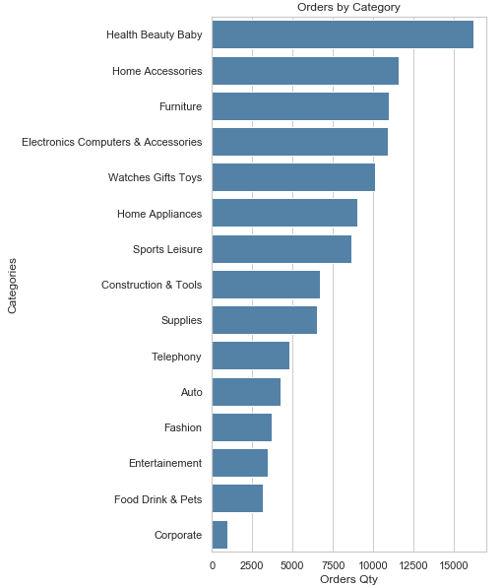
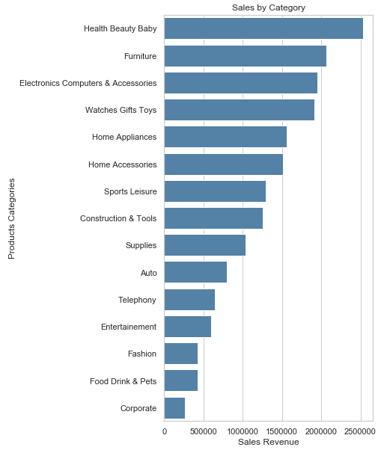

Slide 10
Pipeline
EDA with clean dtypes
Co*
Numerical
Categorical
Ordinal ?
Mutual exclusion?
Numerical : order_purchase_dayofweek, order_purchase_hour
Categorical : Purchase_Time_Zone
Combine
1 x
preprocessor = make_column_transformer(
(numerical_pipeline, numerical_features),
(categorical_pipeline, categorical_features),
? Ordinal_pipeline : - 3, +3)
Transform
Search space :
C : Features Combination?
Transformer
S : {'selector__k': [5, 10, 20, 30]}
R : {‘PCA’: , …}
M : {‘Nb_cluster’
S*
Select
Kbest ?
Visualize
R*
Reduce
PCA, T-sne ?, no reduction, both
Cluster
Cl*
K-Means, Agglomerative Clustering, DBSCAN, K-Modes? K-Prototypes ?
CV -> persp.
ARI
Reval?
Stability
Assess
Quality
Assess
Silhouette vs Davies-bouldin, (elbow is visual),

Slide 11
Combine
Aim is to get an idea of the most valuable features to perform segmentation.
Unfortunately, neither feature combination technique seems embedded in pipeline, nor features selection’s algorithms in such unsupervized context (unlike feature’s importance or coef. weights).
An idea to give chance to any feature for the most efficient segmentation, is to proceed by :
1. K-means with each feature individually, targetting a given k clusters number.
2. Get clustering performance
3. Keep the feature that gives the best result.
Proceed the same loop 1 to 3 with remaining features, until n « most valuable » features seems found.
Implementation made on 2 scoring methods : max silhouette, min Davies-Bouldin Index,
This approach seems interesting only in case of similar data. Because the distribution of each feature, even transformed, has a big impact on the mathematical quality of the clustering.
We also noticed that clustering is better mathematically, when the features number is as llow as possible. This exploin why PCA is so valuable within such approach

Slide 12
Learn about Clients
« naturally » correlated features
Freight value or percentage* versus density, because freight cost is usually calculated with weight and volume.
Category typical values : i.e. Furnitures are high vol. products, basic goods for health and beautye are not has expensive has perfumery, etc.
Customer’s behavior could offer actions, let’s try to see which actions could increase the selling power through Olist.
Total price is not that easy to handle by Olist, but a “charm pricing” strategy is affordable and could be assessed to be applied to most relevant products in order to increase the sales performance.
Get a better knowledge of what kind of customers is about to by a product at what time is another valuable intel : for categories recommendation such as kart and additional item.
Customer’s behaviour can as well be determined by the product review, and this could also affect its own review score, if correlated each other.

Slide 13
* Customer shall surely not pay delivery costs for any items of its order and we assume that for a given price, the costs are adjusted in case of far distance delivery.
From Payments-Centric
A customer can already select the payment means and its potential installements, although this reveal the purchase behavior,
We could try to improve sales or favor highest expenses for customers, by analysing payment total.
From Products/Items-Centric
Product sales comparisons based on their detailed descriptions would be valuable to take actions to enhance seller’s products database.
Charm pricing could affect Customer behavior.
Freight value beeing usually determined by product Weight and Volume, those features may have an hidden impact on Customer’s behavior
From Geoloc-Centric:
A marketplace offers a virtualization of Seller-Customer relations, a deeper look on this hidden aspect and its impact to the customer behavior could be valuable to understand how the real cust-seller distance influence the sales.
From Order-Centric
delivery_vs_estimated would be valuable to remedy unsatisfaction consequences, and its consequence on Review scores.
From Review-Centric
Is the review score given by the customer correlated with the average score? Does the score affects the sales of a product?
Client review would be valuable to remedy unsatisfaction consequences. Does the client follow the crowd?
Customer-Centric selection :
Payment Total
Freight Percentage
Customer – Seller Distance
Charm Price
Review Score Gap
If we want to get to new customers, an idea is to get a picture of When and What they buy, by catching their favorite Time Purchase Zone and Product Category.

Slide 14
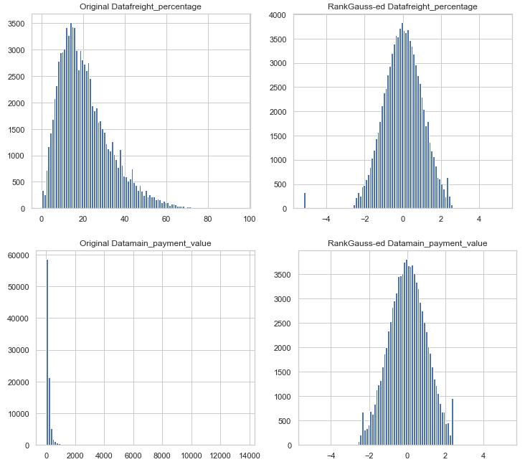
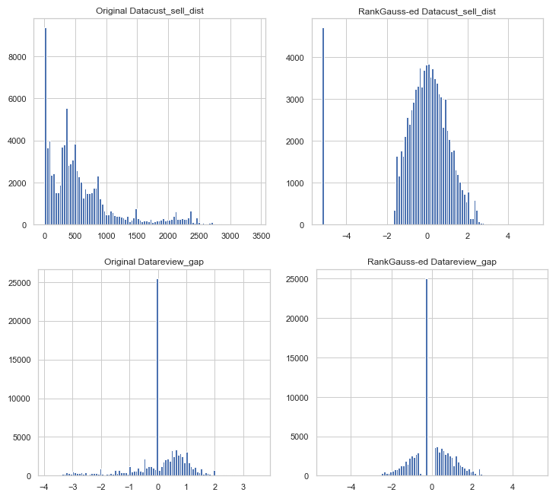
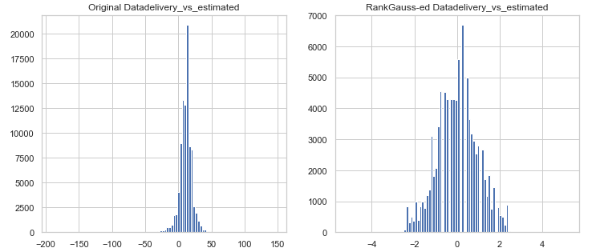
davies_bouldin_score : 0.8377774761211887

Slide 15
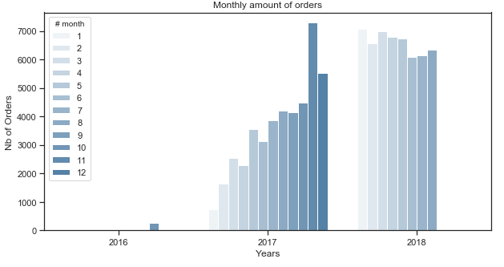

Slide 16
['AroundMed_Paiement' 'OnTime_Delivery' 'BelowMed_FreightCost'
'Near_Dist' 'AroundMed_Review' '1']
['AroundMed_Paiement' 'Late_Delivery' 'OverMed_FreightCost'
'AroundMed_Dist' 'LowerMed_Review' '1’]
['Light_Paiement' 'OnTime_Delivery' 'OverMed_FreightCost'
'AroundMed_Dist' 'AroundMed_Review' '1']
['AroundMed_Paiement' 'OnTime_Delivery' 'AroundMed_FreightCost'
'AroundMed_Dist' 'AroundMed_Review' '1']
['Light_Paiement' 'Late_Delivery' 'AroundMed_FreightCost' 'Near_Dist'
'UpperMed_Review' '0']
['AroundMed_Paiement' 'Late_Delivery' 'BelowMed_FreightCost' 'Near_Dist'
'AroundMed_Review' '1']
['Light_Paiement' 'OnTime_Delivery' 'OverMed_FreightCost' 'Far_Dist'
'AroundMed_Review' '1']
['Light_Paiement' 'OnTime_Delivery' 'OverMed_FreightCost'
'AroundMed_Dist' 'AroundMed_Review' '0']
['AroundMed_Paiement' 'OnTime_Delivery' 'AroundMed_FreightCost'
'AroundMed_Dist' 'AroundMed_Review' '1']
['AroundMed_Paiement' 'Soon_Delivery' 'AroundMed_FreightCost'
'Near_Dist' 'UpperMed_Review' '1']

Slide 17
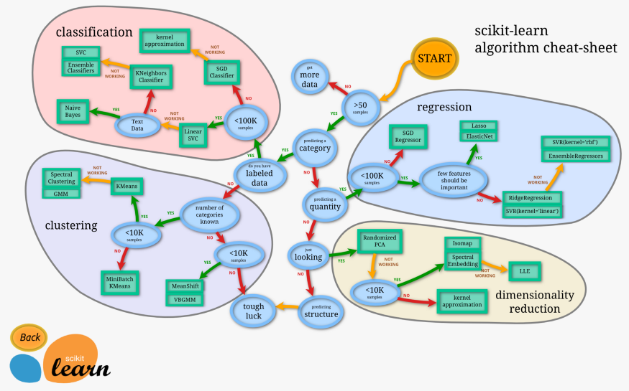
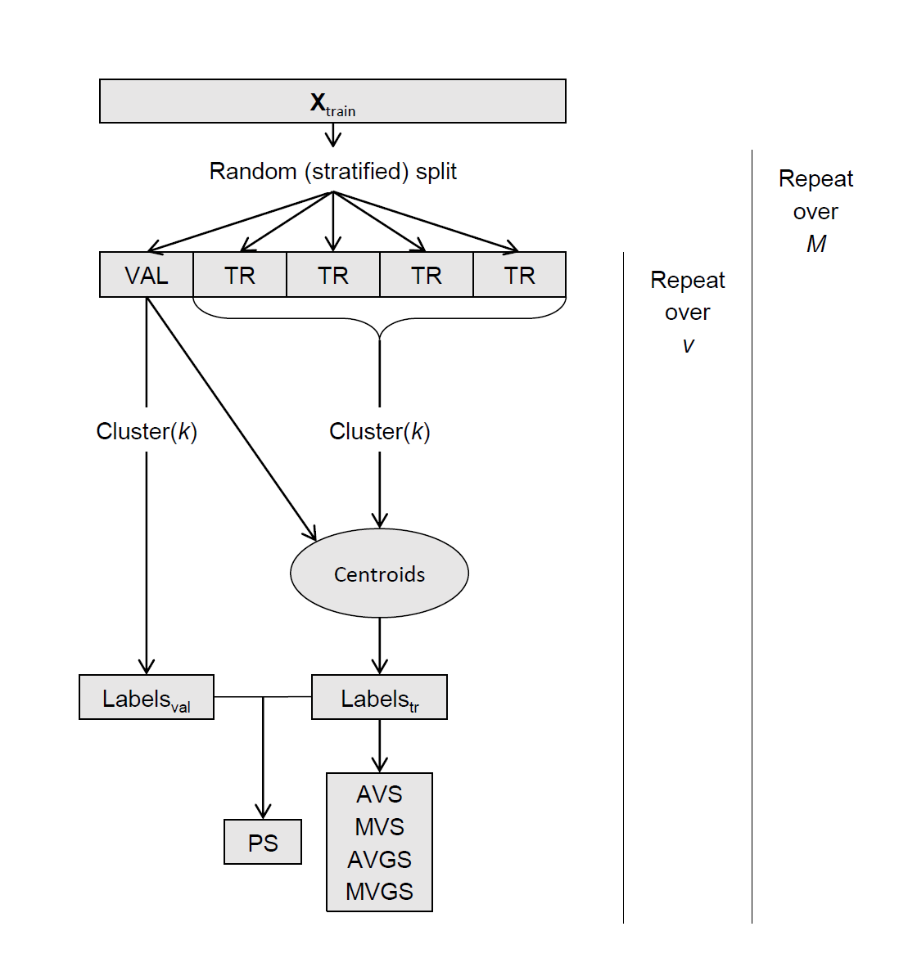

Slide 18


Merge a Client-Centric Dataset
category_name
category_name_translation
most_important_product
{city, state}
{city, state}

