Slide 1

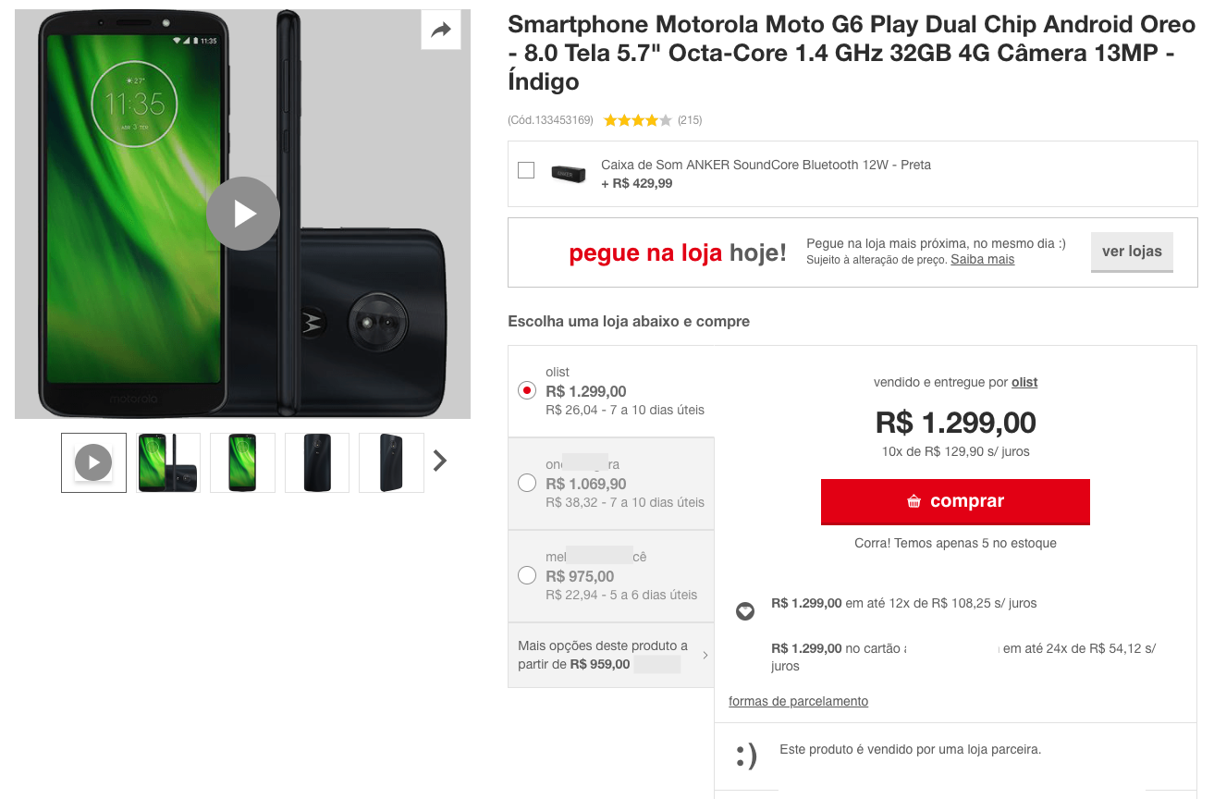

Olist Marketplace: Customer Segmentation  We rely on Olist datasets shared through Kaggle*,  To improve marketing team’s customer understanding,  Through a usable segmentation,  Identifying a right update interval
3 steps :
1. Perform EDA & Feature Engineering to enhance data
2. Combine a variety of modelling approaches
3. Choose the best approach and its improvements
* https://www.kaggle.com/olistbr/brazilian-ecommerce

Slide 2

Data Science : your best Support
What can emerge out of data ?
Exploratory Data Analysis, toward valuable Customer-Centric data
Feature Engineering: You Set the Limits, Pick Your Favourite !
Refine your target : refine Use Cases
What is a good segmentation ?
The most usefull Features, i.e. with adequate type and distribution
The most efficient Models, i.e. with adequate « sensitivity »
The most relevant Metrics, i.e. with meaningfull results
How to achieve Olist business goals ?
Actionability
Stability & further proceedings

Slide 3
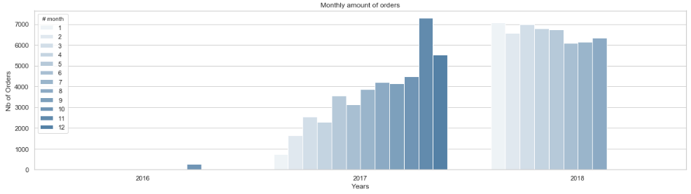
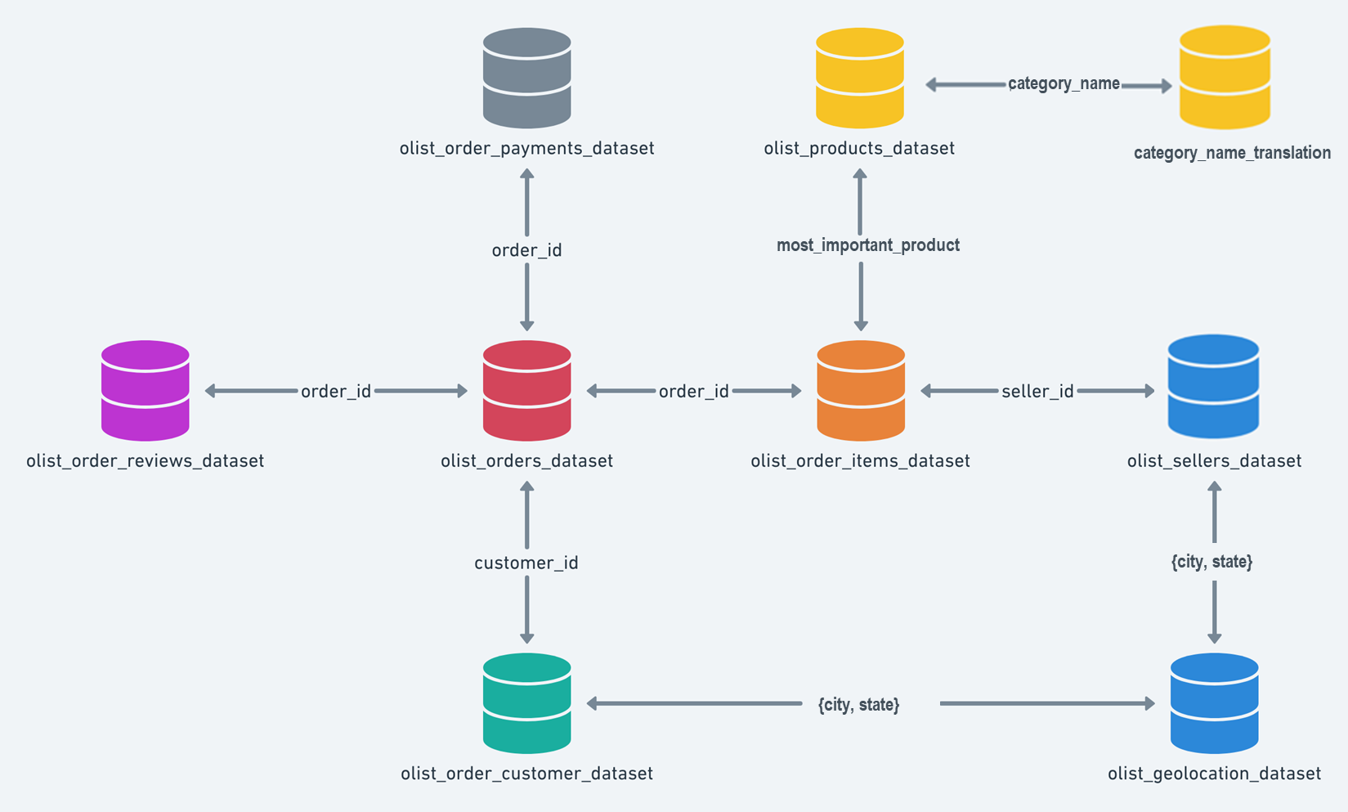
1.a. Merge a Customer-Centric Dataset
Data Truncature
Orders number rise from end 2016 and is stable in 2018
Only 3% of Customers (3k) made more than a Single Order!
RFM* techniques are not valid
Only 3 % of Orders are not single_product & 10% multi-item in shopping carts
Simplified 1:1 cardinality for {Customer_unique – Order – Product – Review} is valid
* Recency and Frequency would require the knowledge of multiple timestamped orders and senseful anteriority.
2
1
From Order-Centric to Customer-Centric data:
1. Focused on the most_important_product (of highest value)
2. Attached a category to the product
3. Keeping for any customer_unique_id, the « single_product » & last delivered Orders
3.
Let’s browse some Customer-Centric features !
Notes:
Why such data troncature statement :
Identification of unexpectedly poor quantities of a given type of order (multi_orders, multi_products)
Consequence for the study :
Rebuild a balanced dataset would imply to adjust with an additionnal sample of original datas. For instance : how many single_orders should we keep, on which basis ?
We would rather get to a clearly biased dataset.

Slide 4

1.b. Engineer Customer-Centric Features
While Order-Centric datasets enable many calculation with groupby and consolidation by merge,
Client-Centric features can be engineered to get the « Who » : Customers Groups, e.g. by studying :
What : the product, its value and price (the « M » criteria of RFM)
The « charm price » (price with a « 9, 99 or x90 » termination)
The product category, and its caracteristics : size, weight
When : the purchase_time_zone (as a clustering of purchase_dayofweek & purchase hour)
Why :
the Review Scores interest and behaviour, as well as the « popularity » of the product or its seller.
the quality of product’s description.
Where : the Customer-Seller distance, linked to the delivery time and freight cost.
each item has the freight calculated accordingly to its measures & freight value is splitted between items
How :
The kind of payment, with payment_type, installements size, …
the review score given by the customer

Slide 5






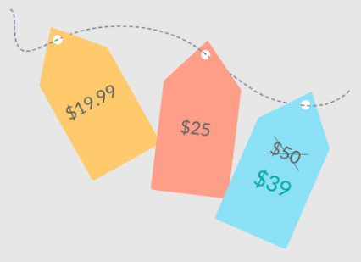



1.b. Overview : the unlimited Feature Engineering field
What : product_cat
product_weight_g
product_size
product_density
Why : product_qlty_idx*
product_photos_qty product_description_length
product_name_length
product_sales_count
product_revenue
How : main_payment_type(_cat)
payment_installments_size(_cat)
payment_sequence_size(_cat)
What : payment_total*
main_payment_value
payments
products
When : purchase_time_zone_cat
order_purchase_dayofweek
order_purchase_hour
delivery_vs_estimated*
estimated_delivery_time effective_delivery_time
orders
customer
What : total_price*
charmed_price(_cat)
freight_percentage*
total_freight
items_qty
product_price
product_freight
items
Why : product_review_mean*
product_review_count
customer_review_count
How : review_gap*
review_answer_delay*
customer_review_mean
reviews
Sellers &
geoloc
Where : cust_sell_dist*
seller_city &state
customer_city & state
Why : seller_sales_count
seller_revenue
seller_main_product_cat
Pick your favorite feature out of :
- 42 numerical
- 7 categorical / ordinal
nb *: Most features can also be derived as an ordinal « level », according to your rules or targets

Slide 6

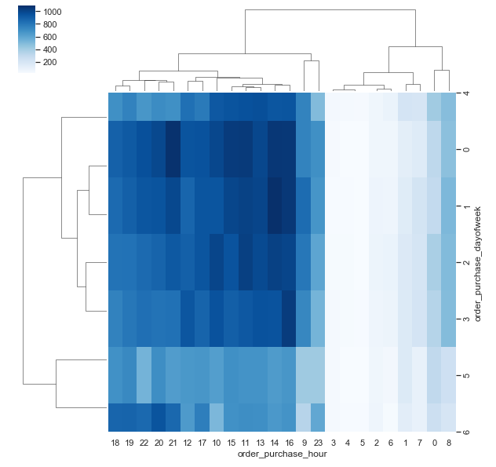
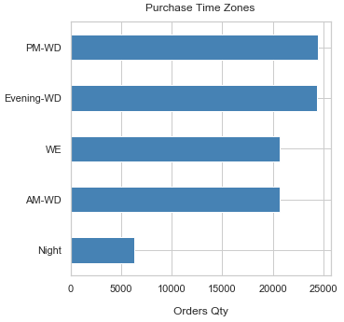
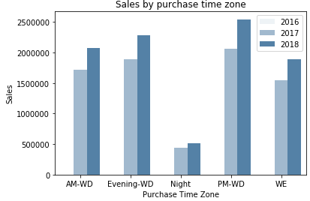
1.c. Refine your Goals, Find the Right Target
RFM easy actionability has emerged during years of practices, is now enhanced by Machine Learning.
You shall not « put » customers in a frozen matrix any more, but drive your ability to « learn » from data.
Let’s see practical examples :
The « Right » features
The right product :
Product_review_mean : « stars » influence
The right time :
purchase_time_zone_cat : build purchase time zone (through hierarchical clustering technique out of day & hour timestamp)
The right product description :
product_qlty_idx : e.g. build a product description index
The right pricing and its attractivity :
Total_price & charmed_price : « charmed » by 0,99 termination
The right satisfaction level :
review_gap : value the gap between product and customer review, to define who’s a worst, same or better scorer.
The right location :
cust_sell_distance : so far so close thanks to a virtual marketplace
The most powerfull & efficient Customer’s segmentation shall first suits to Your Goals

Slide 7
Use Case : building a « Right » communication campaign
payments
Why : product_qlty_idx(_lvl)
products
When : purchase_time_zone_cat
orders
customer
items
What : product_price(_lvl)
charmed_price_cat
reviews
Why : product_review_mean(_lvl)
How : review_gap(_lvl)
Sellers &
geoloc
Where : cust_sell_dist(_lvl)
We’ll use this shorlist of 7 features, incl. 2 of type Categories, and 5 Numerical (with their derivation as Ordinal)

Slide 8
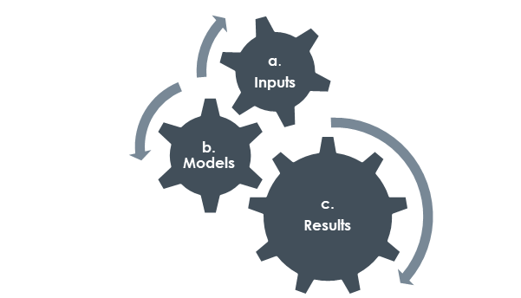
Data Science : your best Support
We’re now able to define Use Cases and refine targets
Next, what is a good segmentation ?
The most usefull Features, i.e. with adequate type and shape
The most efficient Models, i.e. with adequate sensitivity
The most relevant Metrics, i.e. with meaningfull results
Any approach is made of 3 interdependent steps,
with a resulting « sensitivity »
Transform inputs
Reduce dimension
Initialize &
« feed »
clusters
Find the
optimal solution
This is a matter of « distance » and its generalization computation
The right combination of transformers, reducers, models, metrics has to be chosen and tuned to enhance results

Slide 9
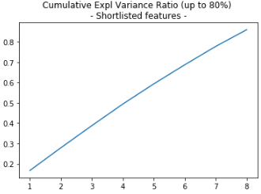
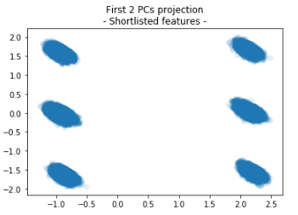
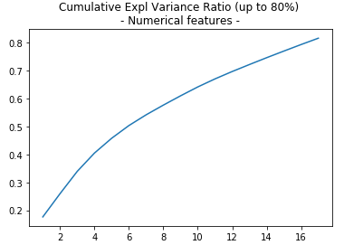
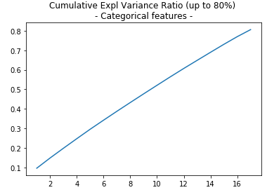
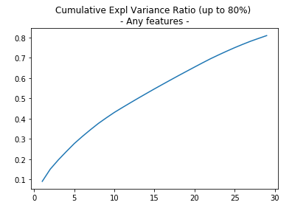
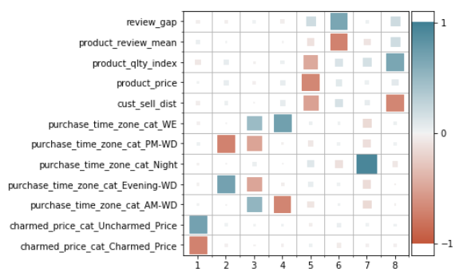
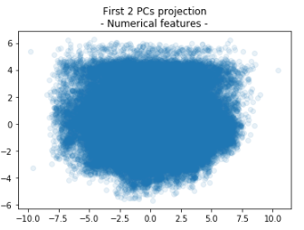
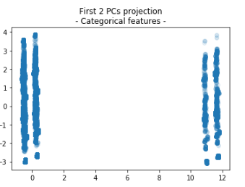
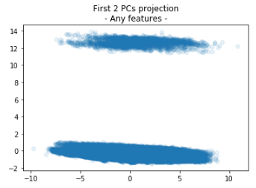
Toward the best segmentation 2.a. Issue : mixed type of features
Aim is to deal equally with features of any type
Transformers : onehot encoding / quantile transformer, scaled
Reducer : hereby, resulting PCA’s cumulative explained variance increase linearly
Use Case Focus (dim 12)
Cumul. expl. Variance PC1-PC2 projection
Only numerical
(dim 42)
Only categorical
(dim 43)
Any features
(dim 85)
8 PCs for 12 variables
Discrete features highly affect results for such reducer
4 firsts PCs taken by « _cat »
Notes:
Heatmaps (with Spearman rank correlation) : help to catch correlated features (& drop redundancies)
Pairplots : help to catch trends or pattern between a features and a Goal (e.g. inscrease sales)
Once we put discrete or even non-normally distributed features, this takes the lead on other features
.e.g. Charm price binary (0, 1) or discrete Review Scores (1 to 5) introduce bias, even on optimal number of segments.
we may try to remedy this effect and tends to normal-distributed features, build new features such as « indexes »
Or we could target this effect, consider this as an emerging categorization and refine it.

Slide 10
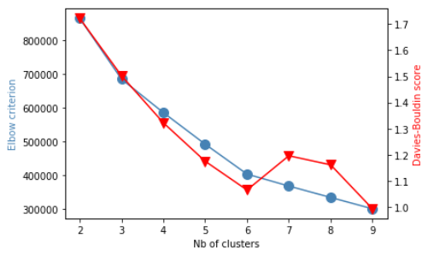
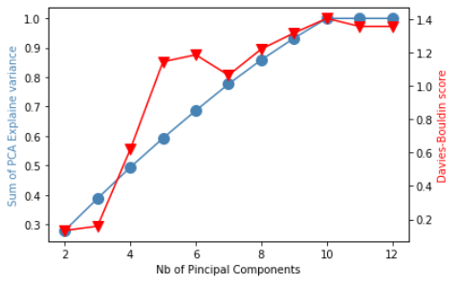
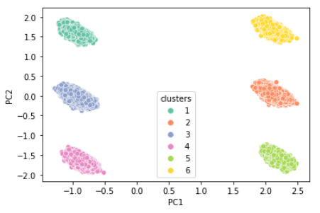
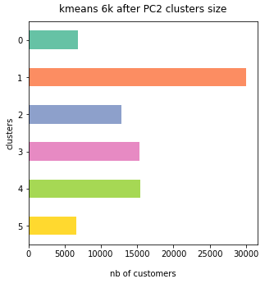
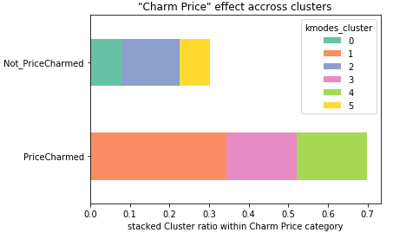
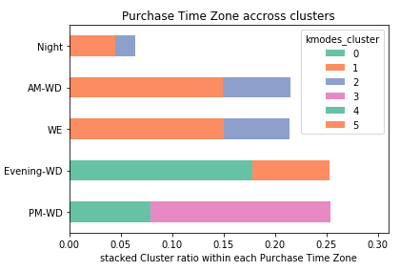
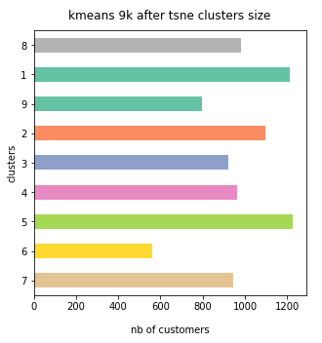
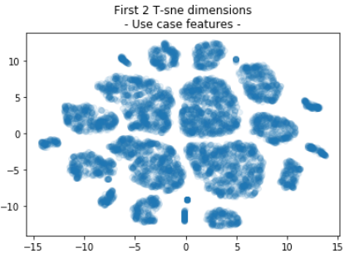
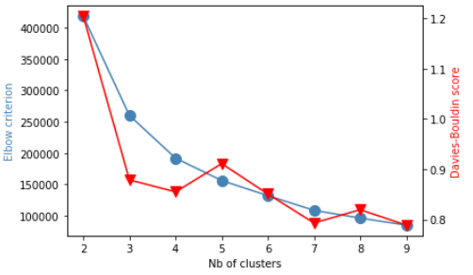
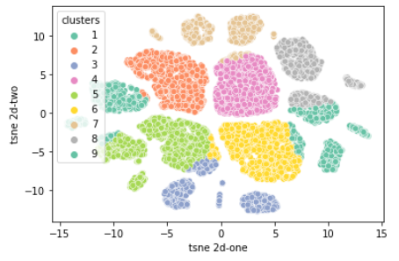
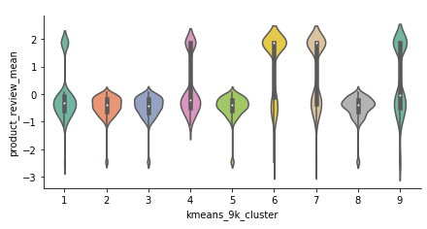
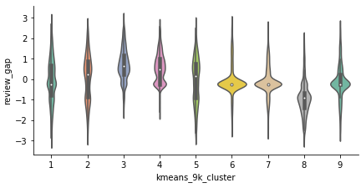
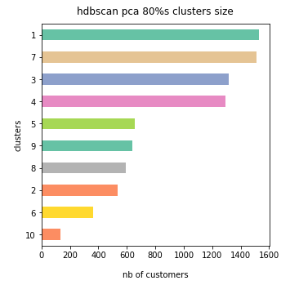
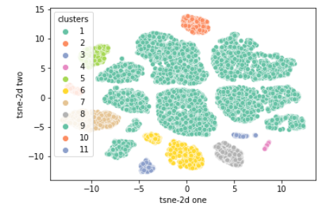
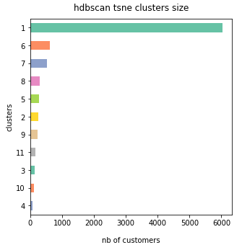
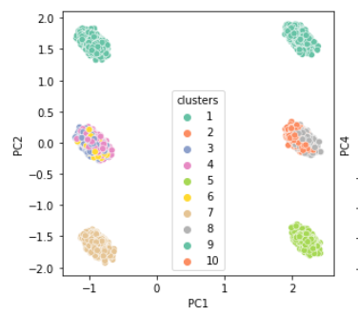
Toward the best segmentation 2.b. consistent reducer & model & meaningfull results
- Qualitative results -
Use Case : K-means after PCA
Optimal nClusters : 6 Optimal nComponents : 2 6 clusters projection PC1-PC2
Cluster’s balance
Discriminating features
Charm_price_cat
Purchase_time_zone_cat
kmeans
Use Case : alternate dimension « reducers » & K-Means
t-SNE 2d
t-SNE with 9 Clusters
Product_review_mean
Review_gap
t-SNE 2d Optimal k : 4 or 9
kmeans
Use Case : alternate clusterer HDBSCAN - agglomerative
After t-sne
Cluster’s balance
Discrimiating features
after PCA 80%
None !
None !
hdbscan
hdbscan
Many alternate dimension reducers, clusterers technique could be explored
Depending on the goal we want to achieve
Notes:
Heatmaps (with Spearman rank correlation) : help to catch correlated features (& drop redundancies)
Pairplots : help to catch trends or pattern between a features and a Goal (e.g. inscrease sales)
Once we put discrete or even non-normally distributed features, this takes the lead on other features
.e.g. Charm price binary (0, 1) or discrete Review Scores (1 to 5) introduce bias, even on optimal number of segments.
we may try to remedy this effect and tends to normal-distributed features, build new features such as « indexes »
Or we could target this effect, consider this as an emerging categorization and refine it.

Slide 11
Toward the best segmentation 2.c. Meaningfull results
Quantitative Evaluation:
DB-Index, same ground
Silhouette Score, various ground (normalized)
Quantitative Evaluation:
DB-Index, same ground
Silhouette Score, various ground (normalized)
Clusterers | K-means |  |  |  | HDBSCAN
Reducers | none | pca (80%) | pca 2 PC | tsne | none | pca (80%) | pca 2 PC | tsne
optimal cluster number | 6 | 6 | 6 | 9 | 20 | 10 | 2 | 11
silhouette score | 0.257372 | 0.326331 | 0.904481 | 0.404643 | 0.130021 | 0.399960 | 0.634935 | 0.006387
cluster balance | average | good | bad | average | - | average | average | very bad
discriminatory features | 2 / 7 | 2 / 7 | 2 / 7 | 2 / 7 | - | 2/ 7 | 2/ 7 | 2/ 7
actionability | poor | biased (categories) |  | poor | bad
to emphasize actionability : try alternate approaches that would bring most valuable qualitative results
Introduce weighted techniques to ensure desired feature to be discriminant
K-Modes extension to K-Means could enable to assert action considering categorical features
Through the 4 interdependent steps of any segmentation approach, we shall pick a consistent set of techniques among the large palette of transformers, reducers, clusterers and evaluation techniques.

Slide 12
Data Science : your best Support
We’re now able to define Use Cases and refine targets
We know how to select and tune an approach
Next, how to achieve Olist business goals ?
Actionability
Stability & further proceedings

Slide 13
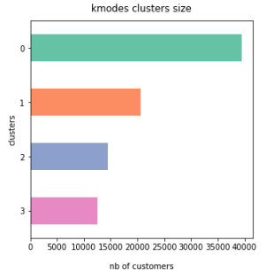
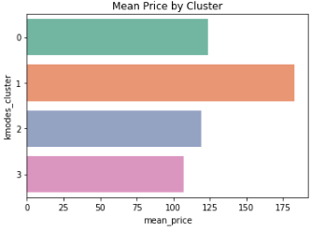
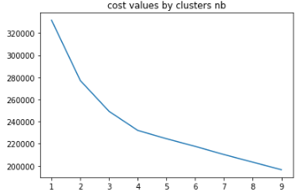
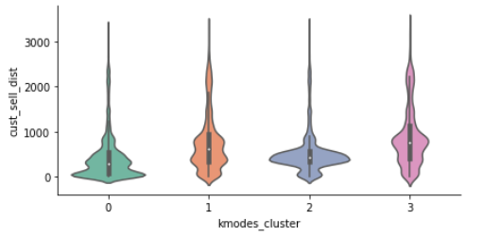
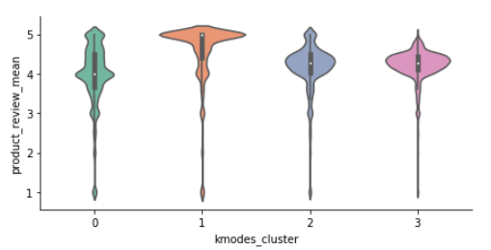
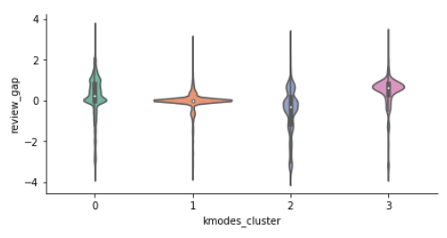
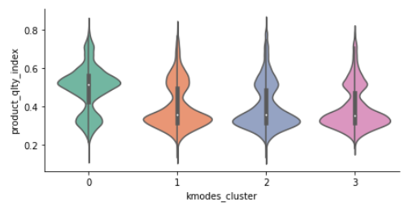
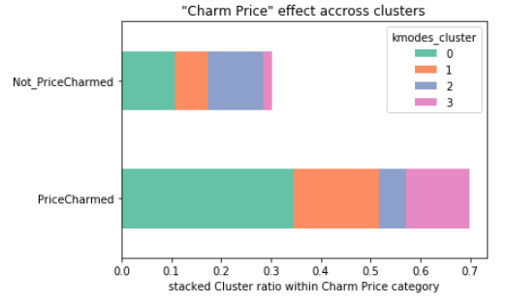
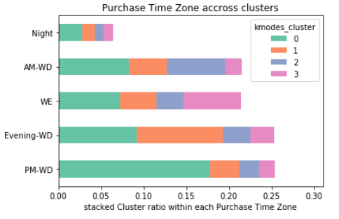
Actionability Explore K-Modes
What : k-Modes extends k-Means algorithm for categorical features, minimizing a cost function measuring matching dissimilarity
Pros :
« raw » data (turned to categorical)
clear cluster description
deterministic (with « Cao » init)
Cons :
introduce a sensitivity to feature engineering : reward same k optimal clusters than feature discretization
would consider ordinal as categorical (losing the « real » distance between levels)
stability is compromized because of its sensitivity to discretization
K-Modes gets a direct « cluster Zero » description : feature’s most frequent values
Resulting cluster’s balance
Goal: Mean Price
K-Modes build clusters iteratively until cost slows its decrease
Find your target
Refine your use case : what matters most?
Re-engineer your features accordingly
Notes:
Idea is to perform K-Modes technique, dedicated to categorical features, on level features.
Pros : get clear centroïd details and cluster description
Cons : consider ordinal as categorical features, losing the « real » distance between levels
Method : starting with an initial centroids seed, refine clusters by minimizing dissimilarity (Hamming distance from cluster mode).
! Currently a research topic, to find the most efficient technique.
Basics : many seeds, few clusters, and of course few features and especially few categories (prevent having too small populated categories)
Evaluation : the lowest cost gives the best clustering.

Slide 14
Actionability K-Modes results
Cluster 0 :
['Near_Dist', 'Light_Price', 'High_QltyIdx', 'Low_Score’, 'Better_Review', 'Charmed_Price', 'PM-WD’],
Customer of the largest segment, they claim a good product description of below mean priced products. They seem satisfied by low review score while giving a better score. They live the closest to commercial areas and seems not sensitive to charm pricing. They spread across any purchase time zone.
Cluster 1 :
['Far_Dist', 'Medium_Price', 'Low_QltyIdx', 'Top_Score', 'Same_Review', 'Charmed_Price', 'Evening-WD’]
Customers of the interesting second largest segment, buy more expensive products, no matter their description’s quality and are not sensitive to charm pricing. They live far from the sellers, meaning they could not get to stores. Top review score seems mandatory to them while they score the same. Their favorite purchase time zone is the evening of a working day.
Cluster 2 :
['AroundMed_Dist', 'Light_Price', 'Low_QltyIdx', 'Medium_Score’, 'Worst_Review', 'Uncharmed_Price', 'AM-WD’]
Customers of the second smallest segment are the worst reviewers while purchasing medium scored products, not matter their description’s quality. They are located around the median distance to sellers, but live already two far to get those shops other than virtually. These customer seems to reject charm pricing. Their favourite purchase time zone is the morning of a working day. They buy more often products of Electronics, Computers & Accessories.
Cluster 3 :
'Far_Dist', 'Light_Price', 'Low_QltyIdx', 'Medium_Score’, 'Better_Review', 'Charmed_Price', 'WE’]
Customers of the smallest segment are the best reviewers while purchasing medium scored products, not matter their description’s quality. They are the farthest customers. They have the highest sensitivity to charm pricing. Their favourite purchase time zone is the week-end. They buy more often products of Telephony, Supplies and Health Beauty Baby Caterogies.
With basic goal of sales increase :
Action 1 : improve scoring, targetting cluster 3 customers, i.e. mainly during the week-end, catching them on the charm price sensitivity, arguing that they can afford any products thanks to the marketplace, no matter the live far from the original commercial areas (action about freight fares to study). Additionnal action targetting cluster 2 could be, mainly during the morning, to fasten regular cart
Action 2 : improve sales, targetting cluster 1 customers, i.e. mainly during the evening of a working-day, catching them on the top review scores and arguing that those selected products are now available thanks to the market place (new sellers joigned, top ratings).

Slide 15
Stability Choice of baseline & further action
Remember stability is biased due to data troncature, and marketing should decide either to keep « rising » period (2017) or focus only on « stable » period (2018), then decide :
1. Keep your customers in your target
2. Adapt your target to customers
Sability assesment by comparison
Compute segmentation on 2 periods
Re-map clusters according to centroïds
Measure deviation of centroïds coordinates
Pros : enable to keep target
give a clear understanding of evolution
If needed : refine categories or levels
Cons : feature re-interpretation
The 2 periods shall be similar
Clear understanding of target is a pre-requisite
Stability assessment measuring dissimilarity
Compute segmentation on a baseline
Aggregation : put new data (e.g. monthly)
Assess deviation computing adjusted Rand index
Pros : enable to keep features
A larger baseline and smaller additions
If needed : enable to refine categories or levels
Cons : target may change
New (increased or switched) baseline computation

Slide 16
Stability Use case on both approaches
1. Keep your customers in your target
Due to threshold effects, risk is high to loose the essence of a segment !
Work on feature’s discretization to restrain volatility
2. Adapt your target to customers
 | Stable
Rising | Cluster 0 | Cluster 1 | Cluster 2 | Cluster 3
Cluster 0 | (o,o,o,x,x,o,o) | (x,x,o,o,x,x,o) | (x,o,x,x,o,o,x) | (x,o,o,o,o,o,x)
Cluster 1 | (x,x,x,o,x,o,x) | (o,o,x,x,o,x,x) | (x,x,o,x,x,o,o) | (o,x,x,x,x,o,x)
Cluster 2 | (x,o,x,xo,x,o) | (x,x,x,x,x,o,x) | (o,o,o,o,x,x,x) | (x,o,x,x,x,x,x)
Cluster 3 | (x,o,x,x,x,o,x) | (o,x,x,x,x,x,x) | (x,o,o,o,o,o,x) | (o,o,x,x,o,o,o)
 | Stable
Rising | Cluster 0 | Cluster 1 | Cluster 2 | Cluster 3
Cluster 0 | 5 | 3 | 3 | 5
Cluster 1 | 2 | 3 | 3 | 2
Cluster 2 | 3 | 1 | 4 | 1
Cluster 3 | 2 | 1 | 5 | 5
 | Stable
Rising | Cluster A | Cluster B | Cluster C | Cluster D
Cluster 0 | 2
Cluster 1 |  | 4
Cluster 2 |  |  | 3
Cluster 3 |  |  |  | 2
Stability assessment measuring dissimilarity
Compute segmentation on a baseline
Aggregation : put new data (e.g. monthly)
Assess deviation computing adjusted Rand index
Pros : enable to keep features
A larger baseline and smaller additions
If needed : enable to refine categories or levels
Cons : target may change
New (increased or switched) baseline computation

Slide 17
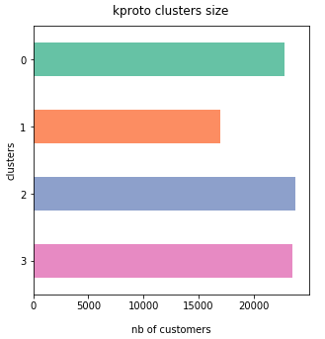
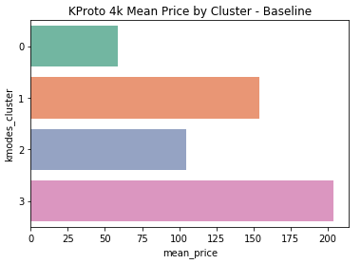
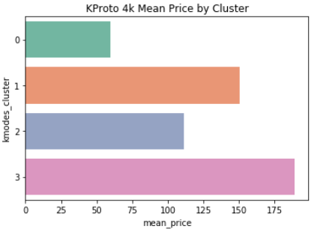
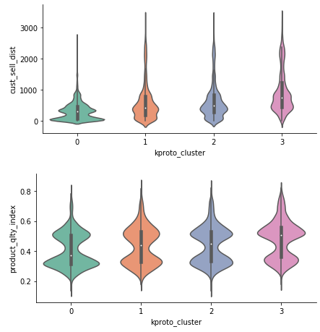
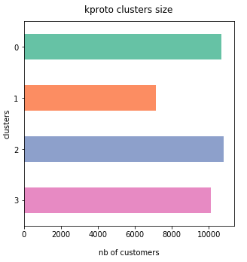
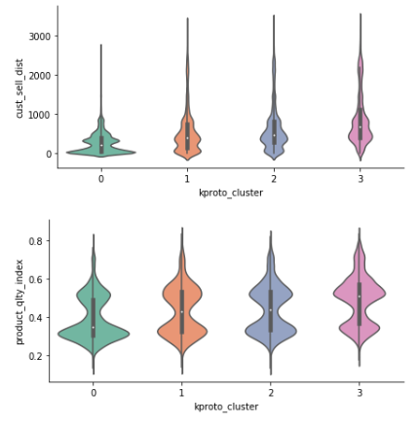
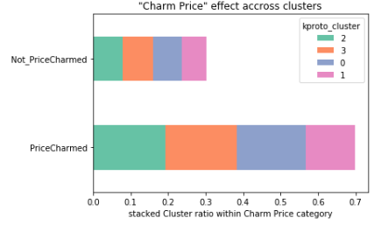
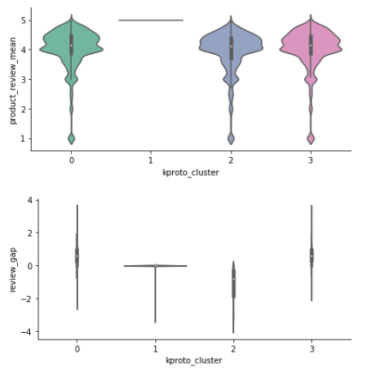

Actionability (3/3) K-Prototypes to address mixed-type features
What : k-Prototypes aim is to combine K-Means and K-Modes, again with cost matching dissimilarity
Pros :
Really « raw » data
Remedy the bias to consider ordinal as categorical (losing the « real » distance between levels)
Cons :
harder results interpretation
(not weighted) penalize Categorical Features
Following observation, we drop this orientation

