Slide 1
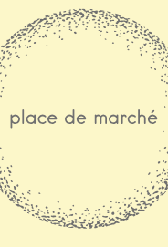
Products’ Classification Engine with text & image feasibility study
Goal of “Place de Marché” is to enhance users' experience
sorting products reliably in categories
through a scaled and automated products classification engine

Slide 2
Project’s scope: Feasibility study expectations
Key points
Feasibility study
1
Feature Engineering : process text // image
4
5
Cluster and visualize
3
Feature Engineering : create {BoW, BoVW}
6
Reduce & Combine
2
Global EDA : inputs & target analysis
Robustness @scale
Scaling
Optimize:
Only
final
evaluation matters
Alternate…
processors
extractors
reducers
Classify
Classiffy
Illustration
≠
Evaluation
Evaluate & Optimize
Expected decisions :
Feasibility study validation Y N
Engage next steps Y N

Slide 3

Feasibility study contents
1
Feature Engineering : process text // image
4
5
Cluster and visualize
3
Feature Engineering : create features {BoW, BoVW}
6
Reduce & Combine
2
Global EDA : inputs & target analysis
P6_01_Notebook
P6_01a_Explorations_NB
P6_01b_CNN_Dedicated_NB
*.csv files for intermediate results

Slide 4



Global EDA
Inputs :
One *.csv files with 1050 products descriptions & image filename
1050 jpg files
Target :
Category : product_category_tree
14 features:
Among 6 possible primary keys : keep “image” and use df index
Remove 10 useless features
Build an extended description (brand, name, decription)
Filling by ‘ ’ the 32 % missing “brand” information
Consistency checked between ‘image’ & image files folder
uniq_id
crawl_timestamp
product_url
product_name
product_category_tree
pid
retail_price
discounted_price
image
is_FK_Advantage_product
description
product_rating
overall_rating
brand
product_specifications

Slide 5
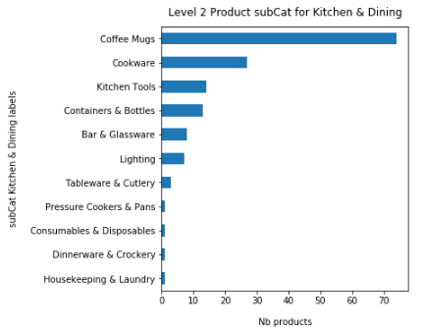
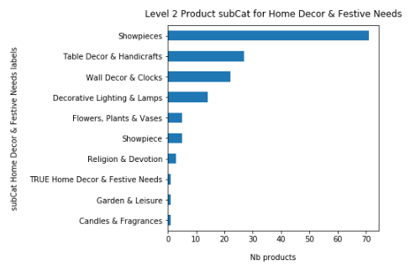
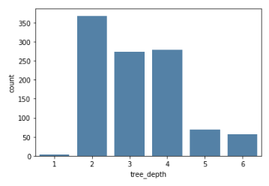
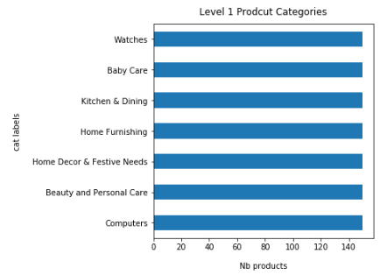
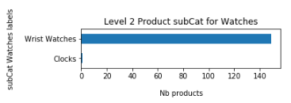
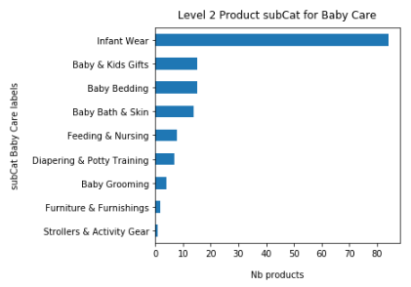
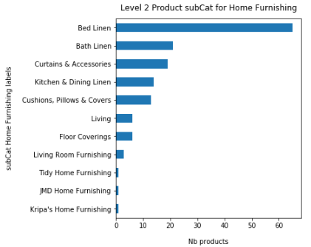
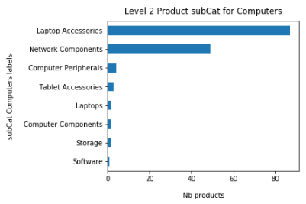
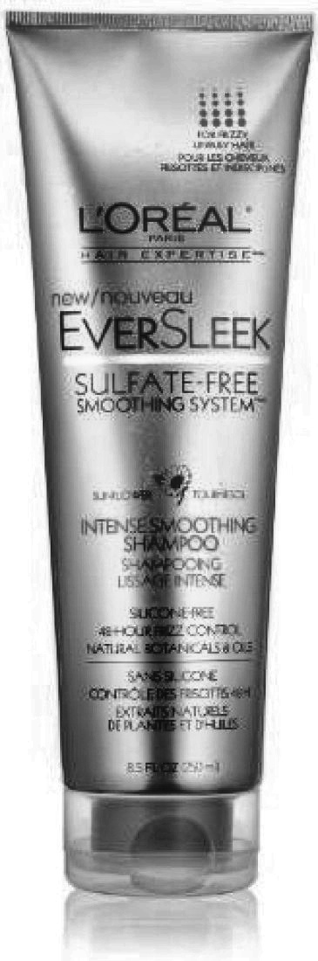
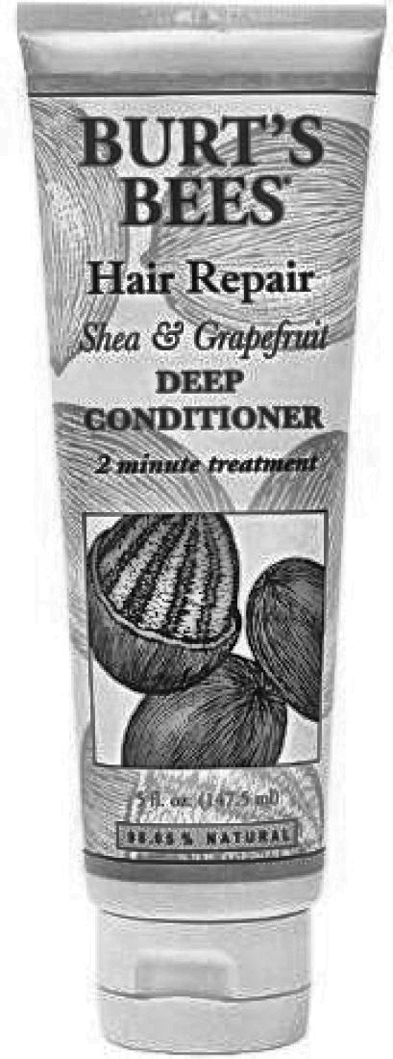
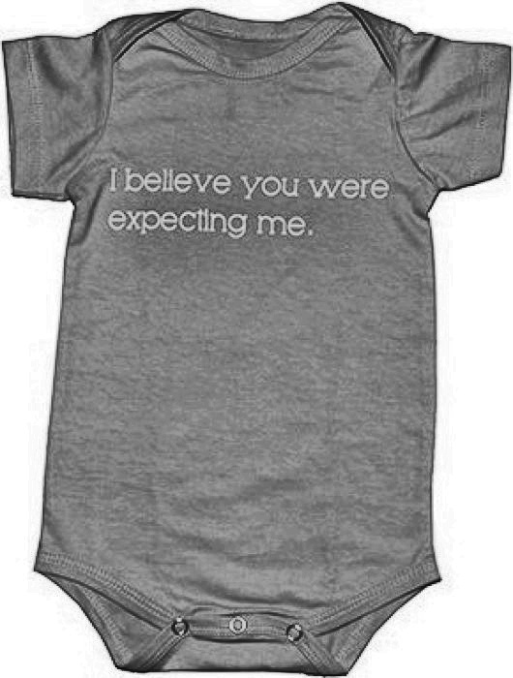
Global EDA: Products Categories Clip or Collect ?
Pattern is: 1st level >> 2nd level >> … >> n level >> concat(Product_name, ProductDescription) ending with ‘…’
Extraction of tree depth, level’s labels & observation of products count’s balance :
Mostly in 2 to 4 levels
The 7 level 1 categories
The 62 level 2
categories
Key point:
Remedy unbalanced classes,
e.g. with similar amount of similar products at a given category level
Dealing with cross category similarity and internal category dissimilarity
Beauty
Baby
= ≠
Alternate approaches:
Either clip data to same-sized classes (e.g. by sampling), but not enough inputs,
Or collect additional descriptions and images e.g. through an API : purpose of the company’s project.

Slide 6

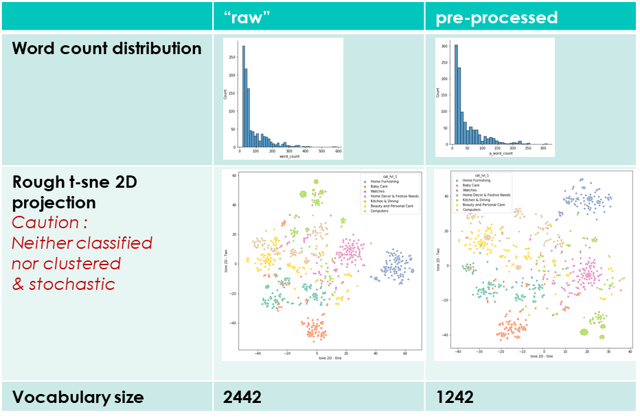
Text processing : pre-process please refer to Explorations_NB : section 2.
Product’s “description” is a string, with average 80 words count.
It appears being a concatenation of many inputs, with repeated info and details such as size, price, etc.
We compute tf-idf matrix, illustrated through t-sne 2D projections
To get an adequate corpus, we pre-process text :
Switching to lower case,
Getting rid of punctuation, numbers, < 3 words length,
Tokenizing
Stemming
Removing default’s stop words & custom’s (iteratively)
1
2
3
5
4
Result is a processed_description for each product

Slide 7
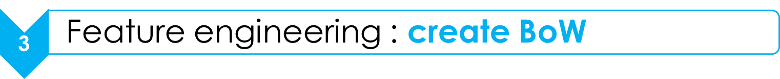
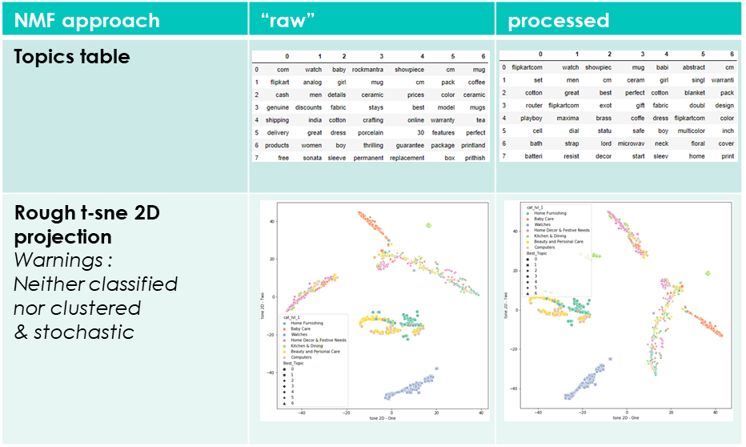
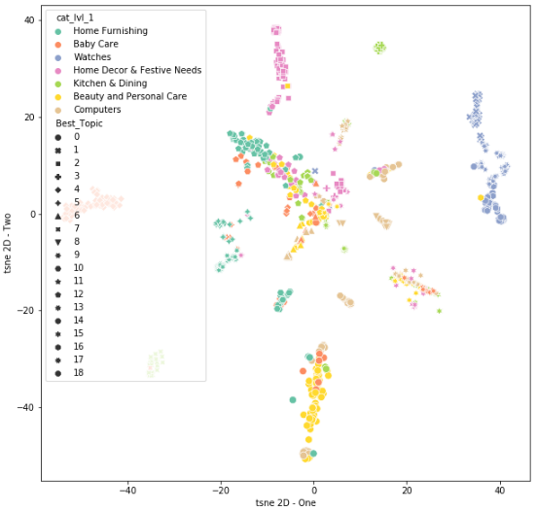
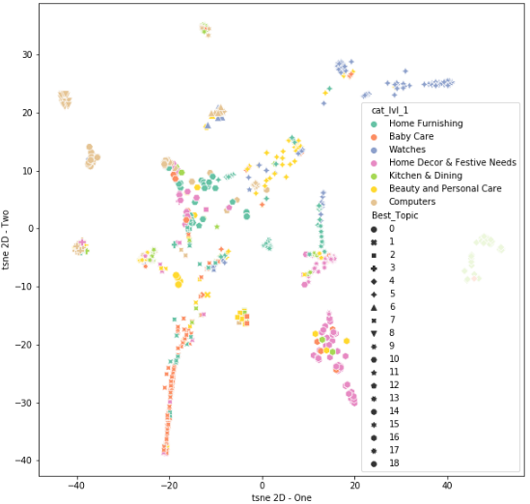
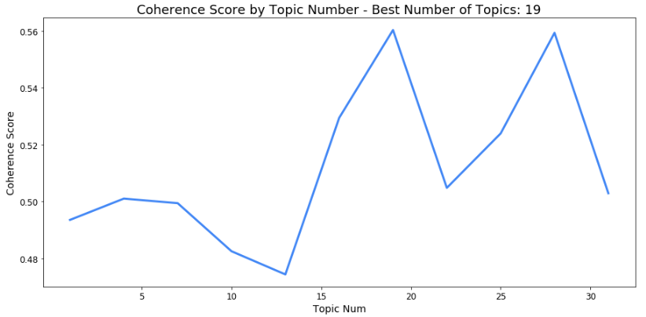
Text processing : Bag of Words
NMF with “as few” topics as lvl 1 categories:
NMF with “optimal”* topics number:
Reduces the size of “carryall” topic,
Highest sparsity, with few topics for a single 1st level category,
“Mixed topics & categories” area split into smaller areas,
Still a high level of confusion for products with “weak” coordinates.
LDA “optimal” as alternate approach
! Topics markers
Coherence score to get an optimal* topics numbers (NMF)
! Topics markers
* Caution : optimization is only valid considering final classifier
Notes:
We used c_v coherence here. Such exploratory result is for illustration only, we found many research papers discussing the alternate scoring methods.
Basically : coherence is as high as the top words are commons between items of a corpus gathered in one topic.
Our rough interpretation is that an increasing number of topics will decrease the size of a carry-all topic, coherence score provide a quantitative measure of this.
The basis is to get cooccurrence words counts (e.g. top words of topic)
While c_v measures the mean of (cosin) similarity measure through and intermediate “normalized pointwise mutual information (NPMI)” calculation, for any topwords.
U_mass measures the mean (or sum) or log conditional probability and consider top words of higher rank of the same topic.
C_{V} is based on a sliding window, a one-set segmentation of the top words and an indirect confirmation measure that uses normalized pointwise mutual information (NPMI) and the cosinus similarity.
This coherence measure retrieves cooccurrence counts for the given words using a sliding window and the window size 110. The counts are used to calculated the NPMI of every top word to every other top word, thus, resulting in a set of vectors—one for every top word. The one-set segmentation of the top words leads to the calculation of the similarity between every top word vector and the sum of all top word vectors. As similarity measure the cosinus is used. The coherence is the arithmetic mean of these similarities. (Note that this was the best coherence measure in our evalution.)
Proposed in M. Röder, A. Both, and A. Hinneburg: Exploring the Space of Topic Coherence Measures. In Proceedings of the eighth International Conference on Web Search and Data Mining, 2015.
C_{UMass} is based on document cooccurrence counts, a one-preceding segmentation and a logarithmic conditional probability as confirmation measure.
The main idea of this coherence is that the occurrence of every top word should be supported by every top preceding top word. Thus, the probability of a top word to occur should be higher if a document already contains a higher order top word of the same topic. Therefore, for every word the logarithm of its conditional probability is calculated using every other top word that has a higher order in the ranking of top words as condition. The probabilities are derived using document cooccurrence counts. The single conditional probabilities are summarized using the arithmetic mean. (Note that in the original publication only the sum of these values is calculated)
Proposed in D. Mimno, H. M. Wallach, E. Talley, M. Leenders, and A. McCallum: Optimizing semantic coherence in topic models. In Proceedings of the Conference on Empirical Methods in Natural Language Processing, pages 262-272. Association for Computational Linguistics, 2011.
http://www.saf21.eu/wp-content/uploads/2017/09/5004a165.pdf

Slide 8

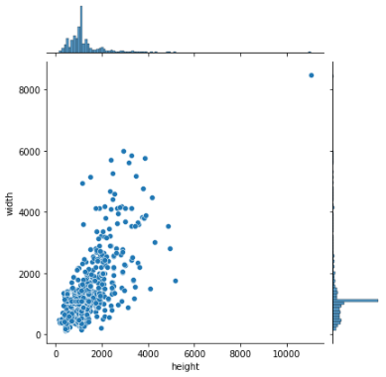
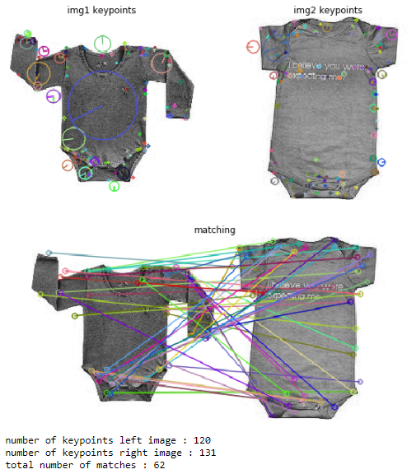
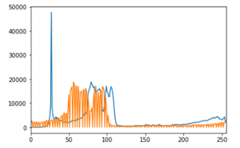
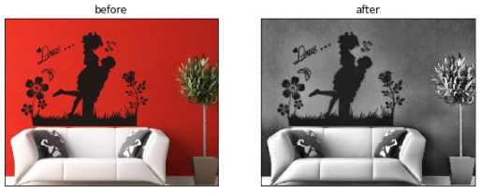
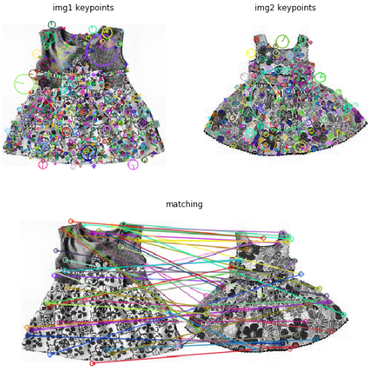
Image processing: pre-process please refer to Explorations_NB : section 3.
Computer vision is not Human vision: we decided to explore processors from a feature extraction and matching perspective (SIFT)
Pictures of various sizes are stored in BGR mode
1.
Alternate processors
2.
Visualize results
3.
Explore* extraction & matching
4. Create images set
- 1 -
Color space / Contrast / Brightness
Adjust size & keep ratio
Enhanced Contrast (through L of LAB space)
Emphasize shape (through binarize & dilate)
- 4 -
Process all images to fill folders of image sets
- 2 -
Visualize results : before & after processing
Guess what is the product here?
- 3 -
Explore* through samples SIFT features extraction & matching :
Keypoints and matching
bodysuit
dress
Get the area of interest?

Slide 9

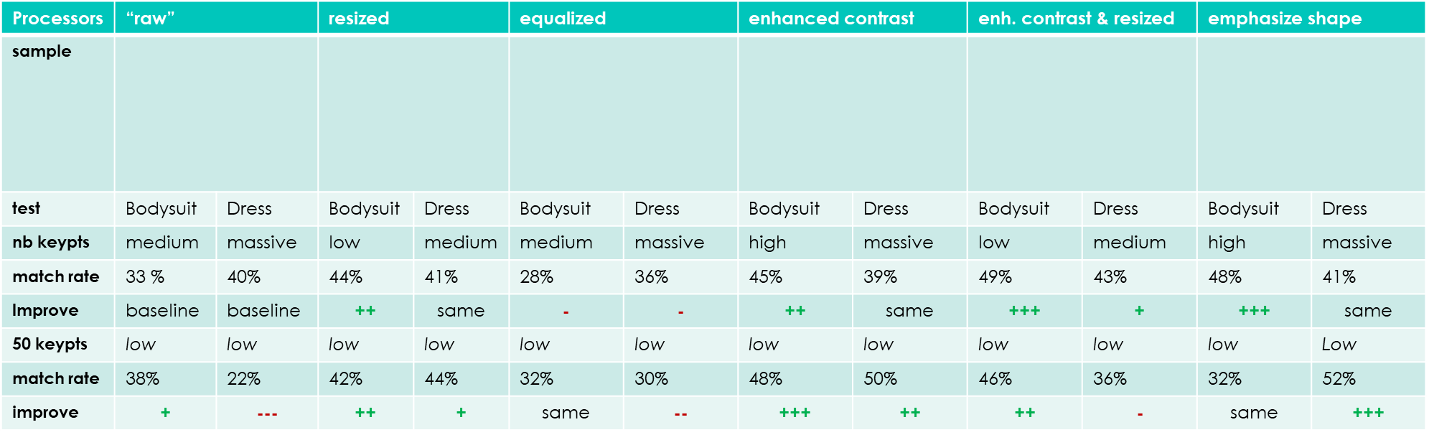
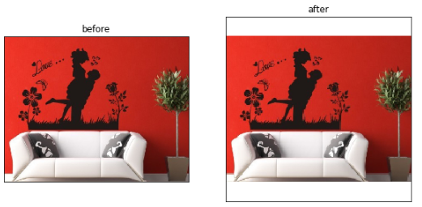
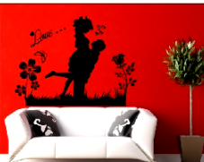
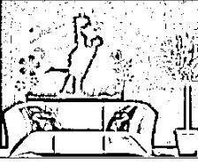
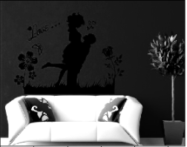
Image processing: pre-process please refer to Explorations_NB : section 3.
Bodysuit - Dress
details
! grayscale
matching rate is “nb matching / avg(keypoints)” and trends observed differs from on sample to another.
while scale shouldn't matter in SIFT case, keypoints total number depends on it.
Introduces idea of a minimum viable threshold for keypoints number
* Caution: proceed statistically and consider classifier results to get valid results.

Slide 10
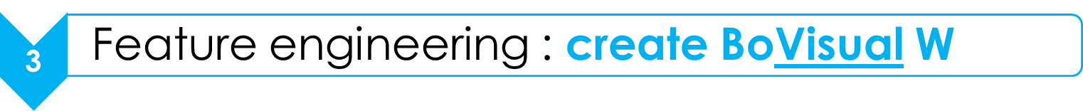
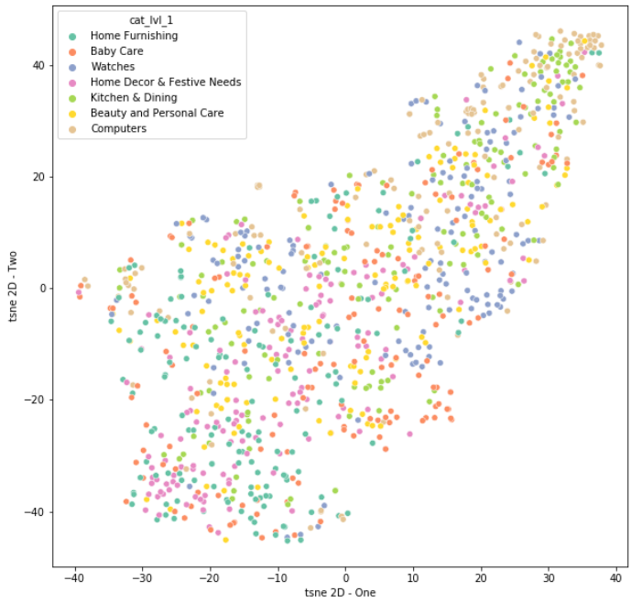
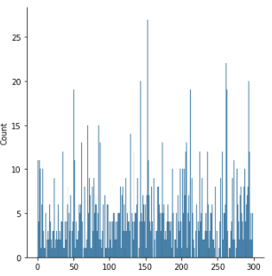
Image processing : Bags of Visual Words
Again a process, with 3 interdependent steps : 1., 2. and 4.
2.
Extract image descriptors
3.
Gather any descriptors
4.
Kmeans to get BoVW
4.
Create histograms
5.
Store results
1.
Select Input
t-sne 2D projection* (case “optim”)
Optimal
vocab size
Optimal
Nb keypoints
Optimal
Image set
Key points : we identify 3 steps where an optimum could be searched :
Find an optimal image set
Find an optimal nb of keypoints
Find an optimal vocab size
We proceed with :
Enhanced constrast images and medium size (for easy data handling)
2 alternate image features :
50 keypoints & 150 BoVW
“Free” keypoints & 300 BoVW
With same rough t-sne parameters, we don’t see a nice projection.
* Caution: consider classifier results to get valid results.

Slide 11

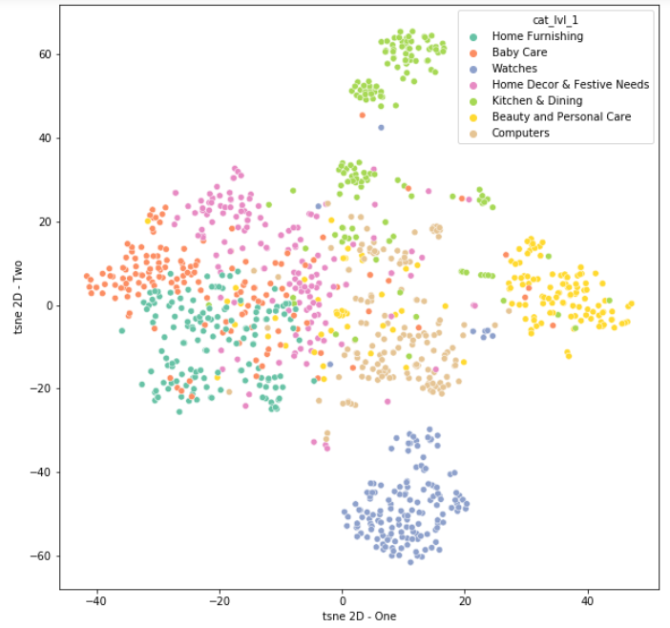
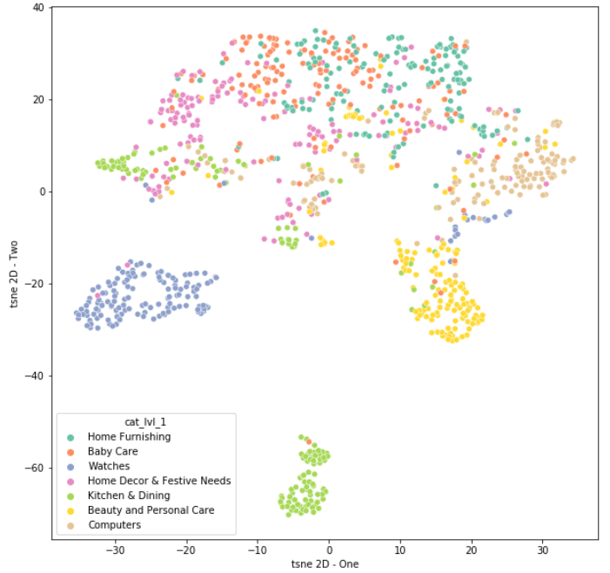
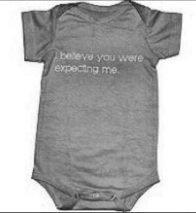
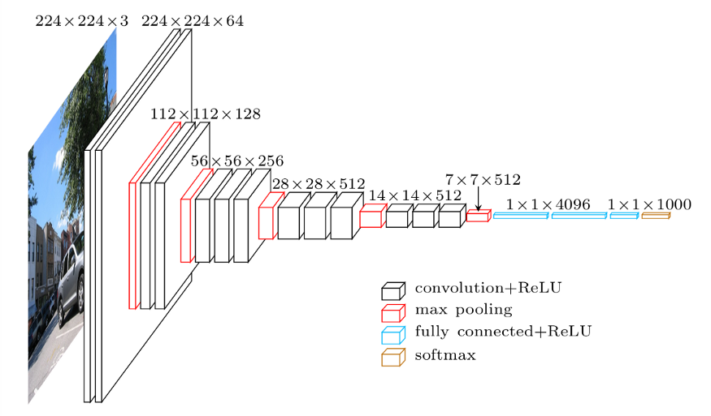
Image processing : CNN transfer learning please refer to P6_01_CNN_Dedicated_NB.ipynb
1. Explore ability to create features from pre-trained VGG16 ImageNet model
4. Make the usual t-sne 2D projection observations
Using rough t-sne after alternate dim reducers (nfm 7)
2. First, the full original CNN provides top classes for an image sample:
Top 3 classes reach 98%
44% Sweatshirt
35% Jersey
19% Bulletproof Vest !
3. we cut at last pooling layer: goal is to get a flatten vector, here dim 512.
5. Further work about CNN : training of the model with our dataset (img generator & augmentation)

Slide 12

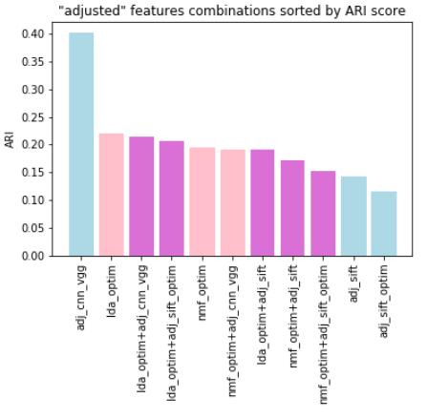
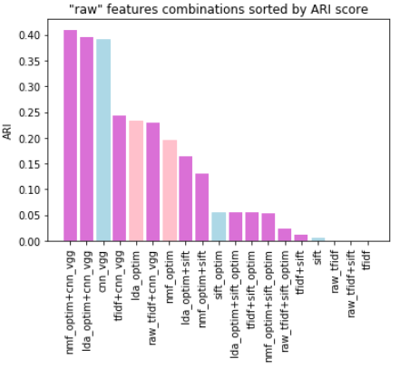
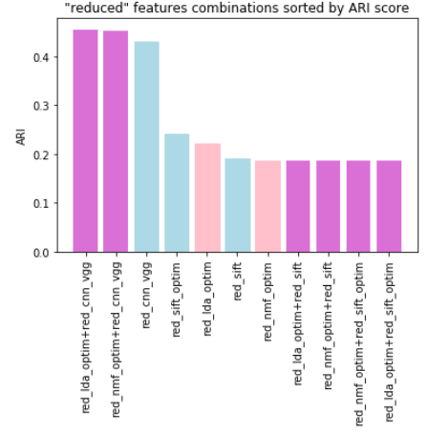
Browse combinations of text / image features Observations of rough clustering ARI score
We “chained” PCA and MNF sliding negative to positive data with an offset.
Dead end in case of [14]
Mainly lower results
Ranking seems irrelevant
Trend is not confirmed
“Adjusted” dim to [14]:
We build alternate combinations of text or image features (incl. single text nor image)
After a PCA 80% reduction, it consists in an assembly of 4 text and 3 image inputs of different resulting [sizes]
raw td-idf [343] or tf-idf with processed text [276]
NMF BoW [14] or LDA BoW [14]
SIFT BoVW [98] optimum [72] cnn_vgg [512]
Promising in case of [7]
Being aware of instability of our rough results
Being aware of our ability to tune any method
Combination of cnn_image and text BoW could even improve results
We should keep both feature and reduction and balance between image and text is a key point.
Ranking by ARI score:
“Reduced” dim to [7]:
Observations:
Results are unstable and we shall proceed statistically
cnn_vgg is on top, enhance txt, opposite to sift BoVW
Confirm this trend with reduced or adjusted inputs dimension.
Proceed next statistically

Slide 13

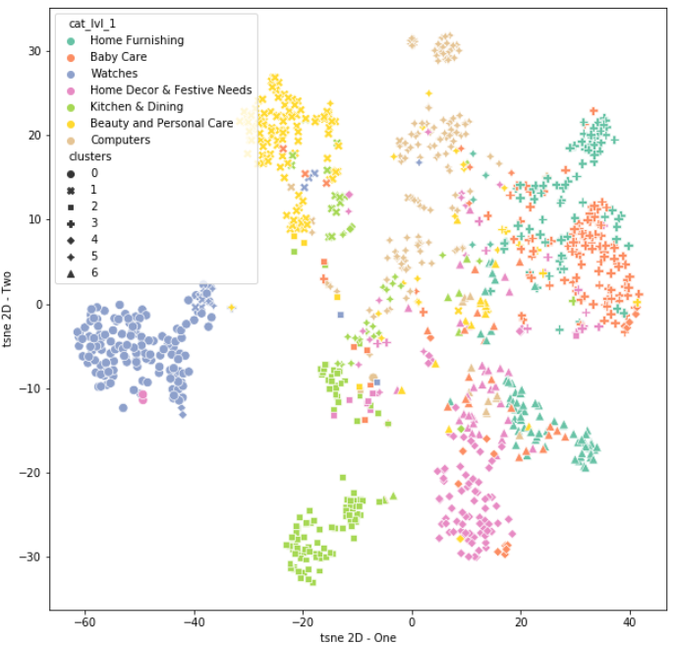
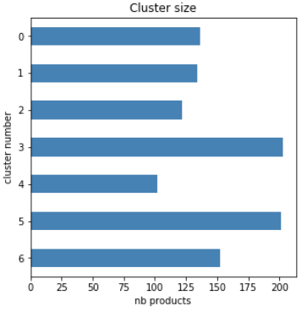
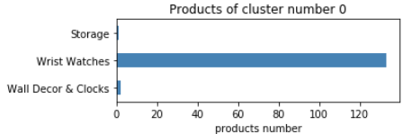
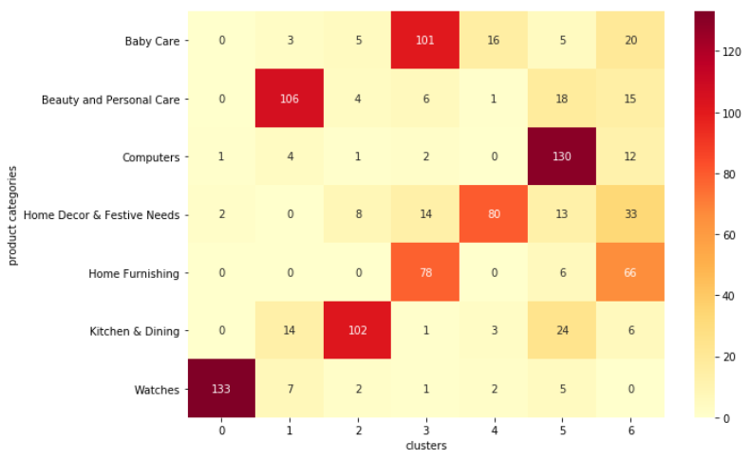
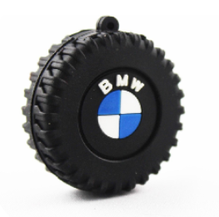
“Best” clustering visualizations: lda_optim & cnn_vgg
t-sne 2D projection
With such combination, clusters are almost balanced:
Digging deeper (Cat level 2), we find only one restricted product’s panel. Strong similarity has been recognized through our study.
Confusion matrix: ARI 46%
Guess what kind of “storage” product we have?

Slide 14
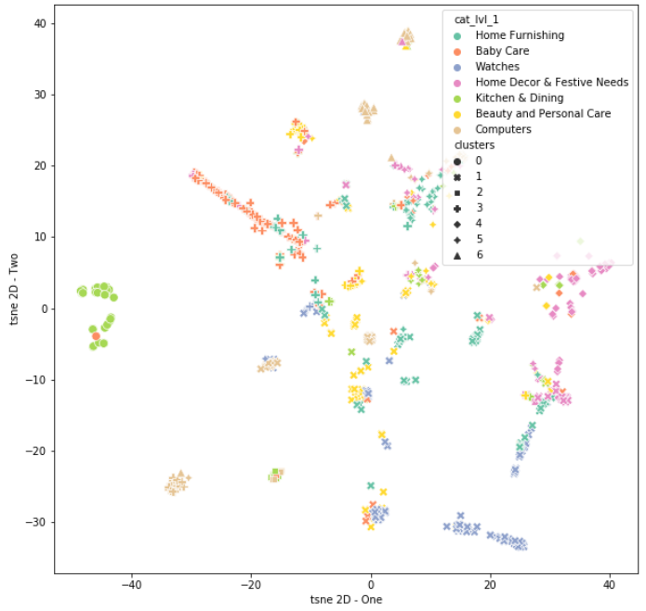
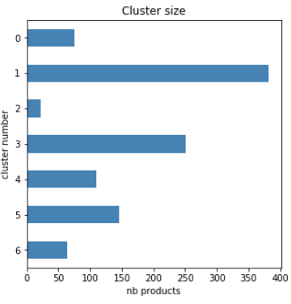
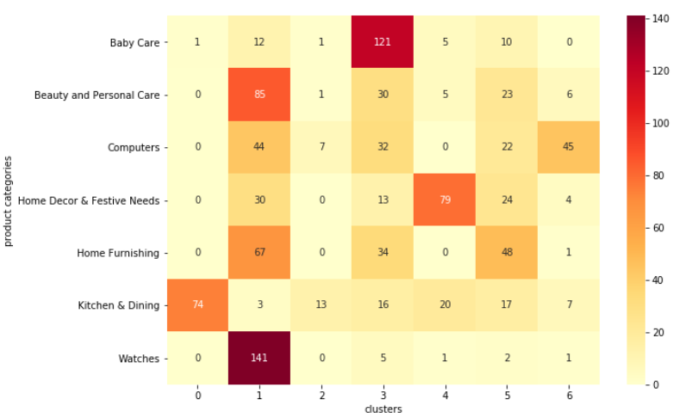
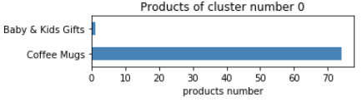
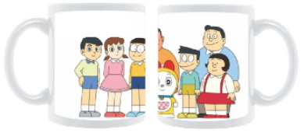
Alternate case to understand combination: lda_optim only
t-sne 2D projection
With text LDA BoW only, clusters are more imbalanced:
Nb 1 is our “carry-all” cluster: il contains “Watches” and a wide range of other categories.
Digging deeper (Cat level 2), we find restricted product’s panel. Strong similarity has been recognized through our study.
Confusion matrix: ARI 20%
Guess what the product of “Baby & Kids Gifts” is about?

Slide 15
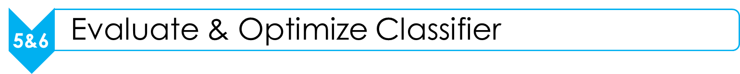
Further steps
Our recommendation is to engage further work on both text & image topics, with key points:
Enhance the hierarchical decomposition through multi-labelling of products
Remedy unbalanced classes (through API)
Refine the scope & target, in order to dig deeper only on right and valuable directions, meaning
Refine the search space, choose among alternate techniques (processors, extractors, reducers)
Expected decisions :
Feasibility study validation Y N
Engage next step : risk & opportunity matrix, project plan Y N
Time for Q&A, Thank you for your attention!

