Slide 1
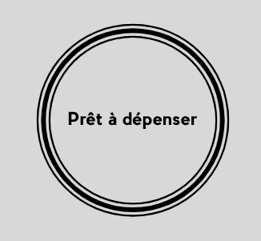
Cash & Revolving loans for clients with no or few loans history
P7 Datascientist – OpenClassrooms
Etienne Lardeur
Mentor : Xavier Tizon
Develop scoring model of the applicant’s risk of failure to repay loan
with prediction interpretation, through an interactive dashboard
to argue whether loan is granted or rejected and help studying why.

Slide 2


Table of contents
Project’s deliverables
+ 5 Jupyter Notebooks:
P7_EDA: Exploratory Data Analysis,
P7_FE: Feature engineering
P7_FS: Feature Selection
P7_Model : Scoring & Model Evaluation,
P7_Interpretation : Model Interpretation,
+ Methodological notice (FR)
+ Dashboard : local_app.py or remote
1
Use case & inputs
2
Scoring & Integration
3
Model
4
Dashboard
5’
3’
4’
15’
https://github.com/EtienneLardeur/P7_Scoring
https://github.com/EtienneLardeur/Streamlit_App

Slide 3
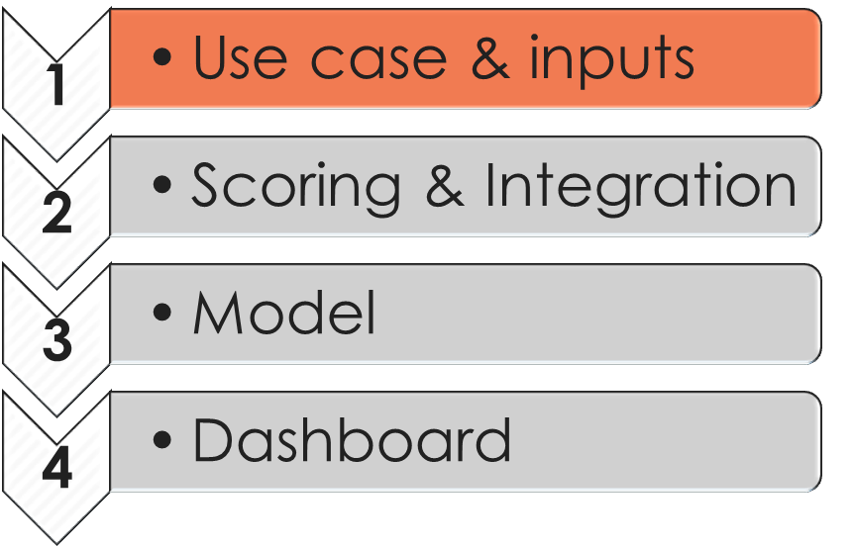
Table of contents
1
Use case & inputs
2
Scoring & Integration
3
Model
4
Dashboard

Slide 4



















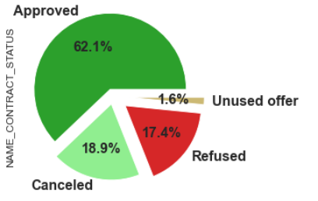

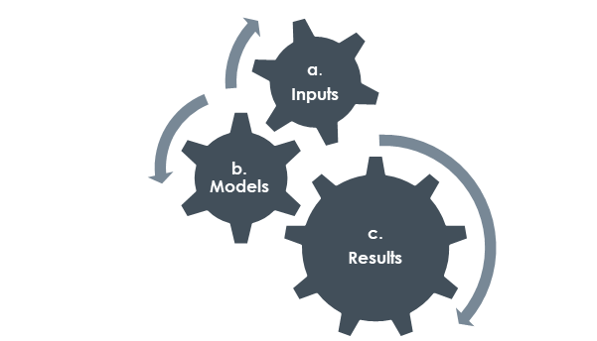
Use case
Growth intentions,
Liquidity & key rates,
Economic health, etc.
Applicants
307 511 past
48 744 new
Global Business Context
?
!
Keep
reason
Application Analysis
Application
Decision
Detect failure…
& learn from it !
Scoring Model
& Interpretability
Business Goals should drive our study, defining how we intend to use the model and its interpretability:
Assess predictions vs reality,
Challenge usual rules with model interpretations,
Define and test risk mitigation actions.
we have no time-stamp nor contextual data to catch repayment failure as “events”… rather than “fix” we would “prevent” defaults by focusing our monitoring
(New)
2
Client’s profile
& payment difficulties 0/1 (Past)
Dashboard
Client’s “internal” applications incl. rejected (95.03 %)
1
Client’s “external” loans (85.84 %)
Predict “0”
Good
Y
N
Predict “1”
Bad
Client’s both loans' knowledge (81.63 %).
Learn from the past
&
Predict
failure
Machine Learning
Anteriority of 8 years
sliding from current application
Notes:
Le projet a pour cadre la décision d’octroyer ou non un prêt bancaire.
Le use case primaire est le suivant : un client ‘applicant’ soumet une demande de prêt à l’organisme.
La demande est analysée et donne lieu au refus ou à l’accord de prêt.
L’organisme collecte alors le motif du refus et, dans le cas de prêts accordés, l’ensemble des données de remboursement.
On note que 17,4 % des demandes sont refusées et parmi les prêts accordés 62% sont effectivement mis en place.
En accumulant au fil du temps le suivi des remboursements des prêts, l’organisme a construit un indicateur cible identifiant une difficulté de remboursement.
L’organisme a par ailleurs collecté 8 années d’antériorité des emprunts internes ou externes contractés par le client.
L’objectif du projet est double:
construire l’approche machine learning permettant de prédire à partir des données collectées une future difficulté de remboursement,
intégrer cette approche dans le processus d’octroi de prêt de l’organisme par la fourniture d’un tableau de bord interactif.
Le projet s’inscrit dans le contexte élargi des KPIs de l’organisme comme les stratégies de croissance, ainsi que des paramètres externes tels que les taux directeurs ou la santé économique. Ces éléments de contexte étant non seulement inconnus mais eux-mêmes fluctuants au cours du temps nous pouvons au mieux considérer qu’il existe des facteurs externes qui pilotent l’activité d’analyse-décision et proposer à ce titre une logique d’interprétation et un tableau de bord ouvert.

Slide 5
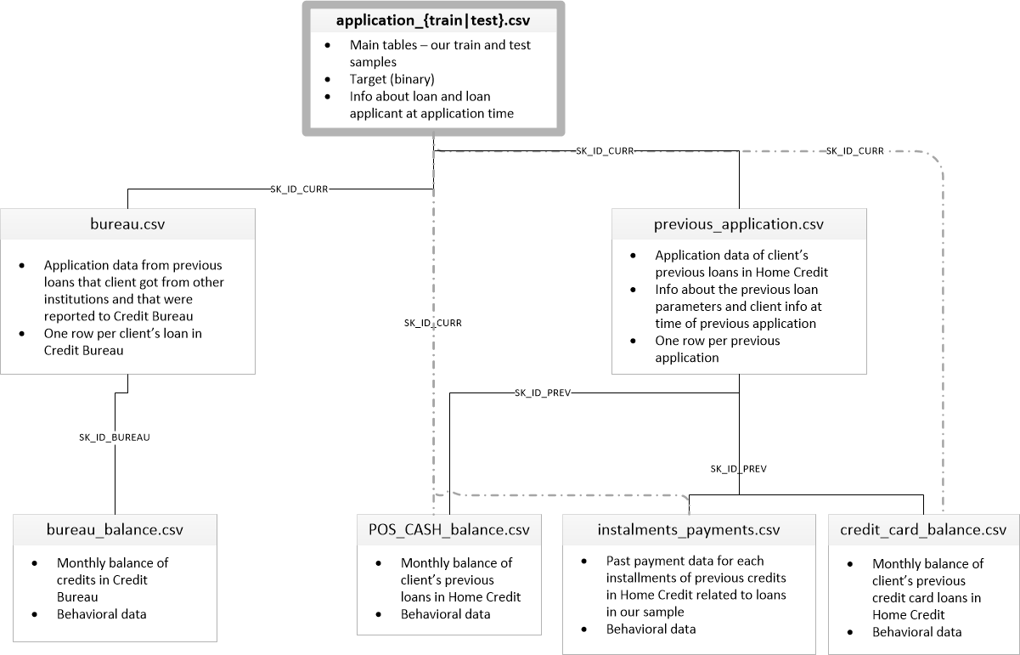

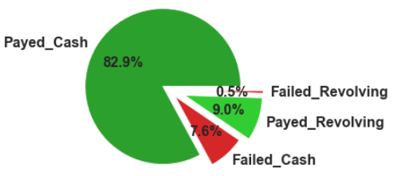
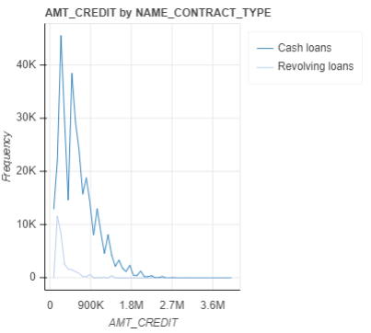
Inputs: overview
Target meaning:
1 - client with payment difficulties: he/she had late payment more than X days on at least one of the first Y installments of the loan in our sample,
0 - all other cases
Profile & Anteriority knowledge: 7 data sources
Loan’s description
+ Client’s profile
1st level
Failure rates:
Global : 8.07%
Revolving 5.48%
Cash 8.35%
“External” loans
“Internal” loans
both loans
both loans
Client’s both loans' knowledge (81.63 %).
2nd level
Credit Amounts:
“Revolving” loans implies lower amounts and ability to cut down further non repaid expenses than for “Cash” loans.
Client’s “internal” applications incl. rejected (95.03 %)
“Cash”
Client’s “external” loans (85.84 %)
3rd level
“Revolving”
Kaggle Kernel re-use: limitations
While Competitors focus on max score “by any means”, we must provide interpretable decisions, including the possibility given to customers to explore their case.
Notes:
La cible est une information binaire qui vaut 1 que lorsqu’un client a connu un défaut de payement (failure) durant plus de X jours pendant les Y premiers remboursements.
Les taux de défauts (failure rates) concernent environ 8% des cas, avec une prévalence des prêts classiques dits ‘cash loans’ sur les prêts dits ‘revolving loans’ (en français renouvelable : lorsque l’organisme met à disposition une somme d’argent réutilisable au fur et à mesure du remboursement, pour effectuer des achats non prédéfinis).
On note qu’on refuse 2 fois plus de demandes que ne l’indiquerait le taux de défauts observés.
Le risque lié à un défaut de remboursement semble moindre dans le cas de prêts renouvelables.
Ces derniers engagent des moindres sommes, et offrent une possibilité d’interruption permettant de limiter les dommages financiers.
Dans ce contexte, nous allons considérer que le couple {X, Y} est décliné de façon à équilibrer pour les 2 types de prêts cette notion de risque associé à un défaut (target = 1).
Une perspective serait d’étudier de façon distincte ces 2 cas de figures.
Les données sources détaillent :
- le « profil » du client et la description du prêt qu’il sollicite,
- l’antériorité interne et externe éventuellement disponible.
Décision :
Le réemploi de kernels kaggles demandé peut représenter un gain de temps substantiel dans l’avancement du projet. Toutefois, cela peut conduire à handicaper la bonne marche du projet. En particulier, tandis que les compétiteurs se focalisent sur l’obtention du meilleur score par tous les moyens, nous devons construire une démarche interprétable et même nous efforcer de rendre transparente l’exploitation du machine learning.
En ce sens, le Feature Engineering et l’étape de Feature Selection font partie intégrante de l’approche de modélisation.

Slide 6
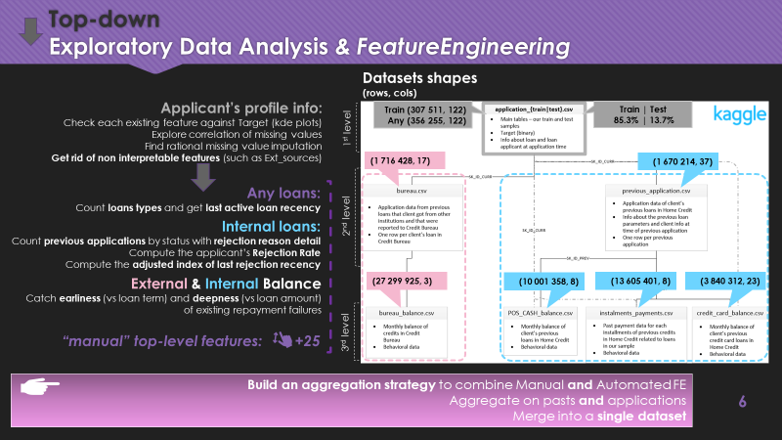
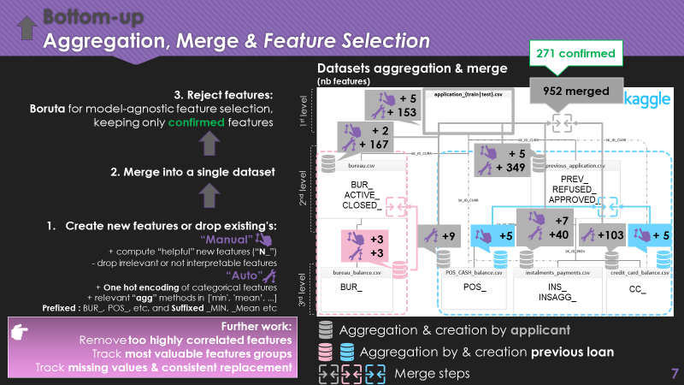
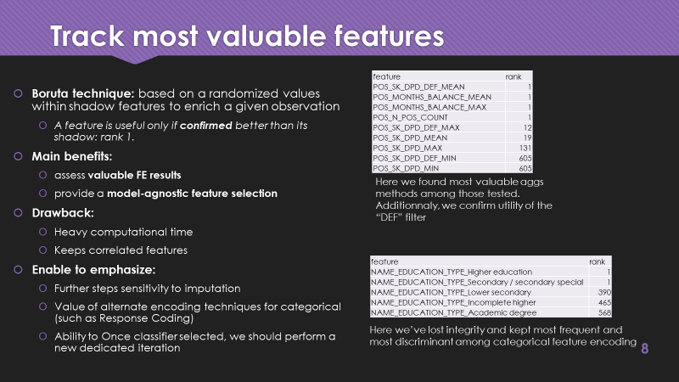
Inputs: analysis & enhancement
interdependence
1. Top-Down
EDA & Manual FE
2. Bottom-Up
Manual & Auto FE & Aggregation
3. Model-agnostic Feature Selection
Further work:
Iterate according to best classifier’s features importance
Take into account interpretability feedbacks
Model
+
Interpretation

Slide 7
Top-down Exploratory Data Analysis & FeatureEngineering
Datasets shapes (rows, cols)
Applicant’s profile info:
Check each existing feature against Target (kde plots)
Explore correlation of missing values
Find rational missing value imputation
Get rid of non interpretable features (such as Ext_sources)
Train (307 511, 122)
Any (356 255, 122)
Train | Test
85.3% | 13.7%
1st level
(1 716 428, 17)
(1 670 214, 37)
Any loans:
Count loans types and get last active loan recency
Internal loans:
Count previous applications by status with rejection reason detail
Compute the applicant’s Rejection Rate
Compute the adjusted index of last rejection recency
2nd level
External & Internal Balance
Catch earliness (vs loan term) and deepness (vs loan amount) of existing repayment failures
(27 299 925, 3)
(10 001 358, 8)
(13 605 401, 8)
(3 840 312, 23)
“manual” top-level features: +25
3rd level
Build an aggregation strategy to combine Manual and Automated FE
Aggregate on pasts and applications
Merge into a single dataset

Slide 8







Bottom-up Aggregation, Merge & Feature Selection
270 confirmed
Datasets aggregation & merge (nb features)
3. Reject features:
Boruta for model-agnostic feature selection,
keeping only confirmed features
952 merged
+ 5
+ 153
1st level
+ 2
+ 167
+ 5
+ 349
2. Merge into a single dataset
BUR_
ACTIVE_
CLOSED_
PREV_
REFUSED_
APPROVED_
2nd level
+7
+40
Create new features or drop existing's:
“Manual”
+ compute “helpful” new features (“N_”)
- drop irrelevant or not interpretable features
“Auto”
+ One hot encoding of categorical features
+ relevant “agg” methods in ['min', 'mean’, ...]
Prefixed : BUR_, POS_, etc, and Suffixed _MIN, _Mean etc
+103
+ 5
+3
+3
+9
+5
3rd level
BUR_
POS_
INS_
INSAGG_
CC_
Further work:
Remove too highly correlated features
Track most valuable features groups
Track missing values & consistent replacement
Aggregation & creation by applicant
Aggregation by & creation previous loan
Merge steps

Slide 9
Track most valuable features
Boruta technique: based on a randomized values within shadow features to enrich a given observation
A feature is useful only if confirmed better than its shadow: rank 1.
Main benefits:
assess valuable FE results
provide a model-agnostic feature selection
Drawback:
Heavy computational time
Keeps correlated features
Enable to emphasize:
Further steps sensitivity to imputation
Value of alternate encoding techniques for categorical (such as Response Coding)
Ability to Once classifier selected, we should perform a new dedicated iteration
feature | rank
POS_SK_DPD_DEF_MEAN | 1
POS_MONTHS_BALANCE_MEAN | 1
POS_MONTHS_BALANCE_MAX | 1
POS_N_POS_COUNT | 1
POS_SK_DPD_DEF_MAX | 12
POS_SK_DPD_MEAN | 19
POS_SK_DPD_MAX | 131
POS_SK_DPD_DEF_MIN | 605
POS_SK_DPD_MIN | 605
Here we found most valuable aggs methods among those tested. Additionnaly, we confirm utility of the “DEF” filter
feature | rank
NAME_EDUCATION_TYPE_Higher education | 1
NAME_EDUCATION_TYPE_Secondary / secondary special | 1
NAME_EDUCATION_TYPE_Lower secondary | 390
NAME_EDUCATION_TYPE_Incomplete higher | 465
NAME_EDUCATION_TYPE_Academic degree | 568
Here we’ve lost integrity and kept most frequent and most discriminant among categorical feature encoding

Slide 10
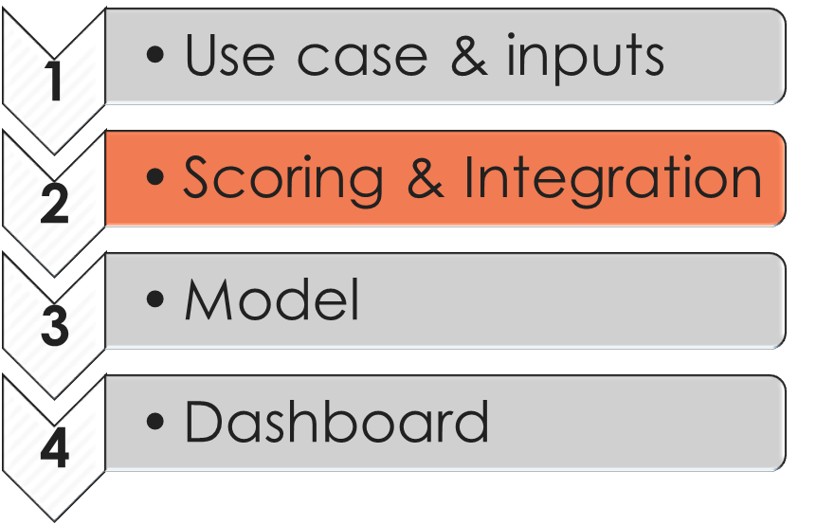
Table of contents
1
Use case & inputs
2
Scoring & Integration
3
Model
4
Dashboard

Slide 11



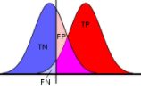

Scoring & integration
According to the target definition 1 - client failed to repay loan, 0 – no difficulty:
Trusting a negative prediction in case of tn: true negative is usual business, but a fn: false negative means exposure to a higher risk of defaults.
Trusting a positive prediction in case of tp: true positive is usual business, but a fp: false positive means losing a “good” client.
→ We want to minimize (fn + fp), with higher interest on fn
Confusion Matrix | Actual 0 Good | Actual 1 Bad
Predict 0 Good | tn Usual business | fn High risk exposure
Predict 1 Bad | fp Loose clients | tp Usual business
- The Confusion Matrix -
1. a classifier is basically as good as its Area under ROC Curve is large
2. Given a certain classifier, we can tune threshold initially set to 0.5, in order to optimize confusion matrix
3. Minimizing fn will consequently increase fp and implies to monitor another score, such as an Fbeta
predict_probas
0: no difficulty 1: fail
1
With : . Precision = tp / (tp + fp)
. Recall = tp / (tp + fn)
Sensitivity
tp / (tp + fn)
random classifier
Best Worst
Lower:
Less fn more fp
Higher recall
Less precision
Higher:
Less fp more fn
Higher precision
Lower recall
0
1 – specificity
1 - tn / (tn + fp)
1
Best value of threshold will depend on value of beta, which approximately measure the n times more important are the damage
- The ROC Curve -
- Threshold adjustment -
- Alternate scoring, to find the “best threshold” -

Slide 12
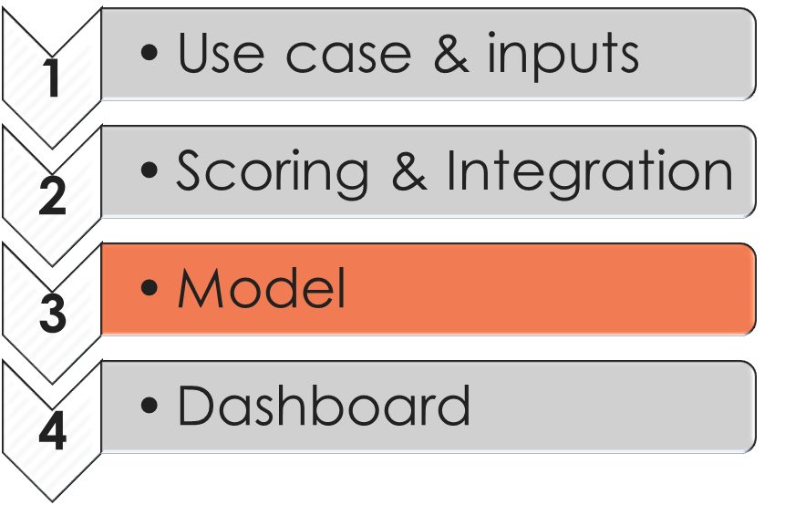
Table of contents
1
Use case & inputs
2
Scoring & Integration
3
Model
4
Dashboard

Slide 13

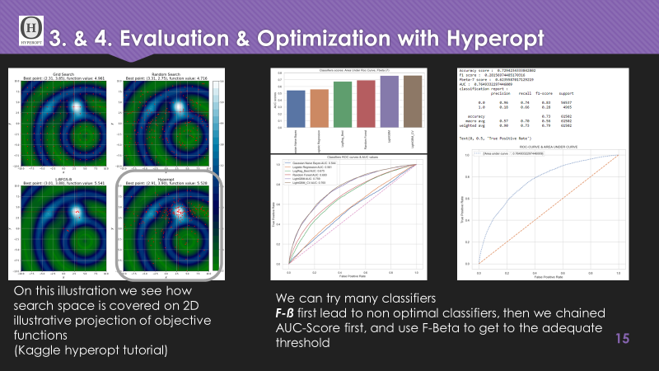
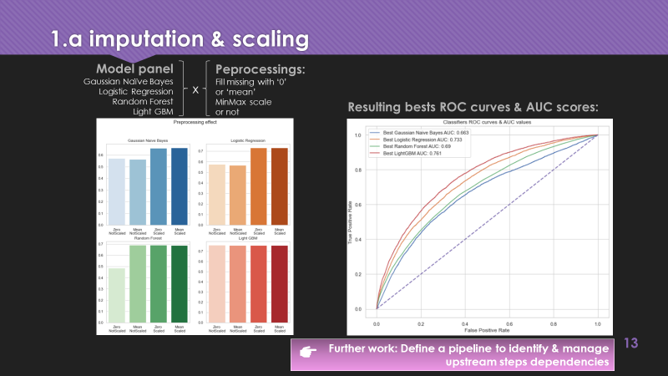
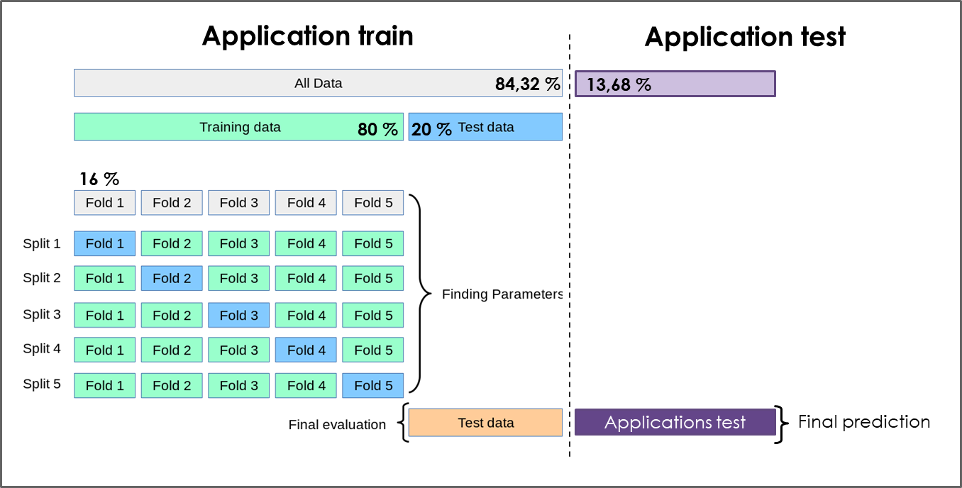
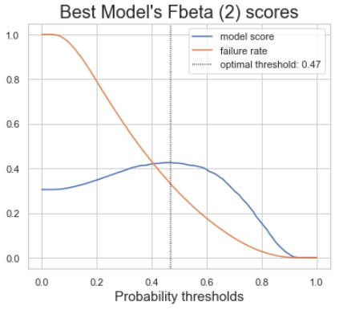
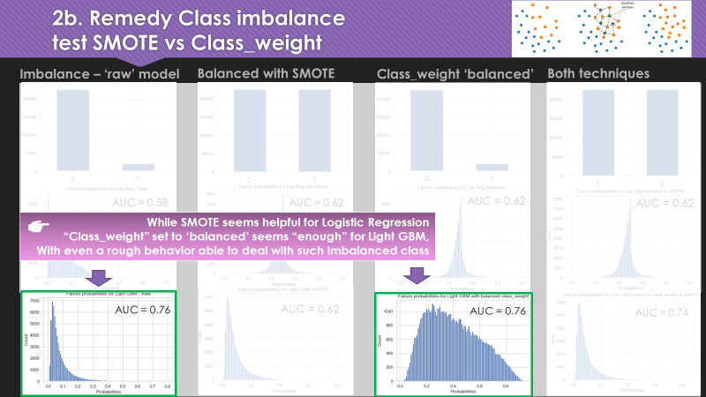
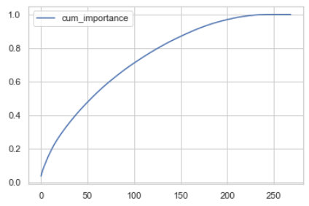
Find the best model: process
1. Assess preprocessing relevance
2. Classifiers evaluation & hyperparam tuning
3. Focus on LightGMB hyperparameters optimization
4. Train best & determine “best” threshold via domain optimization
imputation, scaling
a. Broaden search with any classifier
Best : LGBMClassifier
AUC score: 0.7646
Cross-validation
b. Class imbalance remediation
b. “chain” objective functions
Simplification by cumulative feature importance
1. AUC
2. F-ß
- Threshold trade-off –
Failure rate versus best Fbeta

Slide 14
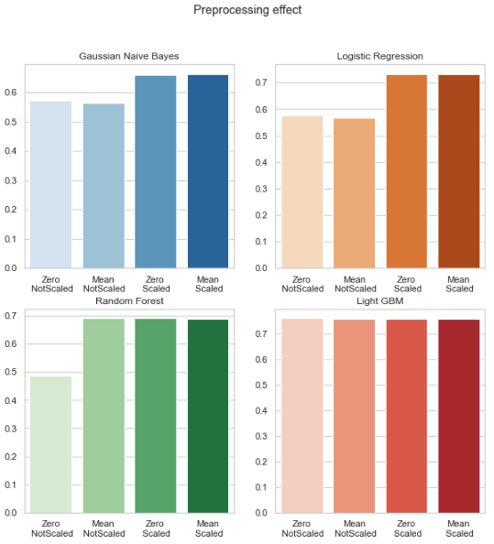
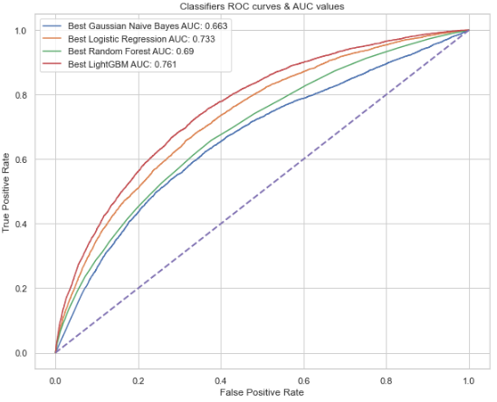
1.a imputation & scaling
Model panel
Gaussian Naïve Bayes
Logistic Regression
Random Forest
Light GBM
Peprocessings:
Fill missing with ‘0’
or ‘mean’
MinMax scale
or not
x
Resulting bests ROC curves & AUC scores:
Further work: Define a pipeline to identify & manage
upstream steps dependencies

Slide 15

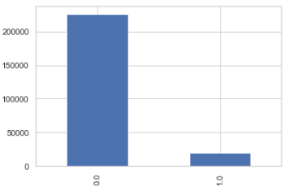
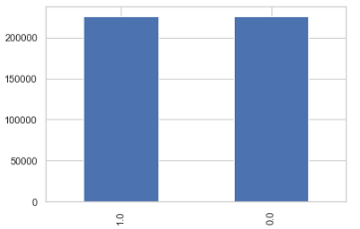
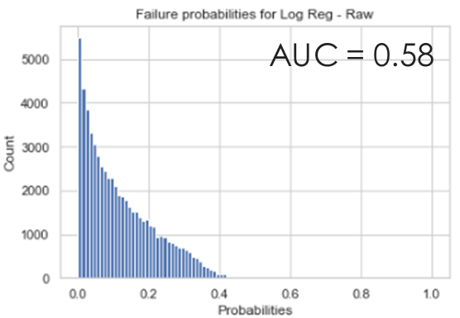
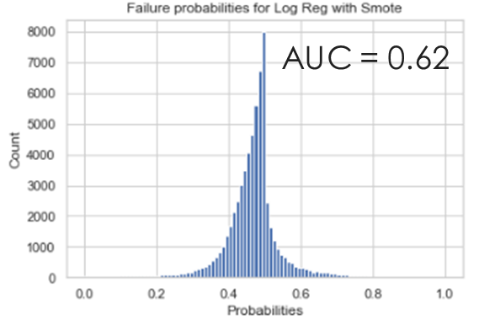
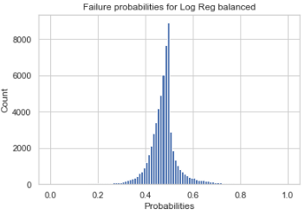
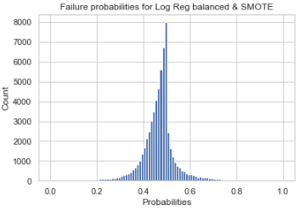
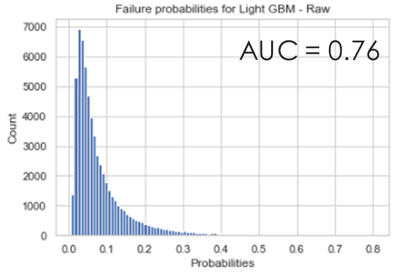
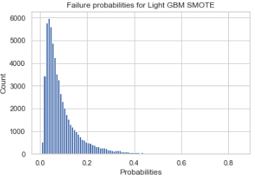
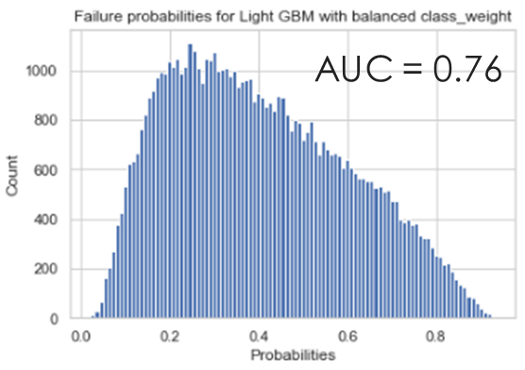
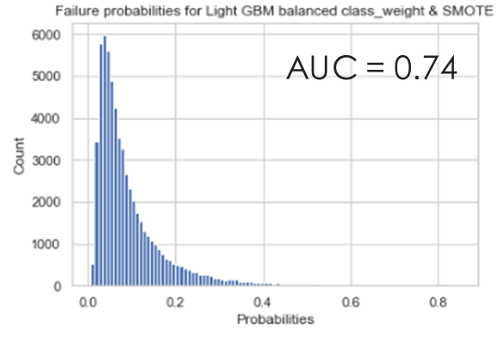
2b. Remedy Class imbalance test SMOTE vs Class_weight
Imbalance – ‘raw’ model
Balanced with SMOTE
Class_weight ‘balanced’
Both techniques
AUC = 0.62
AUC = 0.62
While SMOTE seems helpful for Logistic Regression
“Class_weight” set to ‘balanced’ seems “enough” for Light GBM,
With even a rough behavior able to deal with such imbalanced class
AUC = 0.62

Slide 16
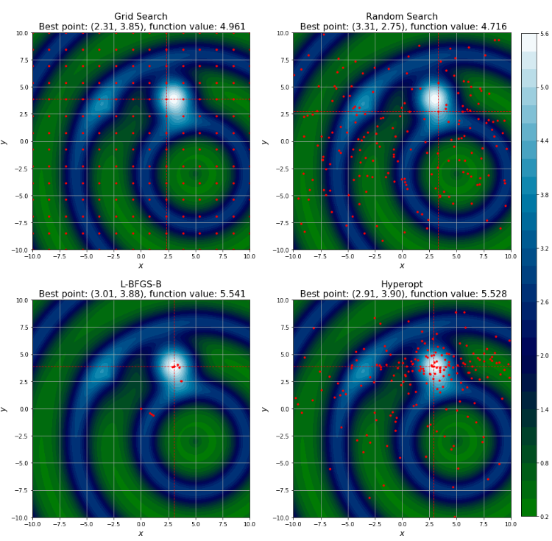
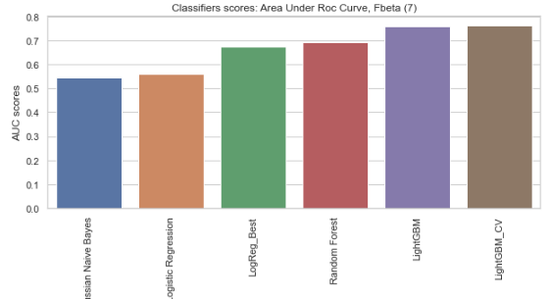
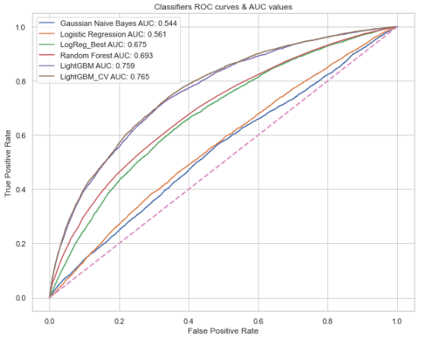
3. & 4. Evaluation & Optimization Hyperopt with CV
Best model:
LGBMClassifier
(boosting_type='goss', class_weight='balanced', learning_rate=0.019…,
max_depth=23,
n_estimators=610,
num_leaves=52)
Best AUC score: 0.7646
With Fbeta score (7): 0.6118
+ Confirmed on 80% model cumulative importance (125 features)
Best AUC score: 0.764
With Fbeta score (7): 0.6105
Imputed by mean, unscaled
On this illustration we see how search space is covered on 2D illustrative projection of objective functions
(Kaggle hyperopt tutorial)
We can try many classifiers
F-ß first lead to non optimal classifiers, then we chained
AUC-Score first, and use F-ß
to find best threshold

Slide 17
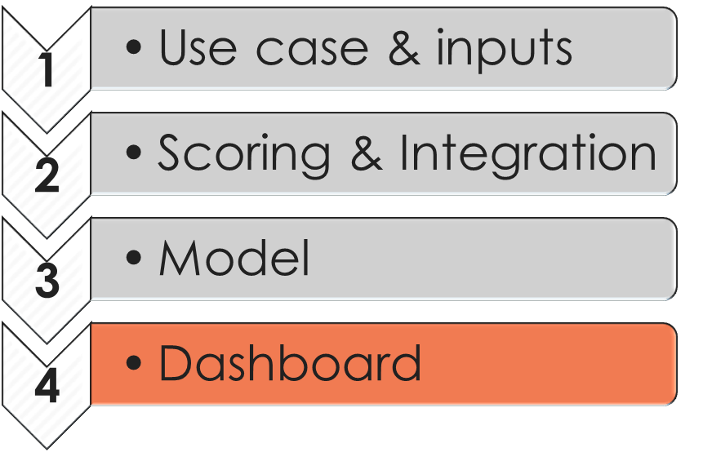
Table of contents
1
Use case & inputs
2
Scoring & Integration
3
Model
4
Dashboard

Slide 18


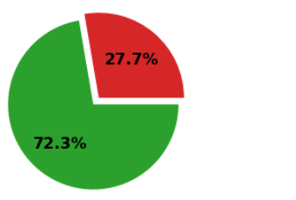

Go back to the Use Case
?
!
Application Analysis
Decision
Application
Interpretability
study of model interpretability, to enable business goals such as :
Assess predictions vs reality,
Challenge usual rules with model interpretations,
Define and test risk mitigation actions.
Providing a Dashboard
2
Dashboard
1
Done! now open the Black Box
Predict “0”
Good
Y
N
Predict “1”
Bad
Predicted
AUC 0.76
observed
observed
Risk
Machine Learning
No Risk
Dashboard
Thresholding as a trade-off

Slide 19
Build Dashboard
Requirements:
Visualize client’s application prediction and its interpretation.
Visualize client’s application details
Compare those detail with any applications or similar applications
Prototype:
Adjust threshold and check failure rate (Supervisor mode): function to actualize predictions
Display samples from both Class (Demo mode only)
Filter client’s application and display details (Analyst mode)
Provide features plain text description (any mode)
Display SHAP interpretation (Analyst mode) : passive results
Display LIME interpretation (Analyst mode) : interactive results
Select the number of features to analyse (sorted by importance)
Select the size of neighborood (number of similar applications)
Compare client’s detail with mean of Class 0, Class 1 and similar applications
Further work :
Tune the current application (Analyst mode
Rename features & update full description

Slide 20
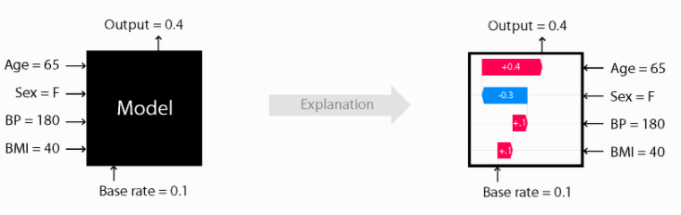
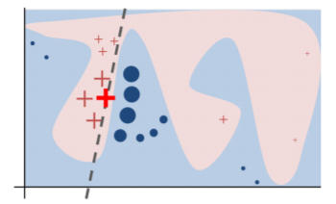
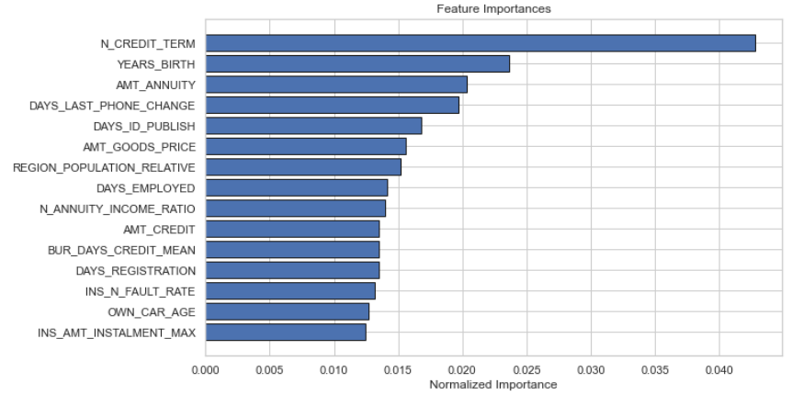
Dashboard: interpretability with “explainers”
Model Interpretability Does Not Mean Causality
1. A first step in the field of interpretability comes with the model’s features importance. This global insight is not enough for an individual application study.
2. To enable local interpretability let’s introduce LIME and SHAP techniques
SHAP
LIME
LightGBM most important features
Explainer != f(model)
samples with distance-weight to provide a local interpretation
Dedicted packages for text, image, etc.
Explainer f(model)
average of the marginal contributions across all permutations (how heavy are the contribution of a feature to the loss).
Enable global and local interpretability
compatible with tree-based model
Gini Importance, or Mean Decrease in Impurity, summed over the number of splits (accross all tress) that include the feature, proportionaly to the number of samples it splits.
https://shap.readthedocs.io/
https://lime-ml.readthedocs.io/
https://arxiv.org/pdf/1602.04938.pdf
Notes:
Gini Importance or Mean Decrease in Impurity (MDI) feature importance as the sum over the number of splits (accross all tress) that include the feature, proportionaly to the number of samples it splits.

Slide 21
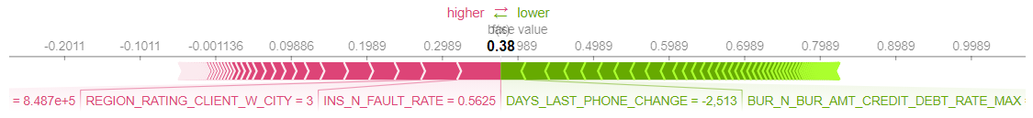
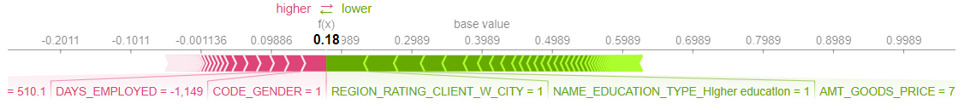
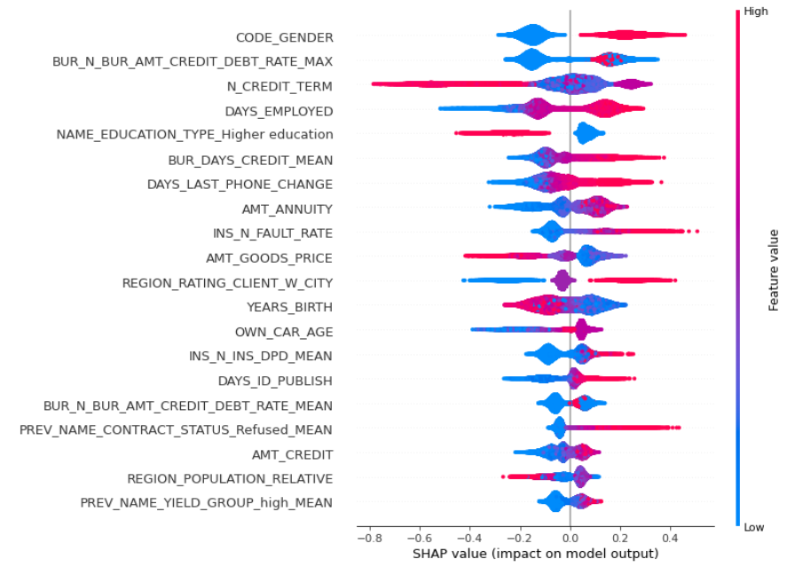
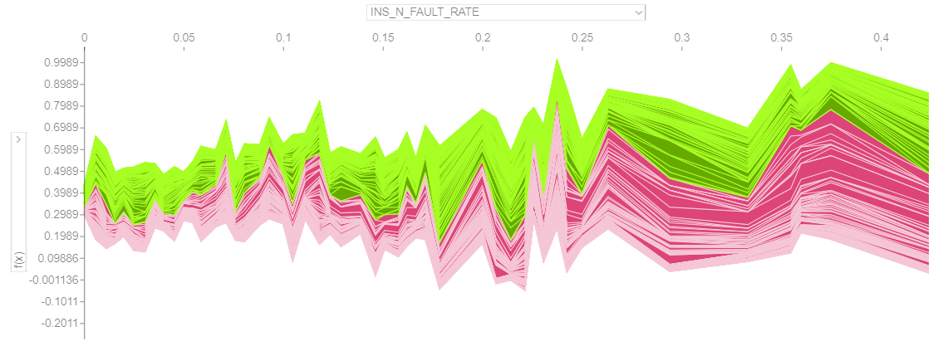
SHapley Additive exPlanations
Force plot of class 1 - Individual
#149596 : 0,42 vs 0,58
Force plot of class 1 - Collective
Summary plot of class 1 - Collective
Force plot – collective (sample 500)
Case of the previous instalments fault rate

Slide 22
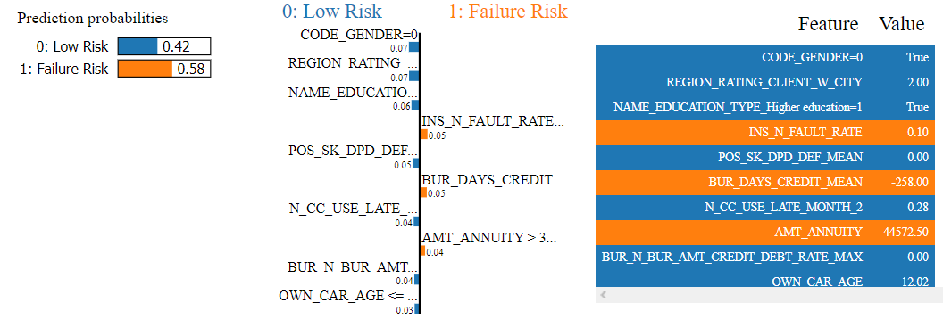
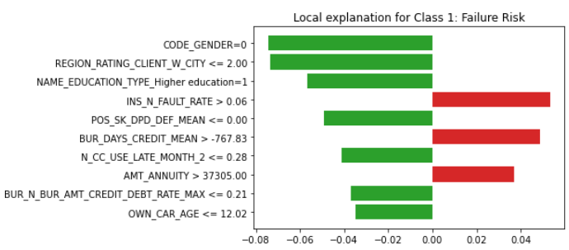
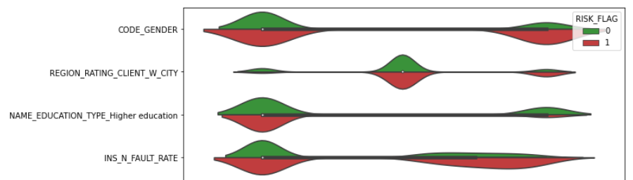
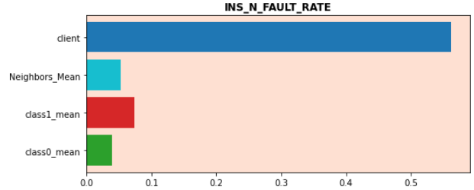
Local Interpretable Model-Agnostic Explanations
Explanation as shown in notebook - Individual
Explanation as plot figure – Class 1
# 149596
#149596
102068
# 149596
Usually Green for Class support, but in our case Class 1 is Risk of failure
contradicts
supports
Interpretation
Overal values distribution, by class
Comparison with Class 0, 1 and similar application
# 149596
While having “good” values for the first three features
Client default rate on past instalments is redhibitory

Slide 23
Build Dashboard
Deploy:
Local host
Remote (github):
inputs
+ app.py
get inputs
make pipeline
Sidebar
Mainframe
Inputs:
Data
Applications
Descriptions
Model
Shap
Explainer
Values
Nb. Nothing to serialize for LIME

Slide 24

Application train
Application test
84,32 %
13,68 %
80 %
20 %
16 %
Applications test
Final prediction

