Slide 1

Cash & Revolving loans for clients with no or few loans history
Aim is to develop a scoring model of the applicant’s risk of failure to repay loan, with prediction interpretation, through an interactive dashboard, to argue whether loan is granted or rejected and help studying why.

Slide 2
Table of contents
EDA, FE & FS (
Model
Scoring (& threshold?)
Upstream steps strategies: impute, scale, class balance
Testing across models & models param : hyperopt
Auc Objective
Fbeta score Objective
Perspectives : embed FS, thresholding pred proba, pipeline incl. upstream
Dashboard
Interpretability

Slide 3


















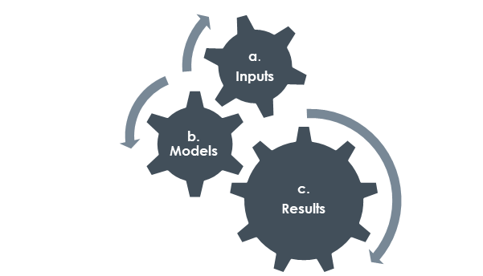
Use case
Growth intentions,
Key rates,
Economic health, …
Clients
Global Business Context
?
!
Application Analysis
Application
Decision
Scoring Model
& Interpretability
Our actual anteriority* client’s knowledge is a combination of:
Client’s profile only (no previous loans, 0.76%, 0.44% in test set and 0.81% in train set),
and optionally:
Client’s “external” loans (85.84%)
Client’s “internal” loans* (95.03%),
Client’s both loans' knowledge (81.63%).
* 8 years sliding from current application
** incl. previous rejected applications
Model Interpretability
Predict “0”
Good
Y
N
Predict “1”
Bad
Machine Learning

Slide 4
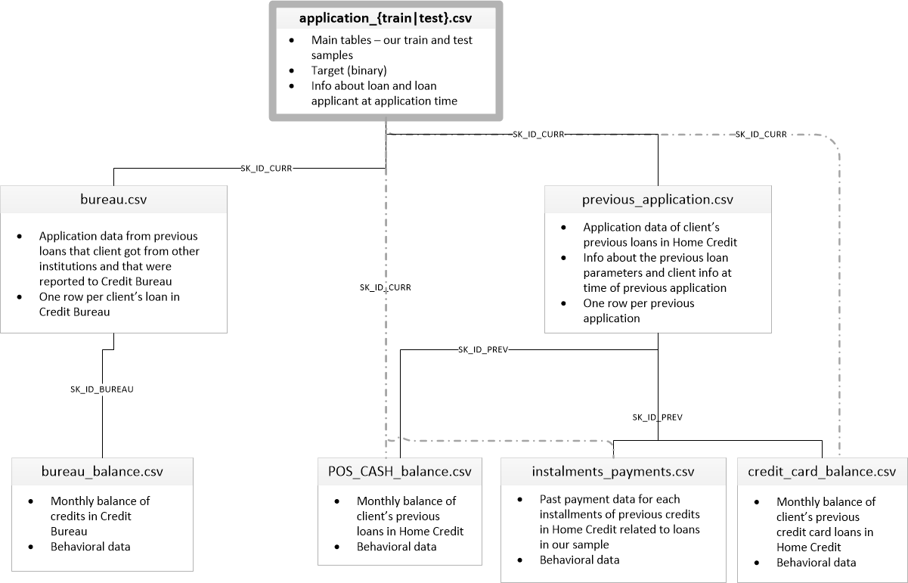

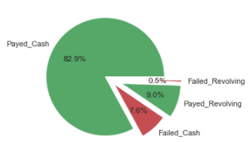
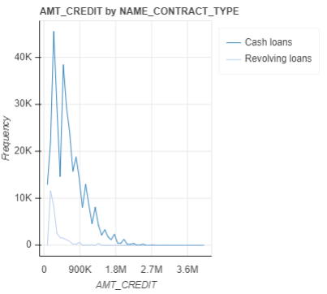
EDA
Target variable :
1 - client with payment difficulties: he/she had late payment more than X days on at least one of the first Y installments of the loan in our sample,
0 - all other cases
Loan’s description
+ Client’s data
{train|test}
1st level
Target Imbalance – by NAME_CONTRACT_TYPE
Failure rates :
Global : 8.07%
Revolving 5.48%
Cash 8.35%
“External” loans
“Internal” loans
2nd level
Credit Amounts
“revolving” loans implies lower amounts and ability to cut down further non repaid expenses than for “cash” loans.
“cash”
3rd level
“revolving”
months balance
(DPD status only)
months balance
(DPD status only)
months balance
(DPD status only)

Slide 5
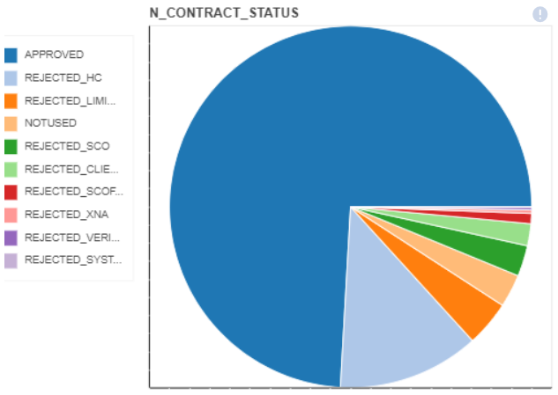
From 3rd level to 1st level:
sk_id_installments, sk_id_focus_credit_balance, sk_id_card_balance
special sk_id_installments_agg build from installments_agg (by previous loan – level 2),
From 3rd level up to 2nd level:
Concat of credit_balance_agg & card_balance_agg, merged with previous loan
From 2nd to 1st level :
sk_id_previous_clean (missing agg removed)
From 3rd to 2nd to 1st level:
bureau_balance agg to bureau then sk_id_burea.

Slide 6
Features Engineering insights
N_BUR_EARLINESS_OVERDUE_RATIO : External loans early failure, calculated on the earliest failed month balance status, normalized with loan duration (0 : no failure, 1: early failure)
Calculated across any loan type.
N_BUR_AMT_CREDIT_DEBT_RATE :

Slide 7
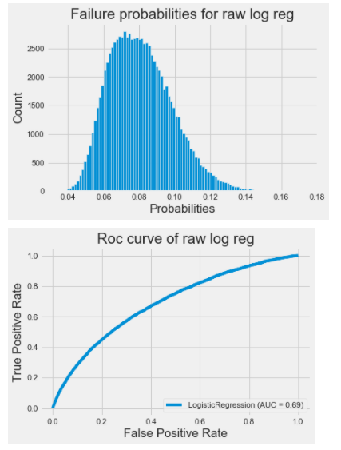
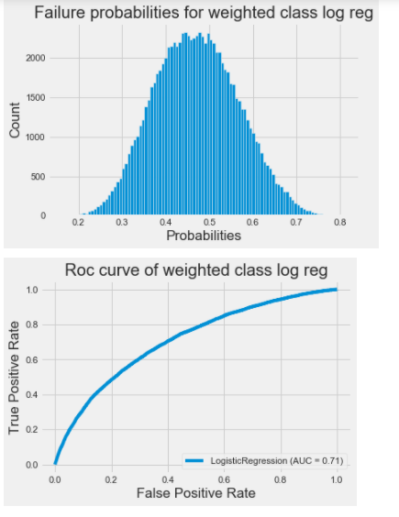
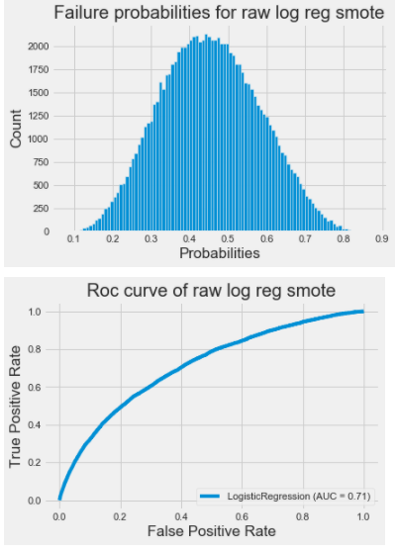
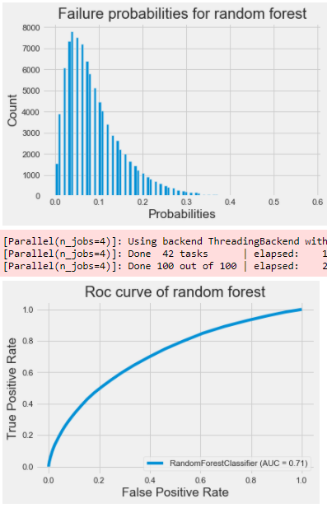
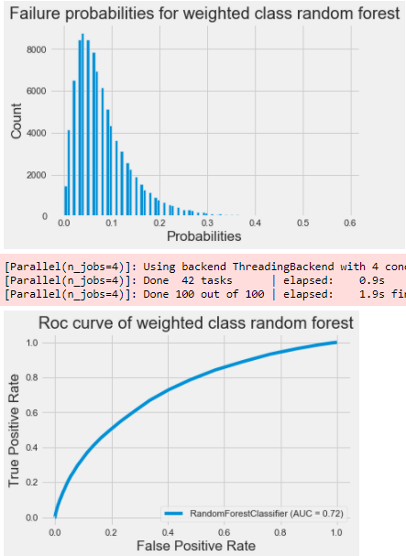
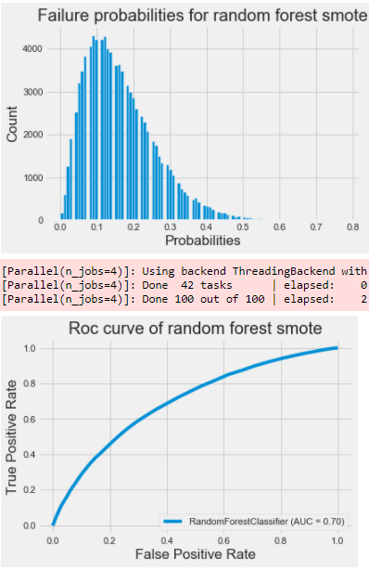
Class_weight=‘balanced’ versus Smote
Logistic regression:
Using balanced class_weight or smote helps improve AUC by a few %
Random forest:
Using balanced class_weight helps improve AUC by a few %
While smote decrease AUC by approx. the same %
AUC 0,71
AUC 0,72
AUC 0,70

Slide 8


Model scoring
Confusion Matrix | Actual 0 Good | Actual 1 Bad
Predict 0 Good | tn Usual business | fn High risk exposure
Predict 1 Bad | fp Loose clients | tp Usual business
“raw” | Actual Good | Actual Bad
Predicted Good | tn 78676 | fn 5546
Predicted Bad | fp 6129 | tp 1902
- 7
1
1
- 1
“Balanced class_weight” | Actual Good | Actual Bad
Predicted Good | tn 54837 | fn 2492
Predicted Bad | fp 29968 | tp 4956
“SMOTE” | Actual Good | Actual Bad
Predicted Good | tn xx | fn xx
Predicted Bad | fp xx | tp xx

Slide 9
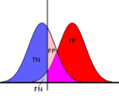

Best model (tuning & selection)
According to the target definition, (1 - client with difficulty to repay loan, 0 – no difficulty):
Trusting a negative prediction in case of tn: true negative is usual business, but a fn: false negative means exposure to a higher risk of defaults.
Trusting a positive prediction in case of tp: true positive is usual business, but a fp: false positive means losing a “good” client.
This mean Recall (or Sensitivity) is n times more important than Precision (1-)
Sensitivity = tp / (tp + fn)
Given a certain classifier (top AUC score), we could tune decision threshold to minimize fn and this will increase consequently fp
1
random classifier
Best Worst
0
1 – specificity
Or 1 - tn / (tn + fp)
1

Slide 10
Model
Best_model
LogisticRegression(C=0.07843860221395219, class_weight='balanced', max_iter=979,
solver='liblinear', tol=3.5415873409699916e-05)
AUC score: 0.7102
Fbeta score (7): 0.6146

Slide 11
LATE_PAYMENT
LATE_PAYMENT feature: I think most of you used installment['DAYS_INSTALMENT']-installment['DAYS_ENTRY_PAYMENT'] as a new feature since it shows number of delays. It was a already good feature but I realized that, when you take last 365 days of installment data and aggregate this delay as a new feature, it added much more value to model. Here is a simple code:
installment_temp = installment[installment.DAYS_ENTRY_PAYMENT >= -365]
installment_temp['LATE_PAYMENT'] = installment_temp['DAYS_INSTALMENT']-installment_temp['DAYS_ENTRY_PAYMENT']
late_payment_feature = installment_temp.groupby('SK_ID_CURR')[['LATE_PAYMENT']].min().reset_index()

Slide 12
Debt ratio
Most important buraeu feature: Debt ratio was the most important feature I found in bureau file. I also tried using more recent bureau data for this feature but it was the best when I used all data.
buro['DEBT_RATIO']=buro['AMT_CREDIT_SUM_DEBT']/buro['AMT_CREDIT_SUM']
debt_ratio_feature = buro.groupby('SK_ID_CURR')['DEBT_RATIO'].max()

Slide 13
Interest Rate Features / previous
Interest rate seems to be an important feature in predicting loan default.(You can see this from the lending club dataset) We were not given interest rate directly in either Main Application data or Previous Application data but we could approximate it:
Previous Application - The key thing here is that AMT_ANNUITY includes interest. Based on AMT_CREDIT, AMT_ANNUITY, and CNT_PAYMENT we can derive interest rate.
prev_app['INTEREST'] = prev_app['CNT_PAYMENT']*prev_app['AMT_ANNUITY'] - prev_app['AMT_CREDIT']
prev_app['INTEREST_RATE'] = 2*12*prev_app['INTEREST']/(prev_app['AMT_CREDIT']*(prev_app['CNT_PAYMENT']+1))
prev_app['INTEREST_SHARE'] = prev_app['INTEREST']/prev_app['AMT_CREDIT']
Then by calculating max, min, mean of features above for each customer, I got several top features for Previous Application table.

Slide 14
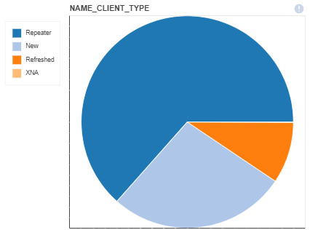
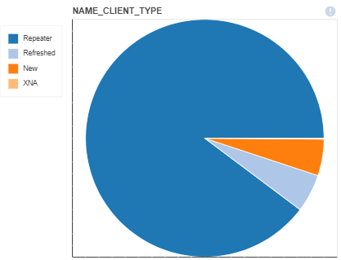
Approved or Refused by Client_Type
approved
refused

Slide 15
Bureau & bureau_balance
After first sight on entire dataset, we keep only valuable info to dig deeper.
Fail lead to either overdue only, or a debt
Bureau :
Current overdue (age is given by DAYS_CREDIT_UPDATE) is given by :
CREDIT_DAY_OVERDUE
N_CREDIT_OBS_WINDOW is approx. : DAYS_CREDIT – DAYS_CREDIT_UPDATE
AMT_CREDIT_SUM (AMT_CREDIT_SUM = AMT_CREDIT_SUM_LIMIT + AMT_CREDIT_SUM_DEBT)
Consider the DEBT rate : bureau['AMT_CREDIT_DEBT_RATE'] = bureau['AMT_CREDIT_SUM_DEBT']/(1 + bureau['AMT_CREDIT_SUM'])
Bureau_balance:
Count month balance status
Typical behaviour is C, …, C, I, …, I, X when closed since C count vals & without failure if I == 0
X_norm == 1 : drop SK_ID_BUREAU (because unknown)
no C should mean Active credit.
Sum(I + X) count should mean Credit duration.

Slide 16
Other insights
• CNT stands for “count”, like CNT_CHILDREN
• AMT stands for “amount”, mostly use for monetary
• FLAG stands for boolean with 1 is yes. FLAG_DOCUMENT means loan applicant have to submit some documents like income proof, and this flag customer actual submitted or not.
• OBS stands for “observation”, also means “is it time for?”.
• DEF stands for “actual default”.
• Different between OBS and DEF (like OBS_30_CNT_SOCIAL_CIRCLE) is that OBS is flagging “is it time for that event to be eligible to happen”, while DEF is that “is it eligible to happen AND actually happened”.
• DAYS stands for “number of days”
• NUM stands for “sequence number”
• x-sell means customers already evaluated risk by previous loans (loans in HC even before previous_application), before giving the loan. This is very valuable feature.
bureau_balance.csv - MONTHS_BALANCE - Month of balance relative to application date (-1 means the information to the freshest monthly snapshot, 0 means the information at application - often it will be the same as -1 as many banks are not updating the information to Credit Bureau regularly)
POS_CASH_balance.csv - MONTHS_BALANCE - Month of balance relative to application date (-1 means the freshest balance date)
Dataset POS_CASH_BAL contains monthly snapshots of previous loans
MONTHS_BALANCE - denotes the number of months relative to the current application (i.e. the loan is being repaid with increasing MONTHS_BALANCE, in other words MONTH_BALANCE is becoming less negative)
CNT_INSTALMENT - denotes the total number of installments (term of the loan). This number may decrease if the client early repays the loan or increase in case of payment difficulties and change of the installment schedule
CNT_INSTALMENT_FUTURE - denotes the number of installments to be paid
NAME_CONTRACT_STATUS - changes when the contract moves to another status (e.g. typically from active to completed when the loan is repaid)

