Slide 1

Cash & Revolving loans for clients with no or few loans history
P7 Datascientist – OpenClassrooms
Etienne Lardeur
Mentor : Xavier Tizon
Aim is to develop a scoring model of the applicant’s risk of failure to repay loan, with prediction interpretation, through an interactive dashboard, to argue whether loan is granted or rejected and help studying why.

Slide 2
Table of contents
Use case
Data Feature Engineering & “model-agnostic” Feature Selection
Model
Scoring method (& use of prediction threshold)
Upstream steps strategies: impute, scale, class balance
Testing across models & models param : hyperopt
Auc Objective
Fbeta score Objective
Perspectives : embed FS, enable thresholding of predict proba, pipeline incl. upstream
Dashboard
Interpretability
1
Use case
2
Inputs
3
Scoring & Model
4
Dashboard

Slide 3



















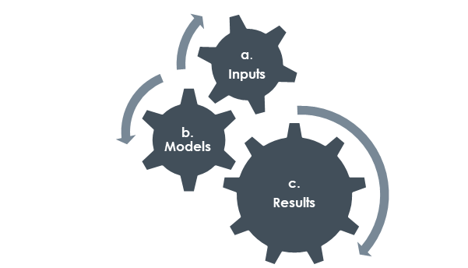

Use case
Growth intentions,
Key rates,
Economic health, …
Applicants
307 511 past
48 744 new
?
Global Business Context
!
No way to assess
Application
Application Analysis
Decision
Detect failure…
& learn from it !
(New)
Scoring Model
& Interpretability
Client’s profile
& payment difficulties 0/1 (Past)
Model Interpretability
Client’s “internal” applications incl. rejected (95.03 %)
In case of approval :
 Update anteriority
 Challenge prediction
+ Client’s “external” loans (85.84 %)
Predict “0”
Good
Y
N
Predict “1”
Bad
Client’s both loans' knowledge (81.63 %).
Machine Learning
Anteriority of 8 years
sliding from current application
Learn from the past
Warning : no time-stamp

Slide 4
Table of contents
Use case
Data Feature Engineering & “model-agnostic” Feature Selection
Model
Scoring method (& use of prediction threshold)
Upstream steps strategies: impute, scale, class balance
Testing across models & models param : hyperopt
Auc Objective
Fbeta score Objective
Perspectives : embed FS, enable thresholding of predict proba, pipeline incl. upstream
Dashboard
Interpretability
1
Use case
2
Inputs
3
Scoring & Model
4
Dashboard

Slide 5
Table of contents
Use case
Exporatory Data Analysis, Feature Engineering & “model-agnostic” Feature Selection
Model
Scoring method (& use of prediction threshold)
Upstream steps strategies: impute, scale, class balance
Testing across models & models param : hyperopt
Auc Objective
Fbeta score Objective
Perspectives : embed FS, enable thresholding of predict proba, pipeline incl. upstream
Dashboard
Interpretability

Slide 6
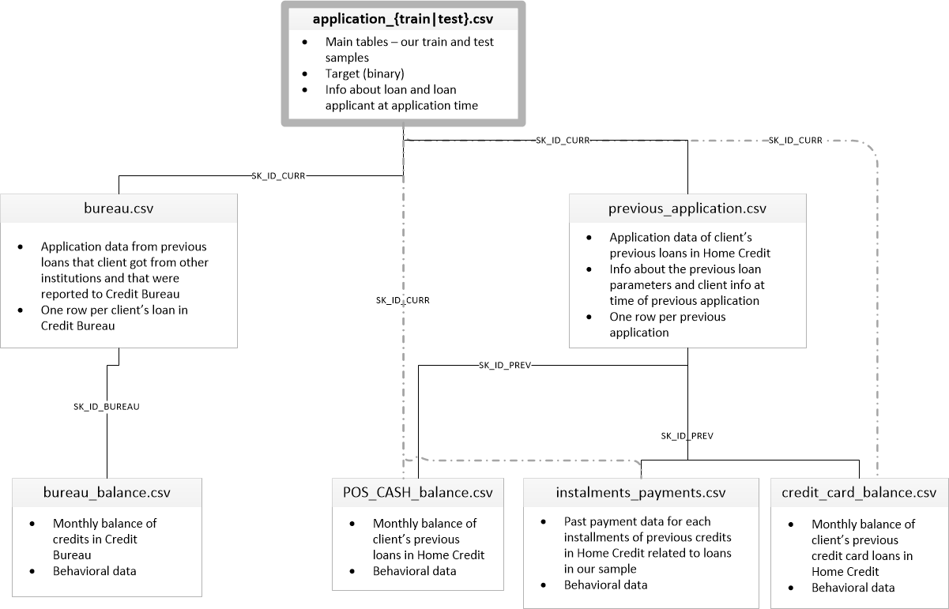

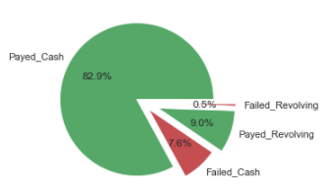
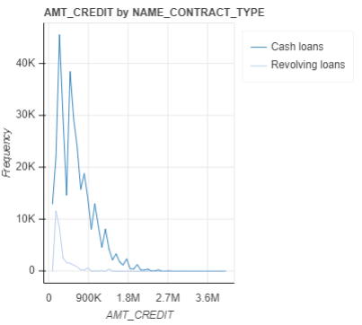
Home Credit Kaggle data & Kernels
Target meaning:
1 - client with payment difficulties: he/she had late payment more than X days on at least one of the first Y installments of the loan in our sample,
0 - all other cases
Profile & Anteriority knowledge: 7 data sources
Loan’s description
+ Client’s profile
1st level
Failure rates:
Global : 8.07%
Revolving 5.48%
Cash 8.35%
“External” loans
“Internal” loans
both loans
both loans
2nd level
Credit Amounts:
“Revolving” loans implies lower amounts and ability to cut down further non repaid expenses than for “Cash” loans.
“Cash”
3rd level
“Revolving”
Kaggle Kernel re-use: limitations
While Competitors focus on max score “by any means”, we must provide interpretable decisions, including the possibility given to customers to explore their case.

Slide 7
Top-down Exploratory Data Analysis & FeatureEngineering
Datasets shapes (rows, cols)
Applicant’s profile info:
Check each existing feature against Target (kde plots)
Explore correlation of missing values
Find rational missing value imputation
Get rid of non interpretable features (such as Ext_sources)
Train (307 511, 122)
Any (356 255, 122)
Train | Test
85.3% | 13.7%
1st level
(1 716 428, 17)
(1 670 214, 37)
Any loans:
Count loans types and get last active loan recency
Internal loans:
Count previous applications by status with rejection reason detail
Compute the applicant’s Rejection Rate
Compute the adjusted index of last rejection recency
2nd level
External & Internal Balance
Catch earliness (vs loan term) and deepness (vs loan amount) of existing repayment failures
(27 299 925, 3)
(10 001 358, 8)
(13 605 401, 8)
(3 840 312, 23)
“manual” top-level features: +25
3rd level
Build an aggregation strategy
Combine Manual and Automated FE
Aggregate on pasts and applications
Merge into a single dataset

Slide 8







Bottom-up Aggregation, Merge & Feature Selection
271 confirmed
Datasets aggregation & merge (nb features)
3. Reject features:
Boruta for model-agnostic feature selection,
keeping only confirmed features
940 merged
+ 6
+ 153
1st level
+ 2
+ 167
+ 5
+ 327
2. Merge into a single dataset
BUR_
ACTIVE_
CLOSED_
PREV_
REFUSED_
APPROVED_
2nd level
+7
+40
Create new features or drop existing's:
“Manual”
+ compute “helpful” new features (“N_”)
- drop irrelevant or not interpretable features
“Auto”
+ One hot encoding of categorical features
+ relevant “agg” methods in ['min', 'mean’, ...]
Prefixed : BUR_, POS_, etc, and Suffixed _MIN, _Mean etc
+103
+ 5
+3
+3
+9
+5
3rd level
BUR_
POS_
INS_
INSAGG_
CC_
Further work:
Track most valuable features groups
Track missing values & consistent replacement
Aggregation & creation by applicant
Aggregation by & creation previous loan
Merge steps

Slide 9
Table of contents
Use case
Data Feature Engineering & “model-agnostic” Feature Selection
Model
Scoring method (& use of prediction threshold)
Upstream steps strategies: impute, scale, class balance
Testing across models & models param : hyperopt
Auc Objective
Fbeta score Objective
Perspectives : embed FS, enable thresholding of predict proba, pipeline incl. upstream
Dashboard
Interpretability
1
Use case
2
Inputs
3
Scoring & Model
4
Dashboard

Slide 10
Track most valuable features
Forewords: Boruta is based on a randomized values within shadow features to enrich a given observation. A feature is useful only if confirmed better than the best randomized feature.
Here are a few examples of Boruta ranking : 1 is best
feature | rank
POS_SK_DPD_DEF_MEAN | 1
POS_MONTHS_BALANCE_MEAN | 1
POS_MONTHS_BALANCE_MAX | 1
POS_N_POS_COUNT | 1
POS_SK_DPD_DEF_MAX | 12
POS_SK_DPD_MEAN | 19
POS_SK_DPD_MAX | 131
POS_SK_DPD_DEF_MIN | 605
POS_SK_DPD_MIN | 605
feature | rank
PREV_PRODUCT_COMBINATION_Cash X-Sell: low_MEAN | 1
PREV_PRODUCT_COMBINATION_POS mobile with interest_MEAN | 21
PREV_PRODUCT_COMBINATION_Card Street_MEAN | 67
PREV_PRODUCT_COMBINATION_Cash_MEAN | 87
PREV_PRODUCT_COMBINATION_POS household without interest_MEAN | 130
PREV_PRODUCT_COMBINATION_Cash X-Sell: high_MEAN | 134
PREV_PRODUCT_COMBINATION_Cash Street: high_MEAN | 159
PREV_PRODUCT_COMBINATION_POS industry with interest_MEAN | 193
PREV_PRODUCT_COMBINATION_Cash X-Sell: middle_MEAN | 218
PREV_PRODUCT_COMBINATION_POS household with interest_MEAN | 232
PREV_PRODUCT_COMBINATION_Card X-Sell_MEAN | 250
PREV_PRODUCT_COMBINATION_POS industry without interest_MEAN | 258
PREV_PRODUCT_COMBINATION_Cash Street: low_MEAN | 283
PREV_PRODUCT_COMBINATION_Cash Street: middle_MEAN | 286
PREV_PRODUCT_COMBINATION_POS mobile without interest_MEAN | 347
PREV_PRODUCT_COMBINATION_POS other with interest_MEAN | 350
PREV_PRODUCT_COMBINATION_POS others without interest_MEAN | 482
PREV_PRODUCT_COMBINATION_nan_MEAN | 605

Slide 11



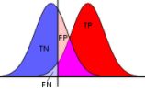

Find the best model: selection & tuning
According to the target definition 1 - client failed to repay loan, 0 – no difficulty:
Trusting a negative prediction in case of tn: true negative is usual business, but a fn: false negative means exposure to a higher risk of defaults.
Trusting a positive prediction in case of tp: true positive is usual business, but a fp: false positive means losing a “good” client.
→ We want to minimize (fn + fp), with higher interest on fn
Confusion Matrix | Actual 0 Good | Actual 1 Bad
Predict 0 Good | tn Usual business | fn High risk exposure
Predict 1 Bad | fp Loose clients | tp Usual business
- The Confusion Matrix -
1. a classifier is basically as good as its Area under ROC Curve is large
2. Given a certain classifier, we can tune decision threshold initially set to 0.5, in order to minimize fn
3. This will consequently increase fp and implies to monitor another score, such as an Fbeta
predict_probas
1
With : . Precision = tp / (tp + fp)
. Recall = tp / (tp + fn)
Sensitivity
tp / (tp + fn)
random classifier
Best Worst
Lower:
Less fn more fp
Higher recall
Less precision
Higher:
Less fp more fn
Higher precision
Lower recall
0
1 – specificity
1 - tn / (tn + fp)
1
Best value of threshold will depend on value of beta, which approximately measure the n times more important are the damage
- The ROC Curve -
- Threshold adjustment -
- Alternate scoring, to find the “best threshold” -

Slide 12
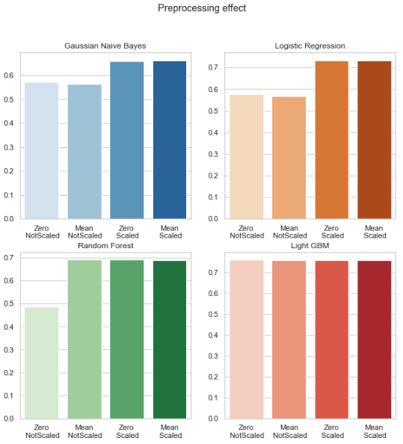
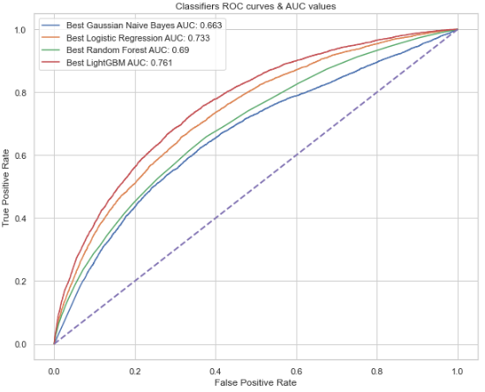
Adequate preprocessing
Model panel
Gaussian Naïve Bayes
Logistic Regression
Random Forest
Light GBM
Peprocessings:
Fill missing with ‘0’
or ‘mean’
MinMax scale
or not
x
Resulting bests ROC curves & AUC scores:
Further work: Define a pipeline to identify & manage
upstream steps dependencies

Slide 13
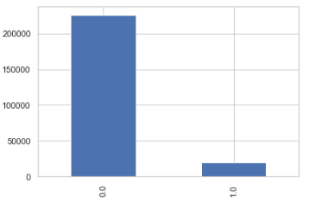
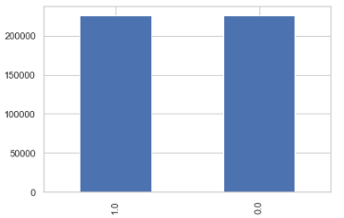
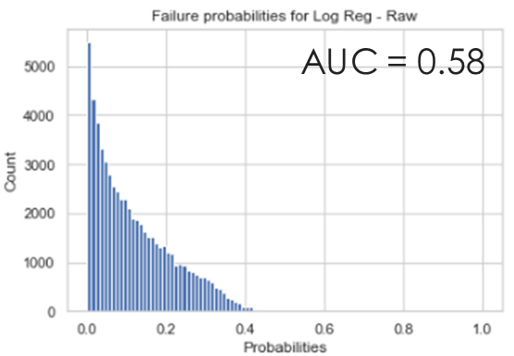
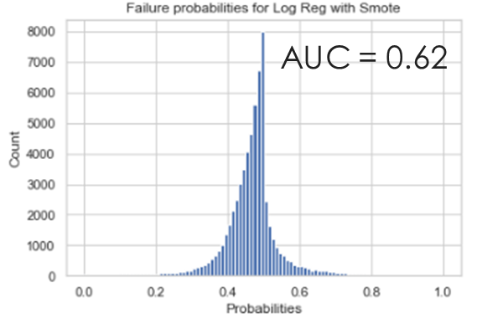
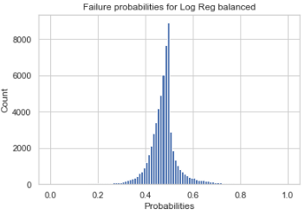
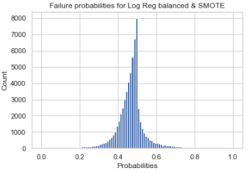
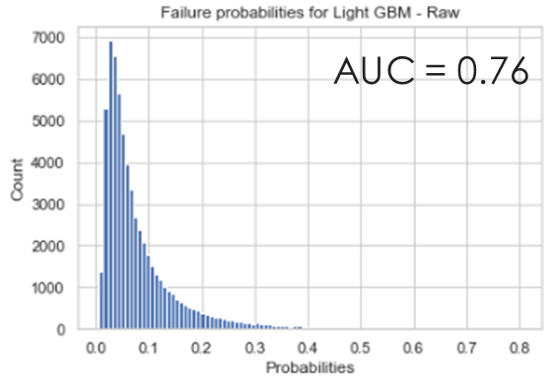
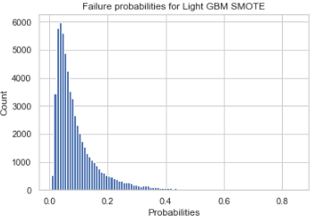
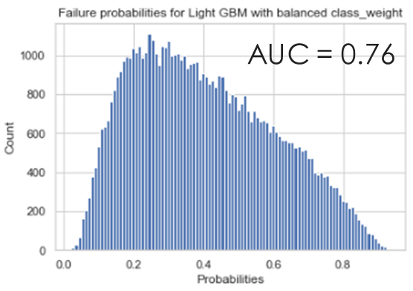
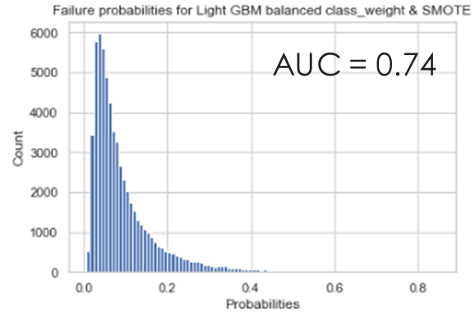
Remedy Class imbalance test with Logistic Regression & Light GBM
Imbalance – ‘raw’ model
Balanced with SMOTE
Class_weight ‘balanced’
Both techniques
AUC = 0.62
AUC = 0.62
While SMOTE seems helpful for Logistic Regression
“Class_weight” set to ‘balanced’ seems “enough” for Light GBM,
With even a rough behavior able to deal with such imbalanced class
AUC = 0.62

Slide 14
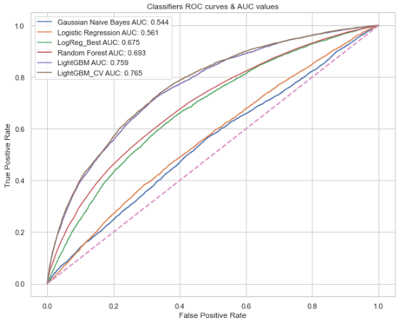
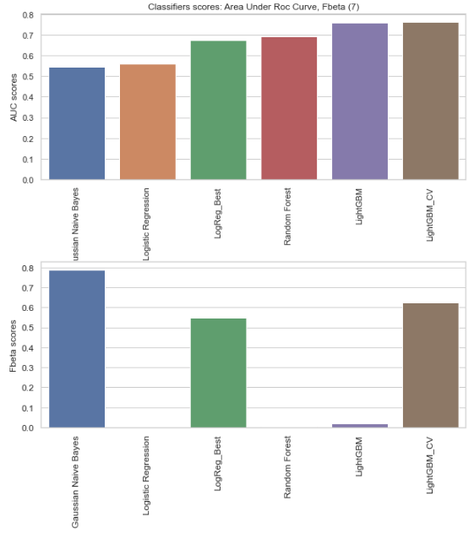
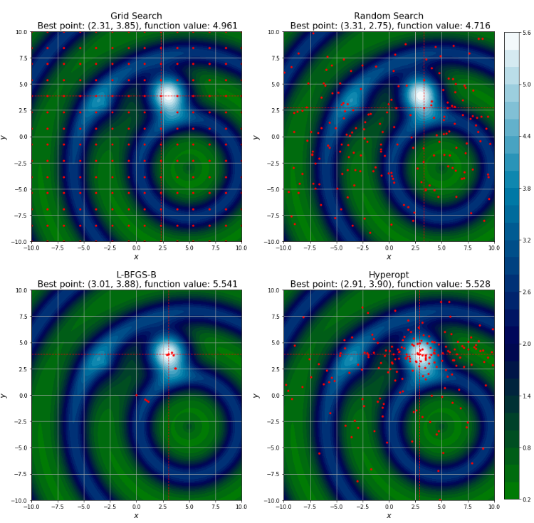
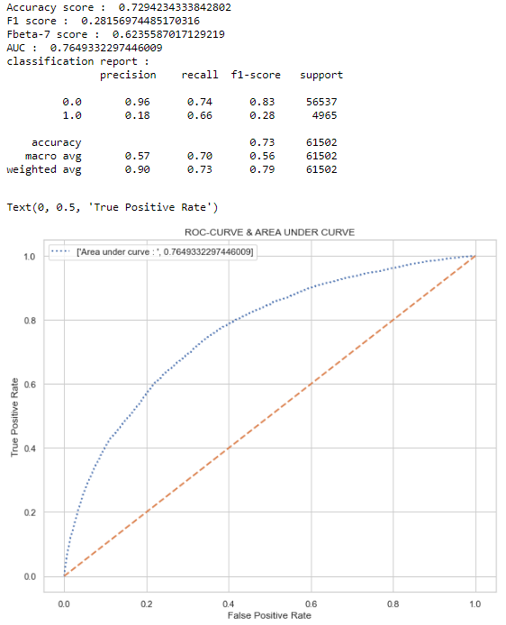
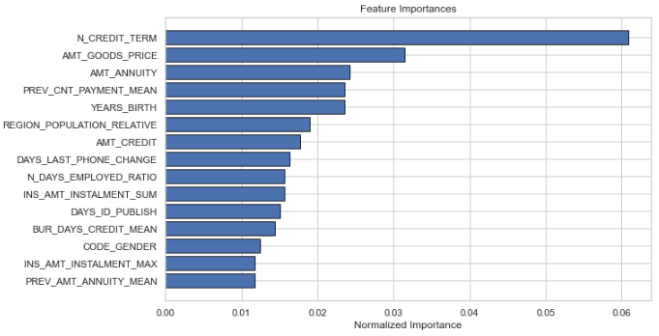
Optimization : hyperopt & cross-validation

Slide 15
Features Engineering insights
N_BUR_EARLINESS_OVERDUE_RATIO : External loans early failure, calculated on the earliest failed month balance status, normalized with loan duration (0 : no failure, 1: early failure)
Calculated across any loan type.
N_BUR_AMT_CREDIT_DEBT_RATE :

Slide 16
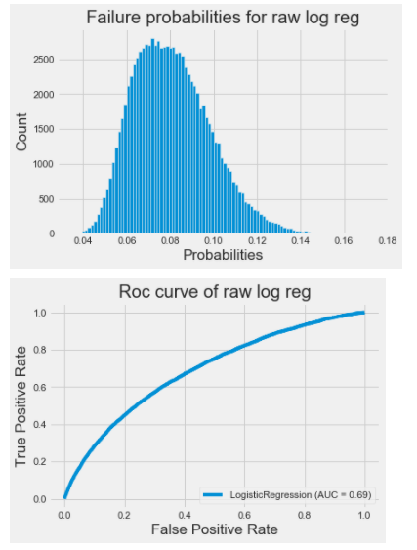
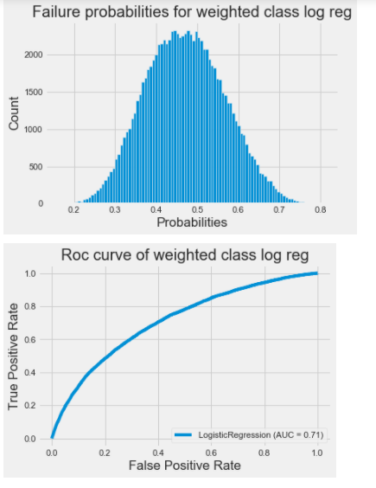
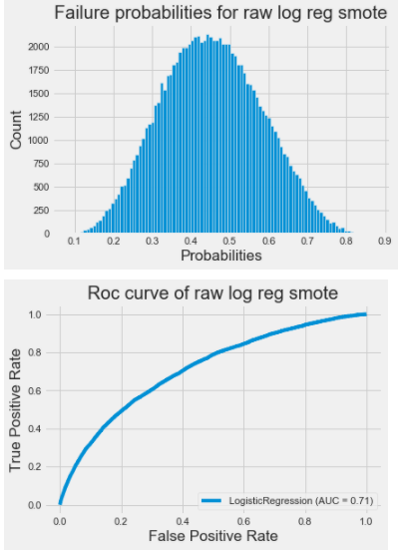
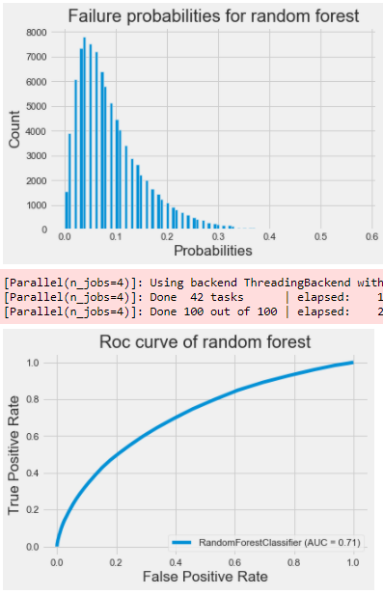
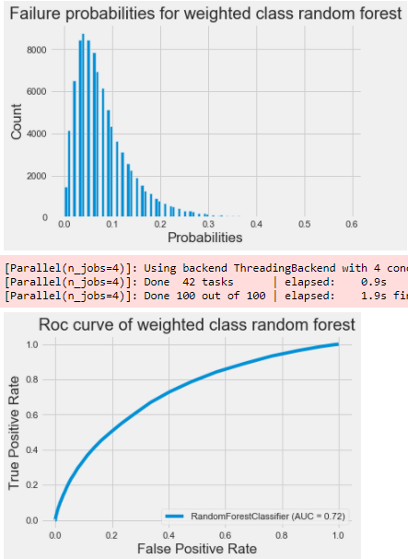
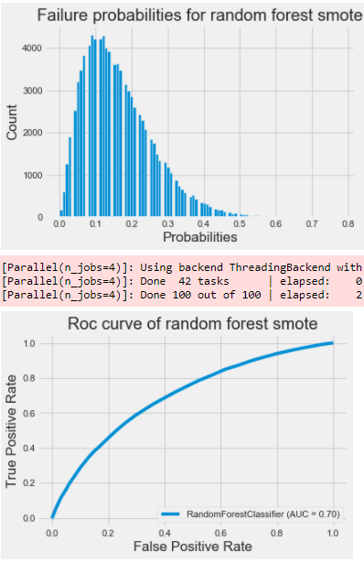
Class_weight=‘balanced’ versus Smote
Logistic regression:
Using balanced class_weight or smote helps improve AUC by a few %
Random forest:
Using balanced class_weight helps improve AUC by a few %
While smote decrease AUC by approx. the same %
AUC 0,71
AUC 0,72
AUC 0,70

Slide 17
Model scoring
“raw” | Actual Good | Actual Bad
Predicted Good | tn 78676 | fn 5546
Predicted Bad | fp 6129 | tp 1902
- 7
1
1
- 1
“Balanced class_weight” | Actual Good | Actual Bad
Predicted Good | tn 54837 | fn 2492
Predicted Bad | fp 29968 | tp 4956
“SMOTE” | Actual Good | Actual Bad
Predicted Good | tn xx | fn xx
Predicted Bad | fp xx | tp xx

Slide 18
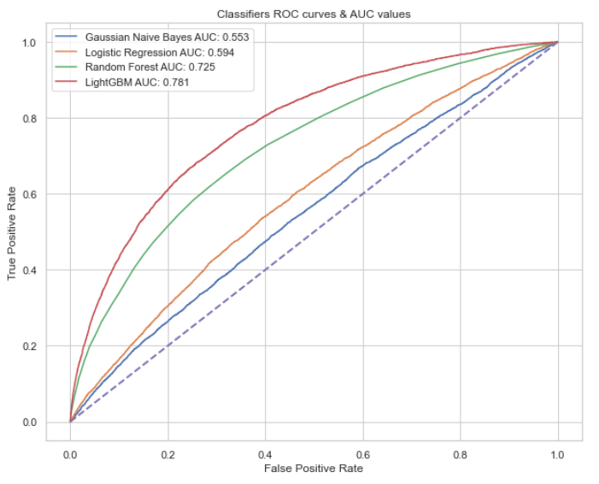

Slide 19
Model
Best_model
LogisticRegression(C=0.07843860221395219, class_weight='balanced', max_iter=979,
solver='liblinear', tol=3.5415873409699916e-05)
AUC score: 0.7102
Fbeta score (7): 0.6146
Further work:
Define a pipeline to identify & manage upstream steps dependencies

Slide 20
LATE_PAYMENT
LATE_PAYMENT feature: I think most of you used installment['DAYS_INSTALMENT']-installment['DAYS_ENTRY_PAYMENT'] as a new feature since it shows number of delays. It was a already good feature but I realized that, when you take last 365 days of installment data and aggregate this delay as a new feature, it added much more value to model. Here is a simple code:
installment_temp = installment[installment.DAYS_ENTRY_PAYMENT >= -365]
installment_temp['LATE_PAYMENT'] = installment_temp['DAYS_INSTALMENT']-installment_temp['DAYS_ENTRY_PAYMENT']
late_payment_feature = installment_temp.groupby('SK_ID_CURR')[['LATE_PAYMENT']].min().reset_index()

Slide 21
Debt ratio
Most important buraeu feature: Debt ratio was the most important feature I found in bureau file. I also tried using more recent bureau data for this feature but it was the best when I used all data.
buro['DEBT_RATIO']=buro['AMT_CREDIT_SUM_DEBT']/buro['AMT_CREDIT_SUM']
debt_ratio_feature = buro.groupby('SK_ID_CURR')['DEBT_RATIO'].max()

Slide 22
Interest Rate Features / previous
Interest rate seems to be an important feature in predicting loan default.(You can see this from the lending club dataset) We were not given interest rate directly in either Main Application data or Previous Application data but we could approximate it:
Previous Application - The key thing here is that AMT_ANNUITY includes interest. Based on AMT_CREDIT, AMT_ANNUITY, and CNT_PAYMENT we can derive interest rate.
prev_app['INTEREST'] = prev_app['CNT_PAYMENT']*prev_app['AMT_ANNUITY'] - prev_app['AMT_CREDIT']
prev_app['INTEREST_RATE'] = 2*12*prev_app['INTEREST']/(prev_app['AMT_CREDIT']*(prev_app['CNT_PAYMENT']+1))
prev_app['INTEREST_SHARE'] = prev_app['INTEREST']/prev_app['AMT_CREDIT']
Then by calculating max, min, mean of features above for each customer, I got several top features for Previous Application table.

Slide 23
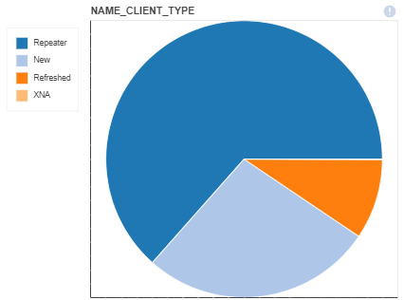
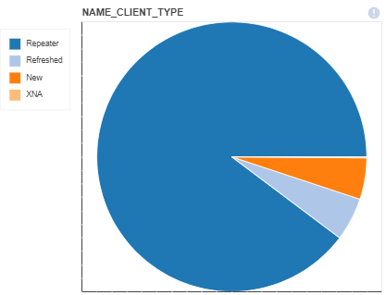
Approved or Refused by Client_Type
approved
refused

Slide 24
Bureau & bureau_balance
After first sight on entire dataset, we keep only valuable info to dig deeper.
Fail lead to either overdue only, or a debt
Bureau :
Current overdue (age is given by DAYS_CREDIT_UPDATE) is given by :
CREDIT_DAY_OVERDUE
N_CREDIT_OBS_WINDOW is approx. : DAYS_CREDIT – DAYS_CREDIT_UPDATE
AMT_CREDIT_SUM (AMT_CREDIT_SUM = AMT_CREDIT_SUM_LIMIT + AMT_CREDIT_SUM_DEBT)
Consider the DEBT rate : bureau['AMT_CREDIT_DEBT_RATE'] = bureau['AMT_CREDIT_SUM_DEBT']/(1 + bureau['AMT_CREDIT_SUM'])
Bureau_balance:
Count month balance status
Typical behaviour is C, …, C, I, …, I, X when closed since C count vals & without failure if I == 0
X_norm == 1 : drop SK_ID_BUREAU (because unknown)
no C should mean Active credit.
Sum(I + X) count should mean Credit duration.

Slide 25
Other insights
• CNT stands for “count”, like CNT_CHILDREN
• AMT stands for “amount”, mostly use for monetary
• FLAG stands for boolean with 1 is yes. FLAG_DOCUMENT means loan applicant have to submit some documents like income proof, and this flag customer actual submitted or not.
• OBS stands for “observation”, also means “is it time for?”.
• DEF stands for “actual default”.
• Different between OBS and DEF (like OBS_30_CNT_SOCIAL_CIRCLE) is that OBS is flagging “is it time for that event to be eligible to happen”, while DEF is that “is it eligible to happen AND actually happened”.
• DAYS stands for “number of days”
• NUM stands for “sequence number”
• x-sell means customers already evaluated risk by previous loans (loans in HC even before previous_application), before giving the loan. This is very valuable feature.
bureau_balance.csv - MONTHS_BALANCE - Month of balance relative to application date (-1 means the information to the freshest monthly snapshot, 0 means the information at application - often it will be the same as -1 as many banks are not updating the information to Credit Bureau regularly)
POS_CASH_balance.csv - MONTHS_BALANCE - Month of balance relative to application date (-1 means the freshest balance date)
Dataset POS_CASH_BAL contains monthly snapshots of previous loans
MONTHS_BALANCE - denotes the number of months relative to the current application (i.e. the loan is being repaid with increasing MONTHS_BALANCE, in other words MONTH_BALANCE is becoming less negative)
CNT_INSTALMENT - denotes the total number of installments (term of the loan). This number may decrease if the client early repays the loan or increase in case of payment difficulties and change of the installment schedule
CNT_INSTALMENT_FUTURE - denotes the number of installments to be paid
NAME_CONTRACT_STATUS - changes when the contract moves to another status (e.g. typically from active to completed when the loan is repaid)

Slide 26
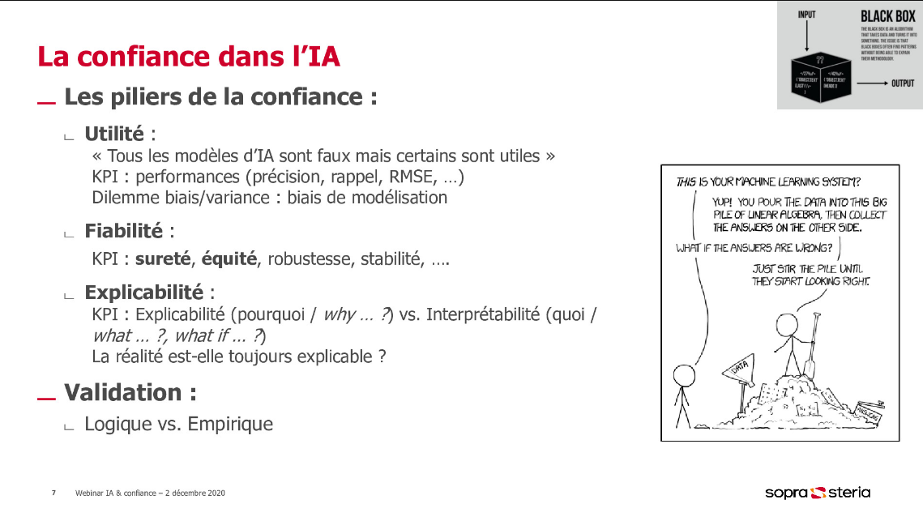
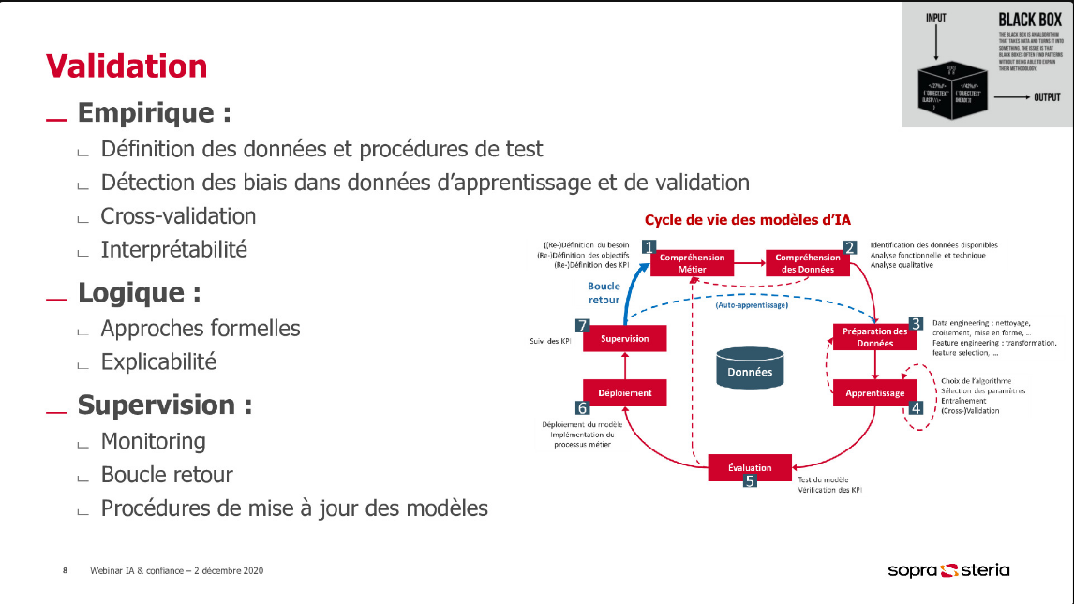
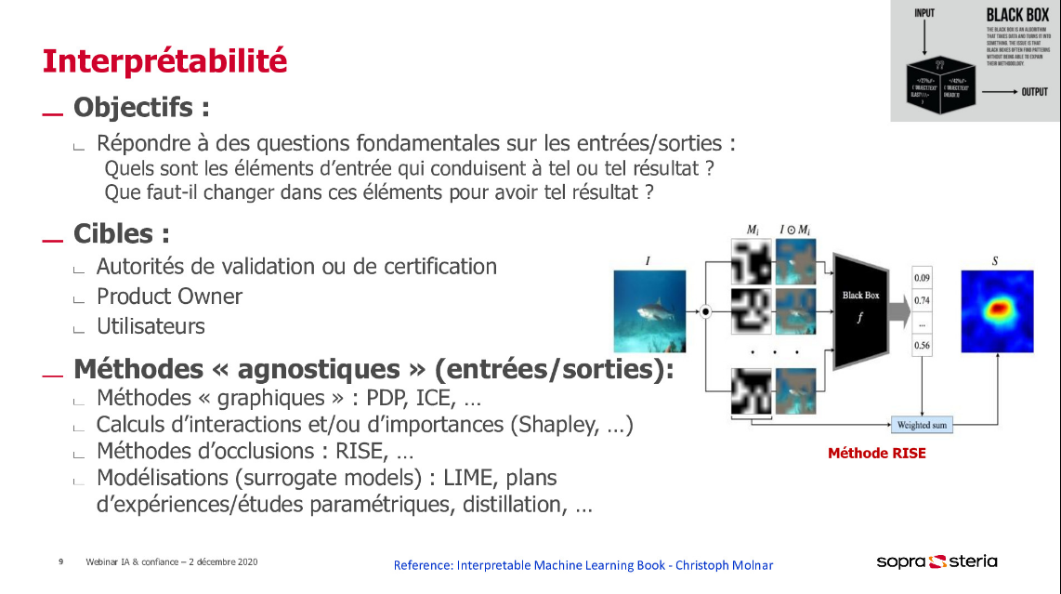
Interpreter : observer inputs / outputs et dire quoi
Expliquer : ouvrir la boite noire et dire pourquoi
Reglementation dans certains secteurs : doit être explicable (logique)
Lesaffre François marie & poujol michel

