Slide 1

Société Financière, crédits à la consommation pour des personnes ayant peu ou pas du tout d'historique de prêt
Développer un modèle de scoring de la probabilité de défaut de paiement du client
Interpréter les prédictions de façon transparente à l’aide d’un dashboard interactif motivant la décision d’octroi de prêts aux clients
Leur permettre l’exploration de leur situation.

Slide 2
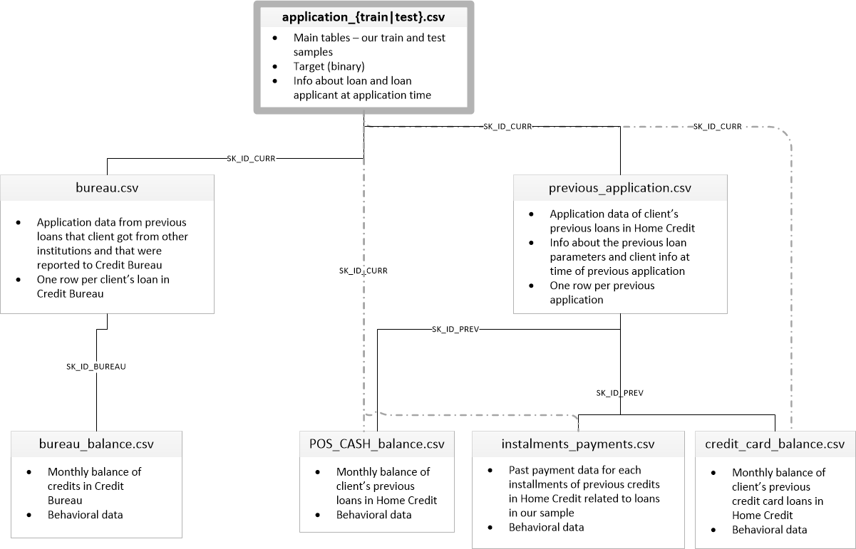

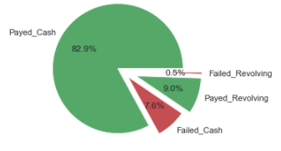
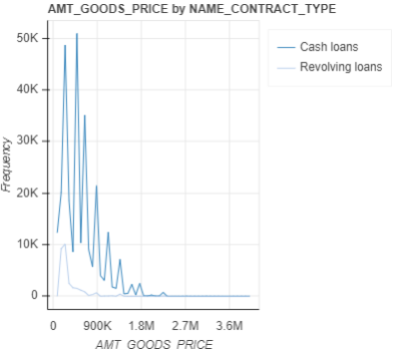
EDA
Target variable :
1 - client with payment difficulties: he/she had late payment more than X days on at least one of the first Y installments of the loan in our sample,
0 - all other cases
Loan’s description
+ Client’s data
{train|test}
“External” loans
(Failure :
Revolving 5,8%
Cash 9,11%)
“Internal” loans
months balance
(DPD status only)
Target Imbalance – by NAME_CONTRACT_TYPE
months balance
(DPD status only)
months balance
(DPD status only)

Slide 3
Features Engineering & Aggregation
Installments :

Slide 4
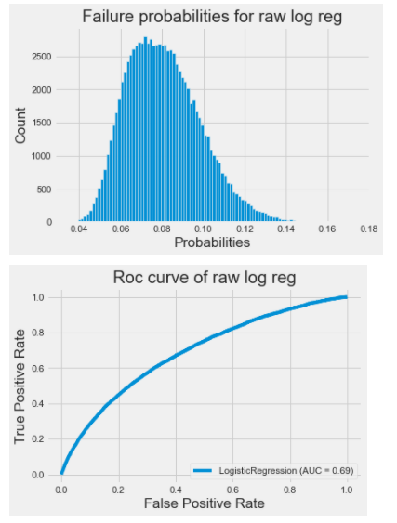
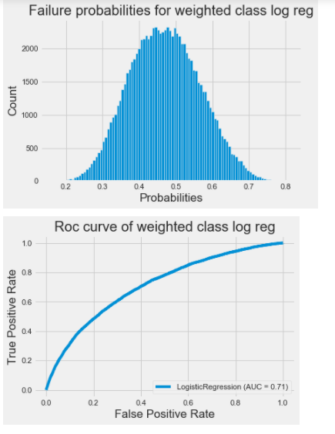
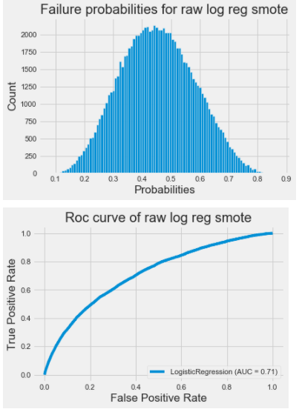
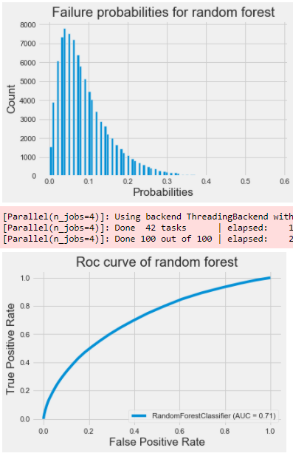
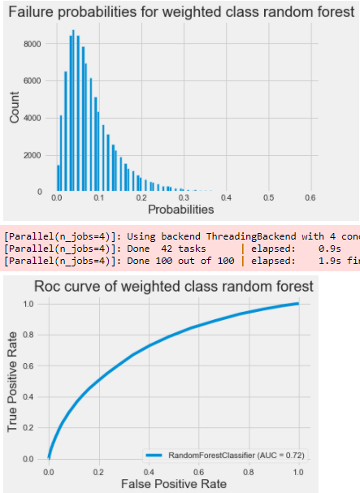
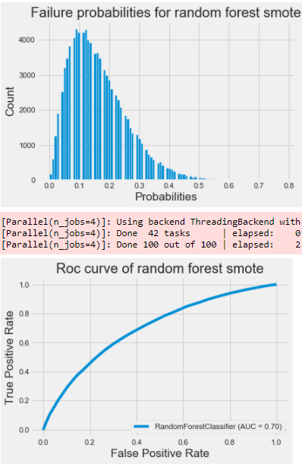
Class_weight=‘balanced’ versus Smote
Logistic regression:
Using balanced class_weight or smote helps improve AUC by a few %
Random forest:
Using balanced class_weight helps improve AUC by a few %
While smote decrease AUC by approx. the same %
AUC 0,71
AUC 0,72
AUC 0,70

Slide 5
Bureau & bureau_balance
After first sight on entire dataset, we keep only valuable info to dig deeper.
Fail lead to either overdue only, or a debt
Bureau :
Current overdue (age is given by DAYS_CREDIT_UPDATE) is given by :
CREDIT_DAY_OVERDUE
N_CREDIT_OBS_WINDOW is approx. : DAYS_CREDIT – DAYS_CREDIT_UPDATE
AMT_CREDIT_SUM (AMT_CREDIT_SUM = AMT_CREDIT_SUM_LIMIT + AMT_CREDIT_SUM_DEBT)
Consider the DEBT rate : bureau['AMT_CREDIT_DEBT_RATE'] = bureau['AMT_CREDIT_SUM_DEBT']/(1 + bureau['AMT_CREDIT_SUM'])
Bureau_balance:
Count month balance status
Typical behaviour is C, …, C, I, …, I, X when closed since C count vals & without failure if I == 0
X_norm == 1 : drop SK_ID_BUREAU (because unknown)
no C should mean Active credit.
Sum(I + X) count should mean Credit duration.

Slide 6
Other insights
• CNT stands for “count”, like CNT_CHILDREN
• AMT stands for “amount”, mostly use for monetary
• FLAG stands for boolean with 1 is yes. FLAG_DOCUMENT means loan applicant have to submit some documents like income proof, and this flag customer actual submitted or not.
• OBS stands for “observation”, also means “is it time for?”.
• DEF stands for “actual default”.
• Different between OBS and DEF (like OBS_30_CNT_SOCIAL_CIRCLE) is that OBS is flagging “is it time for that event to be eligible to happen”, while DEF is that “is it eligible to happen AND actually happened”.
• DAYS stands for “number of days”
• NUM stands for “sequence number”
• x-sell means customers already evaluated risk by previous loans (loans in HC even before previous_application), before giving the loan. This is very valuable feature.
bureau_balance.csv - MONTHS_BALANCE - Month of balance relative to application date (-1 means the information to the freshest monthly snapshot, 0 means the information at application - often it will be the same as -1 as many banks are not updating the information to Credit Bureau regularly)
POS_CASH_balance.csv - MONTHS_BALANCE - Month of balance relative to application date (-1 means the freshest balance date)
Dataset POS_CASH_BAL contains monthly snapshots of previous loans
MONTHS_BALANCE - denotes the number of months relative to the current application (i.e. the loan is being repaid with increasing MONTHS_BALANCE, in other words MONTH_BALANCE is becoming less negative)
CNT_INSTALMENT - denotes the total number of installments (term of the loan). This number may decrease if the client early repays the loan or increase in case of payment difficulties and change of the installment schedule
CNT_INSTALMENT_FUTURE - denotes the number of installments to be paid
NAME_CONTRACT_STATUS - changes when the contract moves to another status (e.g. typically from active to completed when the loan is repaid)

Slide 7
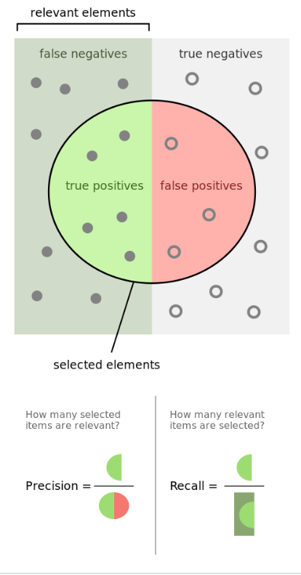
Taget :
1 - client had late payment more than X days on at least one of the first Y installments of the loan in our sample,
0 - all other cases)
La prediction porte sur Pfail + Ppay = 1, mais
 | Predict proba 0 | Predict proba 1 | TARGET predict | TARGET csv
SK_ID | Ppay | Pfail | 0 ou 1 | 0 ou 1
ran_for_pred.round() => inférieur ou supérieur à un seuil => comment le specifier?

Slide 8




Use case
clients
application
Knowledge:
Profile only
External knowledge
Past knowledge
Past & external knowledge

Slide 9
LATE_PAYMENT
LATE_PAYMENT feature: I think most of you used installment['DAYS_INSTALMENT']-installment['DAYS_ENTRY_PAYMENT'] as a new feature since it shows number of delays. It was a already good feature but I realized that, when you take last 365 days of installment data and aggregate this delay as a new feature, it added much more value to model. Here is a simple code:
installment_temp = installment[installment.DAYS_ENTRY_PAYMENT >= -365]
installment_temp['LATE_PAYMENT'] = installment_temp['DAYS_INSTALMENT']-installment_temp['DAYS_ENTRY_PAYMENT']
late_payment_feature = installment_temp.groupby('SK_ID_CURR')[['LATE_PAYMENT']].min().reset_index()

Slide 10
CREDIT_UTILIZATION
CREDIT_UTILIZATION feature: In blogs and papers I've read, most of them was saying credit utilization is a strong indicator for a risky customer and you can calculate it simply by dividing Credit card balance by credit card limit. It was making sense but didnt work when I calculated on full credit card dataset. Again I tried checking results on more recent credit card data. Finally I've found that last 2 months' data was more valuable for my model. You can see the simple code and check yourself with different months:
month = -2
cred_temp = cred_card_bal[cred_card_bal.MONTHS_BALANCE >= month]
cred_temp['CRED_UTIL'] = cred_temp['AMT_BALANCE'] / cred_temp['AMT_CREDIT_LIMIT_ACTUAL']
cred_util_feature = cred_temp.groupby('SK_ID_CURR')['CRED_UTIL'].max().reset_index().rename(columns={'CRED_UTIL':'CRED_UTIL_'+str(month*-1)})

Slide 11
Debt ratio
Most important buraeu feature: Debt ratio was the most important feature I found in bureau file. I also tried using more recent bureau data for this feature but it was the best when I used all data.
buro['DEBT_RATIO']=buro['AMT_CREDIT_SUM_DEBT']/buro['AMT_CREDIT_SUM']
debt_ratio_feature = buro.groupby('SK_ID_CURR')['DEBT_RATIO'].max()

Slide 12
Interest Rate Features / previous
Interest rate seems to be an important feature in predicting loan default.(You can see this from the lending club dataset) We were not given interest rate directly in either Main Application data or Previous Application data but we could approximate it:
Previous Application - The key thing here is that AMT_ANNUITY includes interest. Based on AMT_CREDIT, AMT_ANNUITY, and CNT_PAYMENT we can derive interest rate.
prev_app['INTEREST'] = prev_app['CNT_PAYMENT']*prev_app['AMT_ANNUITY'] - prev_app['AMT_CREDIT']
prev_app['INTEREST_RATE'] = 2*12*prev_app['INTEREST']/(prev_app['AMT_CREDIT']*(prev_app['CNT_PAYMENT']+1))
prev_app['INTEREST_SHARE'] = prev_app['INTEREST']/prev_app['AMT_CREDIT']
Then by calculating max, min, mean of features above for each customer, I got several top features for Previous Application table.

Slide 13
Interest Rate Features / application
We were not given CNT_PAYMENT in Main Application data and but we could predict it from Previous Application table. I built a lightgbm from Previous Application table by using AMT_CREDIT, AMT_ANNUITY, AMT_CREDIT/AMT_ANNUITY to predict CNT_PAYMENT. The model got a RMSE ~2.78. After applying the model on Main Application table, I got predicted CNT_PAYMENT(EXP_TERM) for each record and then I created exact same features as I did for previous app table. After applying the model on Main Application table, I got predicted CNT_PAYMENT(EXP_TERM) for each record and then I created exact same features as I did for previous app table.
main_app['INTEREST'] = main_app['EXP_TERM']*main_app['AMT_ANNUITY'] - main_app['AMT_CREDIT']
main_app['INTEREST_RATE'] = 24*main_app['INTEREST']/(main_app['AMT_CREDIT']*(main_app['EXP_TERM']+1))
main_app['INTEREST_SHARE'] = main_app['INTEREST']/main_app['AMT_CREDIT']
Overall, several of these interest rate related features joined my top 10 lgb features and gave ~0.0006 boost in CV.

Slide 14
Filtering Previous application data by NAME_CONTRACT_STATUS column
for value in prev.NAME_PRODUCT_TYPE.unique(): #prev is the previous application data
prev_approved = prev[prev.NAME_CONTRACT_STATUS == value]
print(value)
num_cols = prev_approved.columns[prev_approved.dtypes!= object]
num_cols = [col for col in num_cols if col not in ['SK_ID_CURR','SK_ID_PREV']]
features = prev_approved.groupby('SK_ID_CURR')[num_cols].max().reset_index()
newcols = ['_'+value+'_max'+'_prev_'+col for col in features.columns if col not in ['SK_ID_CURR']]
features.columns = ['SK_ID_CURR']+newcols
data = data.merge(features,'left','SK_ID_CURR')
test = test.merge(features,'left','SK_ID_CURR')

Slide 15
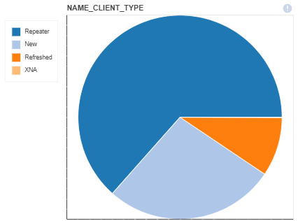
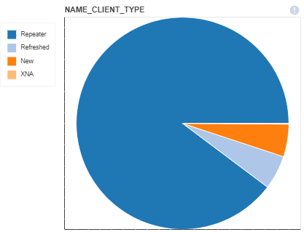
Approved or Refused by Client_Type
approved
refused

