Slide 1
How to become a heart doctor with Python?
Etienne LECONTE – 12/10/2020

Slide 2


Slide 3
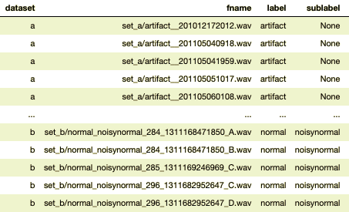
Collecting lots of labelled heartbeats…
800+ occurrences with file names, label and sublabel if it exists
Audio files in a separate file, all in .wav
CHALLENGE: load every audio file and “translate” them into numerical data

Slide 4



Libraries to process audio
Dedicated libraries to analyse and process audio files in Python
CHALLENGE: Installation of pyAudioProcessing… that I ended up not using

Slide 5

Let’s see the process of feature extraction for one file

Slide 6
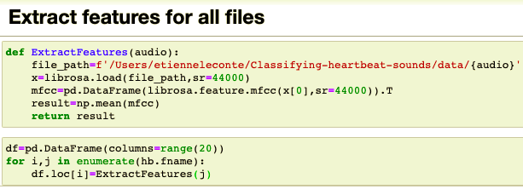
Next steps
Build a function to automize the feature extraction & build the final dataframe
Re-label the labels:
normal = 1 / not normal = 0
Describe the data, plot its distribution, standardize it

Slide 7
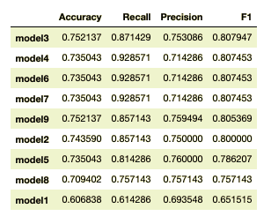
Model building without feature selection
9 models built:
Decision Tree
Ada Boost
Random Forest
Logistic Regression
KNN
Gaussian NB
SVC
XGBoost
CatBoost

Slide 8
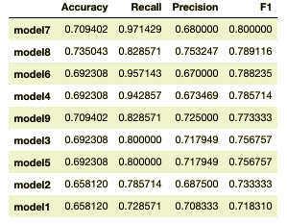
Model building with feature selection
Decision Tree
Ada Boost
Random Forest
Logistic Regression
KNN
Gaussian NB
SVC
XGBoost
CatBoost
Feature Selection method used: F-test
CHALLENGE: Finding out what feature selection method to use

Slide 9
Improvements
Maybe more features to extract
Do a multi-class classification
Record my own heart and classify it

Slide 10


Thank you! Any questions?

