Slide 1

Feature Selection and Scaling

Slide 2
Goal of this Lecture
The goal of this lecture is to:
Understand why we might have to make changes to the features we receive in a dataset in order to build an algorithm;
Know what the different techniques for manipulating features are;
Learn when it is appropriate implement each technique and how to do so.

Slide 3
What is feature Engineering?
1

Slide 4
Feature Engineering
Feature engineering (selection and scaling) is the process of creating new features or modifying the existing features in order to achieve better results in our machine learning algorithms.
The reason we want to do this in the first place is because (with only a limited amount of data) proper feature engineering often leads to better results (i.e. better performing ML models).

Slide 5
Feature Engineering
Feature Engineering (Set of Techniques and choices)
Feature Selection (Selecting a subset of features)
Feature Standardisation (feature values to gaussian)
Feature Normalisation (0-1 range)

Slide 6
Feature Scaling
2

Slide 7
Feature Scaling
Feature scaling is the process of rescaling the features so that they have the same order of magnitude.

Slide 8
Feature Scaling: Example
 | Engine Displacement | Cylinders | Fuel Barrels/Year | CO2 Emission Grams/Mile | Manufacturer (Label)
1 | 2.4 | 4 | 19.388824 | 522.764706 | AM General
2 | 4.2 | 6 | 25.354615 | 683.615385 | AM General
3 | 4.2 | 4 | 20.600625 | 555.437500 | AM General
4 | 3.8 | 6 | 25.354615 | 683.615385 | AM General
... | ... | ... | ... | ... | ...

Slide 9
Feature Scaling: Example
 | Engine Displacement | Cylinders | Fuel Barrels/Year | CO2 Emission Grams/Mile | Manufacturer (Label)
1 | -0.616822 | -1.00560 | 0.398406 | 0.398528 | AM General
2 | 0.633752 | 0.133841 | 1.733866 | 1.749543 | AM General
3 | -0.616822 | -1.00560 | 0.669671 | 0.672953 | AM General
4 | 0.633752 | 0.133841 | 1.733866 | 1.749543 | AM General
... | ... | ... | ... | ... | ...

Slide 10
Feature Scaling
Often we distinguish between two types of feature scaling operations:
Feature Scaling
Feature Standardisation
Feature Normalisation

Slide 11
Feature Scaling: Standardisation
3

Slide 12

Feature Scaling: Standardisation
In standardization, we impose several statistical properties on the variable: the mean value is set to 0, and the standard deviation is set to 1.
We achieve this by subtracting the mean from each value in the feature, and dividing by standard deviation. This is also sometimes called 'z-score normalization'.

Slide 13
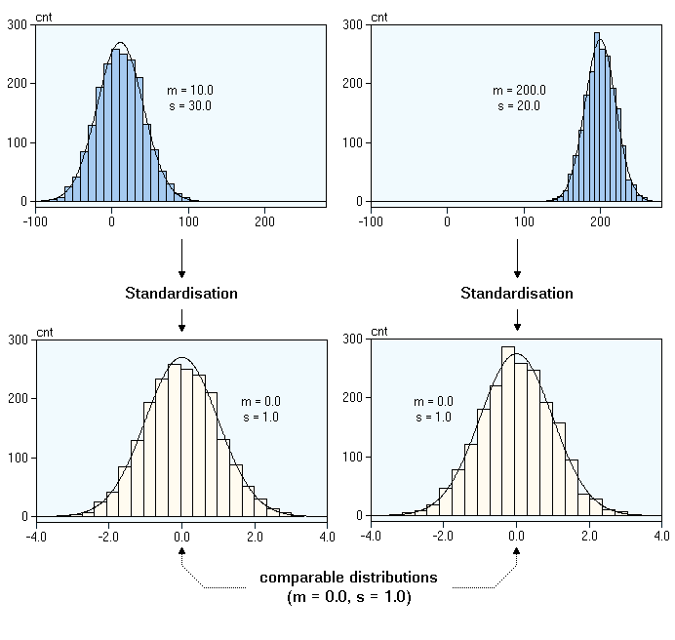
Feature Scaling: Standardisation
Variable A
Variable B

Slide 14
Feature Scaling: Standardisation
We standardise because we want to:
Reduce the effects of outliers in the feature, by imposing this standard deviation on the feature with a fixed value.
Additionally, it allows two features with dissimilar scales or units to be compared. Different feature scales would be statistically reflected in differences both in the mean and standard deviation. Standardizing these two numbers across features takes away the influence of these scale differences.

Slide 15
Feature Scaling: Implementation
Link to implementation.

Slide 16
Feature Scaling: Normalisation
4

Slide 17

Feature Scaling: Normalisation
With normalisation the feature is rescaled to a range between 0 and 1, without any changes in its original distribution within that range.
Mathematically, we achieve this by subtracting the minimum value of the feature from each value of the feature, and dividing by the difference between the largest value and the minimum value. It is sometimes called min-max normalisation.

Slide 18
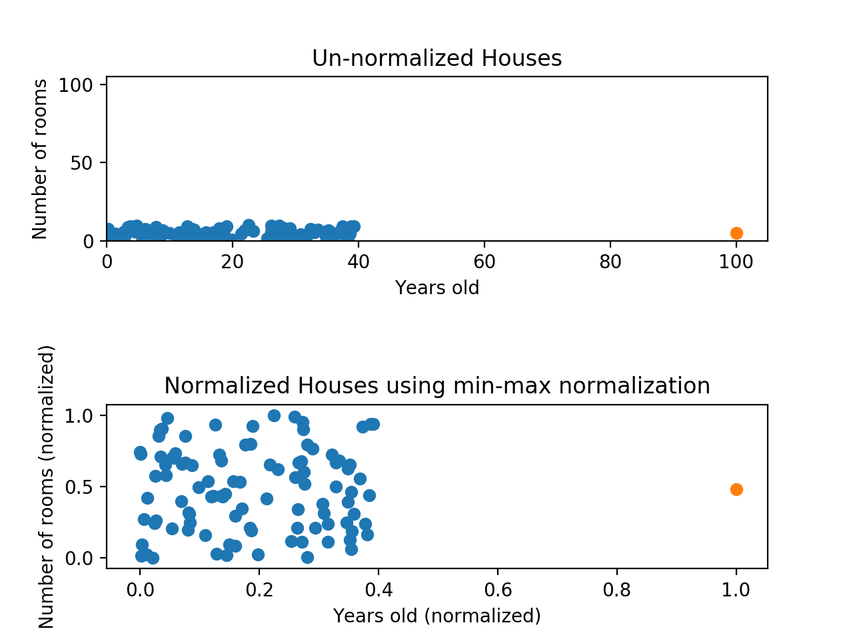
Feature Scaling: Normalisation
Consider the following example.
We see that only the range of the data has changed -- any outliers in the feature are still included, but just within this smaller range.

Slide 19
Feature Scaling: Normalisation
Normalisation is therefore more useful in cases where your data has few outliers but highly variable ranges.
It is also useful if you do not know how your data is distributed.
It is generally applied with algorithms that do not make assumptions about the distributions of the features. (e.g. neural networks)

Slide 20
Feature Scaling: Implementation
Link to implementation.

Slide 21
Part II: Feature Selection
5

Slide 22
Feature Selection
Feature selection is the process of selecting the relevant features in order to reduce the dimension of the data (i.e. number of columns) and to optimise performance.

Slide 23
Feature Selection
Feature Selection
Input Focussed
Output Focussed
Correlation Threshold
Backwards Elimination
Forwards Selection

Slide 24
Feature Selection: Correlation Threshold
6

Slide 25
Feature Selection: Correlation Threshold
It might be the case that we have repetitive data in our dataset. For instance, it may be that there are features that are highly correlated with each other. We call this multicollinearity.
Multicollinearity means that two or more variables are effectively communicating the same information twice.
Neglecting to remove one of these columns, causes the algorithm to overweigh the importance of this information in determining the outcome.

Slide 26
Feature Selection: Correlation Threshold
Multicollinear Features
 | Year_of_Birth | Age | Gender | …. | Income (label)
1 | 1990 | 30 | Male | ... | 32421
2 | 1971 | 49 | Female | ... | 12019
3 | 1984 | 36 | Female | ... | 3219129
4 | 1955 | 65 | Male | ... | 68432
5 | 2001 | 19 | Female | ... | 9421
... | ... | ... | ... | ... | ...

Slide 27
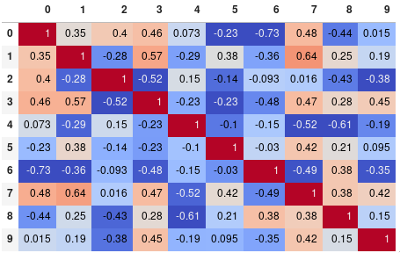
Feature Selection: Correlation Threshold
We can determine multicollinearity for features by setting a correlation threshold and subsequently removing redundant features.
Select a Threshold (e.g. corr = 0.6)
Remove Features > corr_threshold.

Slide 28
Feature Selection: Correlation Threshold
Advantage:
By removing this feature, we reduce the redundant information in the dataset, as well as multicollinearity between the features (this can be problematic for some algorithms such as Linear Regression).
Disadvantage:
A downside to this process is that the cutoff for 'highly' correlated must be determined by the analyst, which introduces bias.

Slide 29
Output Focussed Feature Selection
7

Slide 30
Output Focussed Feature Selection
Backwards and Forward selection are output focussed techniques for identifying those features in a dataset that are most important in determining the outcome.
The goal here is to construct a dataset with the smallest amount of noise relative to signal by including just those columns that are most relevant to determining the outcome.

Slide 31
Output Focussed Feature Selection
Output Focussed Feature Selection
Backwards Elimination
Forward Selection

Slide 32
Feature Selection: Forward Selection
8

Slide 33
Outcome Focussed Feature Selection
Forward Selection Process.
Multiple models are created, each using just one feature as the input variable being used to predict the outcome. This will result in a model for each one of the features in the dataset;
Features are added to each model, one by one;
When the performance of the model does not improve with the addition of features, the process is stopped we know which features are relevant.

Slide 34
Outcome Focussed Feature Selection
Feature 1
Feature 3
Feature 1
Feature 3
Feature 1
Feature 3
Feature 1
Feature 2
Feature 2
Feature 3
Feature 2
Feature 3
Feature 1
Feature 4
Feature 3
Feature 3
Feature 3
Feature 4
Feature 3
Feature 1
Feature 5
Feature 3
Feature 1
Feature 5
Feature 4
Feature 3
Feature 1
Feature 5
Feature 3
Feature 5
Feature 5

Slide 35
Feature Selection: Backward Elimination
9

Slide 36
Outcome Focussed Feature Selection
Backward Elimination Process (the opposite process of FS).
At first, all features are included as input variables to determine the outcome;
Then, gradually the least significant features are removed from the model one by one;
If the performance does not improve anymore when more features are removed, we stop.

Slide 37
Outcome Focussed Feature Selection
Feature 2
Feature 3
Feature 1
Feature 2
Feature 3
Feature 1
Feature 3
Feature 1
Feature 2
Feature 1
Feature 2

Slide 38
Outcome Focussed Feature Selection
Advantage:
Both mechanisms (forward and backward) are effective in removing features that do not substantially contribute to the determination of the outcome, removing noise from the data.
Removing features like this also makes the process faster.
Disadvantage:
Both are susceptible to missing global optima for local ones, meaning that they will stop searching for a more optimal solution as soon as accuracy stops improving even if continuing would later produce a larger improvement in accuracy later on.
Additionally, as you might imagine, these techniques become prohibitively expensive on very large datasets.

Slide 39
Summary
10

Slide 40
Summary
Standardization reduces the influence of different feature scales by setting the mean to 0 and standard deviation to 1;
Normalization places all features within the range [0,1] but does not change their distributions;
Correlation thresholds help us eliminate those columns that convey the same information as others;
Forward selection and backward elimination can help you identify those columns which are most important in determining the outcome.

Slide 41
The End.

