Slide 1
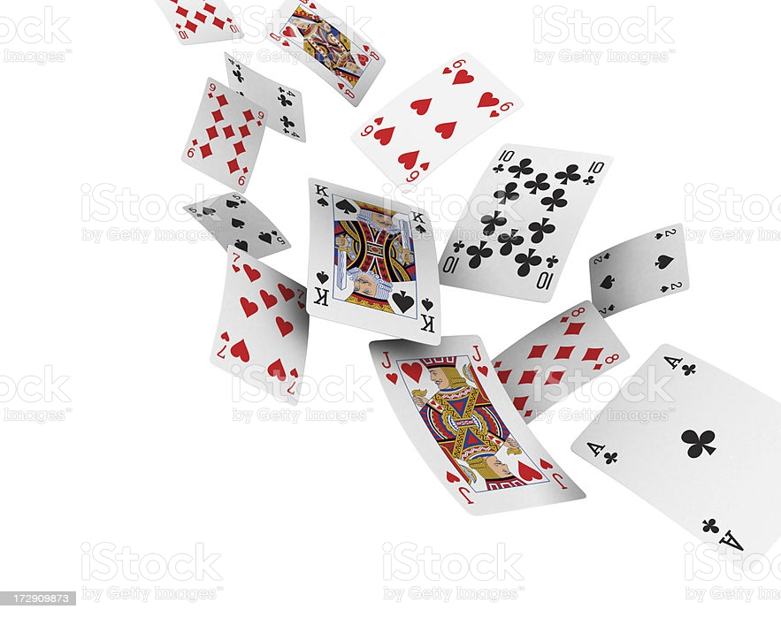
Project 1: building a modified version of Solitaire using python (week-1 lessons)
Thinh Nguyen
Cohort: DAPT0321
Amsterdam, Mar-2021

Slide 2
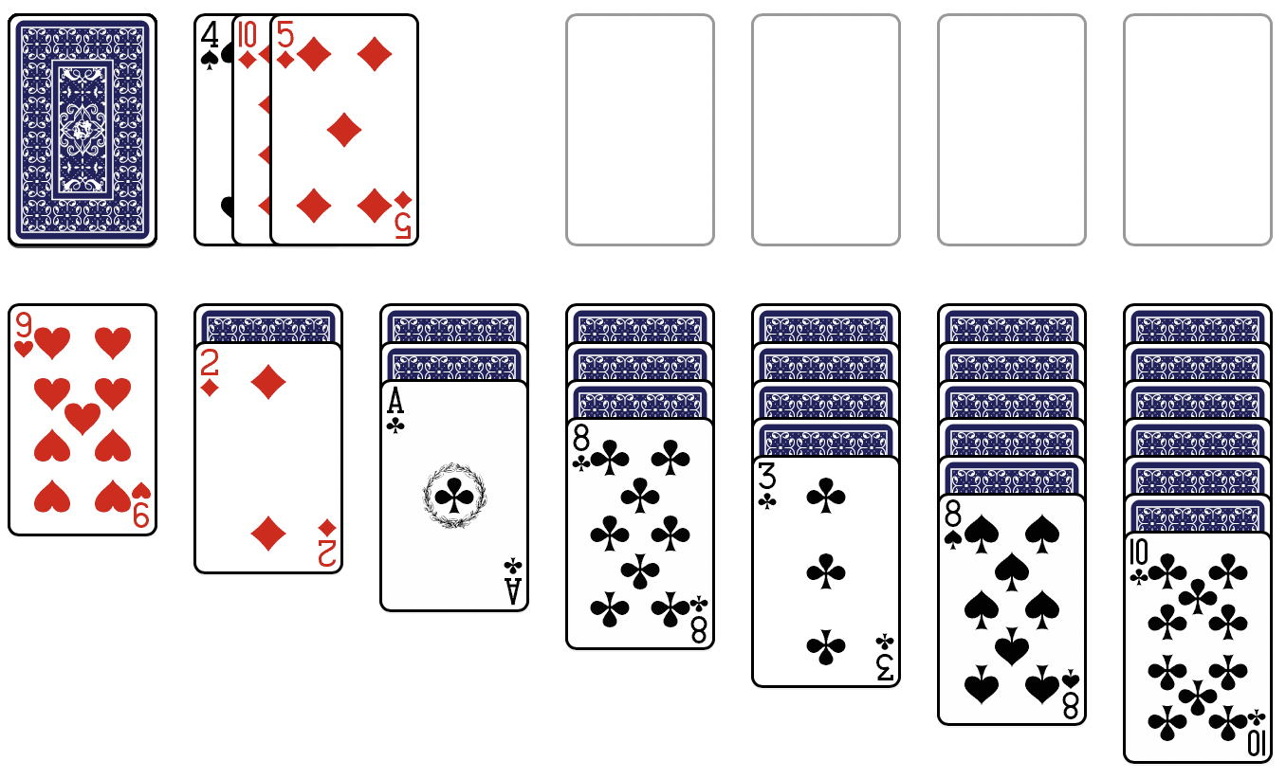
Quick reminder – original game
Foundations
Stock pile
Tableaus

Slide 3
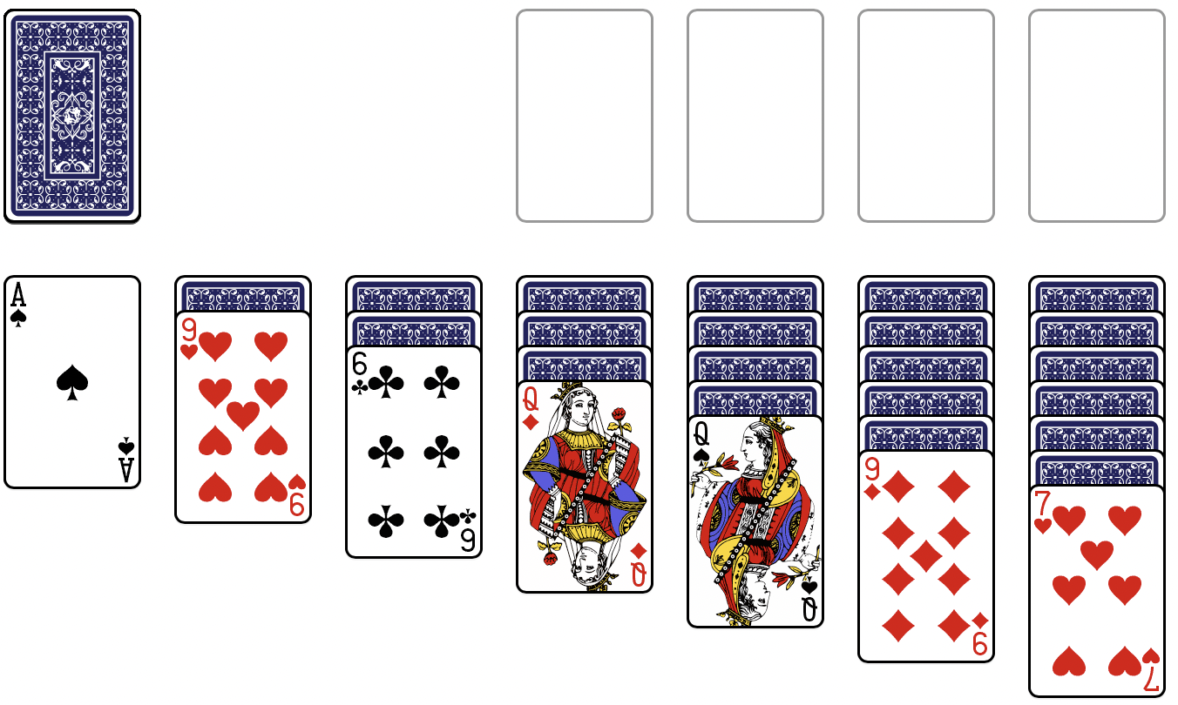
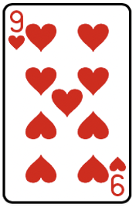

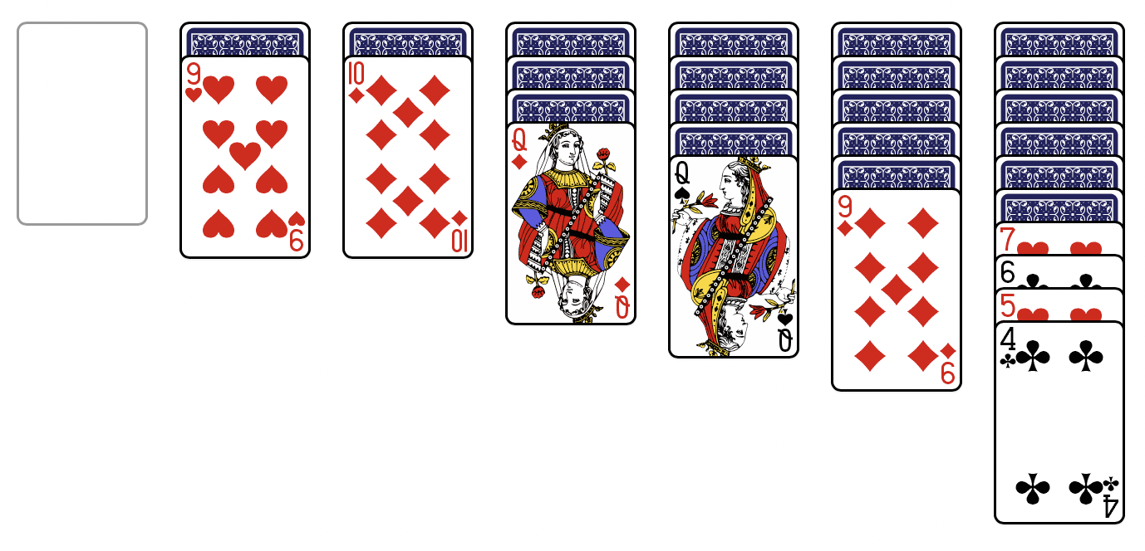
Changes to the rules
Stock pile:
only 1 card is visible at a time
one will already be visible at the start
❤️
♦️
♠️
♣️
Moving among tableaus:
- possible only to move the whole of all the visible cards on the move-from tableau

Slide 4
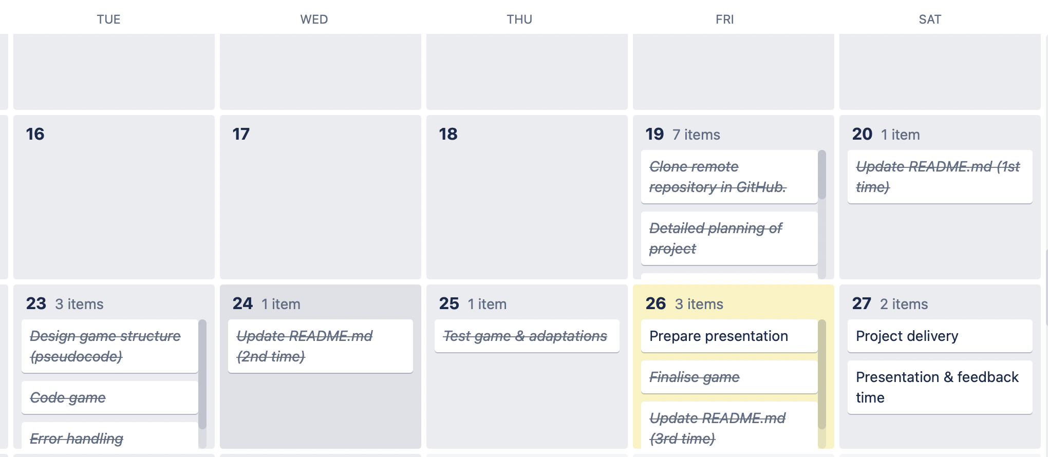
Workflow

Slide 5
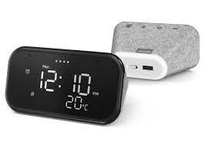
Challenges during the process
Mainly time
Connecting functions in the main body of codes
Too many ifs statements
To have codes written in a neat/smart and good-practice way

Slide 6
Learnings
Useful to make pseudo-codes before coding (although I did it mostly in my head for this project)
Specifically for the broken-down pieces, where many loops or logical statements are involved
Learned how to assign multiple returned variables of a function to multiple variables at a time
Error-handling will always take place, no matter how comprehensive I think I am in my scenario thinking
It is possible to have emoji-style symbols in your codes
Applied a lot of what I learned so far in this project
.gitignore, how to modify readme.md
❤️
♦️
♠️
♣️

Slide 7
Future improvements
About the game itself:
scale it up to the full original rules
find ways to control the difficulties of the game (easy → hard)
About workflow of coding:
Make better use of pseudo-codes to facilitate the coding process

