Slide 1

openSMILE

Slide 2
Brief introduction
Examples of use
How to use?

Slide 3
Brief introduction
« We introduce the openSMILE feature extraction toolkit, which unites feature extraction algorithms from the speech processing and the Music Information Retrieval communities. Audio low-level descriptors such as CHROMA and CENS features, loudness, Mel-frequency cepstral coeﬃcients, perceptual linear predictive cepstral coeﬃcients, linear predictive coeﬃcients, line spectral frequencies, fundamental frequency, and formant frequencies are supported. »
Translation: all the descriptors & features you can imagine to describe a speech sound

Slide 4
Brief introduction
Examples of descriptors
F0
MFCCs
Voicing
Breathyness / Creakiness
Statistics of all descriptors
….

Slide 5
Brief introduction
Why using it?
- reproducible results
- gold standard in speech recognition tasks
- cited a lot (not a good argument)
When using it?
- to compute speech features (although there are many other ways)
- to run a control test (reviewers can/will ask)
- to do machine learning (classif/regression) with a feature based approach
Why have I used it?
- because a reviewer ask
Is it user-friendly and relevant for basic research?
- not at all (unless you want to do engineering development)
- feature approach generalize badly and often lead to black-boxes

Slide 6
Brief introduction
Statistical inferences of separate features
t-test
anova
mixed models
…
openSMILE features
Data
Machine Learning
SVM
ridge-regression
K-means
…

Slide 7
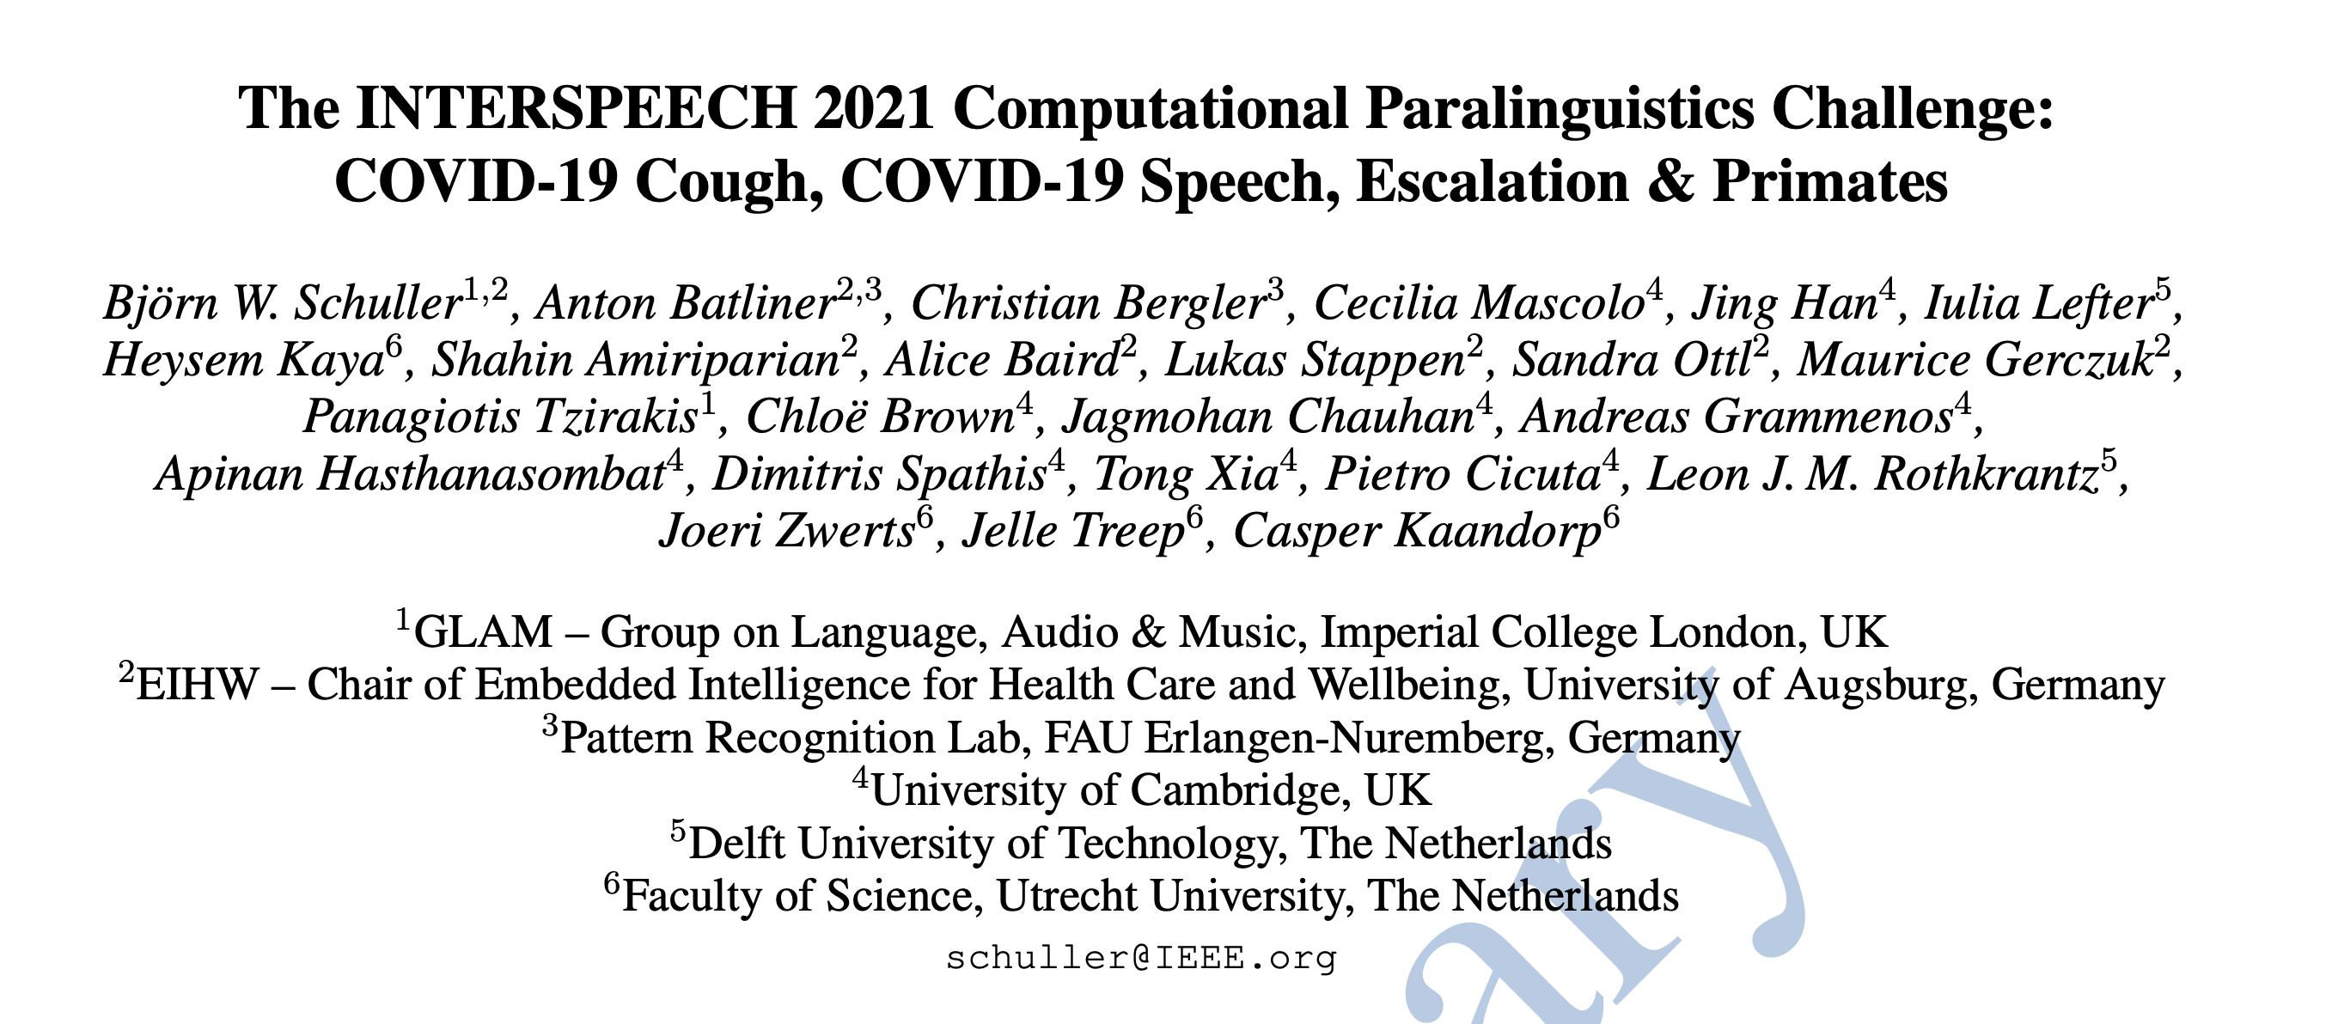
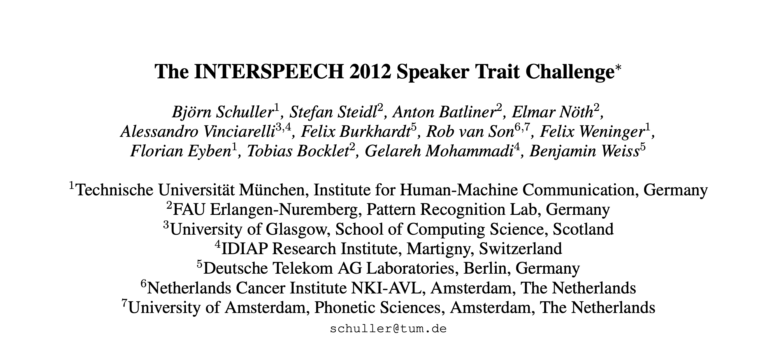
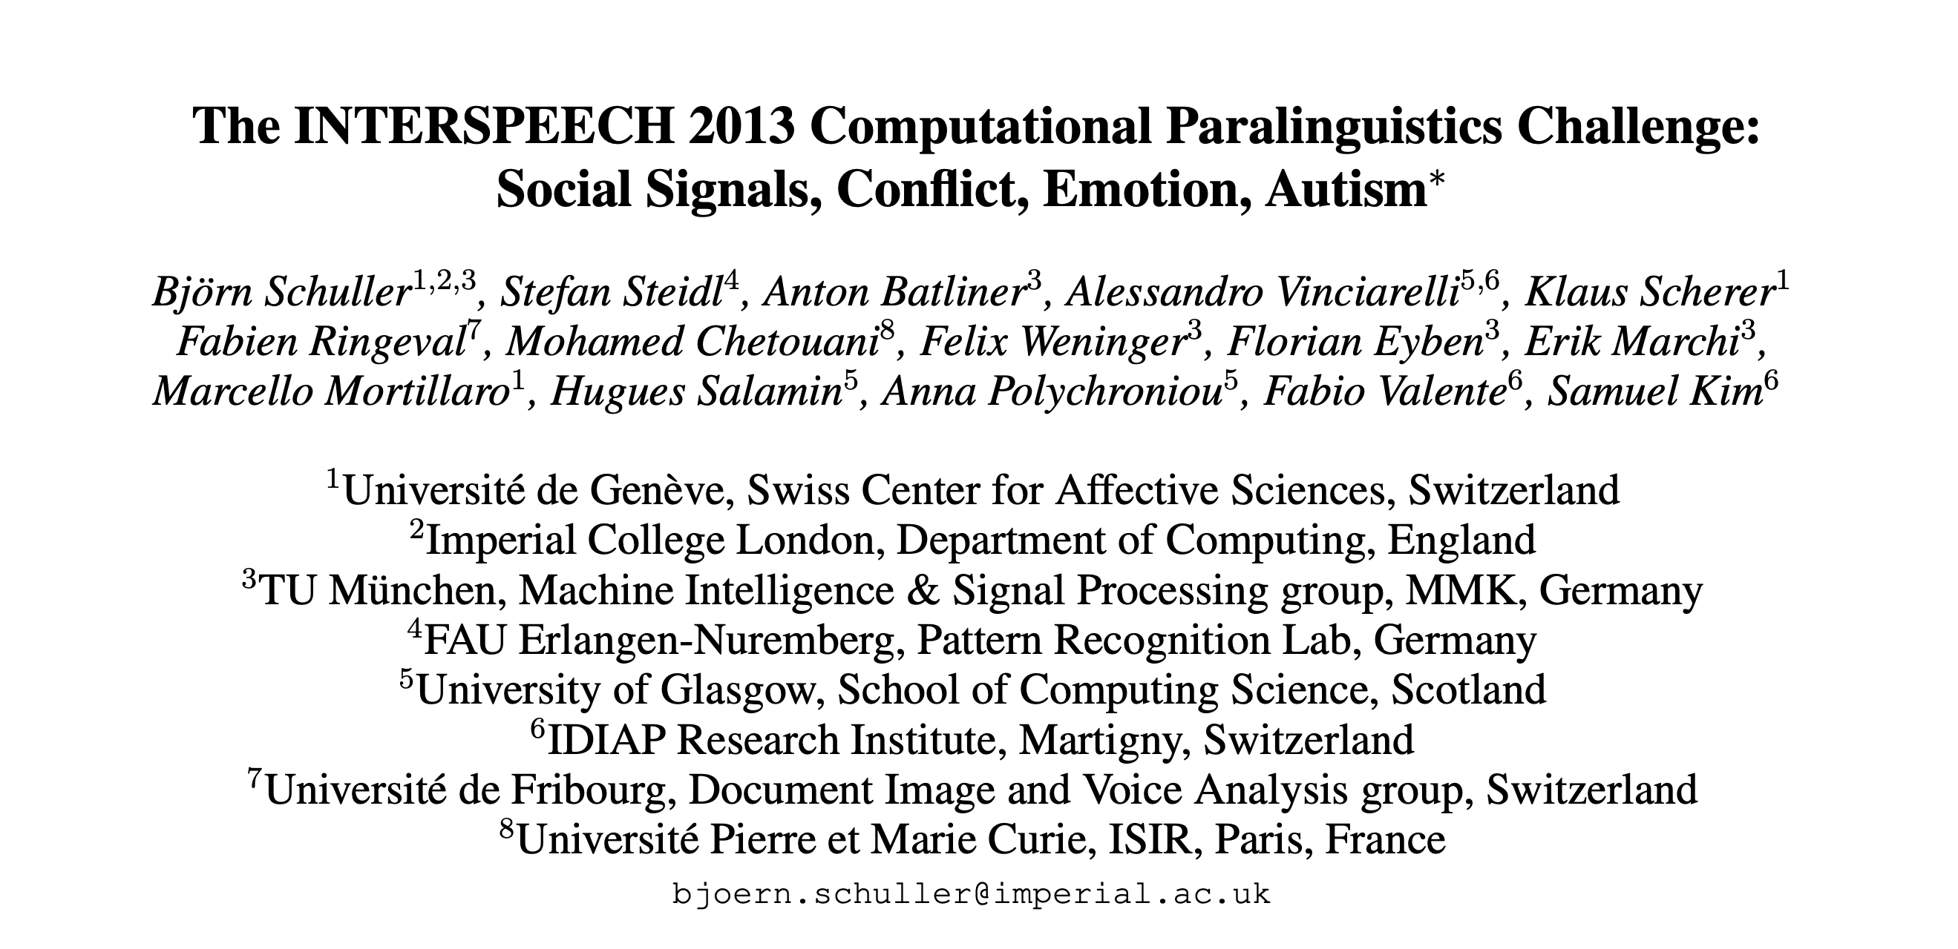
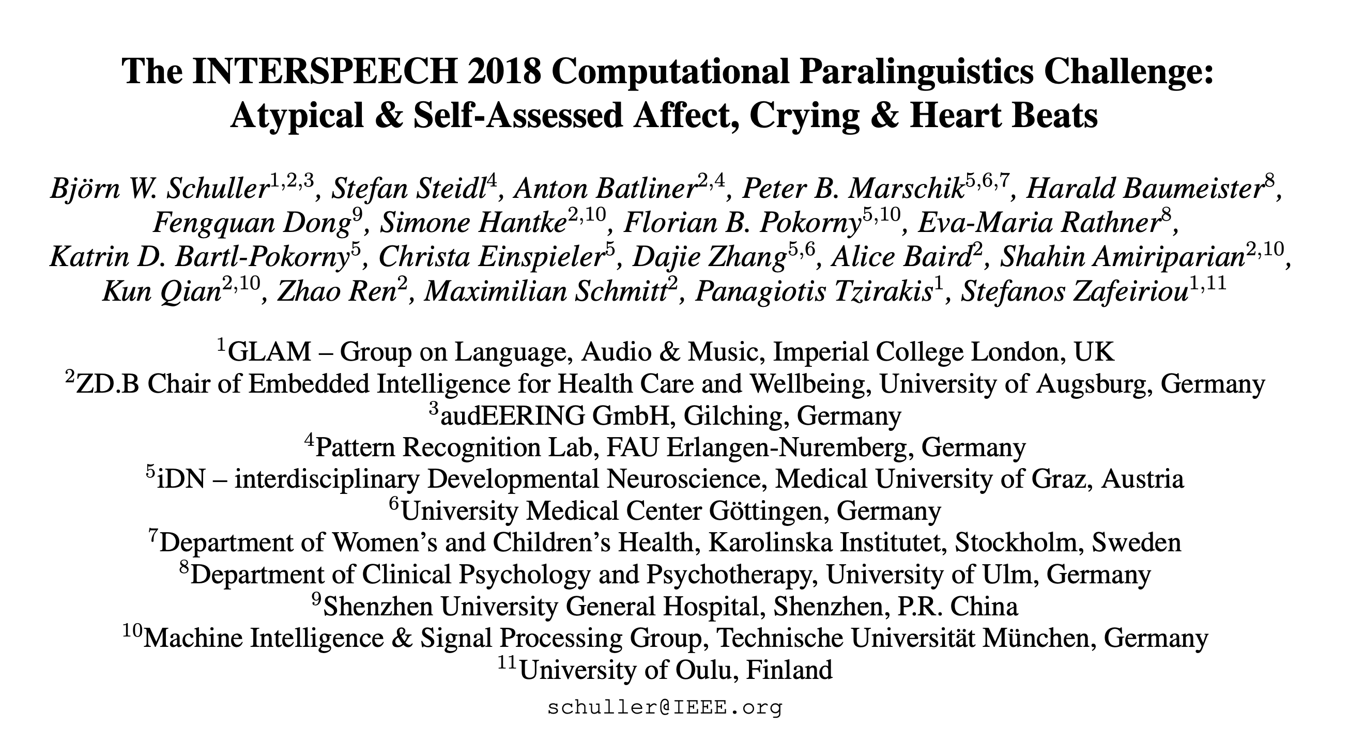
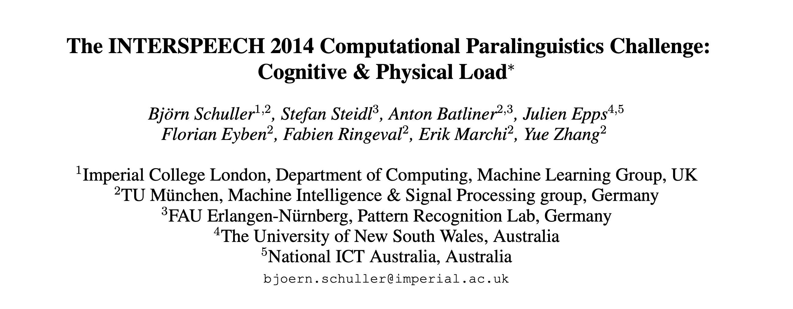
Examples of use
Paralinguistic tasks

Slide 8
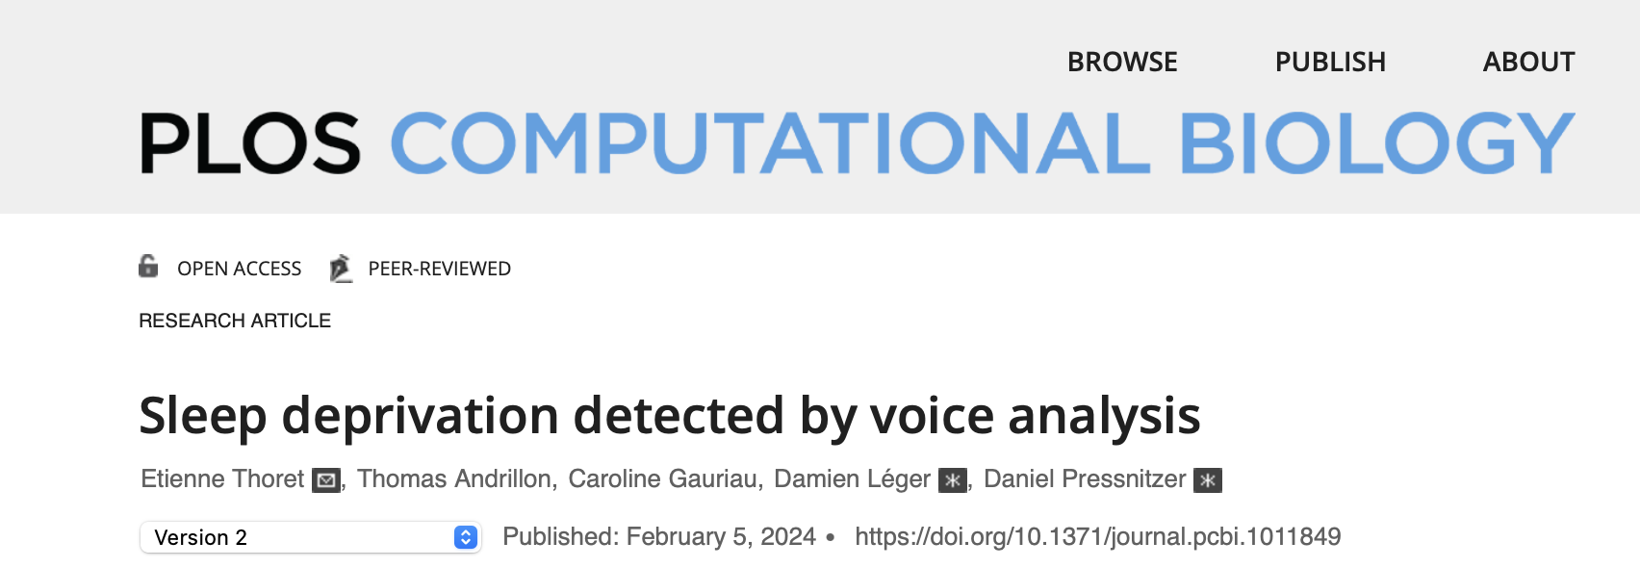
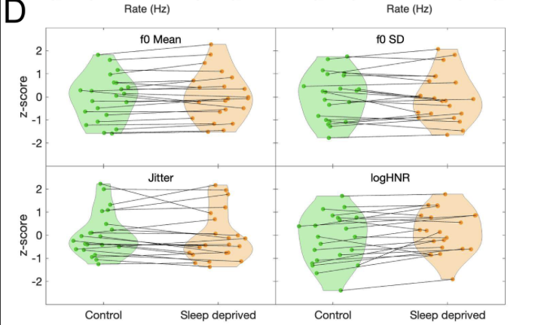
Examples of use

Slide 9
How to use?
1. Which openSMILE features we want to extract
  The config file problem
  Solution: always using the dame
  Ask Bjorn Schuller for a better tuto ☺
  what is used
2. Extracting openSMILE features
  Use the code ‘00_extractOpenSMILE_features.py’
3. Organize openSMILE features
  Use the code ‘01_reorganize_features.py’
4. Do the stat/ML you want to do
  Use the code ‘02_stats.py’ & ‘03_ML.py’
5. Use my xAI framework to understand what is used

Slide 10
How to use?
Stats
ML
PCA => RBF+SVM
20 components, 86% variance explained
cross-val, 10-seeds
Results
Ids: Bacc: M=.38, SD=.12
Species: Bacc: M=.90, SD=.09
Black-box…

Slide 11
Which features?
Bubbles & Reverse correlation!
1. Add/Multiply noise at the input of the classifier
2. Reverse correlate it with CLF decisions
3. Look at the important/prototypical features

Slide 12
Bubbles
Which features?
identities
Most important features
species
'F0final_sma_amean' 'F0final_sma_absmean' 'F0final_sma_qmean' 'F0final_sma_nzamean' 'F0final_sma_nzabsmean' 'F0final_sma_nzqmean' 'F0final_sma_nzgmean' 'F0final_sma_meanPeakDist' 'F0final_sma_peakMean' 'F0final_sma_linregc1' 'F0final_sma_linregc2' 'F0final_sma_qregc3' 'F0final_sma_qregerrQ' 'F0final_sma_upleveltime25' 'F0final_sma_leftctime' 'F0final_sma_rightctime' 'F0final_sma_(null)3' 'voicingFinalUnclipped_sma_upleveltime25' 'voicingFinalUnclipped_sma_downleveltime25' 'voicingFinalUnclipped_sma_upleveltime50' 'voicingFinalUnclipped_sma_downleveltime50' 'voicingFinalUnclipped_sma_risetime' 'voicingFinalUnclipped_sma_falltime' 'voicingFinalUnclipped_sma_leftctime' 'voicingFinalUnclipped_sma_rightctime' 'jitterLocal_sma_amean' 'jitterLocal_sma_nzabsmean' 'jitterLocal_sma_nzqmean' 'jitterLocal_sma_(null)3' 'jitterDDP_sma_meanPeakDist' 'jitterDDP_sma_qregerrA' 'shimmerLocal_sma_kurtosis' 'shimmerLocal_sma_(null)0' 'shimmerLocal_sma_(null)3' 'logHNR_sma_nzgmean' 'logHNR_sma_peakMean' 'logHNR_sma_linregc2' 'logHNR_sma_qregerrA' 'logHNR_sma_upleveltime90' 'logHNR_sma_falltime' 'logHNR_sma_duration' 'F0final_sma_de_absmean' 'F0final_sma_de_qmean' 'F0final_sma_de_nzqmean' 'F0final_sma_de_nzgmean' 'F0final_sma_de_variance' 'F0final_sma_de_stddev' 'F0final_sma_de_kurtosis' 'F0final_sma_de_numPeaks' 'F0final_sma_de_peakMean' 'F0final_sma_de_peakMeanMeanDist' 'F0final_sma_de_linregerrA' 'F0final_sma_de_linregerrQ' 'F0final_sma_de_qregc1' 'F0final_sma_de_qregc2' 'F0final_sma_de_qregc3' 'F0final_sma_de_qregerrA' 'F0final_sma_de_qregerrQ' 'voicingFinalUnclipped_sma_de_amean' 'voicingFinalUnclipped_sma_de_absmean' 'voicingFinalUnclipped_sma_de_nzamean' 'voicingFinalUnclipped_sma_de_nzqmean' 'voicingFinalUnclipped_sma_de_skewness' 'voicingFinalUnclipped_sma_de_kurtosis' 'voicingFinalUnclipped_sma_de_qregc2' 'voicingFinalUnclipped_sma_de_centroid' 'voicingFinalUnclipped_sma_de_upleveltime25' 'voicingFinalUnclipped_sma_de_downleveltime25' 'voicingFinalUnclipped_sma_de_risetime' 'voicingFinalUnclipped_sma_de_falltime' 'voicingFinalUnclipped_sma_de_leftctime' 'voicingFinalUnclipped_sma_de_rightctime' 'jitterLocal_sma_de_numPeaks' 'jitterLocal_sma_de_qregerrA' 'jitterLocal_sma_de_upleveltime25' 'jitterLocal_sma_de_downleveltime25' 'jitterLocal_sma_de_lpc' 'jitterDDP_sma_de_nzabsmean' 'jitterDDP_sma_de_kurtosis' 'shimmerLocal_sma_de_meanPeakDist' 'logHNR_sma_de_nzgmean' 'logHNR_sma_de_linregerrA' 'logHNR_sma_de_qregc2' 'logHNR_sma_de_leftctime' 'logHNR_sma_de_rightctime'
'F0final_sma_qmean' 'F0final_sma_peakMean' 'F0final_sma_linregc1’ 'F0final_sma_linregc2' 'F0final_sma_linregerrQ' 'F0final_sma_qregc1’ 'F0final_sma_downleveltime90' 'voicingFinalUnclipped_sma_linregc2’ 'voicingFinalUnclipped_sma_risetime' 'voicingFinalUnclipped_sma_falltime’ 'jitterLocal_sma_nzqmean' 'jitterLocal_sma_skewness’ 'jitterLocal_sma_lpc' 'shimmerLocal_sma_(null)0' 'logHNR_sma_nnz’ 'logHNR_sma_downleveltime50' 'logHNR_sma_leftctime’ 'F0final_sma_de_nzamean' 'F0final_sma_de_peakMeanMeanDist’ 'F0final_sma_de_qregc3' 'voicingFinalUnclipped_sma_de_amean’ 'voicingFinalUnclipped_sma_de_qregc1’ 'voicingFinalUnclipped_sma_de_qregc2’ 'voicingFinalUnclipped_sma_de_(null)0’ 'jitterLocal_sma_de_downleveltime25’ 'jitterDDP_sma_de_nzamean’ 'jitterDDP_sma_de_(null)0' 'shimmerLocal_sma_de_numPeaks’ 'shimmerLocal_sma_de_meanPeakDist' 'logHNR_sma_de_qregc1'

Slide 13
Reverse correlation
Which features?
Prototypical features
humans
Species task
p_{val} < .05
monkeys

