Slide 1
WISDOM OF CROWDS AND COLLABORATIVE PROJECTS :

Slide 2
Intro :
Presentation :
Twitch Plays Pokemon
Problematics
Plans

Slide 3
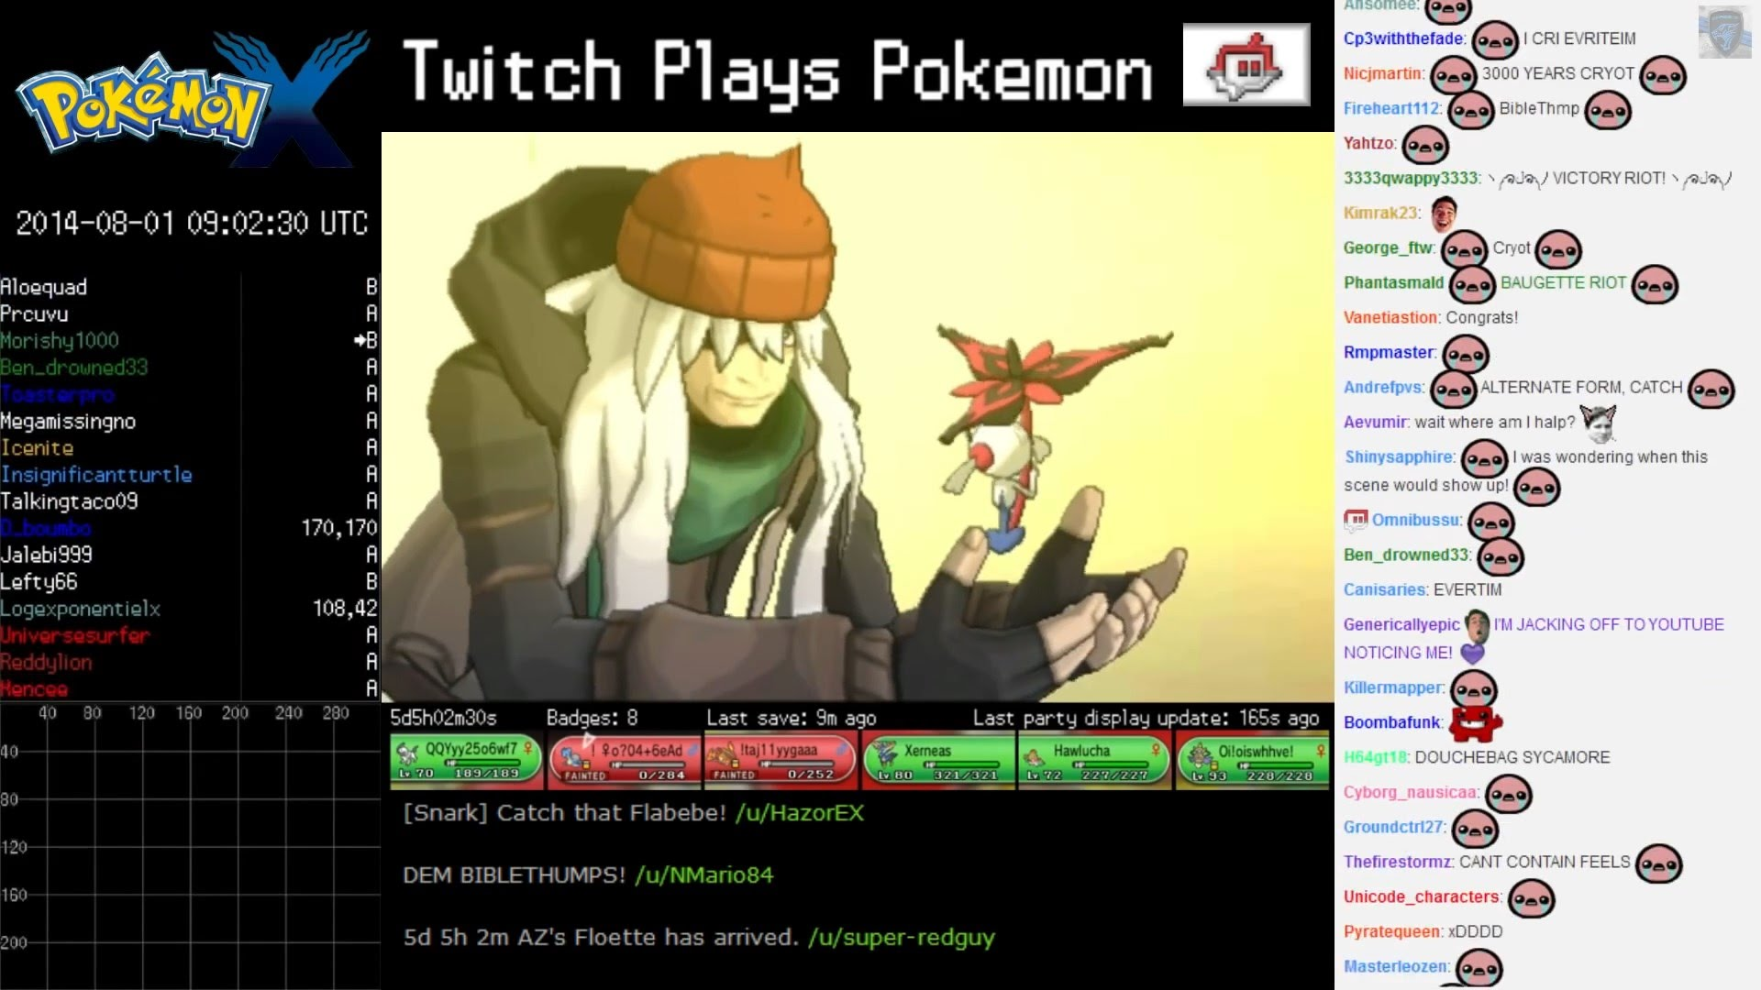
Twitch Plays Pokemon

Slide 4
Problematics ?
Could Constructive project emerge without intelectual Authority ?
Can a bunch of people be much wiser than a group of elite ?

Slide 5

1 - Wisdom of crowds ?

Slide 6
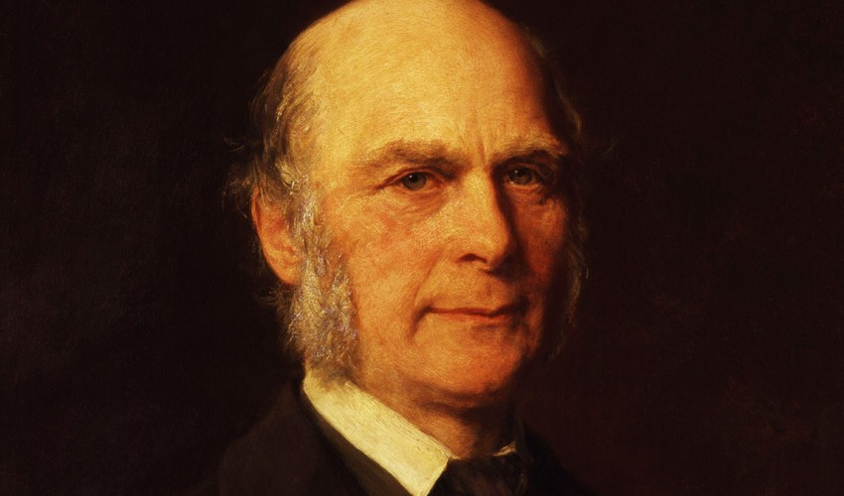
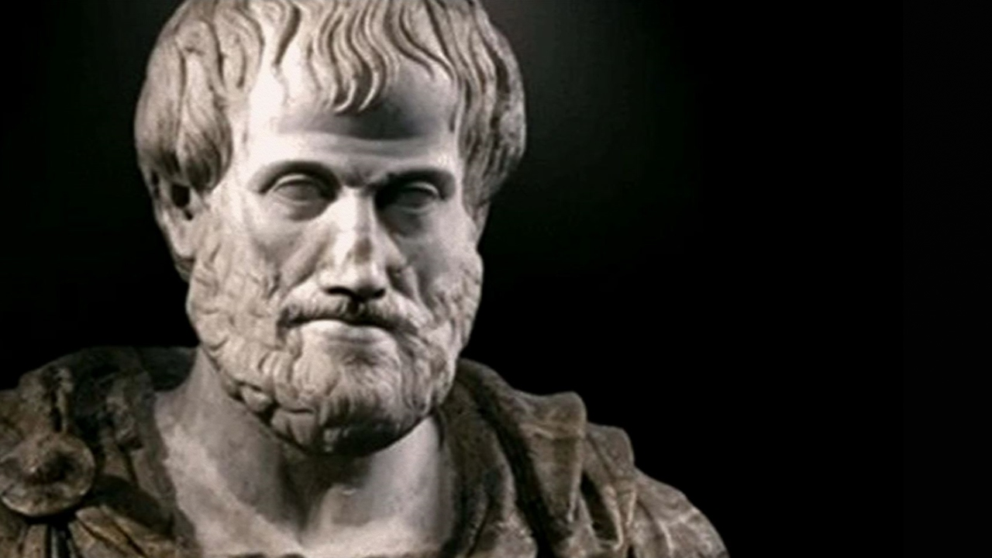
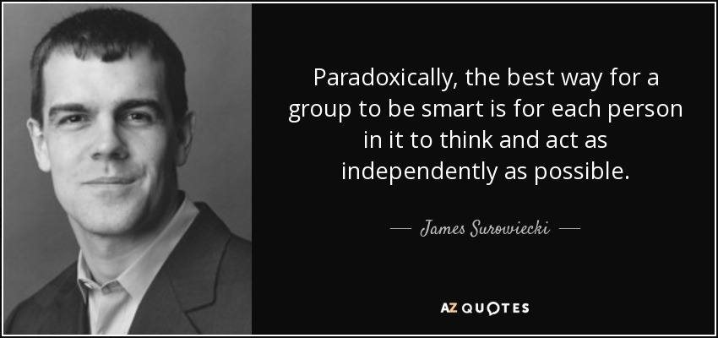
Wisdom of crowds ?

Slide 7
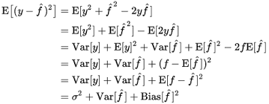
Wisdom of crowds ?
Bias- Variance Dilemma

Slide 8
Wisdom of crowds ?
Bias- Variance Dilemma
=> Collective error = Average of individual error – Diversity of prediction
                !!!!!!!!!!!!!!!!

Slide 9
Conditions ?
Diversity of opinion
Independance
Decentralization
Aggregation ( Algorithm)

Slide 10
2) Collaborative Projects
-Type 1 : Sharing one’s knowledge.
  Collecting information in order to make data bases bigger (Wikipédia, Mormont tree)
-Type 2 : Creating Data.
  Creating data for research from people’s contribution (EyeWire, Stardust@home, Human sciences)
-Type 3 : Development
  Software development : Forges, OpenSource

Slide 11
Open Source
Concept from Eric Raymond

Slide 12
Forge
System of Collaborative development of softwares.
Opensource
Collaborators from differents backgrounds
  Computer scientists, Translators, Graphic designers, ...

