Slide 1
Cytoscape Intro
Open a network file:
  File → Import → Network → from File… (select the TF-TF network file that you have downloaded)
  Select “Advanced Options”, define comment character, and preview.
  Select the source and target node, the interaction type and the edge attribute
Inspect the network and experiment with some of the different visualisations.

Slide 2
Cytoscape Advanced.
Select only the connected component (Tools → Subnetwork creation → Connected components)
Analyse your network (Tools → Network Analyser)
Change the nodes, edges shapes:
  Nodes → Degrees
  Edges → Betweenness
Colour nodes, colour edges based on their activity (activating, repressing)
Change edge shape based on interaction strength.

Slide 3
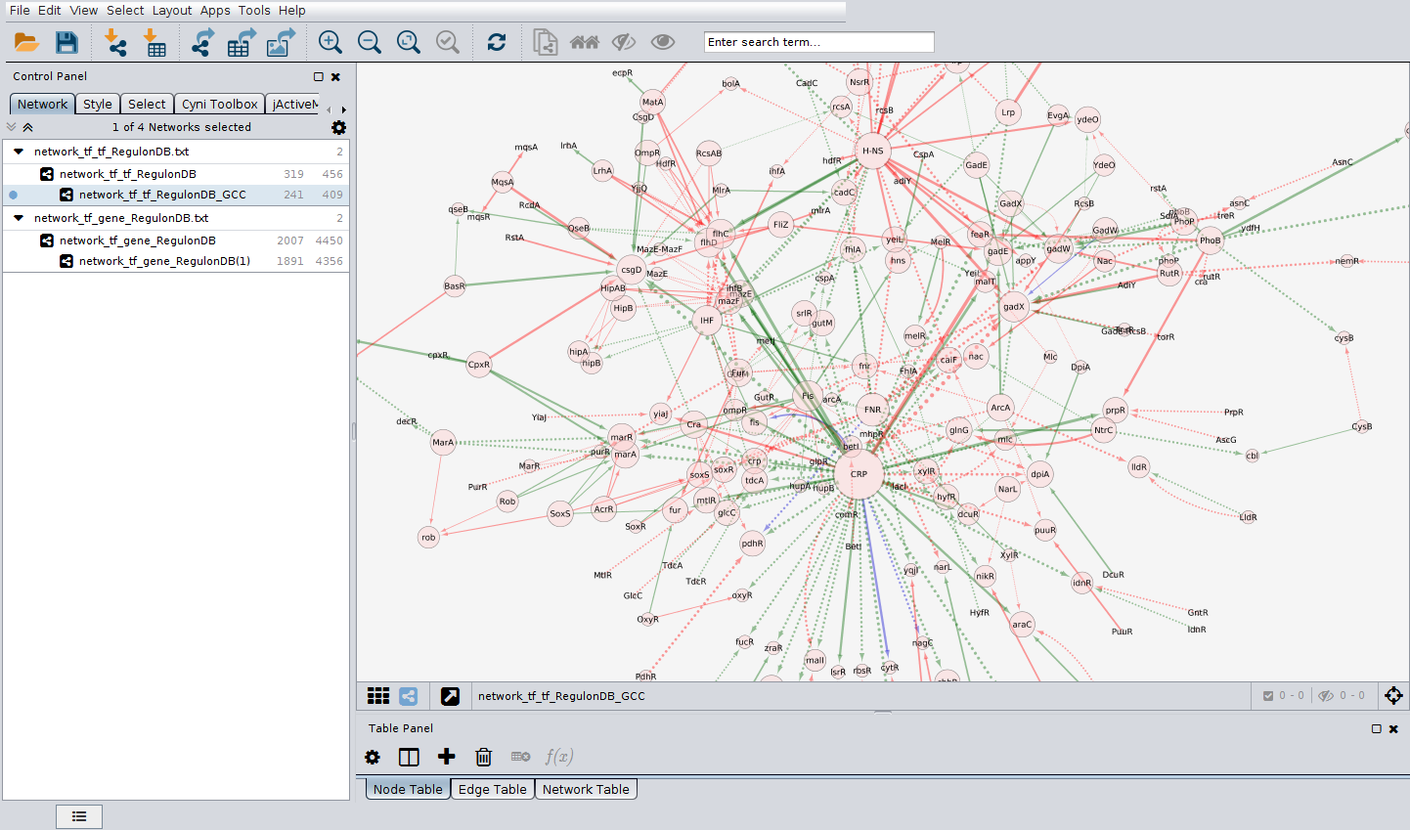
Cytoscape Advanced II
Hopefully you will get an image like the following:

Slide 4
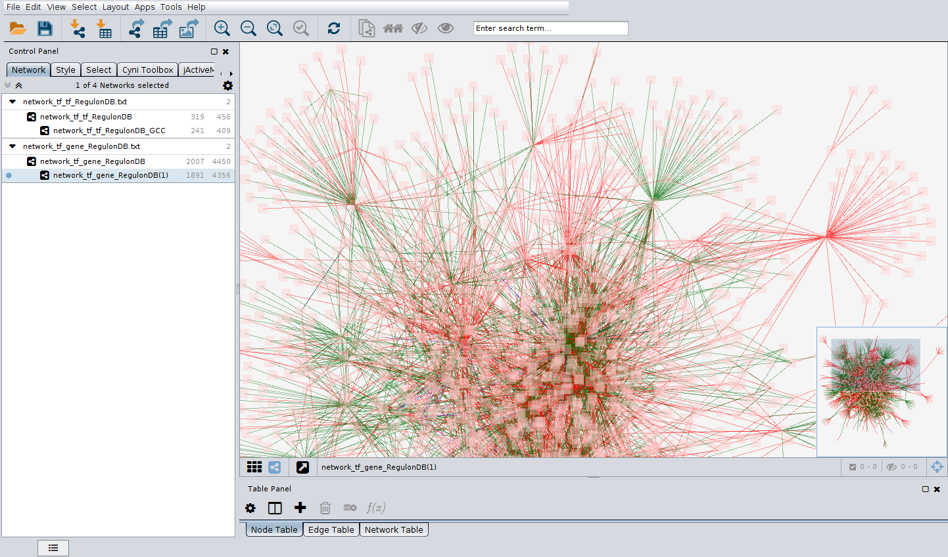
Cytoscape final
Replicate the analysis for the TF-genes network.
Can you identify global activators? repressors?

Slide 5
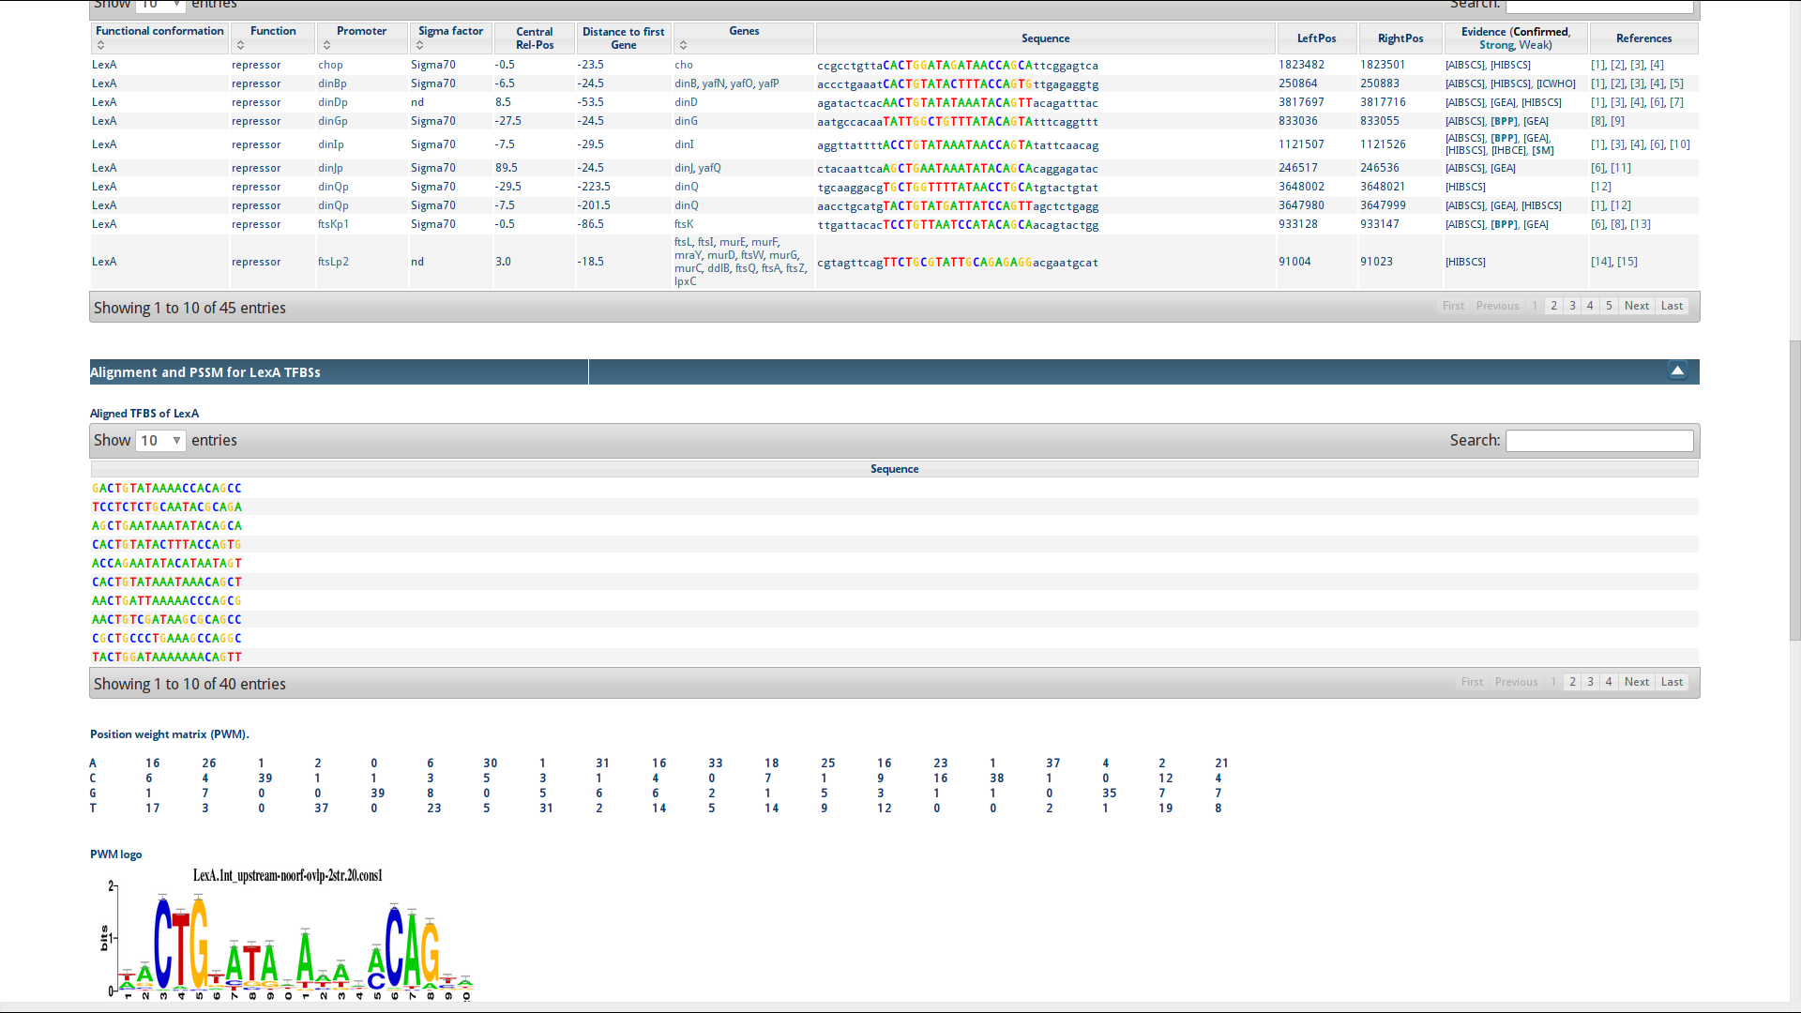
Back to RegulonDB
Choose your TF/gene of interest
Go back to RegulonDB and choose “regulon list”
Find everything you want for each TF.

Slide 6
Transcription regulation is ONLY ONE aspect of Network Biology
Networks everywhere in biology:
  Ecological (food web) networks
  Neuronal networks (cognition).
  Protein interaction networks.
  miRNA, RNAbps and other post-transcritpional regulation networks.
  Disease – symptoms – mutations networks.
  … the list is endless BUT
You now know how to analyse them all with Cytoscape and table files!
There is a series of very well made “official” tutorials for Cytoscape, you can access them here:
http://opentutorials.cgl.ucsf.edu/index.php/Portal:Cytoscape3

