Slide 1
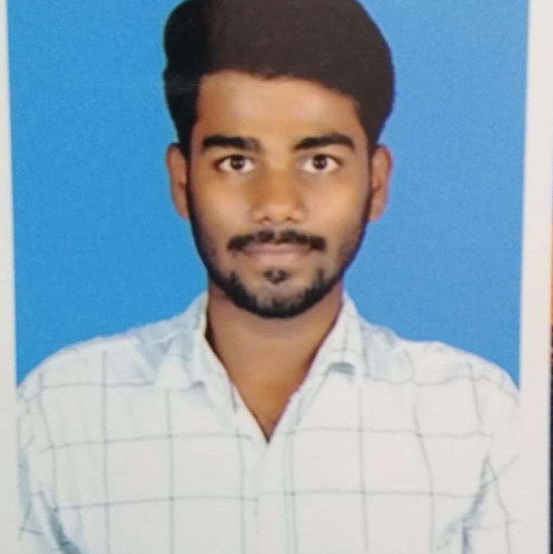


PURUSHOTHAM ETNENI
MASTER OF COMPUTER APPLICATIONS
Computer Science : 2018 -2020
Analyst/Software Engineer
Skills
BANGALORE
Purushotham.etneni@capgemini.com
C# | Basics, OOPS, Exception Handling, Collections & Generics, Delegates, Events , File IO and Serialization
.NET Framework | ADO.NET with Entity Framework And LINQ,ASP.NET with MVC5, ASP.NET CORE WEB API.
ADO.NET | Basics, Connected and Disconnected Architecture
RDBMS | Basic And Advanced Using SQL Server.
UI Technology | HTML 5, CSS And JavaScript
Tools | Git , Ssms, Visual studio, Visual studio code.
Add On Skills | Communication , Team management, Able to work in team, Quick learner.
+91 7842528955
A4
Full Stack Developer
• Hands on experience on C#,ADO.NET,LINQ,Entity framework,Sql Server,ASP.NET MVC5 with WEB API,ASP.NET CORE WEB API.
•Good in developing web pages using HTML, CSS.
•Currently learning on iTransform-Microsoft .Netcore and Azure fundamental
• Hands on experience in developing web pages using HTML5, CSS3, Object Oriented Java script. Good understanding of System Requirement Specification (SRS).
• Proficient in creating Single page Web Application in REACT with Authentication with routing.
Ready to learn new technologies and implement them for the future knowledge improvement and also career growth.
ON DEMAND ONLINE RAILWAY RESERVATION SYSTEM
Case study of On Demand Online Railway Reservation System along with API Gateway, Swagger,responsive UI with HTML5, CSS, js and React used as User Interface.
Three layered architecture which includes a Data Access Layer, Business Logic Layer using C#, ASP.NET CORE WEB API. , SQL Server .
Connecting the application with DB was done using ASP.NET CORE WEB API. Database was designed in SQL Server.
Connecting the application with database was done using ASP.NET CORE WEB API.
Check out my work on GitHub

