Slide 1
JAVA GUI Programming

Slide 2
Java GUI Libraries
Swing
Abstract Windowing Toolkit(AWT)
You should occasionally use AWT (Swing is built on top of AWT).

Slide 3
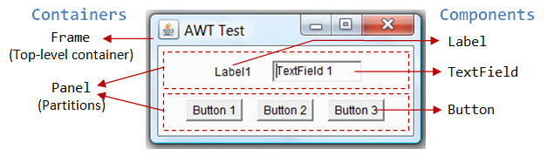
GUI terminology
window: A first-class citizen of the graphical desktop
Also called a top-level container
Examples: frame, dialog box, applet
component: A GUI widget that resides in a window
Also called controls in many other languages
Examples: button, text box, label
container: A component that hosts (holds) components
Examples: panel, box

Slide 4
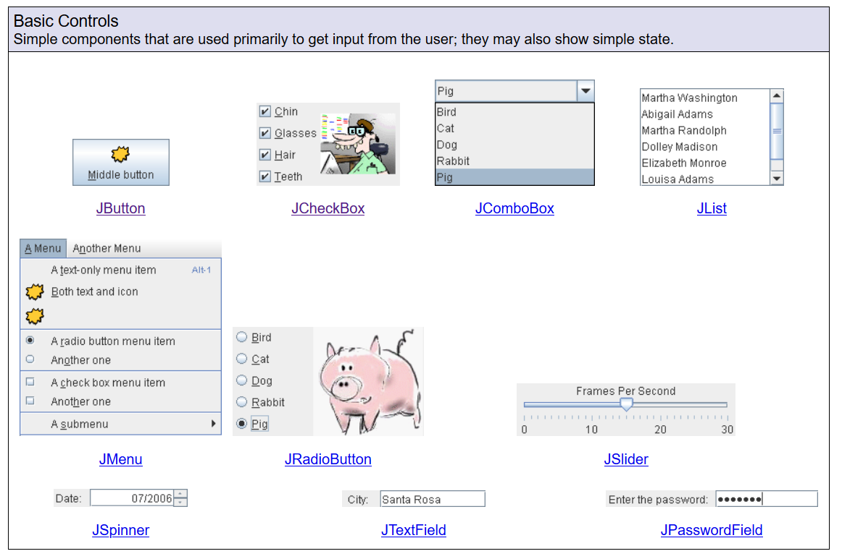
Java Components
https://web.mit.edu/6.005/www/sp14/psets/ps4/java-6-tutorial/components.html

Slide 5
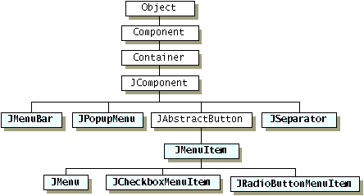
Component and Container Classes

Slide 6
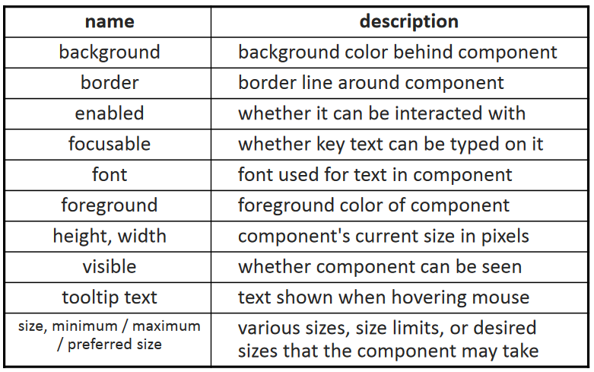
Component fields (properties)
Each has a getter and a setter methods.
Examples: getColor, setFont, isVisible,

Slide 7
Types of Containers
Top-level containers: JFrame, JDialog…
Mid-level containers: panels, scroll panes, tool bars…
Specialized containers: menus, list boxes, 2•
Technically, all J-components are containers

Slide 8
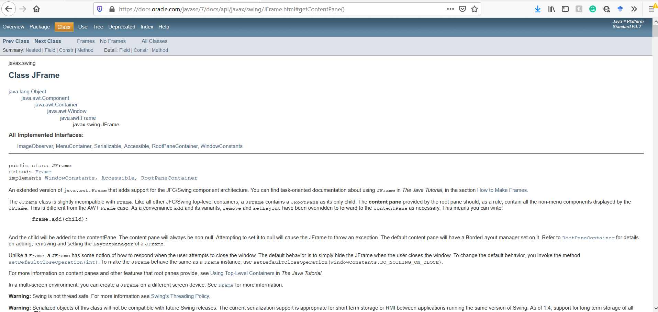
Example
FrameDemo.java
https://docs.oracle.com/javase/7/docs/api/javax/swing/JFrame.html

Slide 9
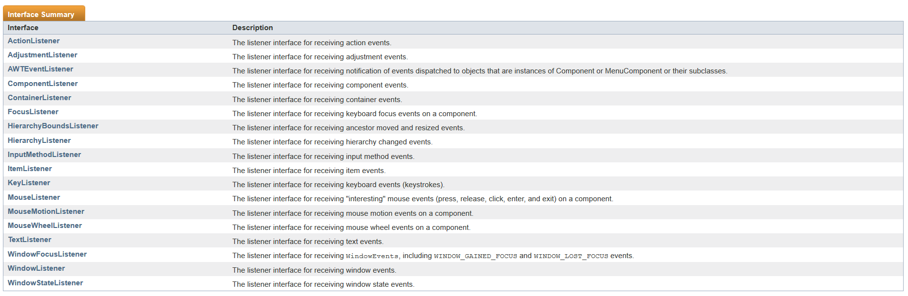
Event Listener
Can you find similarity with any design pattern?
https://docs.oracle.com/javase/7/docs/api/java/awt/event/package-summary.html

Slide 10
More Examples…
https://web.mit.edu/6.005/www/sp14/psets/ps4/java-6-tutorial/components.html

Slide 11
Next Lecture
Layout Manager
More Swing Components

