Slide 1
JAVA GUI Programming-2

Slide 2
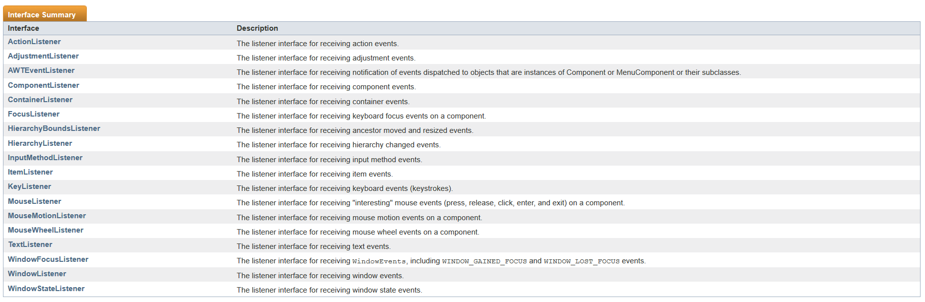
Event Listener
Can you find similarity with any design pattern?
https://docs.oracle.com/javase/7/docs/api/java/awt/event/package-summary.html

Slide 3
Layout Managers
BorderLayout
BoxLayout
CardLayout
FlowLayout
GridBagLayout
GridLayout

Slide 4
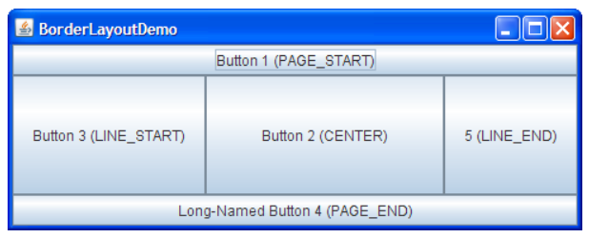
BorderLayout
A BorderLayout places components in up to five areas: top, bottom, left, right, and center.
All extra space is placed in the center area.

Slide 5
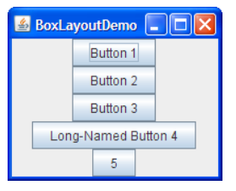
BoxLayout
The BoxLayout class puts components in a single row or column.
It respects the components' requested maximum sizes and also lets you align components.

Slide 6
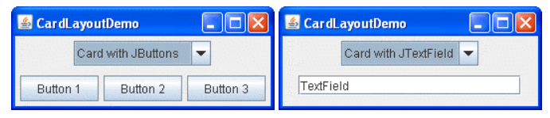
CardLayout
The CardLayout class lets you implement an area that contains different components at different times.
A CardLayout is often controlled by a combo box, with the state of the combo box determining which panel (group of components) the CardLayout displays.

Slide 7
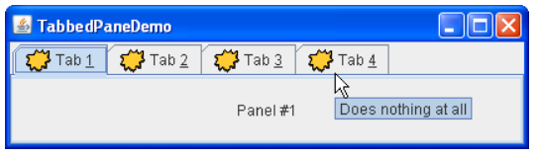
CardLayout…
An alternative to using CardLayout is using a tabbed pane.

Slide 8
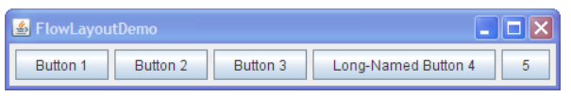
FlowLayout
FlowLayout is the default layout manager for every JPanel.
It simply lays out components in a single row, starting a new row if its container is not sufficiently wide.
Both panels in CardLayoutDemo, shown previously, use FlowLayout.

Slide 9
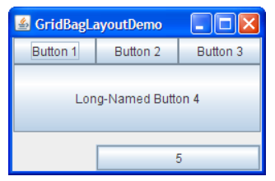
GridBagLayout
GridBagLayout is a sophisticated, flexible layout manager.
It aligns components by placing them within a grid of cells, allowing components to span more than one cell.
The rows in the grid can have different heights, and grid columns can have different widths.

Slide 10
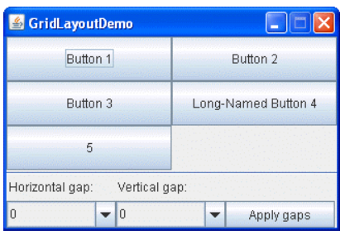
GridLayout
GridLayout simply makes a bunch of components equal in size and displays them in the requested number of rows and columns.

Slide 11
Other Swing Components
JComboBox
JTextArea
JScrollPane

Slide 12
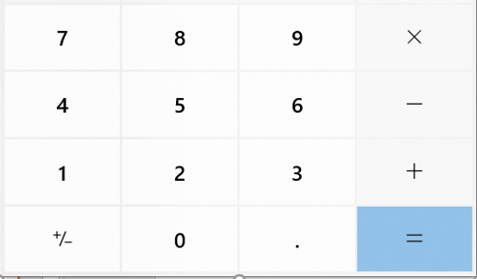
Class Assignment (1 Bonus point) Deadline: 6th April (Monday) at 11:59 pm
Write a java program to implement a very basic calculator (the layout should be similar to the figure below). Your calculator must be able to add, subtract, multiply and divide.

Slide 13
Next Lecture
State Design Pattern

