Slide 1
Strömkretsen
Kalle Hallberg & Kevin Kihlström

Slide 2
Uppgiften

Slide 3

Differentialekvationen

Slide 4
RungeKutta4
function [T, Y] = RK(yprim, t, y, h)
k1 = h*feval(yprim, t, y);
k2 = h*feval(yprim, t+h/2, y+k1/2);
k3 = h*feval(yprim, t+h/2, y+k2/2);
k4 = h*feval(yprim, t+h, y+k3);
ny = k1/6 + k2/3 + k3/3 + k4/6;
Y = (y+ny);
T = t+h;
Intervall [0 0.1] med 2000 steg
h = 0.00005
Relativ tolerans 10^-4, h = h/2;

Slide 5
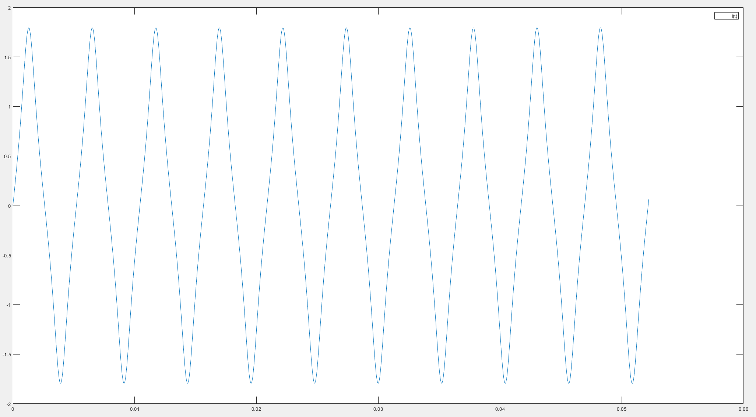
U0 = 1200V

Slide 6
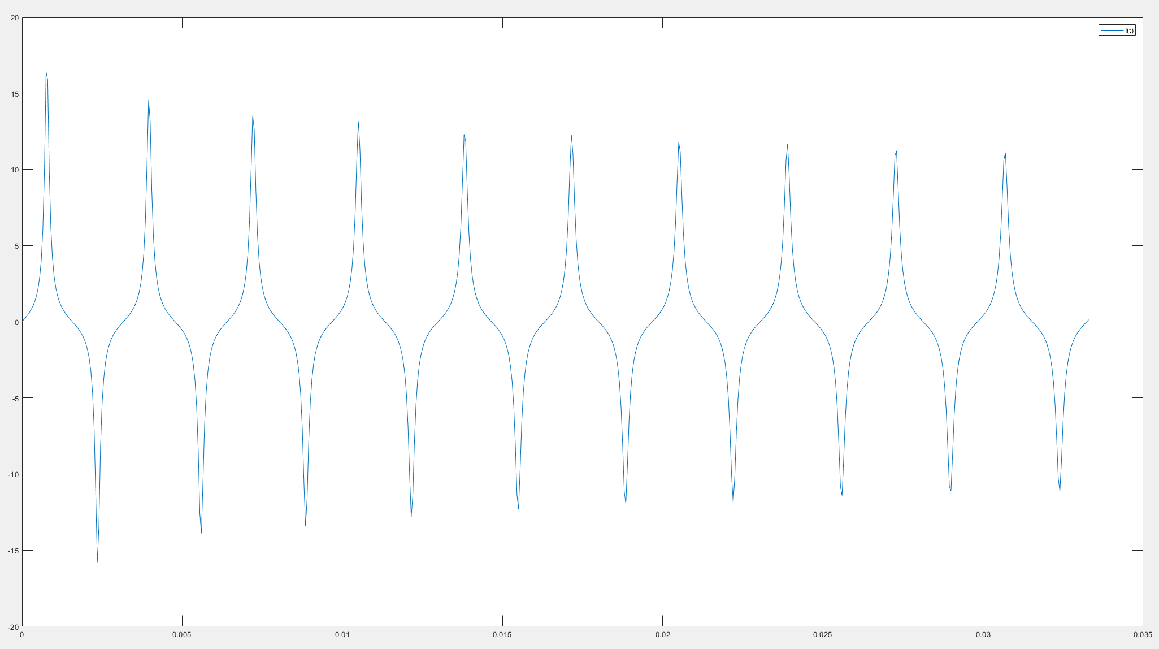
U0 = 2400V

Slide 7
Imax och T
T:
if ygraf(k,1)-ygraf(2,1) < 10^-2 &&
ygraf(k,1)-ygraf(k+1,1) < 0 &&
ygraf(k,1) > 0 && ygraf(k)-ygraf(2) >0
Imax:
if ygraf(k,1) <= ygraf(k-1,1)
T ~ 0,0063s
Imax ~ 0.243286409030988A

Slide 8
Fourieranalys
Beräkna ak i utvecklingen:

Slide 9
Funktion för I(t)sin(kwt)
function [fval] = f(y, k, t, omega)
sval = [];
for x=1:length(t)
sval = [sval; sin(k*omega*t(x))];
end
fvek = [];
for x=1:length(y)
fvek = [fvek;
sval(x,1).*y(x,1)];
end
fval = fvek;
end

Slide 10
Trapetsregeln
a,b = integrationsgränserna

Slide 11
Trapets - funktion
function add = add(vek)
vek(1) = vek(1)/2;
vek(end) = vek(end)/2;
var = 0;
for x=1:length(vek)
var = var + vek(x);
end
add = (vek(1)+vek(end)+var)*0.00005;
end

Slide 12
Funktion aksin(kwt)
function smm = f(t, y)
omega =2*pi/t(end);
smsa = [];
sms = zeros(1, length(t));
for k = 1:14
smsa = [];
for a=1:length(t)
smsa = [smsa; y(k)*sin(k*omega*t(a))];
end
sms(k, :) = smsa(:,1);
end
smm = sms;
end

Slide 13
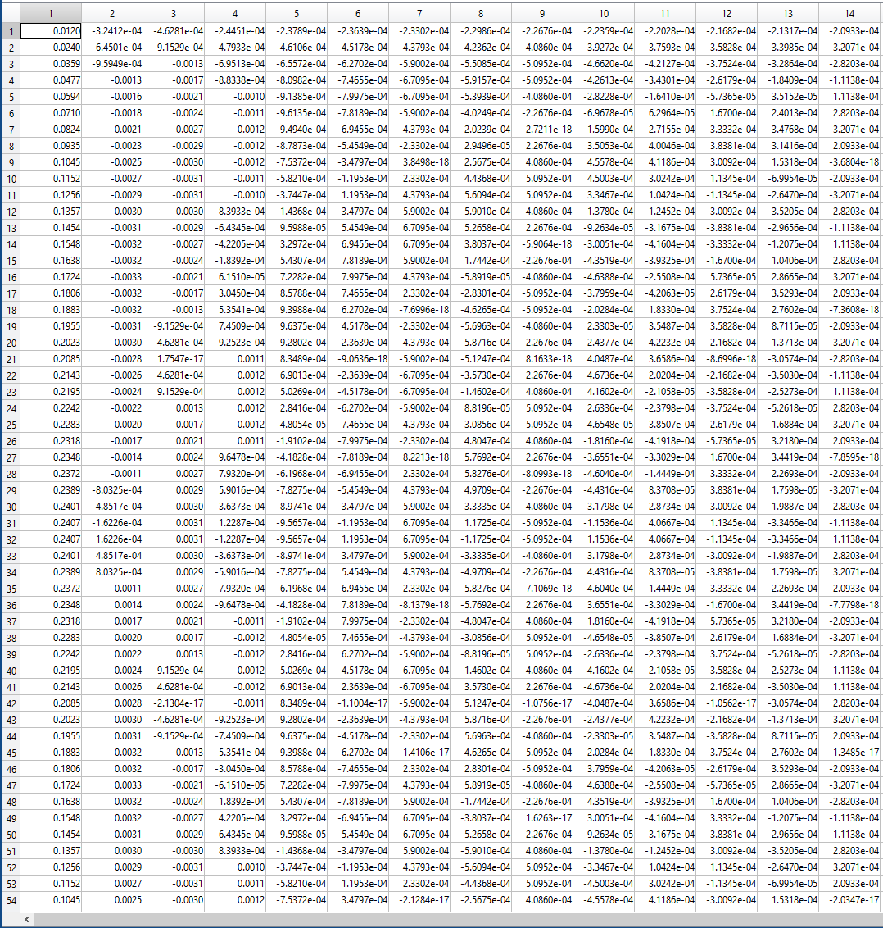
Alla koefficienter

Slide 14
ak vid 2000 steg
0,240811822405381
-0,00325522614048353
-0,00310525538805510
-0,00123399482257884
-0,000964047425901078
-0,000801993226093478
-0,000681300593342480
-0,000591751688770555
-0,000522623199778231
-0,000467505317707299
-0,000422455525097315
-0,000384889705960929
-0,000353040834647143
-0,000325659034980121

Slide 15
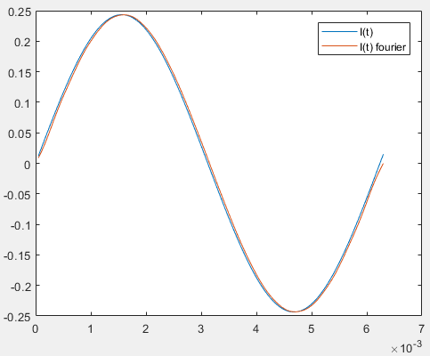
Fourier 2000 steg med 14 koeff

Slide 16
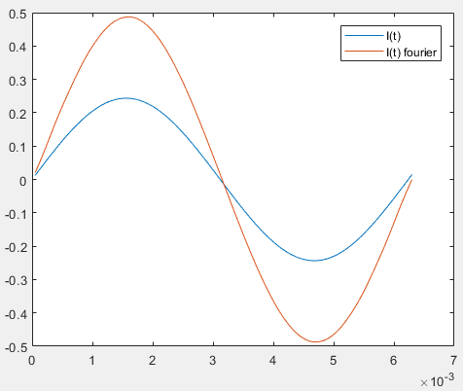
2000 steg 3 koeff.

Slide 17
ak vid 1000 steg
0,00155696366234925
0,120173024508259
-0,00293132933514070
-0,00162113271149855
-0,00117463260472734
-0,00153500416437315
-0,000697198032114387
-0,000610212061431789
-0,000536713624780359
-0,000474061882507238
-0,000431159765769290
-0,000391424511620537
-0,000358098318884615
-0,000329666227395587

Slide 18
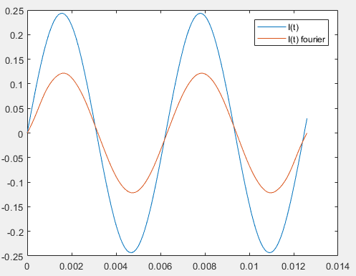
1000 steg 14 koeff.

Slide 19
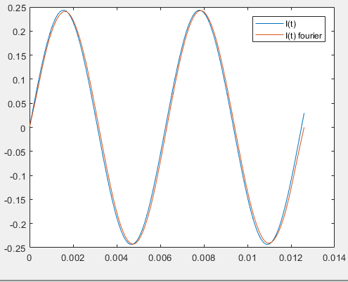
1000 steg 3 koeff.

Slide 20
Tack för oss
Frågor?

