Slide 1


NEXT GEN EMPLOYABILITY PROGRAM
CREATING A FUTURE-READY WORKFORCE
Student Name :
ETTIKALA BHARGAVI
Student ID :
College Name :
SPHOORTHY ENGINEERING COLLEGE
INTERNSHIP_173951615267aee8f889303

Slide 2
CAPSTONE PROJECT SHOWCASE
Project Title
CUSTOM ECOMMERCE PLATFORM USING MERN TECHNOLOGY
Abstract | Problem Statement | Project Overview | Proposed Solution | Technology Used | Modelling & Results | Conclusion | Q&A

Slide 3
Abstract
1
This project focuses on building a custom e-commerce platform using the MERN stack (MongoDB, Express.js, React, Node.js).
2
It is designed to simplify the online shopping experience by providing a clean interface, fast performance, and secure data handling.
3
Users can register, explore product catalogs, manage their cart, and place orders with ease .The goal is to deliver a scalable and user-friendly platform tailored to today’s digital shopping habits.
4
The platform is designed to be secure, scalable, and easy to use, making it a suitable solution for modern online shopping needs.

Slide 4

Problem Statement
Many e-commerce platforms today suffer from poor performance, outdated design, and complex navigation. These issues often frustrate users, leading to cart abandonment and reduced customer satisfaction. Inconsistent product updates and weak backend systems also affect the reliability of these platforms.
To address these challenges, there is a need for a modern, scalable solution that offers a smooth user experience and efficient backend operations. This project aims to build a responsive and secure e-commerce web application using the MERN stack, ensuring fast performance, clean UI, and easy product and user management.

Slide 5
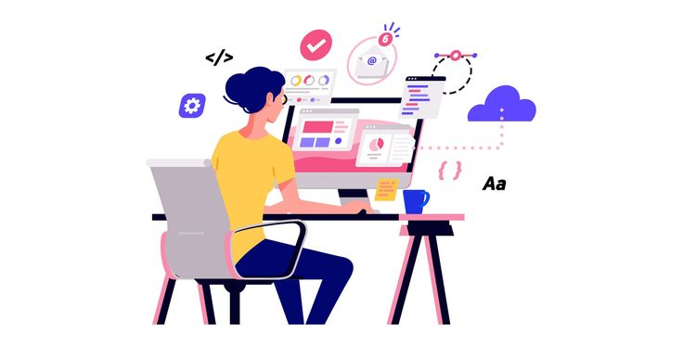
Project Overview
The e-commerce platform is built to:
Allow secure user authentication and profile management.
Display a dynamic product catalog with categories and images.
Enable a smooth shopping cart experience and order placement.
Ensure fast, consistent performance across devices. The project integrates frontend and backend components to work seamlessly together.

Slide 6
Proposed Solution
We propose building a full-stack e-commerce web application using the MERN stack — MongoDB, Express.js, React, and Node.js. This combination enables efficient development of both the frontend and backend while ensuring high performance and scalability.
React is used to create a dynamic and responsive user interface, providing smooth navigation and real-time updates. Node.js and Express.js handle the server-side logic, API requests, and user authentication securely. MongoDB, with Mongoose, manages flexible data storage for users, products, and orders. Together, this architecture supports fast loading times, structured data flow, and a clean shopping experience. Additional features like secure login, cart handling, and modular code design ensure the system is maintainable and ready for future upgrades.

Slide 7
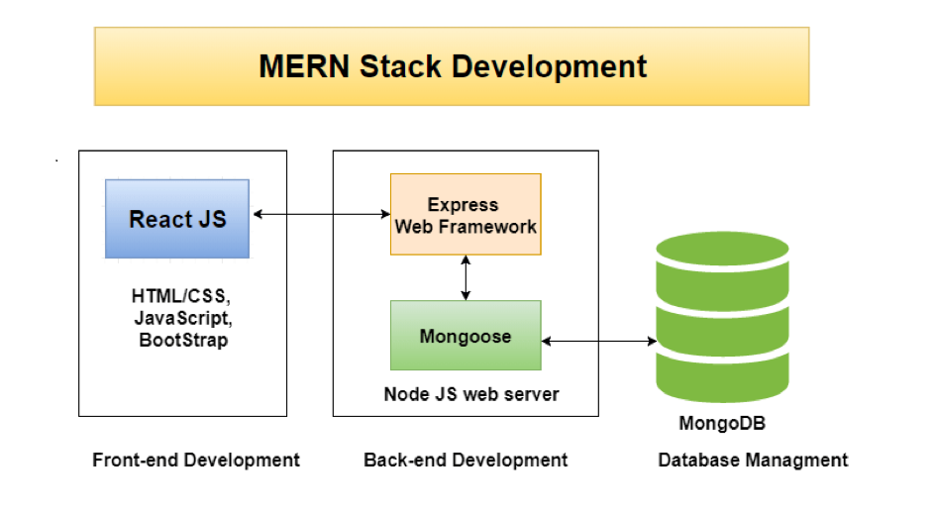
Technology used
Frontend:
React – For building the UI
React Router – For navigation
CSS – For styling
Backend:
Node.js – Server runtime
Express.js – Web framework
Database:
MongoDB – NoSQL storage
Mongoose – Data modelling tool
Tools:
Git/GitHub – Version control
Postman – API testing

Slide 8
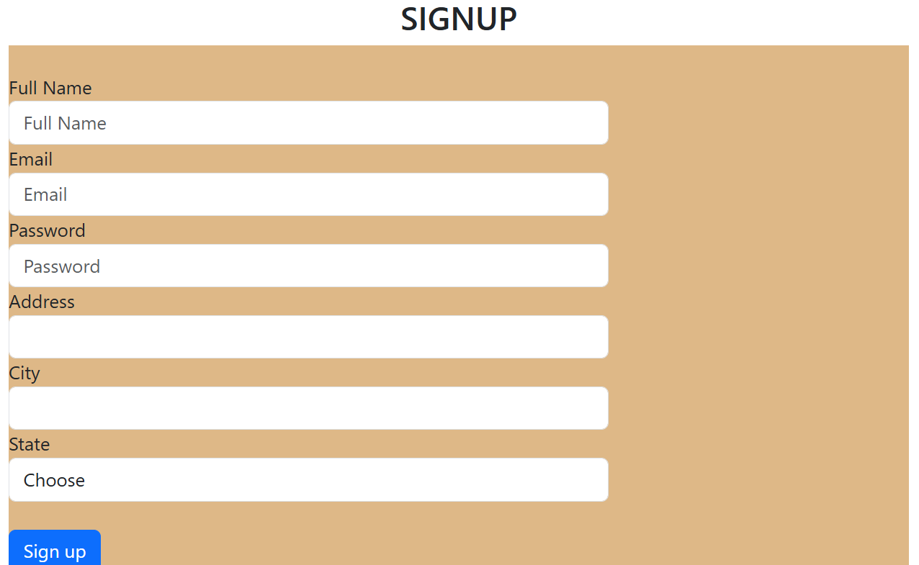
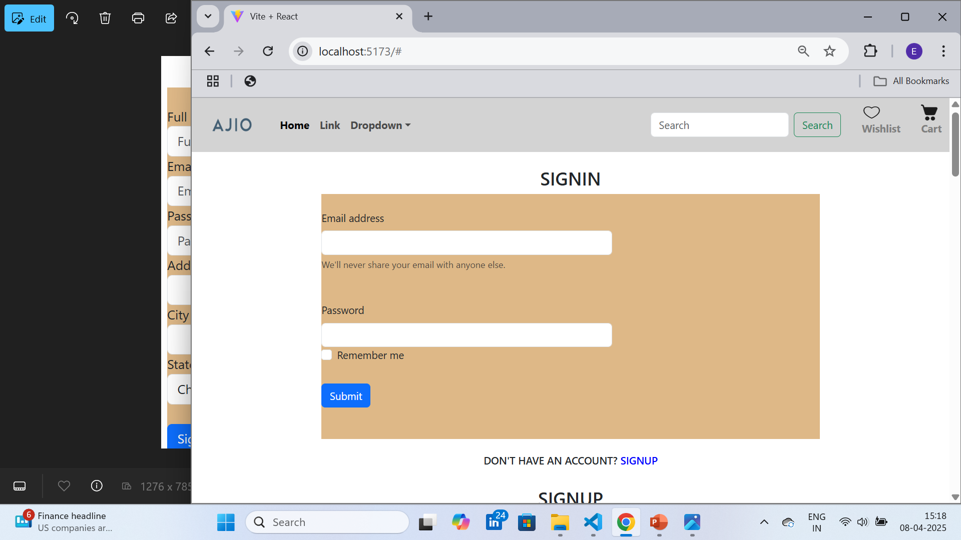
Modelling & Result

Slide 9
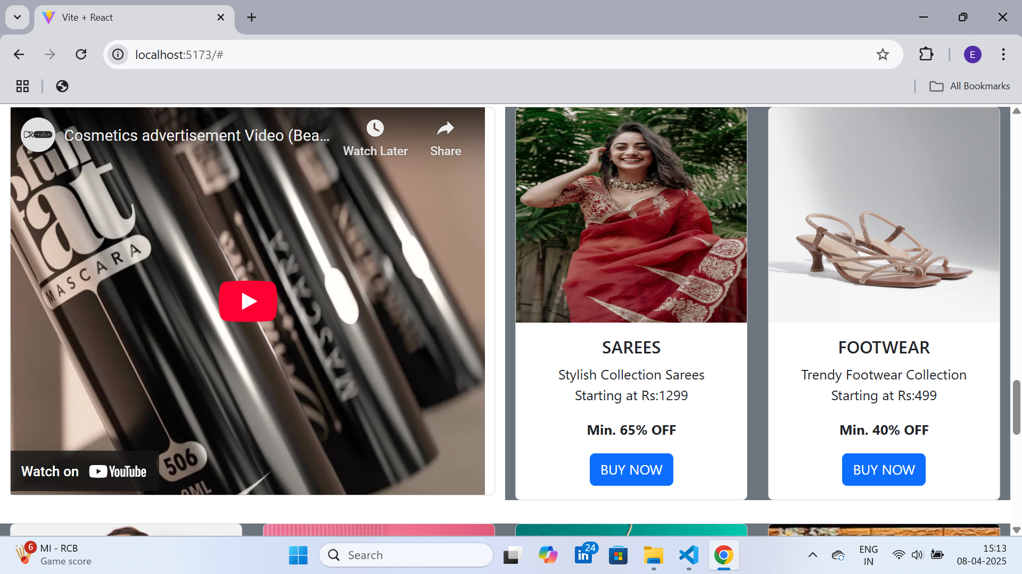
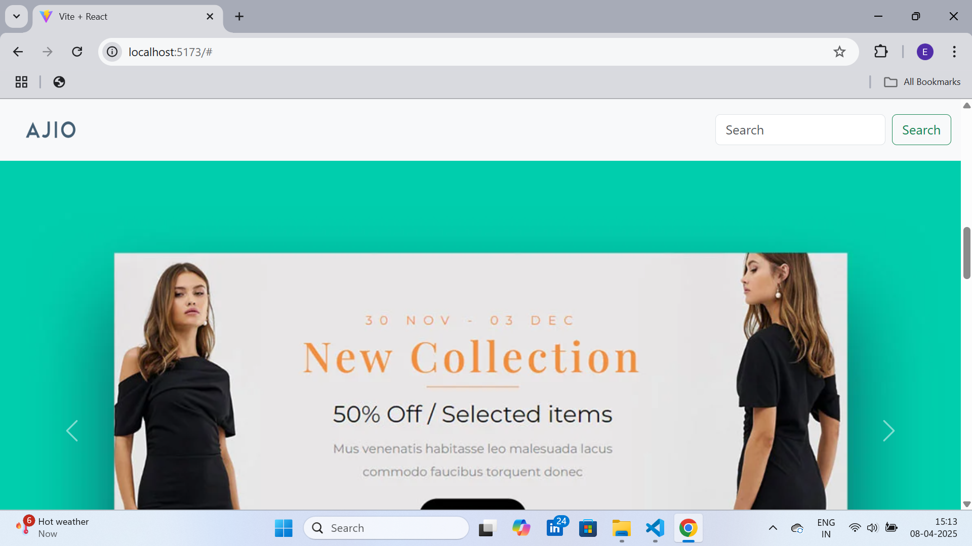
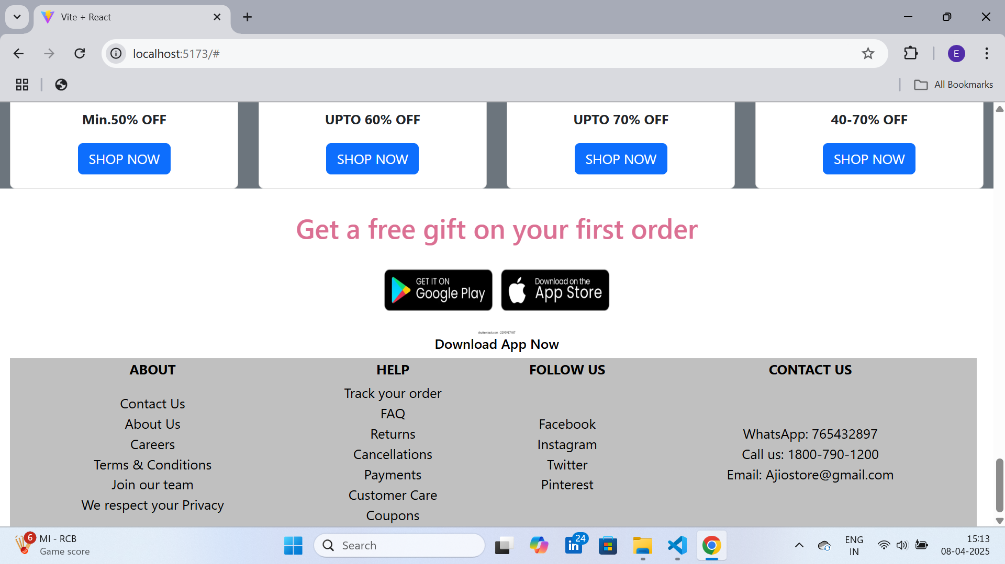
Modelling & Result

Slide 10
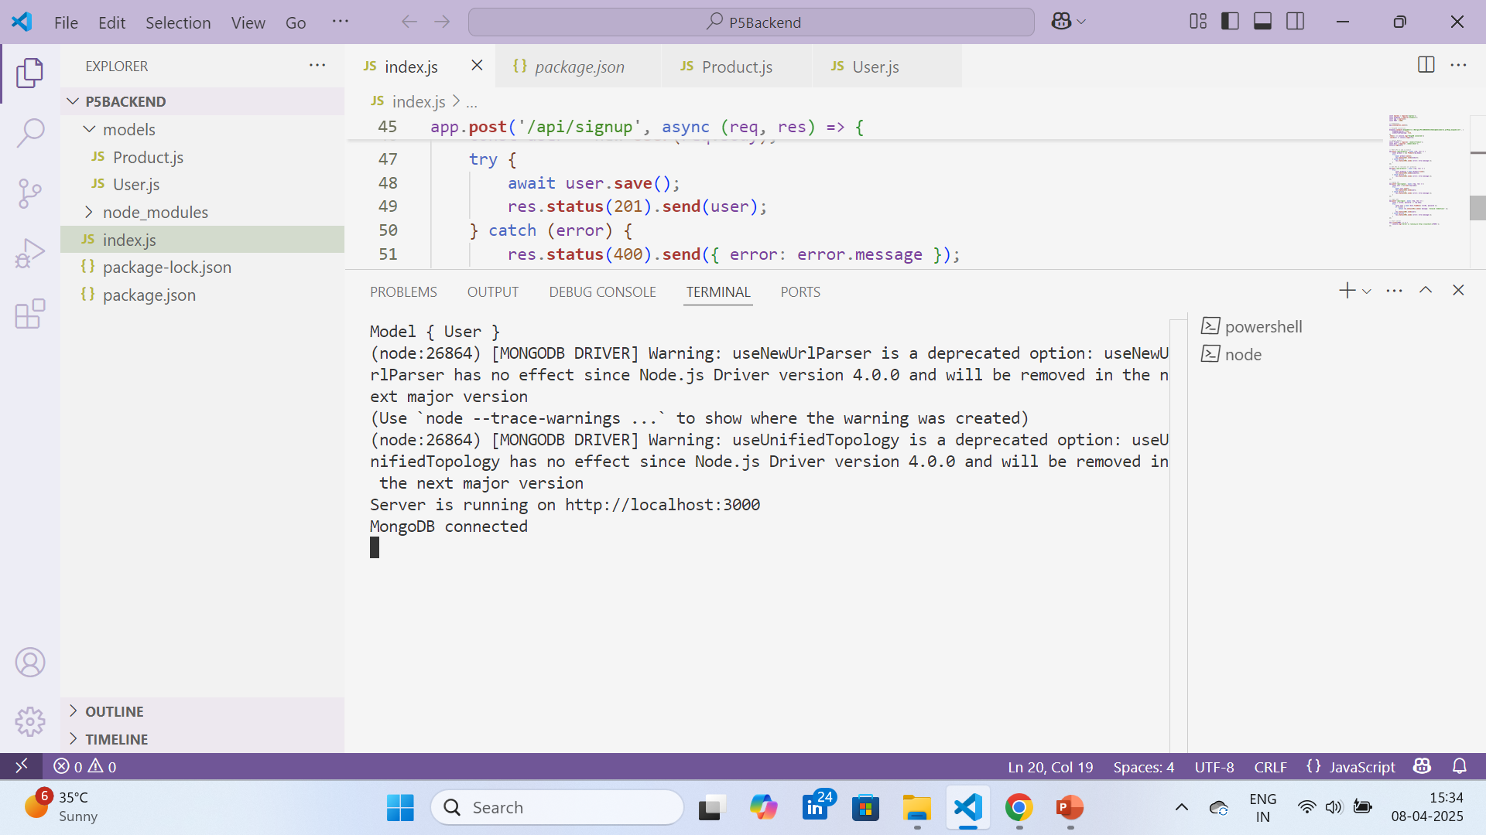
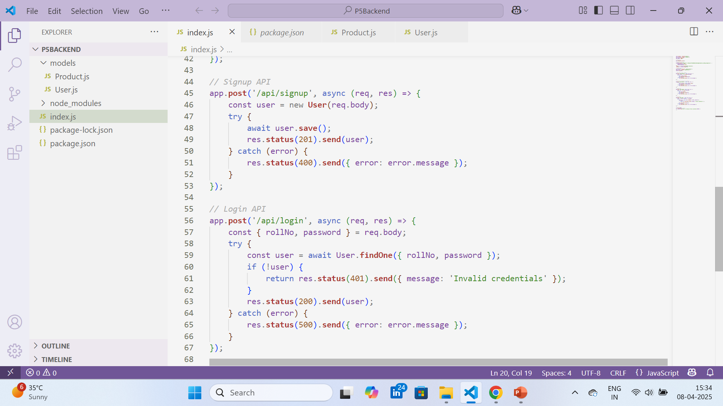
Modelling & Result

Slide 11

Conclusion
This project demonstrates the successful implementation of an e-commerce web application using the MERN stack. It delivers a clean user interface, responsive design, and reliable backend operations, all tailored to enhance the online shopping experience.
Looking ahead, the platform can be improved by adding features like payment gateway integration, product recommendations, and admin dashboards for inventory control. These additions will enhance both the user experience and business functionality, making the application more competitive and production-ready.

Slide 12

Any Queries?
Notes:
Thank You !!

Slide 13

Notes:
Thank You !!

