Slide 1

TravelMate
Technical presentation
Ettore Ricci, Paolo Palumbo, Francesco Boldrini

Slide 2
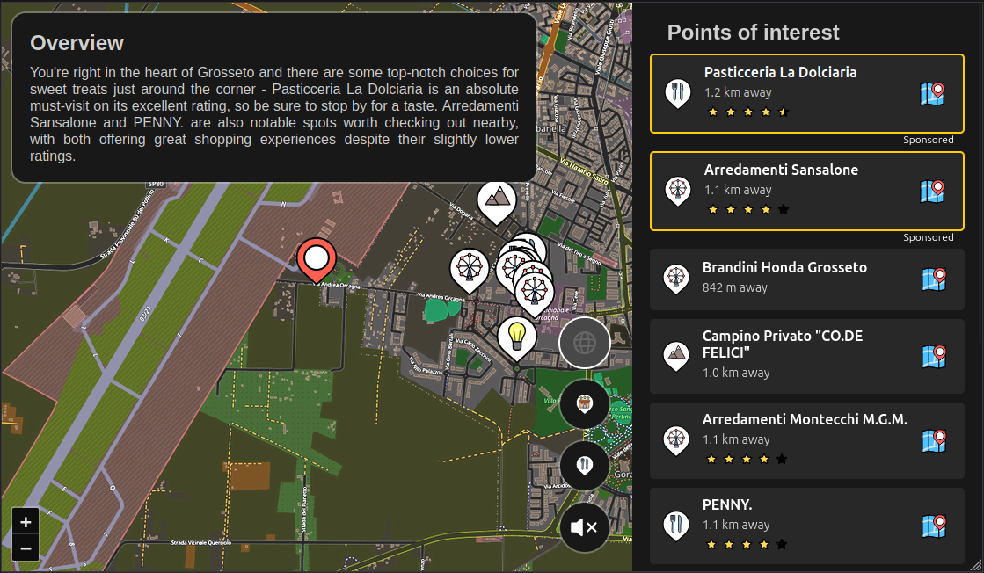
Project overview
Discover nearby points of interest
Filter POI by type
Driver friendly commands
Nearby area AI description read by TTS
Automatic update with use movement

Slide 3
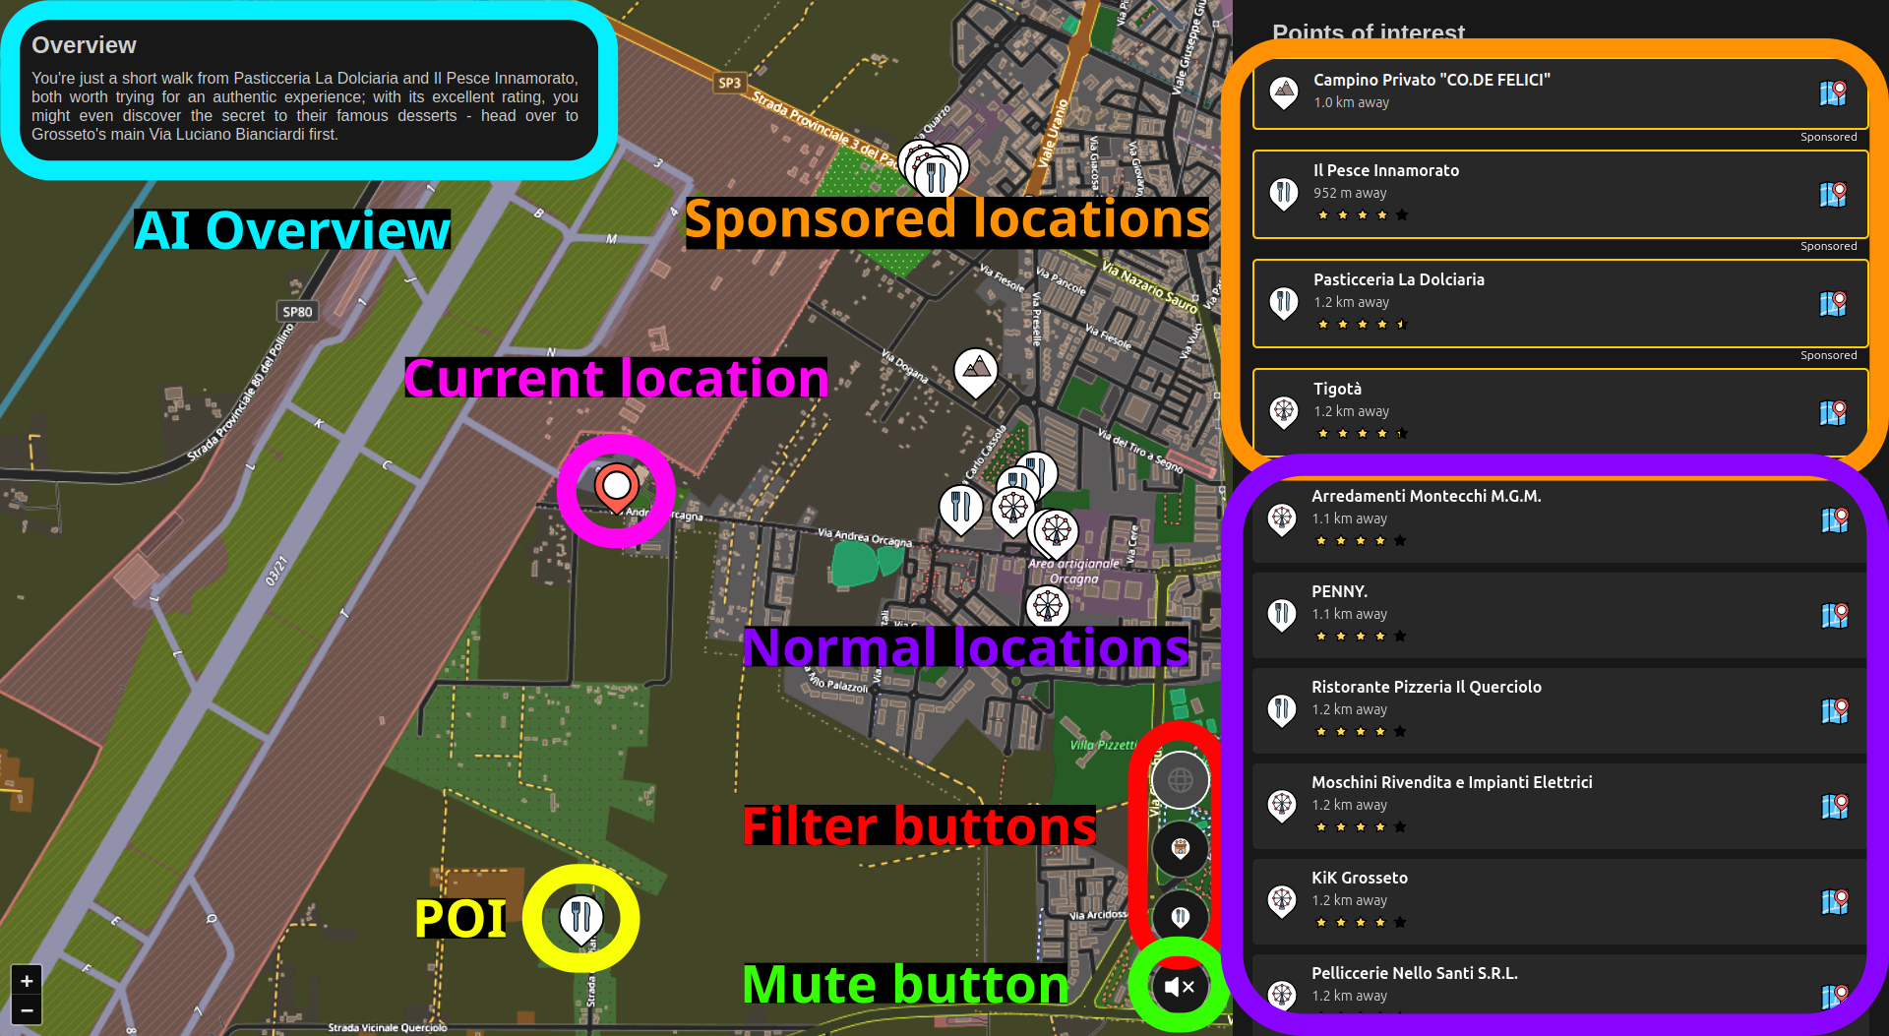
User Interface

Slide 4
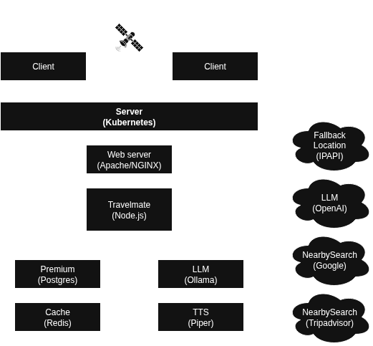
System architecture

Slide 5
Microservices
We developed a microservices-oriented application
This paradigm allows for high scalability and modularity
The app is easily deployable on Kubernetes

Slide 6
Microservices
TravelMate
We used the Next.js React framework to develop the application
The resulting application is platform independent and easy to maintain and develop
We created a reverse proxy for all the APIs that we use to control API access and keep the keys secure

Slide 7
Microservices
Web server
The demo used Apache but any HTTPS-reverse-proxy-capable web server is adequate for the job
Ideally we would use NGINX because it’s easily configurable and deployable

Slide 8
Microservices
LLM
We chose Ollama for self hosting our LLM because it’s fast and requires practically no configuration to work
We configured Ollama to always keep the model loaded to save time on the inference
The LLM we chose is Llama3.2:3b because it’s relatively small but smart enough to follow the prompt correctly
This microservice could be swapped with the OpenAI API if a more powerful model is necessary

Slide 9
Microservices
TTS
Piper and FastAPI were chosen for the job because it was the easiest way to provide a TTS server without resorting to external APIs
Piper is the model that translates text to raw PCM frames while FastAPI serves them on an HTTP stream
Unfortunately Piper is poorly documented and does not have incredible performance, but it’s the model with the lowest latency among the ones we considered

Slide 10
Microservices
Premium
For the demo we used a placeholder service implemented with FastAPI
In a real use-case we would use Postgres to provide the necessary information about the sponsored businesses

Slide 11
Microservices
Cache
In the demo this was disabled
In a real use-case we could use Redis to provide a fast cache that avoids repeated calls to the more costly APIs like Google and LLM

Slide 12
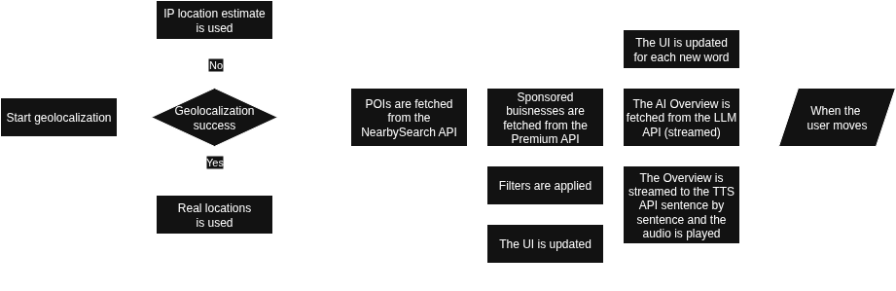
App flowchart

