Slide 1

Code Explanation
Device Driver (virt-sha.c)

Slide 2
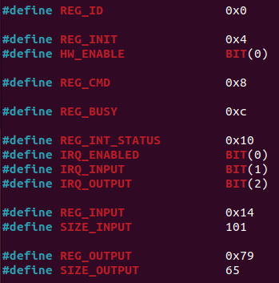
Parameters Definition
All the constants starting with REG, indentifies the offset with respect to the corresponding register mapped in memory.
For example REG_INIT is accessable at a virtual address 0x4 meaning that in our specific case REG_INIT is located at 0x0b000000 + 0x4. 0x0b000000 is in fact the starting address of our memory mapped device.
REG_ID has no useful meaning since it only identifies an id that can be assigned to your device but it can be removed since it is NOT fundamental for the device to work.
REG_BUSY is used to reserve our device when an input has been delivered in order to prevent other applications to access the device.
REG_INIT stores the enable bit used to wake up or disable our device. HW_ENABLE is the macro associated to BIT(0) that create a bit mask.
REG_INIT_STATUS stores the bits to properly read and write interrupt request.
REG_INPUT is the address where a string coming from the ARM processor will be stored. The maximum size is SIZE_INPUT (100 characters + 1 termination string field)
REG_OUTPUT is the address where the coded SHA-256 string is stored. Its size is defined to be 65 characters. This field must not be changed since the SHA-256 always provide 64 bytes as output. Notice that its value is equal to 0x79 = 0x14 + 101 (0x65) .

Slide 3
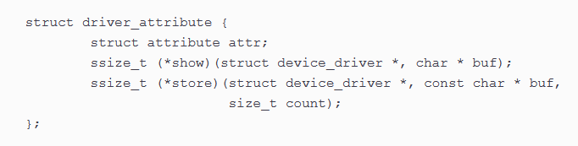
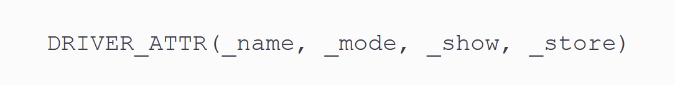
How do we access device memory?
Struct above is the linux definition to use attributes. As can be seen, a read and write function can be defined by the user writing the kernel module. Notice that *buf is the pointer to string that contains data to be read or written.
An attribute is created through the following macro:
Linux provides a special feature to ‘’communicate’’ with the kernel memory using attributes. Attributes are sysfs files exported to the user space by kobjects. An attribute represents an object property that can be readable, writable, or both, from the user space. That said, every data structure that embeds a struct kobject can expose either default attributes provided by the kobject itself (if any), or custom ones. In other words, attributes map kernel data to files in sysfs.
_name is the attribute name
_mode defines the accessing rights
_show and _store are respectively the read and write functions associated to the attribute.

Slide 4

Device Attributes
In our application we defined 4 different attributes:
Let’s analyze for example attribute id:
Inside the macro the first parameter correspond to the specific device attribute. S_IRUGO specifies that id can be accessed only in read mode; for write operations S_IWUSR has to be added vf_show_id is the function to read id, constructed with the constraints and parameters shown in the picture above. NULL as last parameter indicates that no write function is used.

Slide 5
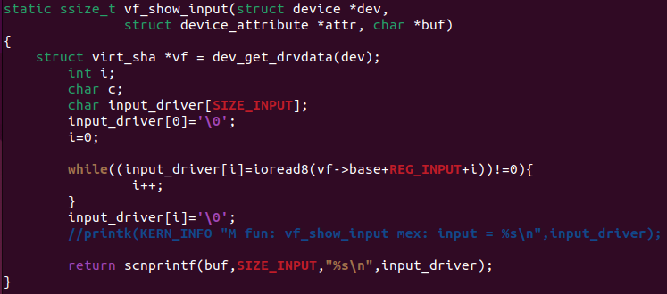
Attribute Read Function
Once an input string has been passed as argument, the user can read what has been stored inside the device.
vf_show_id takes a device struct as first parameter, this is useful to get all the information about the device. For this specific case we’re interested in extracting the starting memory address linked to the device (vf->base). Pay attention that vf->base does not coincide with 0xb0000000 since kernel operates with different addresses (see slide n 8)
While loop cycle is used to write each character one-by-one inside input_driver string. To access the memory, the ioread8 function returns 8 bit, dimension of a character.
To be able to read something from an attribute, the operation has to be performed by scnprintf(). This function is build for the porpuse of storing data inside a buffer (i.e char *buf) and returns the number of written characters. Pay attention that to properly read the content of an attribute, return value of vf_show_input must be equal to the number of charaters contained inside *buf.
Let’s analyze as example the functions related to the input data. Others are very similar to the one presented.

Slide 6
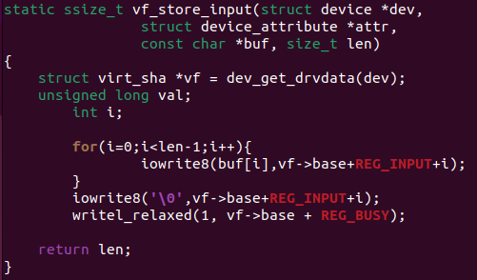
Attribute Write Function
Similarly to what happens with the read function, now the string is passed as argument (*buf) and thorought iowrite8 we can store each store into the device memory.
Let’s analyze as example the functions related to the input data. Others are very similar to the one presented.
In some part of the code you may find these two functions to implement the read and write operations. They both work in the same way as the ioread8 and iowrite8 with the only difference that a 32 bit data is passed.

Slide 7
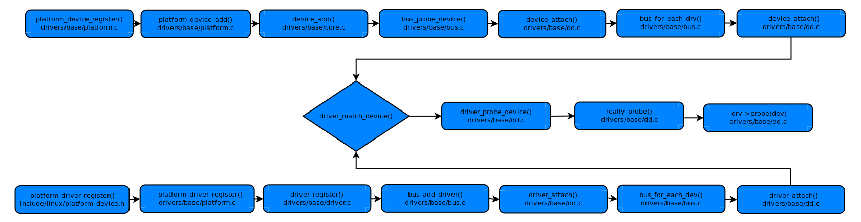
Probe Function
Probe() will be called to make sure that the device exists and the functionality is fine.
Probe() is called at the time of device boot or when device is connected. For a "platform" device the probe function is invoked when a platform device is registered and its device name matches the name specified on the device driver.
Probe function is the way to properly recognize and initialize a device. There are many steps before reaching the link between the driver and the device.

Slide 8
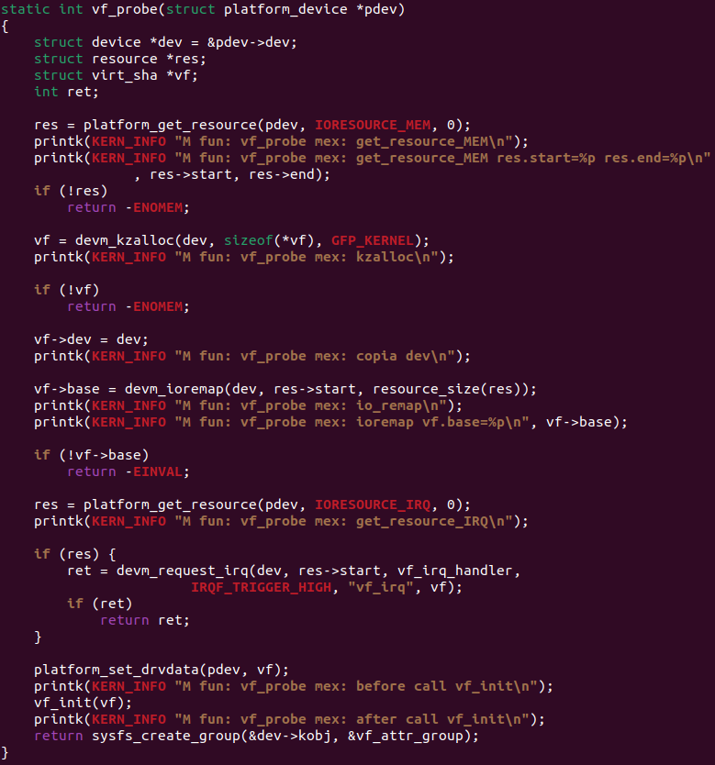
Probe Function
Putting ourself at the end of that chain we remapped the function probe doing many task such as:
kzalloc -> allocate an array of n items, and will zero the entire array before returning it to the caller.
Ioremap -> when kernel code needs to access emory-mapped I/O devices, it must first set up an appropriate kernel page-table mapping. The in-kernel tool for that job is ioremap() . A successful call to ioremap() returns a kernel virtual address corresponding to start of the requested physical address range. This is the time where vf->base is linked to the beginning of the memory reserved to the device.

Slide 9
Probe Function and Platform Devices
Proprierties of a platform device driver:
Platform devices are inherently not discoverable, i.e. the hardware cannot say "Hey! I'm present!" to the software.
Platform devices are bound to drivers by matching names,
Platform devices should be registered very early during system boot. Because they are often critical to the rest of the system (platform) and its drivers. You can test on your own what has just been said: on the previous slide there are many printk(). This function returns messages to the kernel log which can also be read when launching QEMU. During boot time, all the devices are initialized and you will see the instant our system calls the probe function related to our device.
Platform devices are devices that typically appear as autonomous entities in the system and are directly connected with the CPU.
In this project we in fact decided to deal with a platform device able to compute the SHA-256 independent from the main processor.
Platform drivers follow the standard driver model convention, where discovery/enumeration is handled outside the drivers, and drivers provide probe() and remove() methods. They also support power management and shutdown notifications.
To work with a particular platform device, you have to:
register a platform driver that will manage this device. It should define a unique name
register your platform device, defining the same name as the driver.

Slide 10
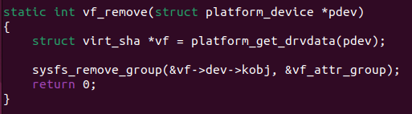
Removing the Device
When the device has to be removed this specific function will be called by the system and through sysfs_remove_group the device will be indefinitely removed and won’t be accessible anymore.

Slide 11
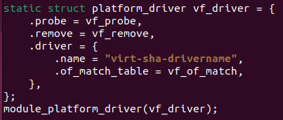

Functions Mapping and Driver Compatibility
When custom code for the probe or whatever function used to define the device is provided, it’s necessary to specify it inside this static struct. For example .probe = vf_probe indicates that vf_probe is the function linux will have to call when probing the device.
Here we assign a name to the driver, it can be whatever since it won’t affect the behavior of simulation.
Here instead is specified the driver compatibility so the name reported “virt-sha-driver” will be important because it will have to used for all the devices intended to work with this specific driver code. So driver virt-sha.c will be linked to the device description virt_sha.c

Slide 12
Code Explanation
Device Description (virt_sha.c)

Slide 13
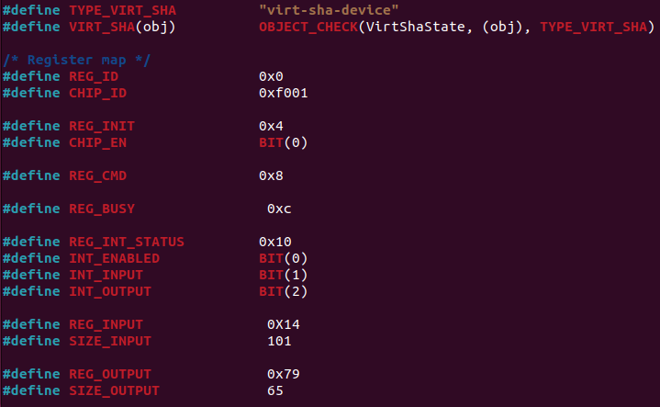
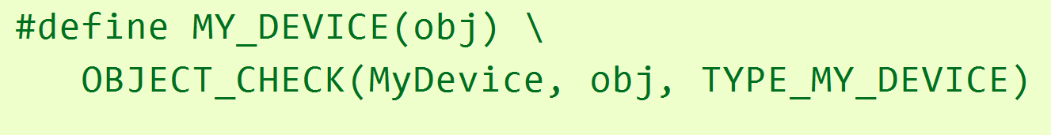
Parameters Definition
It might be noticed that register definition follow the same pattern as for the device driver because we will have to deal with the memory itself inside our device description.
TYPE_VIRT_SHA = ‘’virt-sha-device’’ is useful to indentify our device and set it up when configuring QEMU. This name is used to link this file with ‘’virt.c’’ where the device is added to the QEMU configuration.
OBJECT_CHECK is a macro used for type checking in the QEMU object model. It helps ensure that an object belongs to a specific type before performing operations or accessing its properties. This is crucial for maintaining the integrity and consistency of the object-oriented system within QEMU.
MyDevice: This is the type of the device being checked.
obj: This is a pointer to the object being checked.
TYPE_MY_DEVICE: This indicates the name of the device.

Slide 14
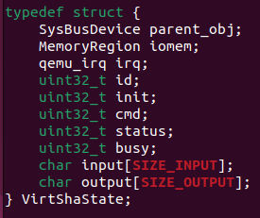
Device Struct
SysBusDevice is a struct representing an hardware device connected to system buses. Having a deeper look at the struct you might see that for example numbers of IO pins are defined.
MemoryRegion is another struct representing and describing a memory region inside our device.
irq is an object used by qemu to interpretates interrupt requests.
The other variables are used to store all the data that we’re writing using the device driver. In fact device driver writes data by accessing memory addresses. Actually we’re simulating a device and so this operation is hidden to the system and performed by using variables.
When for example our driver calls the write function to write something inside REG_CMD, at device level uint32_t cmd will be used.

Slide 15
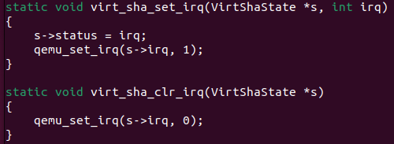
Interrupt
Three different interrupt have been defined:
INT_ENABLED (BIT 0) used to specify wheter interrupts are enabled
INT_INPUT (BIT 1) arised when device has correctly received all characters coming from the processor.
INT_OUTPUT (BIT 2) arised when output is ready.
They’re contained inside REG_INT_STATUS located at offset 0xc.
As it is reported in the previous slide, irq object is the way qemu handles interrupts. However we have to link this object to the interrupt controller.
Inside function virt_sha_realize() you’ll find:
These are the two function that will be called to set or clear interrupts.
When an interrupt is set, the type of interrupt is saved inside status variable and qemu_set_irq properly configure irq object in order to inform the processor of an upcoming interrupt.
Looking at the picture above, an interrupt is arised for value equal to 1 while it is cleared with 0.

Slide 16

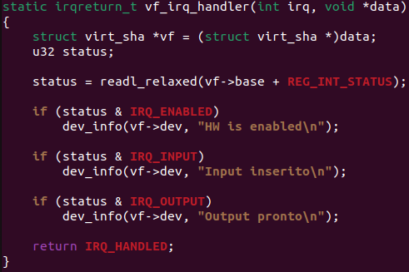
What happens next?
When inside interrupt handler, cpu has to understand what kind of interrupt has been requested. That’s why we perform a reading operation at REG_INT_STATUS.
Reading means accessing the device memory again:
This snap is extracted from reading function inside device description code
Interrupt is cleared and status or interrupt type is returned to the device driver.
Comparing then status with a bitwise operation all the different interrupt types, we’re eventually able to understand what’s coming from the device.
Let’s suppose we have just sent a string as input. The operation is successfull and an IRQ_INT is arised.
The processor will react to the request by calling the interrupt handler function defined inside the file driver:

Slide 17
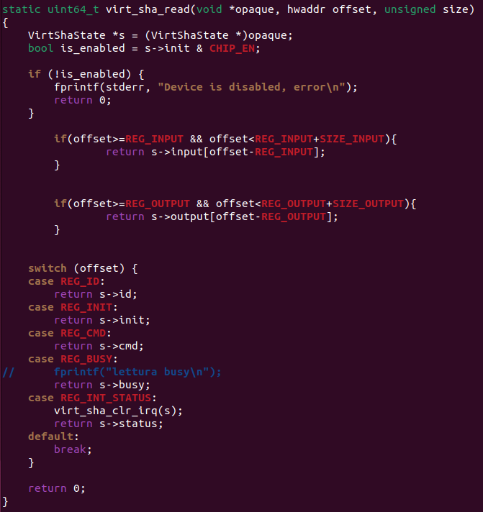
Reading
Differently from what happens inside the device driver, here we have to explain QEMU how to deal with reading and writing operation inside the device. Whenever a readl_relaxed or ioread8 are called QEMU will use our custom reading function to understand what to do.
First of all we must check the device is enabled otherwise no reading can be done.
Notice that at kernel level we have to pass the full address we’d like to access as argument to the function but here, only the offset with respect to the base address is returned.
If REG_INPUT ≤ offset < REG_INPUT + SIZE_INPUT we’re inside the memory region reserved to the input string. When REG_OUTPUT ≤ offset < REG_OUTPUT + SIZE_OUTPUT we’re inside the output memory.
Other cases are taken into consideration with a switch case.
case REG_INT_STATUS is the one used as example in the previous slide.

Slide 18
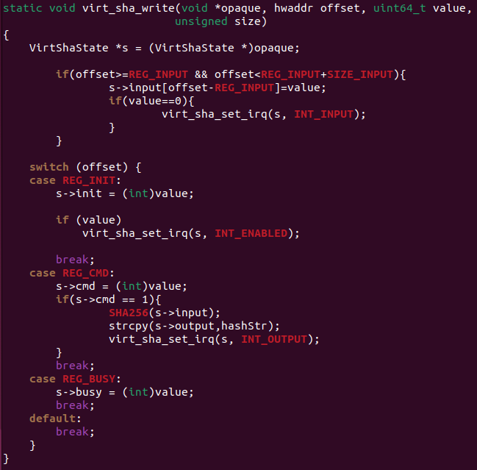
Writing
Differently from what happens inside the device driver, here we have to explain QEMU how to deal with reading and writing operation inside the device. Whenever a writel_relaxed or iowrite8 are called QEMU will use our custom writing function to understand what to do.
Similarly to reading we’re considering all the possible cases.
Whenever a writing operation is done, an interrupt is arised. First if-case regards in fact the string passed as input; when reaching ‘\0’ an interrupt will be notified to the processor.
Lastly REG_INIT will be used to notify the initiliazation of our device and REG_CMD to inform the device to start the conversion of the input string into a coded result.

Slide 19
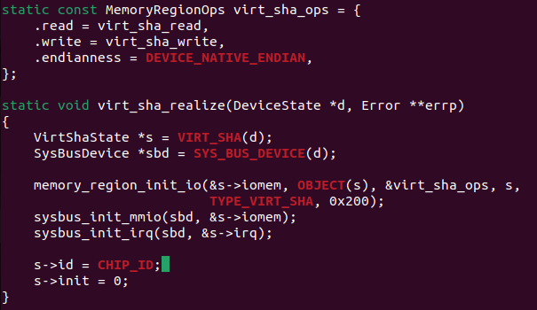
Finalize Description
Like in the device driver we have to map our custom functions: inside MemoryRegionOps you’ll see that both read and write are remapped.
virt_sha_realize in instead the function that helps QEMU initialize our device by assigning a memory region, enabling system buses and interrupt controller.

Slide 20
Main content of the file
This file contains the information to emulate a virtual board.
In this file there are three main parts:
Memory mapping
Interrupt mapping
Add the device to the device tree

Slide 21
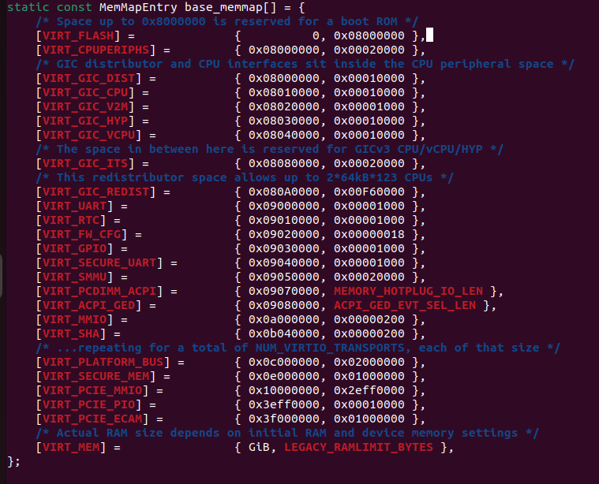
Memory mapping
This is the map of the aarch-softmmu (emulated architecture). In the picture are represented addresses and sizes of components.
0..128MB is space for a flash device so we can run bootrom code such as UEFI.
128MB..256MB is used for miscellaneous device I/O.
256MB..1GB is reserved for possible future PCI support
1GB and up is RAM (which may happily spill over into the high memory region beyond 4GB).

Slide 22
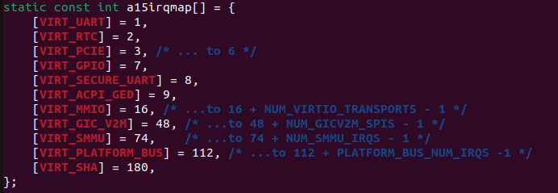
Interrupt mapping
In ARM architecture interrupts are managed by GIC (Generic Interrupt Controller)
A Generic Interrupt Controller (GIC) takes interrupts from peripherals.
Each interrupt source is identified by an ID number.
Each device can map more than one interrupt.

Slide 23
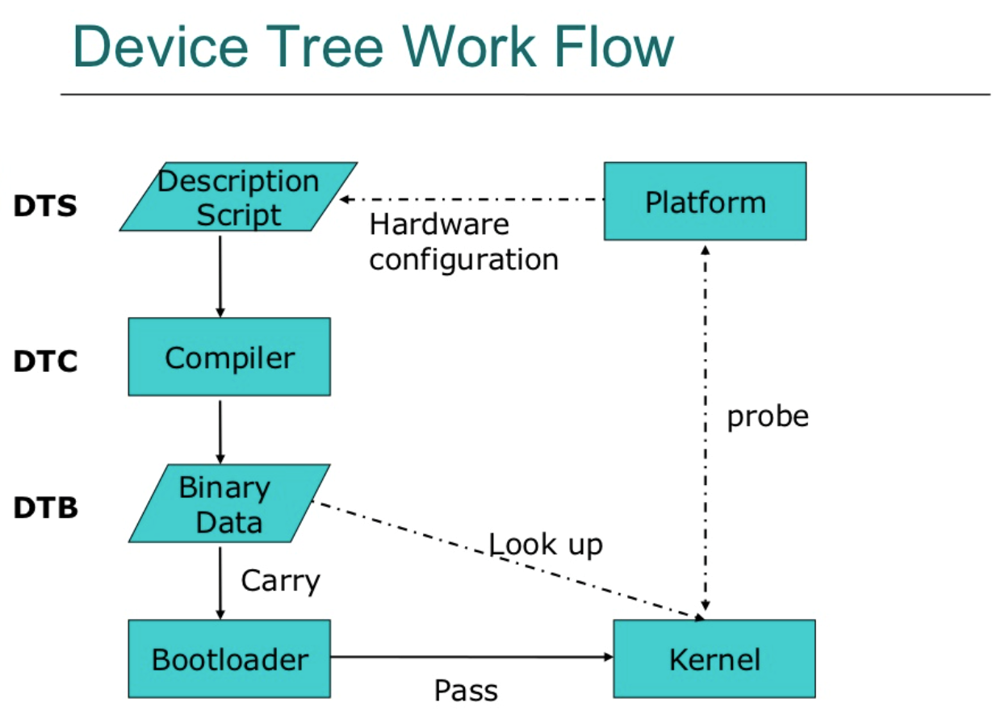
Device Tree
TIPS: You are able to take a look at the linux device tree by navigating inside /proc/device-tree
The device tree is a data structure for describing hardware which can hold any kind of data as internally it is a tree of named nodes and properties. Nodes contain properties and child nodes, while properties are name-value pairs.
More specifically, it is a description of hardware that is readable by an operating system so that the operating system doesn’t need to hard code details of the machine.
SLIDE 25 and 27 show how files are linked using device tree
A device tree is a way to represent hardware. It is comprised of many device tree source (DTS) files. When the source files are compiled, a flattened device tree (FDT), also known as a device tree blob (DTB), is created. QEMU and Linux use the DTB to understand the structure of the hardware without any hard coding involved.
ARM architecture uses the device tree to specify connected device on memory bus. DT properties should contain compatible name, memory address and interrupt specifiers.
QEMU supports the FDT and our device is added by invoking create_virt_sha_device() contained inside virt.c. Whenever a new device has to be created, it should be declared inside virt.c. A new device is not added until QEMU is recompiled.

Slide 24
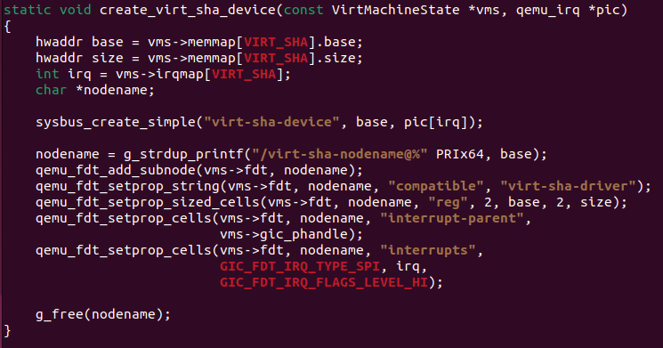
Add the device to the device tree
Adding a device to the device tree we specify:
Device source
Nodename inside the device tree
Driver compatibility
The function create_virt_sha_device is called inside the function machvirt_init .

Slide 25
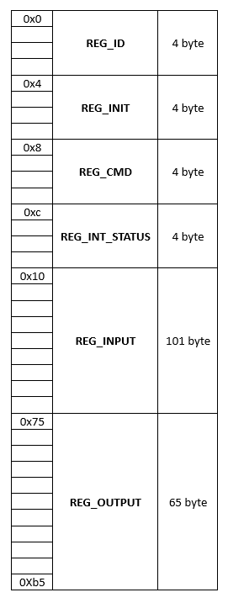
Device memory
CHIP_EN BIT(0)
INT_ENABLED BIT(0)
INT_INPUT BIT(1)
INT_OUTPUT BIT(2)

Slide 26
Content
Files
Names
Memory mapping
Interrupt mapping
Device creation (create_virt_sha_device)
virt.c
virt-sha-device
virt-sha-nodename
SHA256 algorithm
read/write redefinition (MemoryRegionOps)
virt_sha.c
virt-sha-driver
Attribute management
Interrupt management
Probe/Remove Function
virt-sha.c
virt-sha-drivername

Slide 27
Code Explanation
Use of the device

Slide 28
Access attributes
Prompt | Driver | Device
cat id | show_id | virt_sha_read
cat cmd | show_cmd
cat busy | show_busy
cat input | show_input
cat output | show_output
echo «str» > input | store_input | virt_sha_write
echo 1 > cmd | store_cmd
The interface between user and device is managed through attributes.
From user side attributes can be considered ad files so they can be read and written.
Each time we read or write an attribute actually we call one of the show/store function described in the device-driver (virt-sha.c).
Each show/store function execute a read/write operation on a memory region and to perform this operation recalls read/write function described in the device memory options (virt_sha.c).

Slide 29
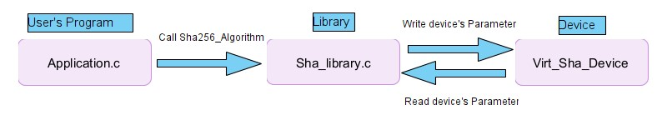
An easier way…
Using direct access to parameters works, but it's quite inconvenient for a user to code all the functions to access and use our device in his program. Nevertheless, a normal user should know if the device and driver are installed, but he cannot know where it is. For this and other reasons we decided to create the library "Sha256_library" that gives some function to interact with the device.
All users should include this library and use it as described in the following slides.

Slide 30
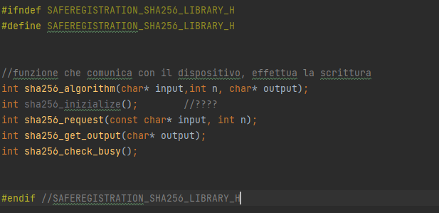
SHA256_library.h
The library we have implemented is a group of functions to make the device more accessible.
The most important function is «sha256_algorithm»: it takes two character pointers as input. The first one is the string which we want to apply sha256 to, the second is the address where we will write back the result. A third parameter is the number of characters of input string, for memory allocation constrain device operate with a maximum of 100 character and so there is a control on it.

Slide 31
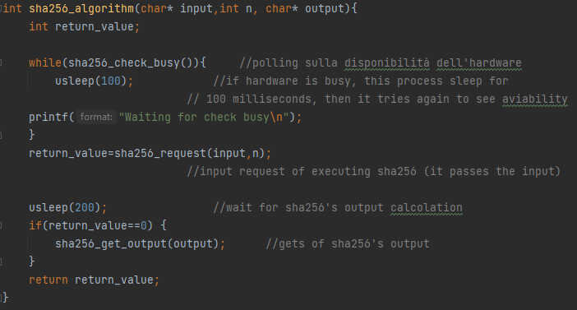
SHA256_algorithm
The steps are quite simple:
Check device availability: the device may be busy, using a simple polling mechanism the program checks if the device is working for another program. If it's not available, it sleeps for 0.1 seconds and tries again, otherwise it goes to the next point. (see chapter xx)
Send request: The program goes to the driver directory and writes the input string to the input attribute. After that it sets the command attribute to "1", this way the driver knows that it is a new input and it can work.
Wait: The program waits 0.2 seconds for all the calculations of sha256 to continue.
Get output: The program will read the output parameter of the driver and send it to the calling program.

Slide 32
Code Explanation
Sha256 and its application

Slide 33
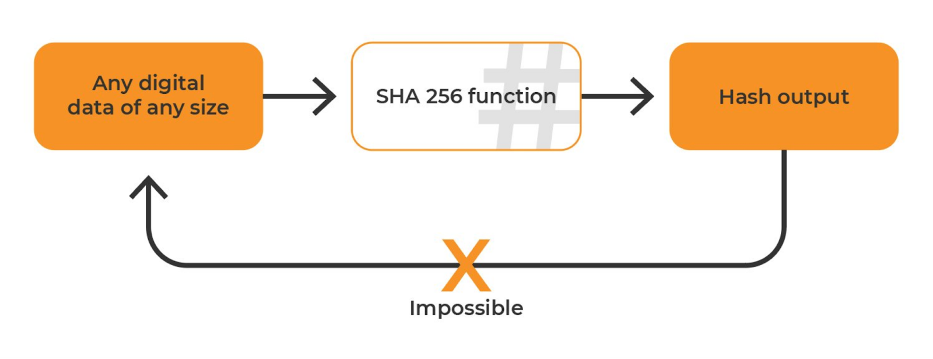
What is SHA256?
SHA stands for Secure Hash algorithm. The function produces a message digest of fixed lenght from an input of variable lenght. The strong point of SHA is that the function is not invertible and so, from the output is not possible to recover input.
SHA256 is part of the family of SHA-2, an evolution of the SHA1 algorithm. It’s output is of 256 bit or 32 Bytes (64 chars if we consider exadecimal output [0%9 plus a%f).
While SHA1 is been proved to be decryptable, SHA2 are still secure.

Slide 34
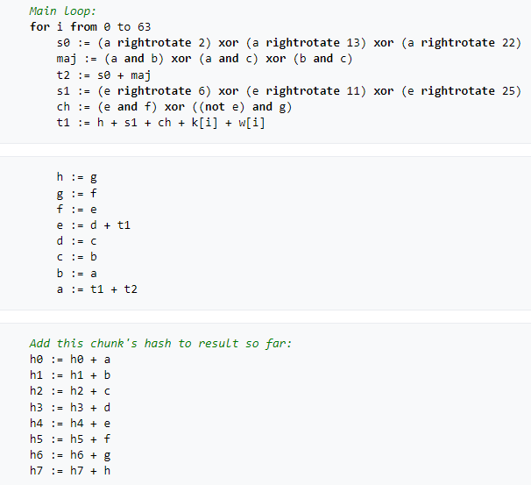
SHA256 characteristics
The complete algorithm is quite complex and can be found on Internet (e.g. on wikipedia https://it.wikipedia.org/wiki/Secure_Hash_Algorithm).
There are 8 variables that at the end are going to form the output.
At first, variables are set to the fraction part of the square roots of the first 8 prime numbers. The preprocess of the input is to add bit to be 512 bits multiple. Every chunk of 512 bit is sequentially elaborate and separate in 16 parts of 32 bits. The parts are then extended to 64 32-bit word.
The main parts of the algorithm can be seen on the right, it does some rotation of the words, sum and Xor. At the end variables are updated with the results of the chunk and so on.

Slide 35
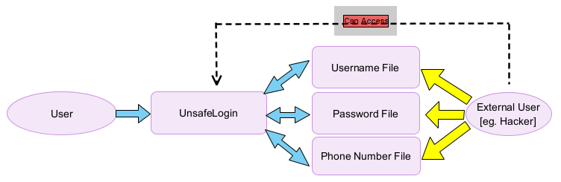
Registration and Log-In without SHA256
An example of application of Sha256 is encryption of data for a login page. Let’s start to analisy this case without an encryption algorithm.
Usually a user can access with username and password. In our example when the user registers himself to our service UnSafeRegistration, he must provide also his telephone number as personal and second factor authenticator. The phone number will be useful for recover the password if the user has forgotten it.
Username, Password and Phone number will be stored somewhere: if someone can access that file, he has free access to user’s account (e.g a disonest employee or an hacker).

Slide 36
Registration and Log-in with SHA256 SafeRegistration.c
The solution implemented in SafeRegistration.c uses Sha256 to make the system more secure. Username is the only file not encrypted and it used to get entry row relate to that user. When a new user register password and username are concatenated and Sha256 is applied to the final string and stored. The same happens for phone numbers.
We use a combination of username + password to avoid having more common password an easy target for an attack (otherwise we could check the conversion of more common passwords like 12345).
When the user tries a login, the program execute sha256 with new input and check if output is equal to the sha256 in encrypted file. In the same way it works for phone number and password recovey.

Slide 37
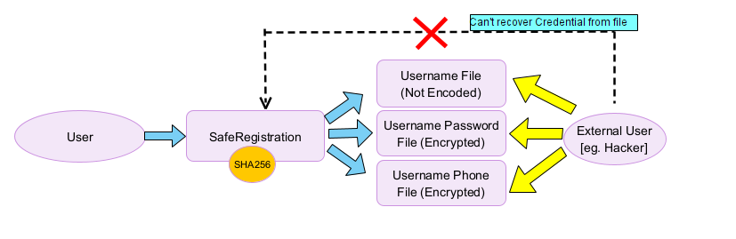
Registration and Log-in with SHA256 SafeRegistration.c
Passwords and phone numbers are not stored raw. If an external user accesses file, he can’t use them to take more information since for definition Sha256 is irreversible.
The only thing he can do is try by brute force and trying to get the same Sha256 with username and password (as he could do without enter the database).
The application is been built and tested with our library and device Sha256.

Slide 38
Code Explanation
1° rule of programming: if it works don’t touch it
Our code:
Problems and possible solutions

Slide 39
Interrupt Usage
We were able to successfully initialize the interrupt controller helping syncronize the device with the driver however this didn’t result in a efficient communication when developing the user-application. The application polls continuosly attribute «busy» in order to understand whether it can proceed by requesting the coded output.
The problem could be avoided if a similar solution could be used to forward the interrupt to user level during the interrupt handler routine. By looking at our code you might see that only device information are reported after an interrupt is received.

Slide 40
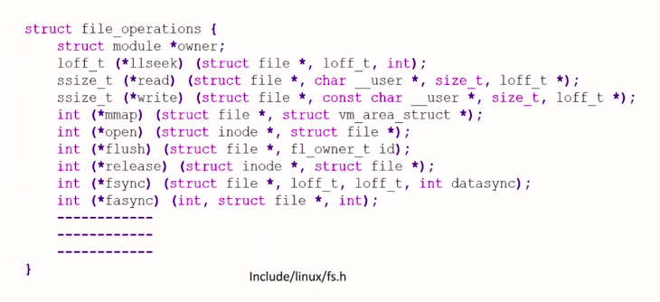
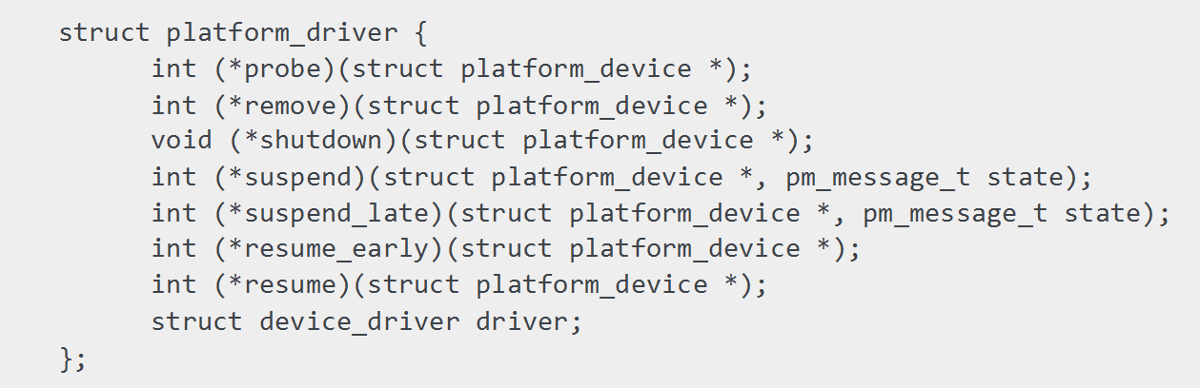
Different Driver Implementation
Some of the functions that can be remapped on a typical character driver. Full list at: https://github.com/torvalds/linux/blob/master/include/linux/fs.h
Since we implemented a platform device, we had to deal with a different implementation of the device driver with respect to what have been seen during the course. For example, no major number has to be assigned; device registration is automatically done at boot time by probe function. No class_create nor device_create is needed.
Complete structure of remappable functions for a platform device driver, in our case only probe and remove were used.

Slide 41
Consequences
VFS for a platform driver doesn’t allow typical .read or .write operations so this is why we had to come up with attributes which are kernel objects exposing properties to the user space.
Attributes as explained in the previous sections allows to properly access the driver and write or read data from the device.
Attributes are system files so at user level can be treated as normal files where read and write can be simply performed with a file open-close (fopen).
Attributes can be found at /sys/devices/platform/MY_PLATFORM_DEVICE/

Slide 42
Other Solutions (not working😭)
- QEMU with BUILDROOT
Problem with the compiler for kernel objects → so used Poky
- IMPLENTING A PCI DEVICE WITH POKY
Experienced some issues during file system creation: some definitions and macros were not accepted by QEMU. By deeply looking at the returned errors we understood that errors were arised because QEMU run by yocto has different features which are internally configured by Yocto and not customizable by the user. To make it more clear: for example the device description code is normally specified inside meson.build file which is used by QEMU during make operation to automatize and simplify the overall configuration. In the QEMU version that we are using inside Poky, this file is not present so the configuration has to be done manually by changing specific lines and files such as: Kconfig, Makefile.objs (at /hw/misc) , config-devices.mak, arm-softmmu.mak
- Tried an External version of QEMU with POKY: it was incompatible with the file system.

