Slide 1
NovaBank Q3 Campaign
Predictive Targeting Framework
Shift from Indiscriminate to Model-Guided Outreach
May 15, 2026 | Ettore Bertolini, Analytics Methods & Frameworks

Slide 2
The Problem: Inefficient Outreach
Current State
Our Solution
• Contact ALL 41,000 clients regardless of interest
• Target only top 20% by model score
• Only 11% conversion rate
• Predicted 66% capture of all subscribers
• €730,960 in wasted calls
• Reduce wasted calls to 1,038
• Net campaign loss: €7,000 per cycle
• Expected ROI: 4.4× (€70K+ net profit)

Slide 3
Financial Impact: Blanket vs. Model-Guided
Metric | Blanket Outreach | Model-Guided (Top 20%) | Improvement
Clients Contacted | 41,188 | ~1,648 | 96% reduction
Conversions Captured | 100% | 66% | Deliberate trade-off
Cost of Wasted Calls | €730,960 | €20,760 | 97% lower
Net Operating Profit | −€7,000 | +€70,740 | 4.4× ROI
Scaled to full campaign: €350K–€370K projected net profit per cycle

Slide 4
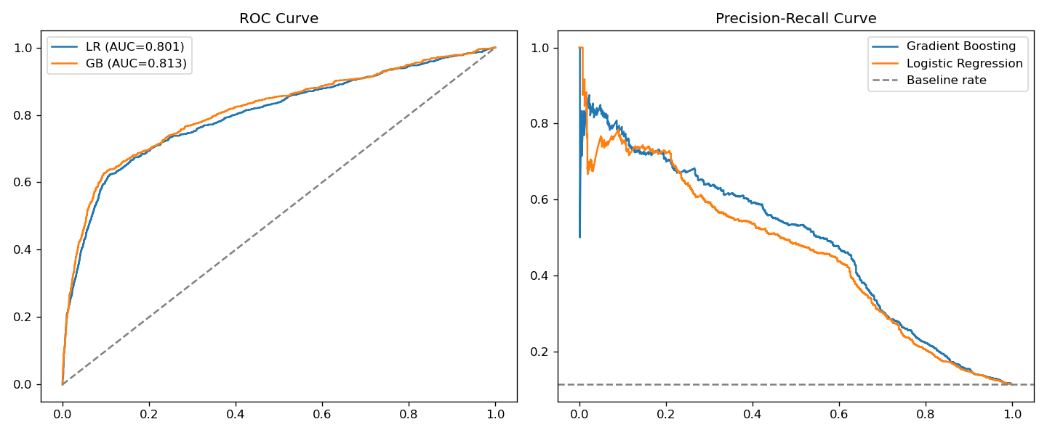
Model & Validation: Gradient Boosting vs. Baseline
Model Specifications
Algorithm: Gradient Boosting Classifier
Training data: 33,000 historical records
Validation: 5-fold cross-validation
Test set size: 8,225 clients
GB outperforms baseline (AUC 0.813 vs 0.801) PR-curve gap widens in high-precision zone — key for top-20% targeting

Slide 5
Model Drivers: What Predicts Subscription?
Employment Level (nr.employed)
42%
Euribor 3-Month Rate
12%
Prior Engagement History
15%
Age (life-stage proxy)
6%
Previous Campaign Success
8%
Other features
17%
✓ Transparent, auditable drivers: macroeconomic factors + engagement history. No prohibited characteristics.

Slide 6
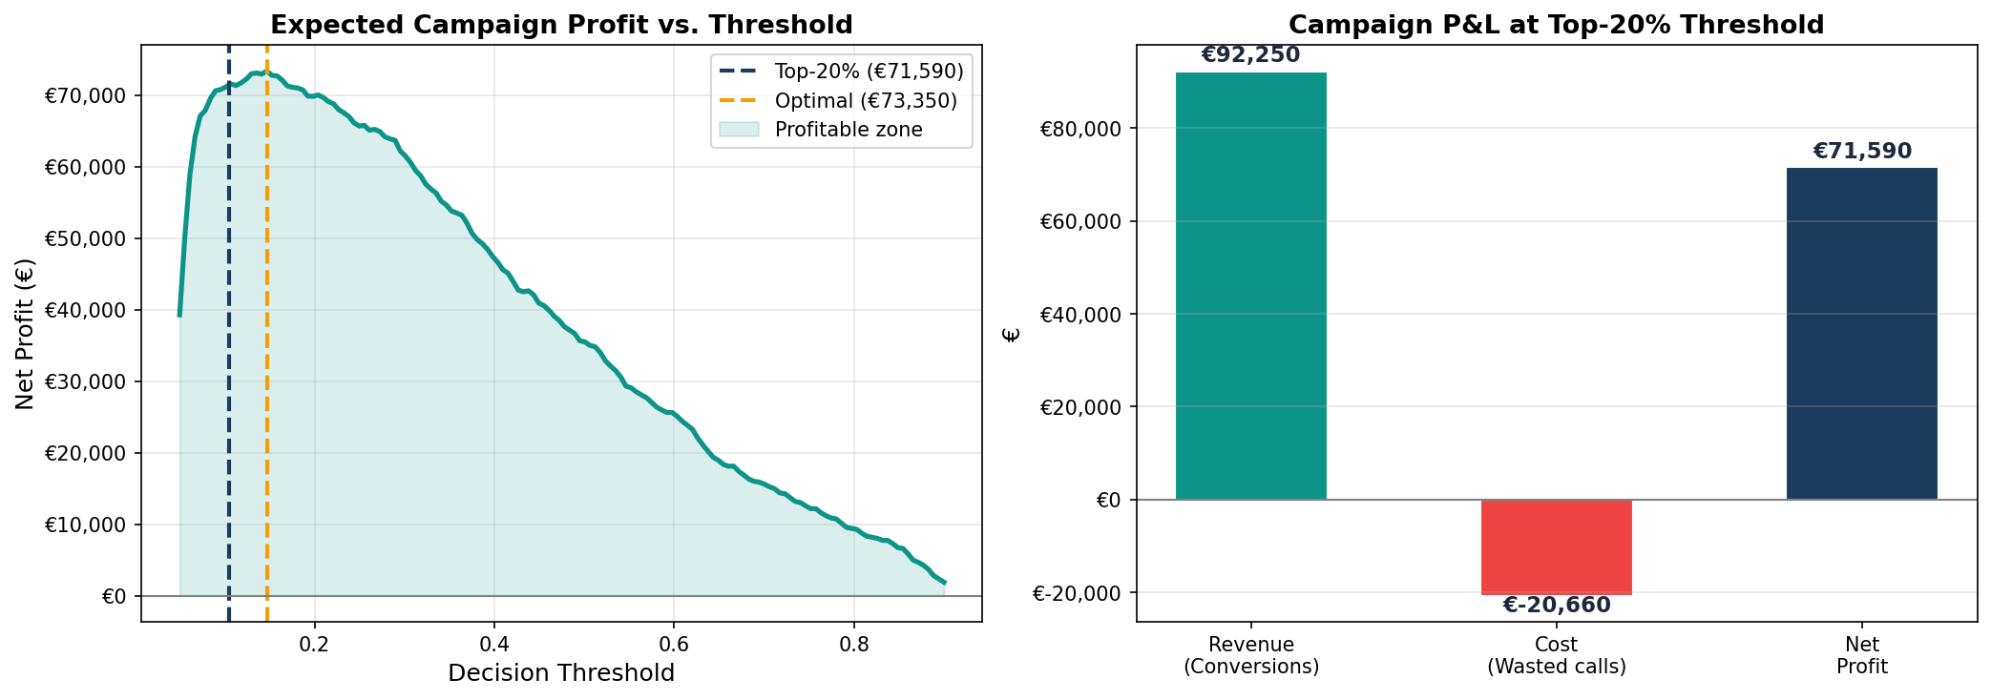
Decision Rule: Fixed Probability Cutoff (≥0.20)
Why Fixed Probability, Not Percentile?
Percentile Rule (Bad)
• Always selects top 20% (8,200 clients) regardless of macro conditions
• Employment crisis: identifies 7,737 low-quality clients
• Profit collapses to €130 in stress scenario
RECOMMENDATION: Use fixed cutoff ≥0.20 in production. Non-negotiable for compliance & macro resilience.

Slide 7
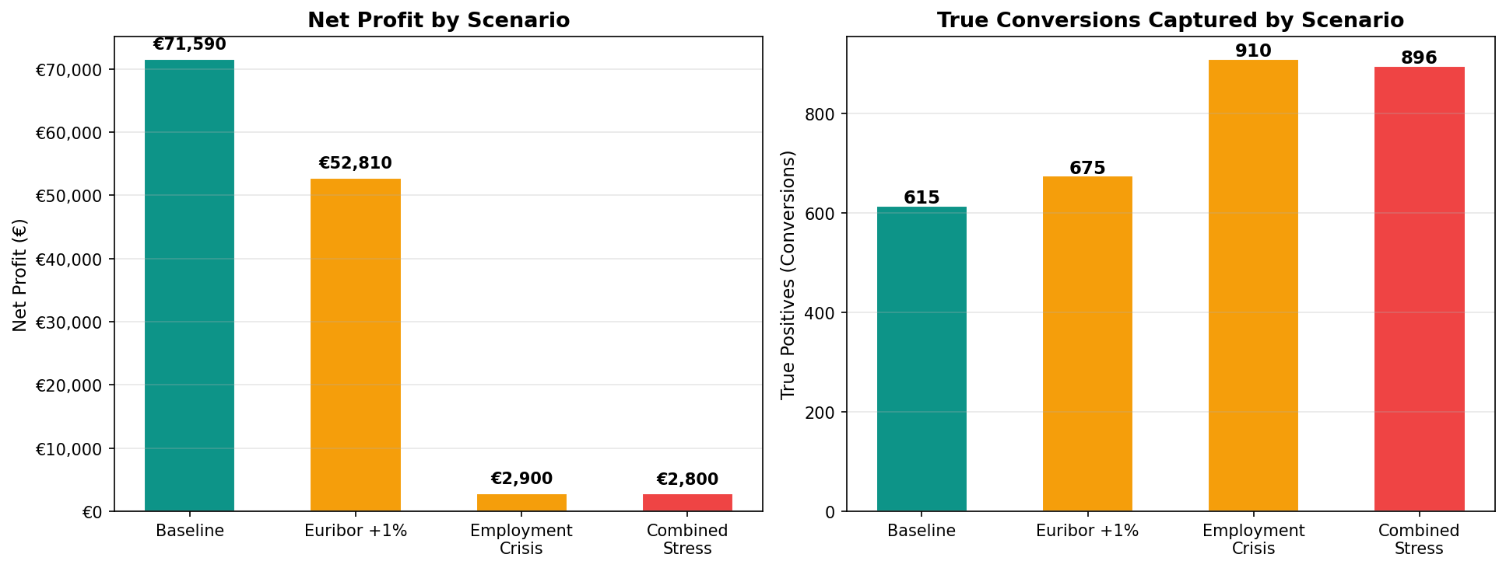
Stress Testing: Macro Sensitivity
Model Resilience Under Economic Shocks
Baseline
Employment stable, Euribor stable
Moderate Shock
Euribor +1%
Combined Crisis
Euribor +1%, Employment −5%
Employment Collapse
Employment −5%
MITIGATION: Monthly re-scoring as macro data arrives. Threshold remains ≥0.20; profit-to-risk ratio improves with frequency.

Slide 8
Pilot Plan: 4-Week Test Before Full Rollout
Scope
2,000 clients: 1,000 model-selected (top 20%) + 1,000 random control
Duration
4 weeks, aligned with Q3 campaign launch
Primary KPI
Model group conversion rate ≥ 2× control rate
Secondary KPI
Net profit ≥ €15,000 above control group
Decision Gate
Week 5: Go/no-go for full Q3 rollout

Slide 9
Key Risks & Mitigations
HIGH
Macro Sensitivity
Model's top predictor is employment level (42% weight). Economic shock reduces profit.
Mitigation: Re-score clients monthly. Fixed cutoff ≥0.20 (not percentile) adapts naturally.
MEDIUM
Threshold Decay
Cutoff calibrated on 2021 data. As behavior & economy shift, threshold may drift.
Mitigation: Revalidate threshold quarterly against holdout set.
MEDIUM
Margin Assumption
Business case assumes €150 margin per deposit. If actual < €50, ROI erodes.
Mitigation: CFO confirms margin before Q3 go-live. Build sensitivity dashboard (€50/€100/€150 scenarios).

Slide 10
Ready to Launch
Next Steps for Leadership
1
Approve model approach & fixed cutoff (≥0.20)
This week
2
CFO confirms €150 margin assumption
This week
3
Design & execute 4-week pilot (2,000 clients)
Next 2 weeks
4
Monitor pilot KPIs; make go/no-go decision
Week 5
5
If approved, roll out to full Q3 campaign
Week 6
Expected Outcome: €350K–€370K net profit per campaign cycle | 4.4× ROI on analytics investment

