Slide 1
Using Literary Evidence

Slide 2
Sample Paragraph: Virginia Woolf Source: http://writing.wisc.edu
POINT: We learn about Mrs. Ramsey's personality by observing her feelings about other characters. Mrs. Ramsey has mixed feelings toward Mr. Tansley, but her feelings seem to grow more positive over time as she comes to know him better.

Slide 3
Evidence/data
"she pitied men always as if they lacked something . . ." (85).
"no woman would look at him with Paul Rayley in the room" (106).
"She liked his laugh. . . . She liked his awkwardness. There was a lot in that man after all" (110).

Slide 4
Summary of conclusions
she finds him annoying
she pities him
she empathizes with him
she is attracted to him

Slide 5
POINT:
POINT: We learn about Mrs. Ramsey's personality by observing her feelings about other characters. For example, Mrs. Ramsey has mixed feelings toward Mr. Tansley, but her feelings seem to grow more positive over time as she comes to know him better. DETAIL: At first Mrs. Ramsey finds Mr. Tansley annoying, as shown especially when he mentions that no one is going to the lighthouse (52). However, rather than hating him, at this point she feels pity: "she pitied men always as if they lacked something . . ." (85). Then later, during the gathering, pity turns to empathy as she realizes that Mr. Tansley must feel inferior. He must know, Mrs. Ramsey thinks, that "no woman would look at him with Paul Rayley in the room" (106). Finally, by the end of the dinner scene, she feels some attraction to Mr. Tansley and also a new respect: "She liked his laugh. . . . She liked his awkwardness. There was a lot in that man after all" (110).REITERATION OF POINT: In observing this evolution in her attitude, we learn more about Mrs. Ramsey than we do about Mr. Tansley. The change in Mrs. Ramsey's attitude is not used by Woolf to show that Mrs. Ramsey is fickle or confused; rather it is used to show her capacity for understanding both the frailty and complexity of human beings.

Slide 6
Kinds of Literary Evidence
Summary
Paraphrase
Quotation

Slide 7
Summary
When you summarize, you point out passages or patterns in the text that contribute to your argument. Use your own words to describe what is happening in the text.
Ex. In “Girl,” Jamaica Kincaid uses a string of imperatives to convey the female protagonist’s fraught relationship with her mother.

Slide 8
Summary
Their house is bogged down with memorabilia. Such objects as the furniture or Tash’s city bus schedule pinned to the bulletin board serve as reminders of what they have lost.

Slide 9
Paraphrase
Paraphrasing consists of putting the text into your own words. You should use paraphrase when the content or idea rather than the wording of the text backs up your argument.
Ex. In a string of commands, the mother instructs her daughter in how to wash clothes, how to smile, and how to lay the table for various meals.

Slide 10
Quotation
Use quotation when the actual words of the text matter to your argument.
Ex. Although Nomi is left with an empty house and empty life, her father has taught her that emptiness contains the most possibility of all “because one can imagine what might go into [it] someday” (Toews 45).

Slide 11
Guidelines for Quotation
Use only what you need: MEGO
Less is more; do not use quotations to pad your essay
Literary essays use more quotations than other essays because in a literary essay, you are analyzing words; this is especially true of poetry analyses.

Slide 12
Types of Quotations
Integrated words (snippets)
Integrated quotes of sentences or longer phrases
Block quotes (more than 4 lines, indented)

Slide 13
Snippet Quotations
Integrated “snippet” quotations must fit into the sentence if you remove the quotation mark.
Indicate with quotation marks
Provide page number and author (if the context does not make this clear)
Ex. Ray and Nomi usually shy away from conversation and exist as “islands of grief” after Trudie leaves (Toews 37)

Slide 14
Integrating Sentences or Longer Phrases
Use quotation marks for the quoted words
Remove end punctuation
Provide page number and author (if the context does not make this clear)
EX. Nomi describes the hypocrisy of teenagers who spend Saturday night “drinking, dropping, smoking, swearing, screwing, fighting, swimming” and then on Sunday morning turn up “back in the pew with Mom and Dad wearing nice (ugly) dresses and buttoned-up shirts flipping through Deuteronomy and harmonizing to the ‘Old Rugged Cross’” (Toews 34).

Slide 15
Block Quotations
Indent and double space quotations of 4 lines or more
Omit quotation marks for block quotations
Place author and page reference outside final punctuation
Framing sentence:
Block quote. (Toews 89)

Slide 16
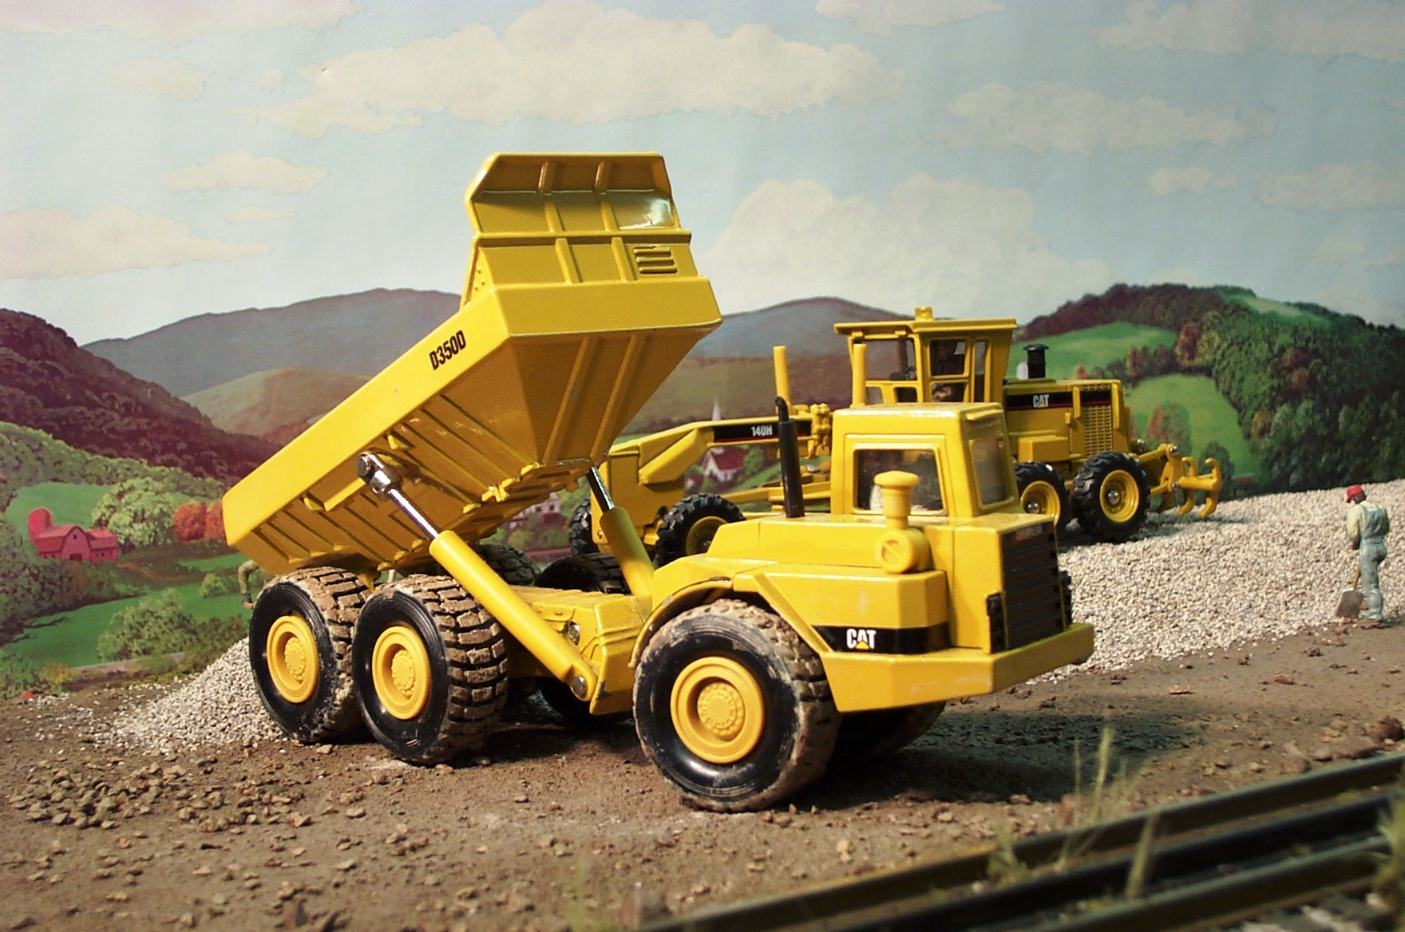
NO DUMPING
Don’t dump truck your quotations: X notes,
Y writes, G argues
Don’t assume your quotations speak for themselves

Slide 17
Framing Quotations
Always frame your quotations; they do not speak for themselves
No quotation should stand alone as a sentence.
Your job is to guide readers through the quotations; tell them what to look for or how to read them.
The frame precedes the quotation.
Make sure you indicate who is speaking (a character? The narrator?) and the so what: what does this quotation contribute to your argument?

Slide 18
Framing Strategies: Three Key Steps
Use a signal phrase to indicate that a quotation is coming: often an author’s name, a reference to the narrator or character
Use an assertion that indicates the relation of the quotation to your argument
Make sure your quotation actually illustrates the assertion.
One or two will not suffice; use all three steps for success.

Slide 19
Successful Framing
Nomi describes the strict binary opposition as it manifests in the ideas of her community: “that’s the thing about this town—there’s no room for in between. You’re in or you’re out. You’re good or you’re bad. Actually very good or very bad” (10).

Slide 20
Successful Framing
SIGNAL: Nomi describes ASSERTION: the strict binary opposition as it manifests in the ideas of her community: “that’s the thing about this town—there’s no room for in between. You’re in or you’re out. You’re good or you’re bad. Actually very good or very bad” (10).
MATCH: the quotation matches the assertion
PUNCTUATION: a colon after the assertion leads into the quotation

Slide 21
Successful Framing
As the story progresses, Nomi realizes and accepts that uncertainty is intrinsic to human life: “But I guess if you can die without ever understanding how it happened you can also live without a complete understanding of how. And in a way that’s kind of relaxing” (Toews 152).

Slide 22
Successful Framing
ASSERTION: As the story progresses, Nomi realizes and accepts that that uncertainty is intrinsic to human life SIGNAL: “But I guess if you can die without ever understanding how it happened you can also live without a complete understanding of how. And in a way that’s kind of relaxing” (Toews 152).
PUNCTUATION: complete sentence plus colon frames quotation.
MATCH: quotation matches assertion

Slide 23
You be the Judge
Nomi feels trapped in the feeling of conformation and of the loss of freedom that she begins to rebel, defining who she is as a person. “That’s the thing about this town—there’s no room for in between. You’re in or you’re out. You’re good or you’re bad. Actually very good or very bad” (10).

Slide 24
You Be the Judge
The reality that Tash believes in is very different from that which the other residents of East Village have built for themselves but both of these realities are equally valid. Later in the novel, Tash discovers metaphors and begins using the word to describe almost everything: “I heard my dad say to her: ‘Tash, some things are real. Some things are nothing but what they are’” (Toews 159)

Slide 25
You Be the Judge
In her futile attempt to suppress her emotions, as she and her father found themselves “…little islands of grief” (Toews 28), instead of sulking, she chose to embrace what she had.

Slide 26
You be the Judge
It is comforting to come home and see a note. This gives Ray and Nomi the security that each will return to answer the other’s questions in the notes. These notes are a form of respect by not bombarding each other with difficult questions face to face, especially the note: “Why didn’t she take me with her?” (254).

Slide 27
You Be the Judge
Not only does Ray write notes with Nomi, but he writes notes to himself, ones that are set daily on the common belongings that he sees every morning. “….His shoes have little cards son them with writing as a reminder of what he was supposed to do next day. I picked one up and it said: Develop new life strategy.”

Slide 28
You Be the Judge
The disappearance of furniture establishes a sense of insecurity that foreshadows events to come and the shattered window gives a literal image of breakage within the Nickel family. This is supported in the fairly ominous sentence that follows: “Half of our family, the better-looking half, is missing” (1).

Slide 29
You Be the Judge
Nomi’s interest and excitement about her faith is expressed when she asks her mother about the excommunication that occurred at the church one afternoon:
What did they do, I asked. Just guess. Well, she said, they may have been fooling around, I don’t know. Fooling around how, I’d asked. Oh, she said, misbehaving. Kissing. Just fooling around. And then what happened, I’d ask. They couldn’t be part of the church, she’d say. That’s right, Mon. And then? Their families weren’t allowed to speak to them. (Toews 58)

