Slide 1
Central Processing Unit (CPU)
Memory Unit (RAM)
Control Unit
Bus
Program
Arithmetic Logic Unit (ALU)
Data

Slide 2

Central Processing Unit (CPU)
Memory Unit (RAM)
Clock
Clock
Control Unit
Bus
Program
Arithmetic Logic Unit (ALU)
Data

Slide 3
Central Processing Unit (CPU)
Memory Unit (RAM)
Cache
memory
(stores copies of data from the memory unit for faster access)
Control Unit
Bus
Program
Arithmetic Logic Unit (ALU)
Data

Slide 4
Central Processing Unit (CPU)
Memory Unit (RAM)
Control Unit
L1 Cache
32 KB
L2 Cache
256 KB
L3 Cache
30 MB (2.5 MB/core)
Arithmetic Logic Unit (ALU)
Control Unit
L1 Cache
32 KB
L2 Cache
256 KB
Program
Arithmetic Logic Unit (ALU)
Bus
Data
Control Unit
L1 Cache
32 KB
L2 Cache
256 KB
Arithmetic Logic Unit (ALU)
…

Slide 5
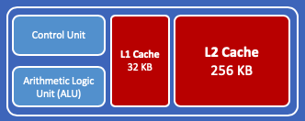
Central Processing Unit (CPU)
Memory Unit (RAM)
Core 0
Core 1
L3 Cache
30 MB (2.5 MB/core)
Core 2
Core 3
Program
Core 4
Core 5
Bus
Data
Core 6
Core 7
Core 8
Core 9
Core 10
Core 11

Slide 6
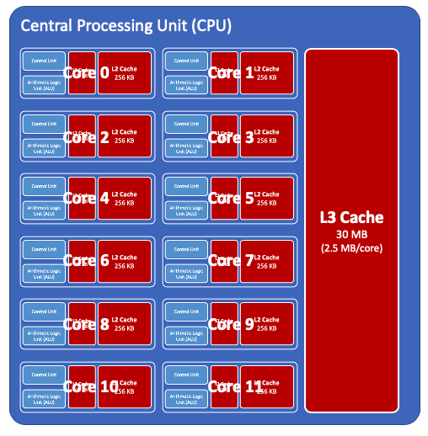
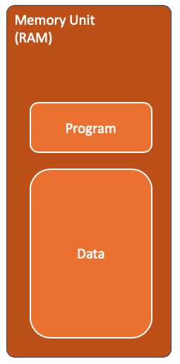
Bus
CPU 0
QPI
Bus
CPU 1

Slide 7
Memory
Memory
PCIe

