Slide 1
Speech and personality
Euan Cockburn
2033584c

Slide 2
What is the study?
What is involved in the study?
What are the main objectives of the study?
Why are these objectives important?

Slide 3
Components of the study
The data used during the project
Phonetics
  What is it?
Measurements of the voice
  What does this include?
Personality
  How do we measure a personality?

Slide 4
The data corpus
The SSPNet Speaker Personality Corpus
Contains:
  640, 10 second voice clips
  Meta data on the speaks, gender and role
  Personality scores given by listeners

Slide 5
Phonetics
Phonetics is the study of how the sounds of speech are made
Phonetics is composed of three major sections
  Articulatory phonetics
  Acoustic phonetics
  Perception

Slide 6
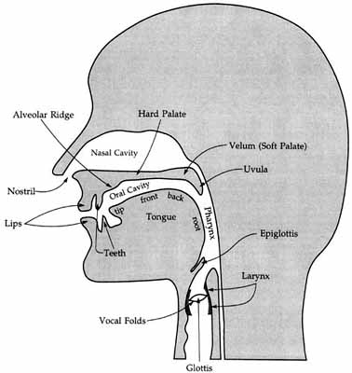
The vocal tract

Slide 7
Articulatory phonetics
Concerned with where in the body a sound originates
How the sounds are created
  S, the tip of the tongue is against the bottom teeth while the back of the tongue is raised
  Sh, the tip of the tongue no longer touches teeth
  Th, tongue is between the teeth

Slide 8
Acoustic Phonetics
Measurement of physical properties of sound
Concerned with measuring human voice
  Pitch, fundamental frequency
  Tone
  Jitter
All measurements shown to be important in literature

Slide 9
Standard parameter set
Lack of uniformity in voice analysis
Standardised set of parameters improves verification of findings
Simplifies process of parameter set generation
Minimal parameters being used

Slide 10
Personality
Personality is just as we imagine, people's defining characteristics and behaviour
In this study a trait based model is used
Big five model
  Extroversion
  Agreeableness
  Conscientiousness
  Neuroticism
  Openness

Slide 11
Results
Analysis of results are not yet complete
Early indications from tests are promising for strong correlations
Especially in measurements related to pitch
Neuroticism and extroversion also appear to be highly recognisable

Slide 12
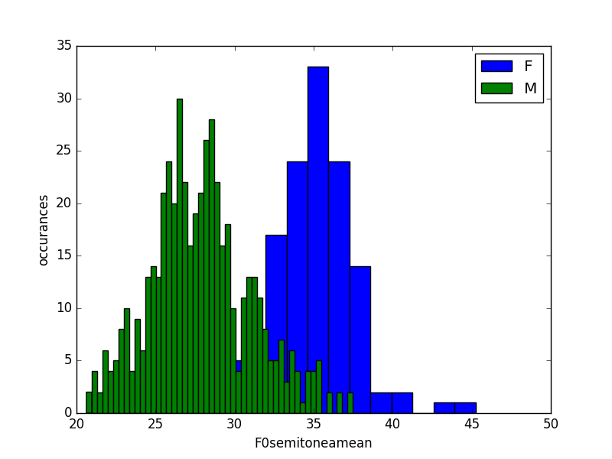
Gender and Pitch

Slide 13
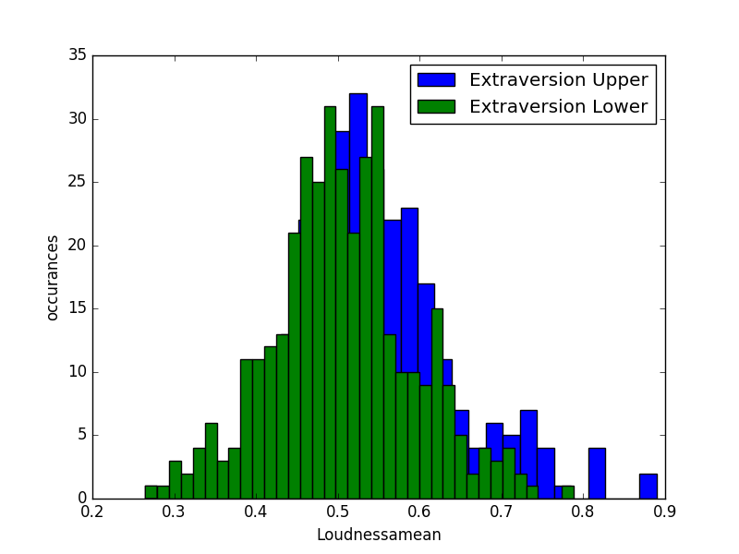
Loudness and Extroversion

Slide 14
Significance
Why do we care?
Enriched interaction with computers
Better able to synthesise voices
Lay the ground work for future research

Slide 15
Reflection
Introduction to phonetics
First study examining the details of speech
Introduction to personality and trait models
Time management involved in such a large project
Working to overcome real world issues and working with others to receive and give help

Slide 16
Thank you for your time
Questions?

