Slide 1
PREDICTING CUSTOMER BUYING BEHAVIOUR
British Airways Data Science case study: two Random Forest analyses of 50,000 booking records, plus the code repository behind them
1 Gini importance 2 Permutation importance 3 Baseline output 4 Next steps 5 GitHub

Slide 2

ANALYSIS 1: GINI IMPORTANCE
What this chart is: the top 10 Gini importances from a 300-tree Random Forest. Each bar shows how much a variable reduced impurity across all trees, so longer bars mean the model leaned on that variable more to separate bookers from non-bookers.
0.77
ROC-AUC
0.35
Precision
0.52
Recall
0.42
F1 score
Accuracy is misleading: 78% is below the 85% baseline of predicting “no booking” for everyone, which catches 0% of buyers.
Australia converts at 5%, Malaysia at 34%
Stays of 7 days or less convert at 19% vs 10% for 2–8 weeks
Chart summary: origin country (Australia, Malaysia) and trip timing (stay length, lead time) carry the most weight. Lead time is spread across three correlated features, so its combined weight is larger than any one bar.
49,281 rows after removing 719 duplicates; 15% booked. 5-fold stratified CV; precision, recall and F1 at the 0.5 cut-off.
Notes:
Impurity importance can favour numeric features with many values. Permutation importance on a hold-out sample ranked Australia and Malaysia origin, flight duration, length of stay and South Korea origin highest.

Slide 3
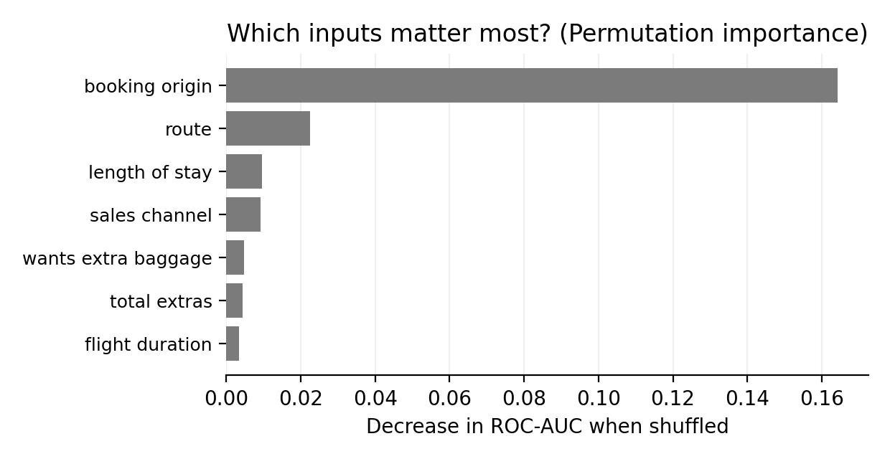
ANALYSIS 2: PERMUTATION IMPORTANCE
What this chart is: permutation importance on a 20% hold-out set. Each bar shows how much the model’s ROC-AUC falls when one input is shuffled, so a bigger drop means the model relies on that input more.
0.772
ROC-AUC
0.292
Precision
0.748
Recall
0.420
F1 score
Accuracy is misleading: 69.1% sits below the 85.1% majority-class baseline, so the model is judged on AUC, recall and precision.
Recall finds about three in four bookers, but low precision means many targeted customers will not book
Use scores to prioritise campaigns and tune the threshold to campaign cost
Chart summary: booking origin dominates, costing about 0.16 AUC when shuffled. Route is a distant second at about 0.02, and every other input is under 0.01.
Duplicates retained; 250 trees; 5-fold CV; hold-out AUC 0.777. Cleaning and settings differ from Analysis 1.

Slide 4
BASELINE MODEL OUTPUT
What this slide is: the actual output of the 500-tree Random Forest baseline (one-hot encoding, 80/20 split, 10,000 hold-out rows): metrics on the right and the top-10 Gini importances on the left.
Metric | Value | What it means
ROC-AUC | 0.786 | Ranks bookers well above chance
Avg. precision | 0.374 | Versus 0.15 base rate
Precision | 0.295 | About 3 in 10 flagged customers book
Recall | 0.793 | Finds about 4 in 5 real bookers
F1 | 0.430 | Balance of precision and recall
Accuracy | 0.686 | Below the baseline, by design
Baseline | 0.850 | “No booking” for everyone
Why accuracy misleads: predicting “no booking” scores 85% but finds 0% of buyers. The model gives up accuracy to find about 79% of them.
Chart summary: booking country dominates. Australia and Malaysia together hold about a third of total importance, followed by length of stay and flight duration. Purchase lead ranks fifth.
Hold-out run of scripts/train_random_forest_gini.py; 0.5 cut-off, balanced class weights.

Slide 5
RESULTS AND NEXT STEPS
What this slide is: how to read the importance chart, what we recommend doing with the model, and the checks that confirm the numbers can be trusted.
Reading the importances
Recommendation / next steps
Use predicted probability to rank customers for targeted campaigns, with the threshold set by campaign cost
Next iteration: gradient boosting plus behavioural features such as search recency
Booking country is the strongest signal: Australia converts at 5%, Malaysia at 34%
Trip length follows: stays of 7 days or less convert at 19% vs 10% for 2–8 weeks
Purchase lead is a modest driver: last-minute bookings convert at 17% vs 14% overall
Sanity checks before trusting the numbers
Row count
50,000 rows loaded, not a truncated sample
Checked
Target balance
14.96% of bookings completed
Checked
ID columns
None in the schema; drop any if found
Verify
Seed stability
Re-run with several seeds; AUC should move under 0.01
To do

Slide 6
GITHUB REPOSITORY
What this is: the project repository for the Customer Booking Model. It holds the work that produced the charts and metrics in this deck.
github.com/Euanher/Customer_Booking_Model
Why this repository is included
What to do next
Reproduce the results: re-run the model and confirm the metrics and charts
Inspect the method: cleaning, feature engineering and validation are open to review
Build on it: reuse the code for the next iteration
Open the link above and review the code against the two analyses
Run it on customer_booking.csv to check the numbers
Send feedback or approve the next step: gradient boosting plus behavioural data such as search recency

