Slide 1
Proof of Concept Assessment
Flynn Eickhoff

Slide 2


Proof of Concept | Submission Guidelines
The following files must be zipped and uploaded to Canvas for assessment. Use the below folder structure and ensure files are in appropriate folders.
ProofofConcept_StudentName.pptx
Within each folder, please submit relevant files. Make sure to delete any unnecessary files and folders within your submission that bloat the file size.
Documentation Folder
Draft Art Bible
Draft Game Design document (includes market research)
Draft Technical Design Document (includes physical resources and equipment)
Prototype Folder
Game prototype build exe and associated files
Game prototype Unity project and associated files
Any additional videos or associated prototype files
Pitch Folder
Final game pitch PowerPoint presentation (includes team roles & responsibilities)
Feedback Folder
Documented feedback and actions taken from playtesting sessions or industry review
ProofofConcept_FirstNameLastName.zip
Documentation
Prototype
Build.zip
Project.zip
Pitch
Feedback

Slide 3

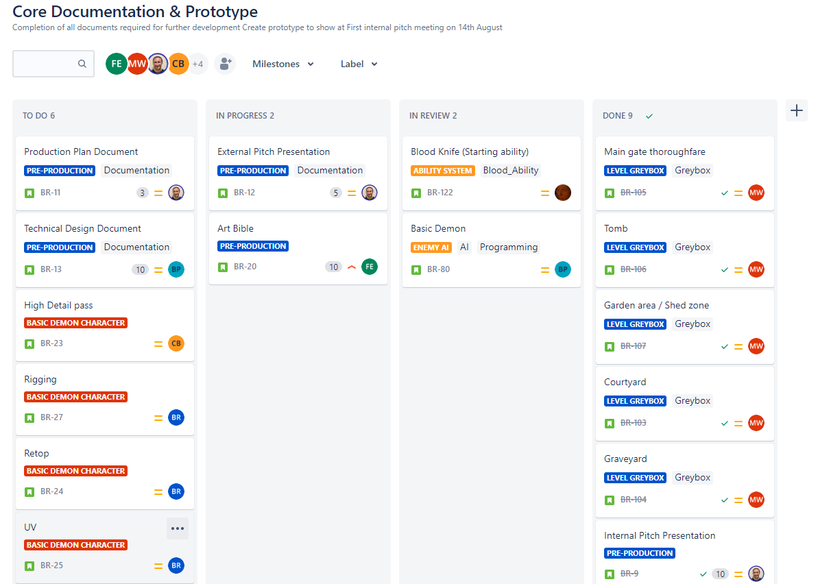
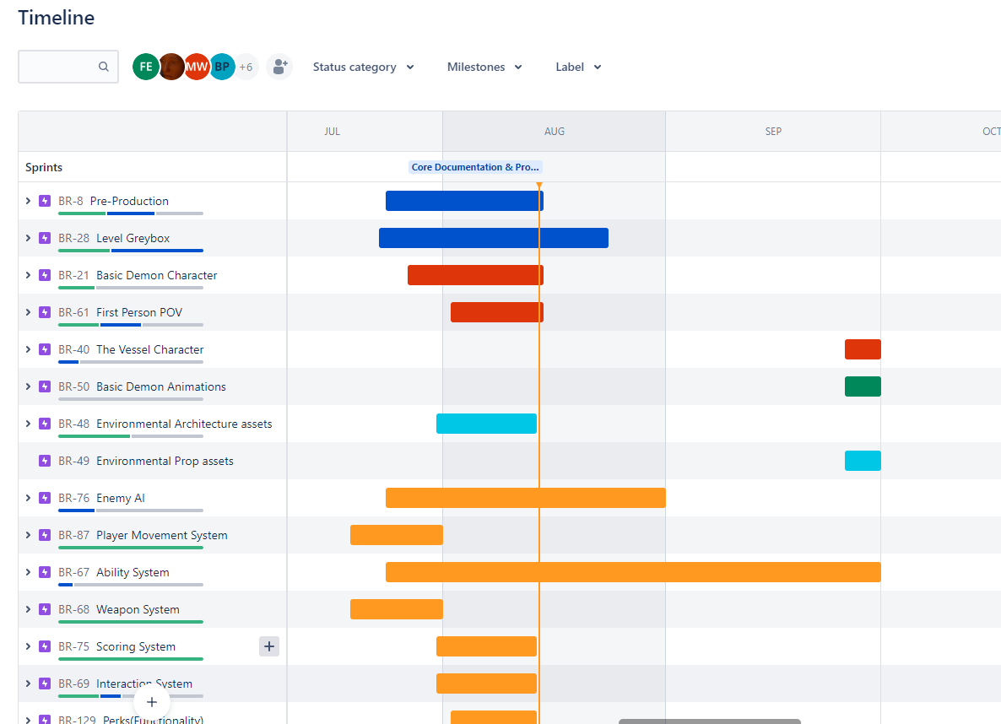
Prototyping | Team Collaboration
Insert a screenshots of your team task dashboard in the project management software below.

Slide 4
Prototyping | Personal Contribution
How have you personally contributed to the project and assisted your team members during the prototyping phase?
Answer here.

Slide 5
Gather Feedback | Playtesting Session
Gather feedback from playtesting or industry review. Take notes below and describe how you will address the feedback.
Questions Asked | Feedback​ | Actions Taken Based on Feedback​
 | ​

