Slide 1
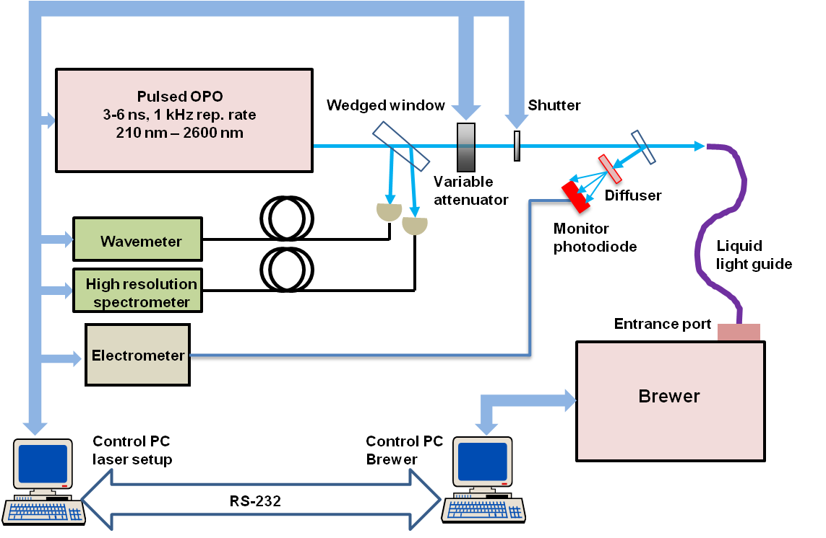
Setup for bandpass and wavelength characterisation of Brewer at PTB

