Slide 1


Semantic Communication Meets Edge Intelligence^{[1]}
提高 2301 班 张禹阳
Jun. 20, 2025
[1] W. Yang et al., "Semantic Communication Meets Edge Intelligence," in IEEE Wireless Communications, vol. 29, no. 5, pp. 28-35, October 2022, doi: 10.1109/MWC.004.2200050

Slide 2
Table of Contents
Introduction
Preliminaries
Edge-Enabled SemCom
Semantic-Aware Edge Intelligence
Case Study
Research Directions
Conclusion

Slide 3
Introduction
Background
6G visions
Key enablers
Artificial intelligence
Limitations of CIT
Internet of Everything
Semantic communication
The achievable transmission rates are approaching Shannon limit
The spectrum resources are becoming more scarce
The mobile data traffic are growing dazzlingly
3 levels of communication
Classic information theory:
a mathematical theory based on probabilistic models
technical level
semantic level
effectiveness level

Slide 4
Introduction
Solution
Challenges of deploying SemCom
Resource-constraint end devices
End devices
huge computational and storage resources of training SE models
X
Implementation
Transfers only the information of interest
Scalable implementation
SemCom
Reduced bandwidth consumption
Enhanced privacy preservation
Improving the generalization capabilities of SE models
Other issues
(privacy loss, etc.)

Slide 5
Introduction
Bilateral benefits
Edge intelligence
SemCom
More powerful computational processing
Massive data acquisition on edge networks
Reduced computational overheads
Reduced communication overheads
Scalable implementation of SemCom systems
Distributed learning and inference under uncertain wireless environment and limited wireless resources

Slide 6
Introduction
Contributions
Introduce a general model system for SemCom
Introduce edge-enabled SemCom by studying a Federated Learning enabled SE system model and edge-sharing knowledge graph for semantic management
Introduce the role of SemCom in training intelligent agents and empowering communication-efficient distributed machine learning
Discuss open issues and future research directions toward SemCom
Provide a case study of semantic-aware resource allocation in wireless powered IoT

Slide 7
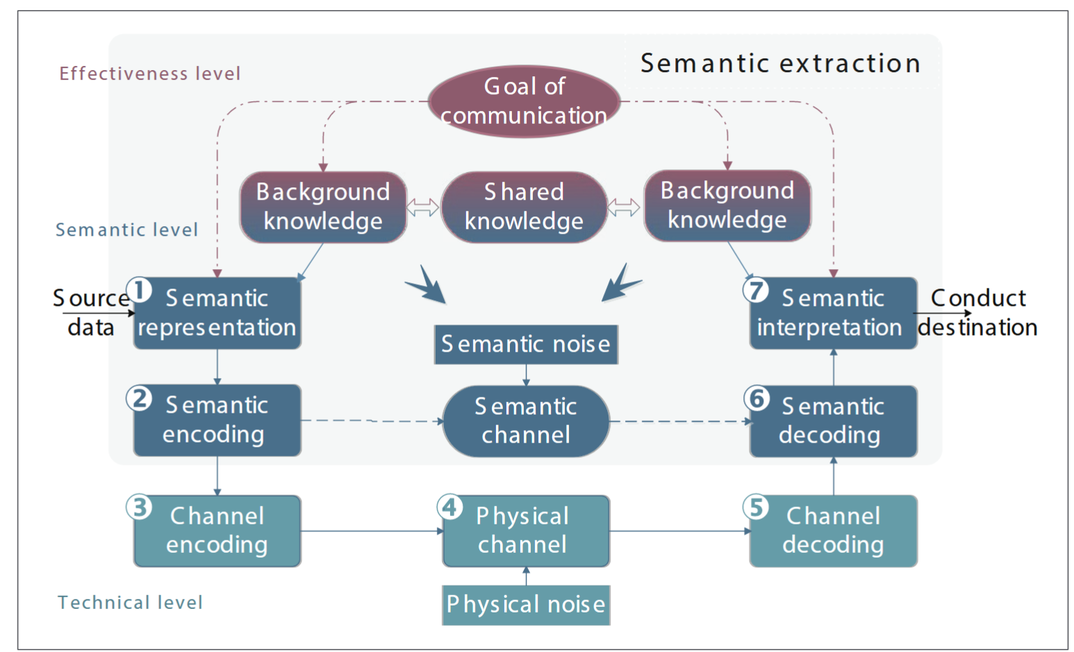
Preliminaries
SemCom framework
Core concern
accuracy of semantic content
Semantic representation module removes redundant information
Background knowledge should be share in real-time
If BK fails to match: semantic noise
Goal of communication
All possibilities of goals should be included
Should instruct SE to filter out irrelevant information
Fig 1. SemCom model

Slide 8
Preliminaries
Semantic metrics
Semantic metrics | Advantages | Disadvantages
Bilingual evaluation understudy (BLEU) | It considers the linguistic laws | It only calculates the differences of words between two sentences
Consensus based Image Description Evaluation (CIDEr) | It evaluate semantic similarity on the basis of a set of sentences with the same meaning | Similar to BLEU, it is also based on the comparisons between word groups
Sentence similarity | The SI in this metric is viewed from a sentence level | much resource consumption, worse generalization capability
Metrics derived from NLP
Avoid treating packets equally
Measure the differences by the recovered sentence and transmitted sentence
Metrics in classical communication systems
Bit-error rate (BER)
Symbol-error rate (SER)
Table 1. Some semantic metrics derived from NLP

Slide 9
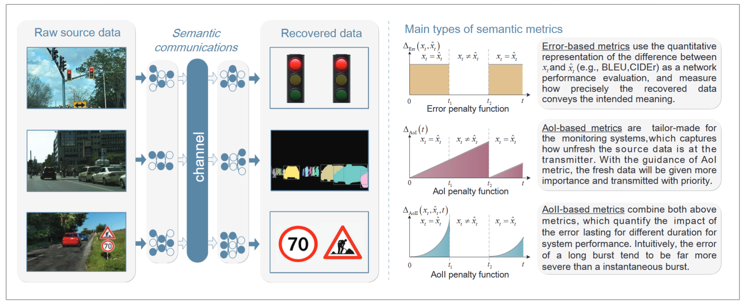
Preliminaries
Semantic metrics
Fig 2. Some SemCom examples and metrics, where $x_{t}$ denotes the transmitted information, and ${\hat{x}}_{t}$ denotes the estimated information inferred from the transmission

Slide 10
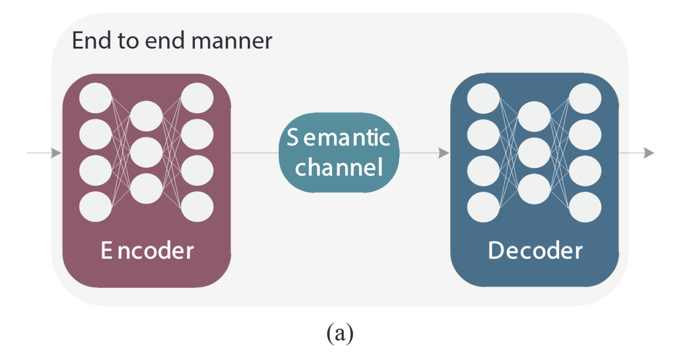
Preliminaries
Semantic extraction techniques
Deep Learning Based SE
Aim: enhance the system robustness at a low SNR with a shorter bit-flow
Encoder and decoder are trained jointly
GANs are used to model the channel dynamics and noise
Adopt cross entropy as the loss function
Drawback: treat the semantic contribution of data equally
Fig 3 (a). System model of DL-based SE

Slide 11
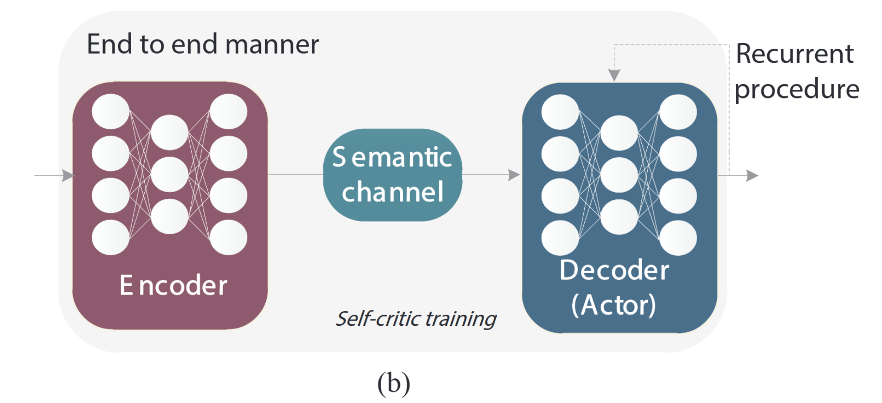
Preliminaries
Semantic extraction techniques
Deep Reinforcement Learning Based SE
Encoder & Decoder: LSTM networks
State: the recurrent state of the decoder and generated words
Transmission between 2 states: determined by the next word
Action of the DRL agent: generate a new word
Self-critic training: identify the intermediate rewards
Non-sequential task: transformed into a recurrent procedure beforehand
Fig 3 (b). System model of DRL-based SE

Slide 12
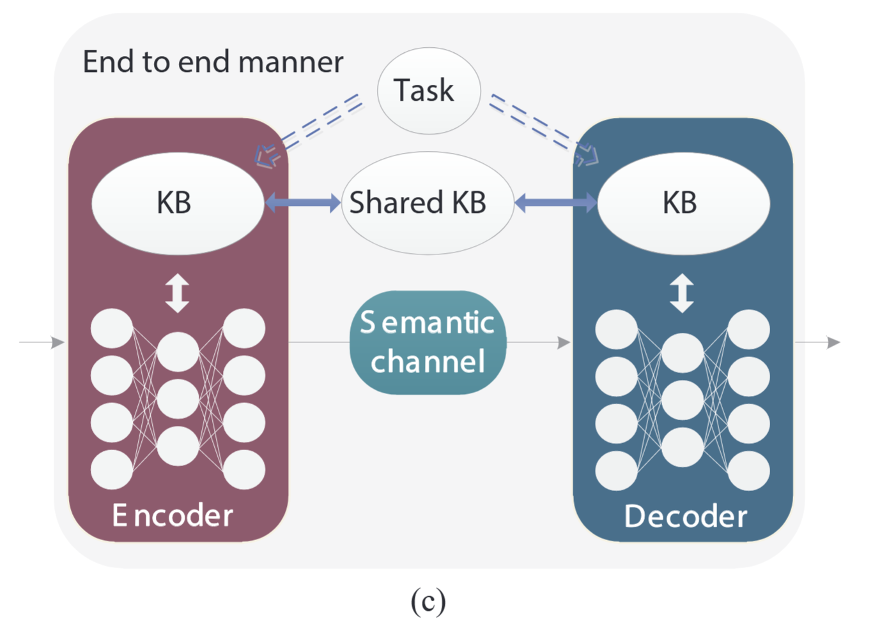
Preliminaries
Semantic extraction techniques
Knowledge Base Assisted SE
Composition
Source information
Communication tasks
Possible ways of reasoning
Function
Quantify the level of relevance of SI (semantic information) for different tasks
Instruct SE to capture SI of interest
Requirement
Synchronization on both sides
Fig 3 (c). System model of KB-assisted SE

Slide 13
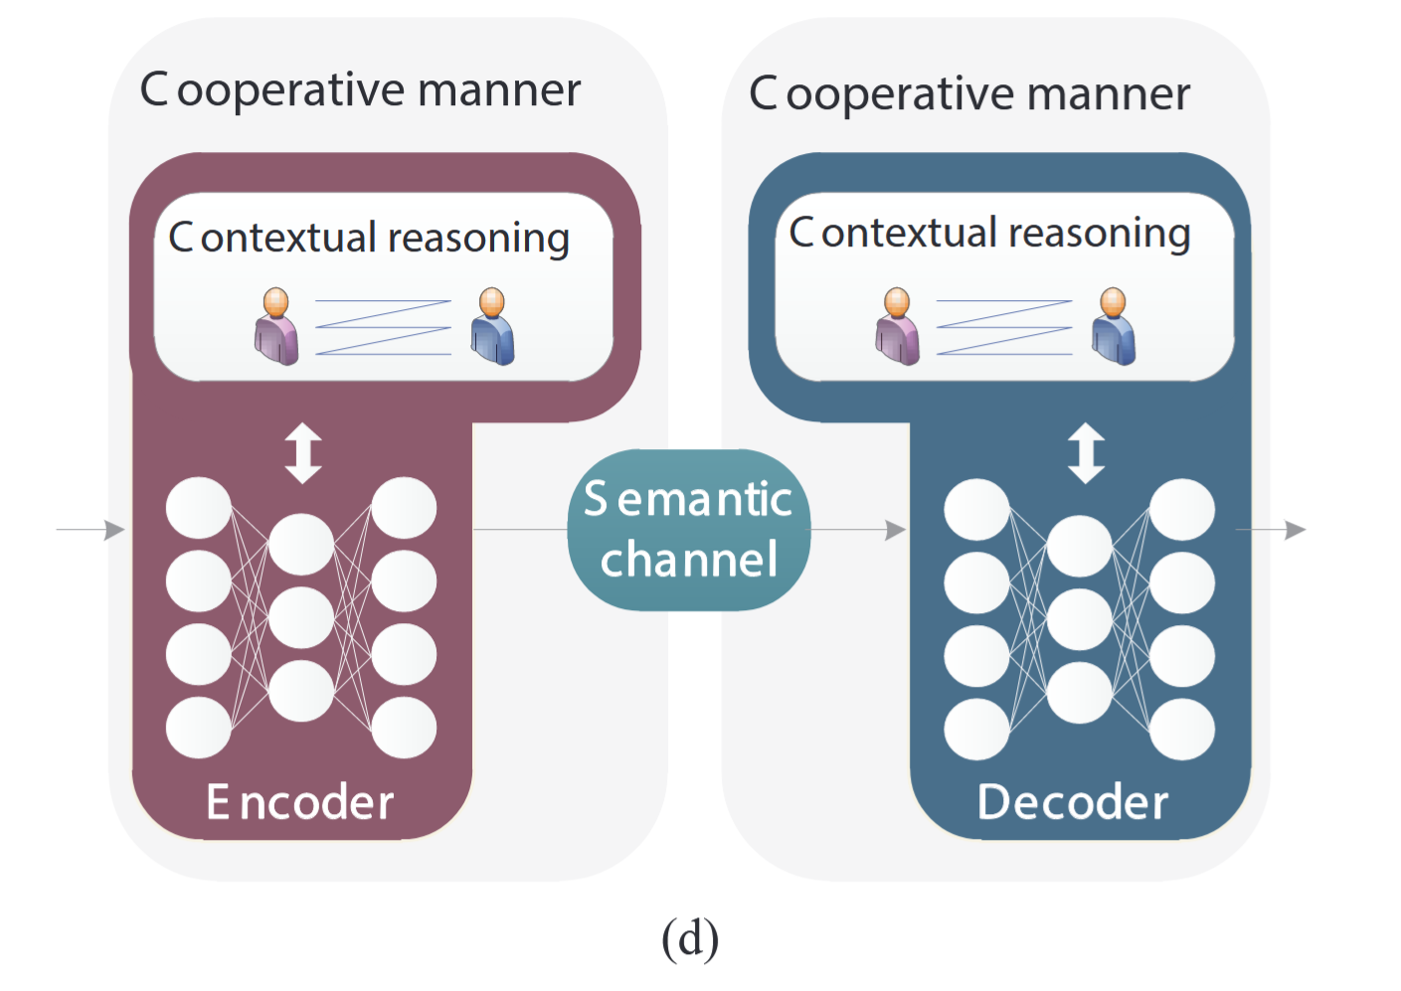
Preliminaries
Semantic extraction techniques
Semantic Native SE
SI
Variable
Learned from iterative communications between intelligent agents
Communication parties
The capabilities of contextual reasoning about the semantics
Promoted intelligentization of communication systems
Fig 3 (d). System model of Semantic native SE

Slide 14
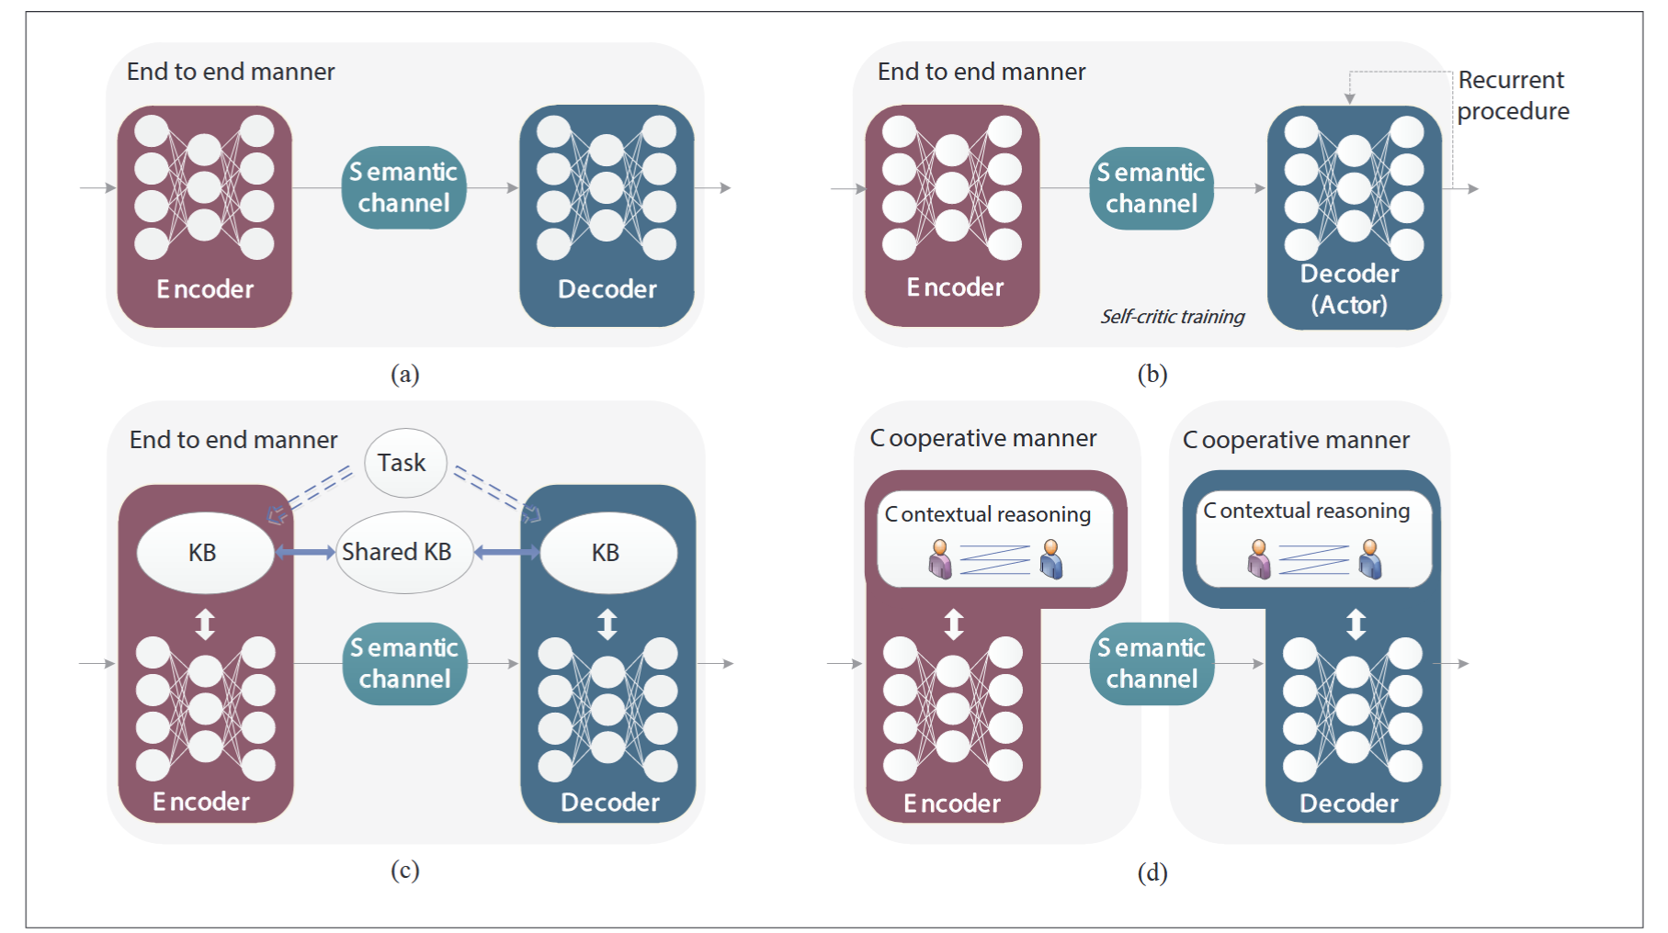
Preliminaries
Comparisons among different SE techniques
Better performance than (a) with huge computational resource consumption
The most used
Only validated for image classification
A theoretical proposition currently

Slide 15



Edge-Enabled SemCom
Challenges
Paradigm of SemCom
Understand-Before-Transmission
Costly training & inference for SE models
A shared KB
Comprehensive sharing of knowledge among devices
Task-specific and separately-trained SE models
Resource-constraint end devices
Long latency in training & updating SE models
Bandwidth cost and privacy loss
Computationally inefficient

Slide 16
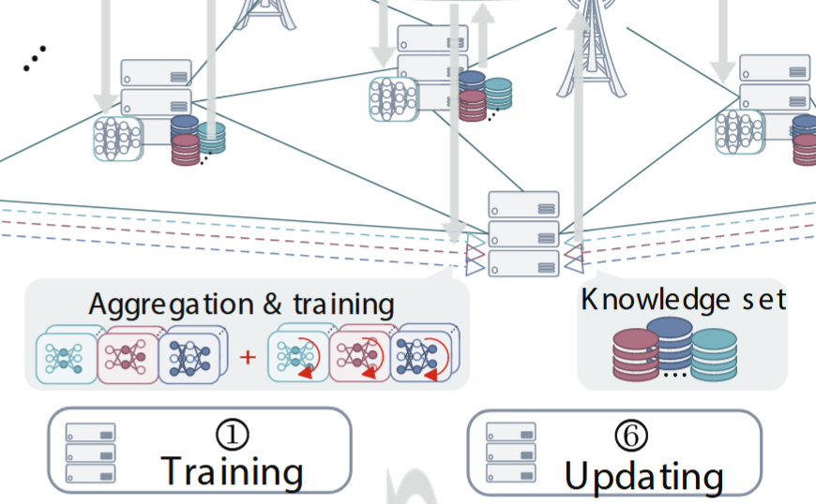

Edge-Enabled SemCom
Federated learning enabled SE
Edge servers
Powerful computation and caching capabilities
BK storage
Reduced communication & computation latency for training
SE model training
Reduced communication parties’ burden
Enhanced privacy
Intermediary for knowledge sharing

Slide 17
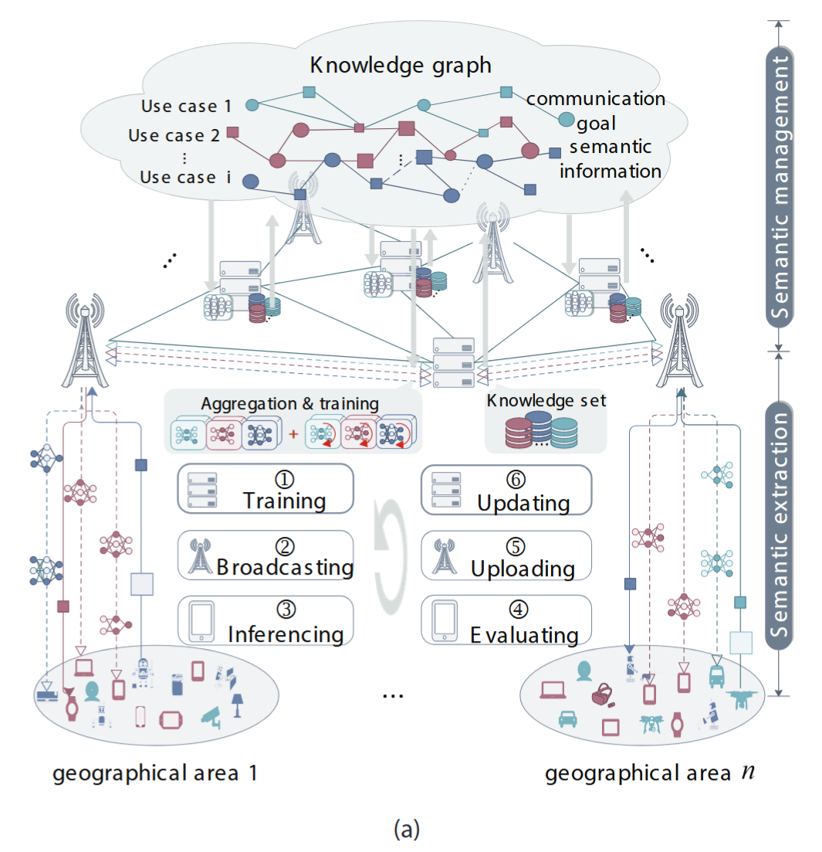
Edge-Enabled SemCom
Federated learning enabled SE
Key procedures
Step 1
Edge server: pre-training or fine-tuning for specific SE tasks
Communication groups: model params. exchange and federated aggregation
Step 2
Broadcast global models to each group
Step 3
SE model encodes and decodes SI
Step 4
Destination devices evaluate the accuracy of SI
Step 5
Newly labeled SI and/or raw data are uploaded to the edge servers
Step 6
Edge servers perform updates for the knowledge sets
Fig 4 (a). Architecture for edge-enabled SemCom

Slide 18
Edge-Enabled SemCom
Efficient SE based on edge-sharing knowledge-graph
Objective: Reduce computational and bandwidth costs in semantic communication by leveraging a fixed KG stored at edge servers
Key Idea: Encode relations between communication goals and features
Advantages:
Reusable & cacheable at the edge, minimizing retraining
Enhances efficiency by focusing only on salient features, reducing redundant data
Facilitates transfer learning across different environments with shared goals like collision avoidance

Slide 19
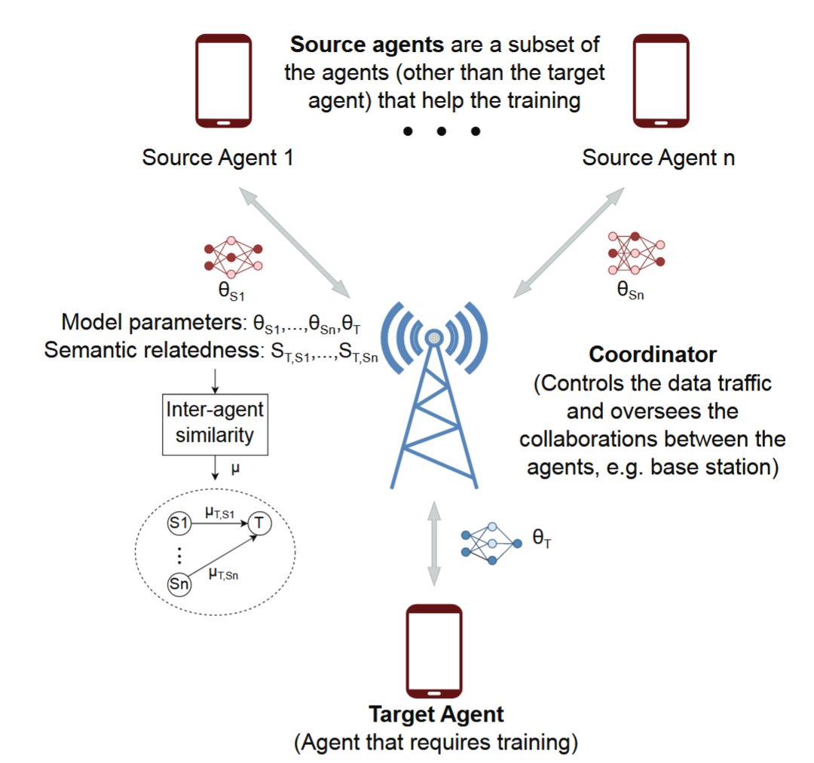
Semantic-Aware Edge Intelligence
Semantic-aware intelligent agent
Deep reinforcement learning
Overfitting issues
Long convergence time
Sub-optimal performance
Collaborative DRL
Model params. or policies exchange
Metrics for source agent selection
Structural similarity to the target agent
Semantic relatedness
The avg. return of the DRL agents improved up to 83% higher than the baseline methods
Fig 4 (b). Example structure of CDRL

Slide 20
Semantic-Aware Edge Intelligence
Semantic-aware distributed deep learning at wireless edge networks
CDRL & distributed DL
High communication overheads for exchanging model params.
Model compression
Gradient sparsification
Model param. pruning
Fig 4 (b). Example structure of CDRL

Slide 21
Case Study
Challenges
Proposed approaches
Redesign energy and data allocation policies to maximize semantic performance
Use an auction-based mechanism where IoT devices bid for energy based on expected semantic gains (sentence similarity, BLEU score)
Allocate energy to devices that provide the highest semantic value, ensuring effective SemCom
Traditional resource allocation maximizes throughput without considering semantic importance or conflicting user-edge goals

Slide 22
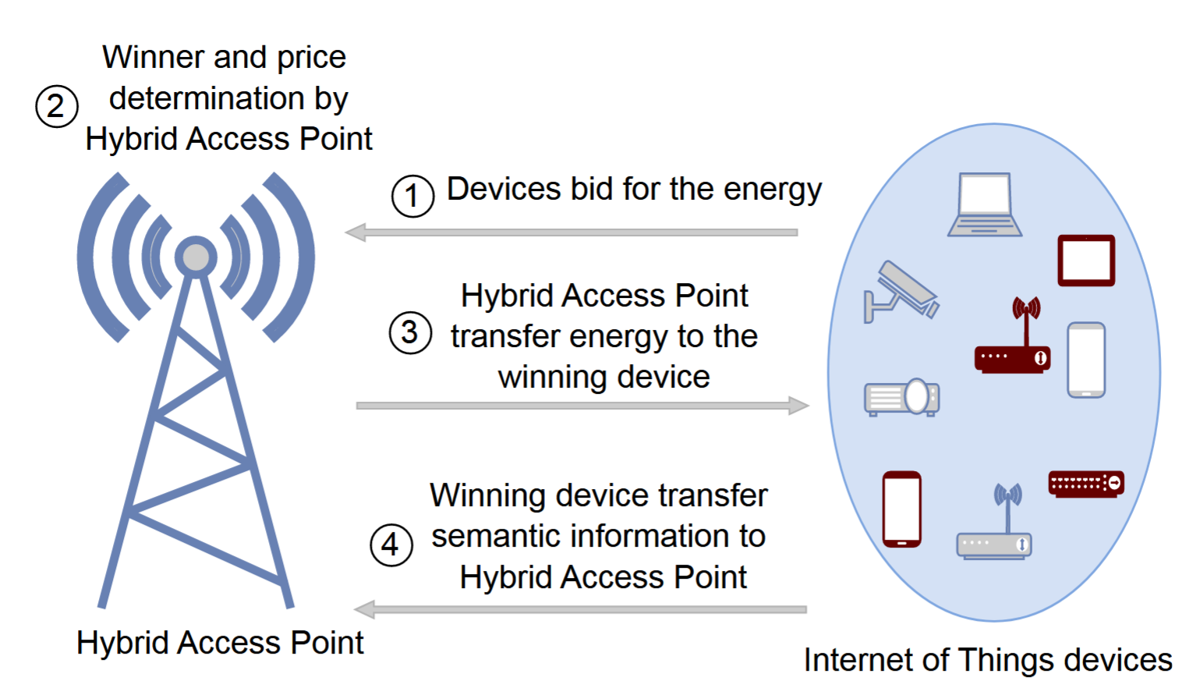
Case Study
System model
Wireless-powered IoT devices encode/decode semantic information from text data
Devices bid for energy
The HAP determines winners via a DL-based auction
Devices adjust output dimensions based on energy constraints
Fig 5 (a). System model of the case study

Slide 23
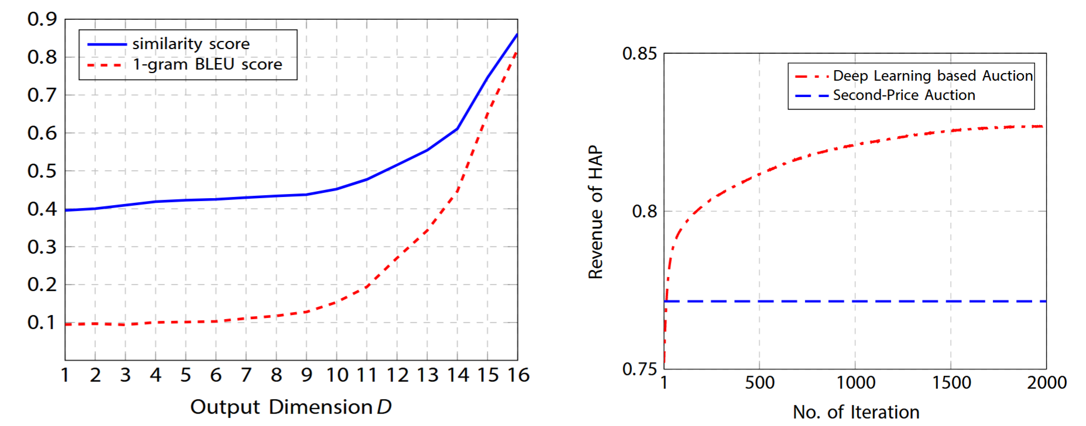
Case Study
Results
Higher semantic quality (sentence similarity, BLEU score) leads to higher bids and better energy allocation
DL auction achieves higher revenue compared to traditional methods, effectively aligning resource distribution with semantic importance
Fig 5 (b). Results of the case study

Slide 24
Research Directions
Edge-enabled SemCom
Semantic-aware edge intelligence
Interpretability & Explainability of SE
Current SE methods are black-box models, limiting trust and understanding
Developing explainable SE is crucial for identifying semantic information and guiding model improvements
Fixed KGs can improve interpretability but require computationally intensive construction
Semantic Privacy & Security
Eavesdropping risks increase in groups sharing similar goals
Introducing semantic noise might enable secure, covert SemCom
Variable-Length Semantic Encoding
Current SE approaches mainly focus on channel dynamics
Future work needed to adapt semantic encoding lengths dynamically based on varying network resources (spectrum, power)
DL-Based Task Similarity Measurement
Existing metrics rely on extensive training and hand-crafted procedures
Future Approach: Use DL to extract semantic embeddings from model params.
Semantic Compression of Model Parameters:
Conventional model compression depends on hyperparameters, which are costly to optimize
Future Approach: Adopt semantic-aware encoding/decoding structures that extract essential information, enabling efficient transmission and accurate reconstruction without manual hyperparameter tuning

Slide 25
Conclusion
Pros
Cons
High Computational Cost: Semantic extraction and model training are resource-intensive
Storage Demands: Significant storage needed for knowledge bases and models at devices/edge servers
Limited Generalization: Mismatch in knowledge sharing can hinder adaptability in dynamic environments
Security Concerns: Sharing knowledge across devices may introduce privacy risks
Implementation Challenges: Integration complexity and resource management across heterogeneous networks
Bandwidth Efficiency: Transmits only task-relevant information, reducing data load
Enhanced Privacy: Limits exposure of raw data, improving security
AI & Edge Synergy: Leverages edge computing and AI for real-time, context-aware communication
Task Optimization: Enables smarter, goal-oriented data exchange, improving system performance
Scalability: Supports large-scale deployments via federated learning and distributed models

Slide 26
Thank you!
提高 2301 班 张禹阳
Jun. 20, 2025

