Slide 1
Some Ideas About Learning
How I learn
Basic Introductions
Use in daily life
Becomes a base for
New info
Do it again
Becoming educated never ends except in ignorance

Slide 2
A Program to Print Hello
In C++ Source Code with output
1 #include <iostream>
2 Int main(){
3 Std::cout<< “Hello World”;
4 return 0;
5 }
Output from .exe:
Hello World

Slide 3
How do I make the Source Code ?
How do I make the .exe file?
This is a very basic description of all you need for systems programming.
Vital Programming Skills
Problem solving, & algorithms.
Knowing the syntax.
Knowing your compiler.
With a mindset to solve problems and a program called a text editor.
With a program called a compiler.
That is the whole point of object oriented programming and all programming generally, to make those million simple steps comprehensible.
~Angela Heywood

Slide 4
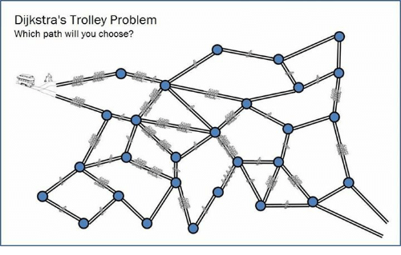
Problems
Search the internet ! Phone a friend ! Read a Book ! Get gud pleb !
~Lizzie Holmes

Slide 5

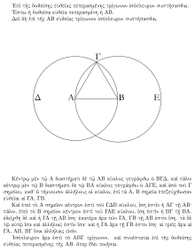
Knowing Syntax

Slide 6
The Compiler how C/C++ code becomes executable
.exe
File
(machine code)
Source
Code
Compiler
The compiler is like the law, when you are young you learn to respect it, when you are older you learn to abuse it…
~Baruch Spinoza

Slide 7
So what is going on inside?
.exe
.LC0:
.string "Hello World"
main:
stp x29, x30, [sp, -16]!
mov x29, sp
adrp x0, .LC0
add x1, x0, :lo12:.LC0
adrp x0, _ZSt4cout
add x0, x0, :lo12:_ZSt4cout
bl std::basic_ostream<char, std::char_traits<char> >& std::operator<< <std::char_traits<char> >(std::basic_ostream<char, std::char_traits<char> >&, char const*)
mov w0, 0
ldp x29, x30, [sp], 16
ret
__static_initialization_and_destruction_0(int, int):
stp x29, x30, [sp, -32]!
mov x29, sp
str w0, [sp, 28]
str w1, [sp, 24]
ldr w0, [sp, 28]
cmp w0, 1
bne .L5
ldr w1, [sp, 24]
mov w0, 65535
cmp w1, w0
bne .L5
adrp x0, _ZStL8__ioinit
add x0, x0, :lo12:_ZStL8__ioinit
bl std::ios_base::Init::Init() [complete object constructor]
adrp x0, __dso_handle
add x2, x0, :lo12:__dso_handle
adrp x0, _ZStL8__ioinit
add x1, x0, :lo12:_ZStL8__ioinit
adrp x0, _ZNSt8ios_base4InitD1Ev
add x0, x0, :lo12:_ZNSt8ios_base4InitD1Ev
bl __cxa_atexit
.L5:
nop
ldp x29, x30, [sp], 32
ret
_GLOBAL__sub_I_main:
stp x29, x30, [sp, -16]!
mov x29, sp
mov w1, 65535
mov w0, 1
bl __static_initialization_and_destruction_0(int, int)
ldp x29, x30, [sp], 16
ret
Source Code
1 #include <iostream>
2 Int main(){
3 Std::cout<< “Hello World”;
4 return 0;
5 }
Compiler

Slide 8
So what are we actually learning?
How to write good code.
Being friendly to the Compiler
Syntax &
Basic programming
Problem Solving & Simple Algorithms

Slide 9
DO NOT LEAVE
I will explain how to setup in Windows, Linux & Mac

Slide 10
Setting up VS for C++ on Windows
A beginner/professional IDE
Download the installer, this is a program to install the IDE
Install ‘Desktop Development with C++’ toolkit.
Open the template for a console application, and run the code given to you.
IDE means Integrated Development Environment and is a compiler, syntax highlighter and more, and you will learn what all these terms mean in time, but they will all make your life easier.

Slide 11
Linux setup
First get the compiler if you don’t have it, using this command: sudo apt-get install build-essential
Second get the text editor vim, using this
Command: sudo apt-get install vim
Setup vim, then write code
To compile & run a simple c++ program,
Enter: g++ hello.cpp
Then: ./a.out
Cd = change directory
Mkdir = make directory
Cd Desktop = move to desktop
Cd .. = go back
Cd ../.. = go back 2 layers

Slide 12
Mac setup
First get ‘Developer Tools’, you may have to google this one, (‘sorry I don’t have a mac’)
You should get all the tools with that download, you can follow the rest of the Linux steps except replace the command vim with vi, try it with vim if vi doesn’t work
To compile & run a simple c++ program,
Enter: g++ hello.cpp
Then: ./a.out

Slide 13
Ye olde C
#include <stdio.h>
Int main(){
printf(“Hello World”);
return 0;
}
This return is why C is still the best

Slide 14
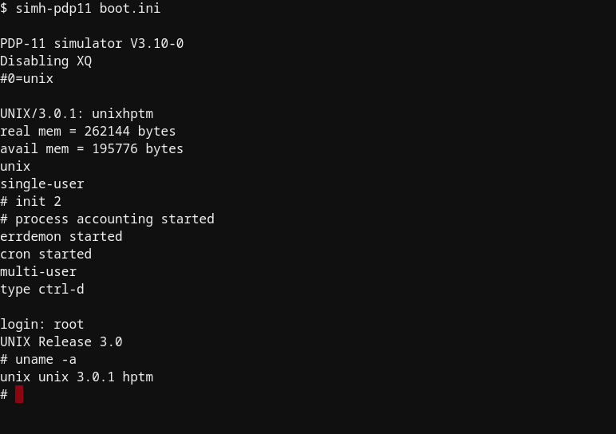
Unix

Slide 15
Hello in C and C++
C
#include <stdio.h>
Int main(){
printf(“Hello World”);
return 0;
}
C++
#include <iostream>
Int main(){
std::cout << “Hello World”;
return 0;
}

Slide 16
What is ‘#include’
What is ‘printf’ and ‘std::cout<<’
#include is a preprocessor command that gets stuff from other files for you to use, you can think of it as a fancy way of copy&pasting
This is a way to print text to the console, how we ‘say hello’

Slide 17
Hello in C and C++
C
#include <stdio.h>
Int main(){
printf(“Hello World”);
return 0;
}
C++
#include <iostream>
Int main(){
std::cout << “Hello World”;
return 0;
}

Slide 18
What is int main()
Main is where the action happens.
Int main is a function called main that is of type int. the Type int is used to store integers. The function main returns an integer type (int).
C++
#include <iostream>
Int main(){
std::cout << “Hello World”;
return 0;
}

Slide 19
What is {}
The curly braces tell the compiler where functions and types are declared
C++
#include <iostream>
Int main(){
std::cout << “Hello World”;
return 0;
}

Slide 20
Ye olde C
#include <stdio.h>
Int main(){
printf(“Hello World”);
return 0;
}
This return is the end of the program in memory
The compiler is what reads curly braces
Curly braces do not get into machine code

Slide 21
DataTypes in C ++
Fundamental User Defined
Int : integer
Char : character
Double : decimal number
Bool : True or False (1 or 0)
Void :
Nullptr :
Struct : basic structures,
Data alone
Class : More complex stuff,
Objects

Slide 22
What is an object?
An object called hello
Deceleration Definition Implementation
Tell the computer what the object is, basic blueprint of data structure
UML
__hello__
+hello()
+sayHi()
+message
hello() {
put the message in the
memory
}
sayHi() {
output the first half of
the message
}
Use the hello files
main() {
run constructor
run member
}
Outputs:
hello

Slide 23
What is an object?
An object called hello in sudocode
Deceleration Definition Implementation
//in C++ we call objects
//class
class hello
{
//the constructor
hello();
//a member function sayHi();
//some data
string message;
};
hello() {
message = "hello world";
}
SayHi() {
I=0
for (while I < 5, add 1+I){
cout << message[I];
}
cout << endl;
return;
}
#include "hello.h"
int main() {
hello h;
h.sayHi();
return 0;
}
Outputs:
hello

Slide 24
What is an object?
An object called hello
Deceleration Definition Implementation
//in C++ we call objects
//class
class hello
{
public:
//the constructor
hello();
//a member function
void sayHi();
//some data
std::string message;
};
#include "hello.h"
int main() {
hello h;
h.sayHi();
return 0;
}
hello::hello() {
message = "hello world";
}
void hello::sayHi() {
for (int i = 0; i < 5; i++) {
std::cout << message[i];
}
std::cout << std::endl;
return;
}
Outputs:
hello

Slide 25
Why use objects?
An object called helloWorld
Deceleration Implementation
#include "hello.h"
class helloWorld:public hello
{
public:
void sayHiWorld();
};
#include "hello.h"
#include "helloWorld.h"
int main() {
hello h;
h.sayHi();
helloWorld hW;
hW.sayHiWorld();
return 0;
}
Definition
void helloWorld::sayHiWorld() {
std::cout << message;
return;
}
Outputs:
Hello
Hello world

