Slide 1
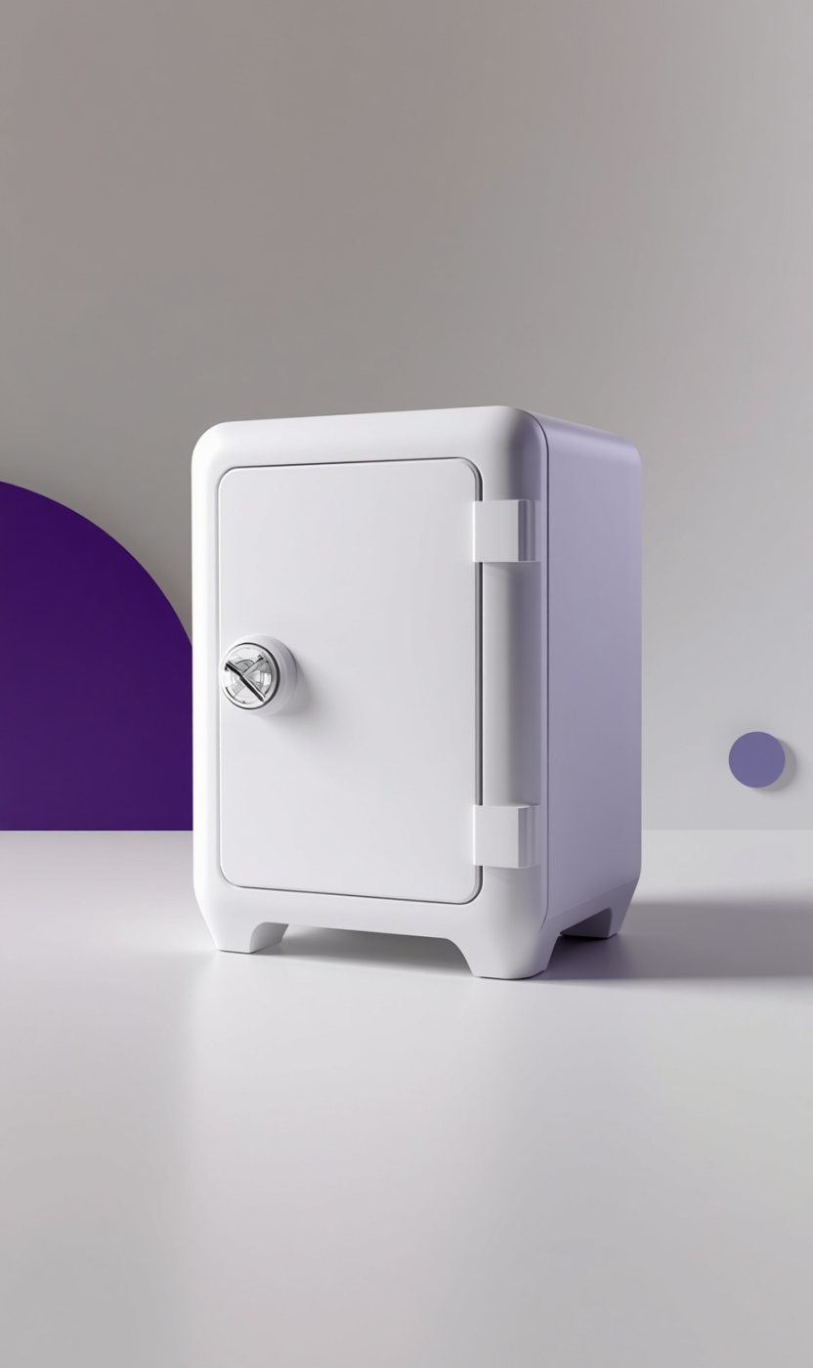

WillVault: On-chain Digital Inheritance
BUILT FOR MONAD BLITZ

Slide 2
The Problem with Traditional Inheritance
WHY IT FAILS
Wills can get lost, forged, hidden, or contested.
Paper documents may be secretly altered, complicating claims.
Heirs often struggle to find or access assets after sudden deaths.
Lawyers, escrow, and courts can be slow and costly.

Slide 3
The Solution: WillVault
ENCRYPTED DIGITAL VAULT
WillVault is an encrypted digital vault on the Monad blockchain, equipped with a built-in dead-man's switch for secure inheritance.
AUTOMATED ACCESS
Heirs can access documents automatically after a set interval of silence, eliminating the need for lawyers or escrow services.

Slide 4
How WillVault Works
PROTECT YOUR LEGACY
Create a secure vault to store encrypted documents, ensuring that your vital information is notarized and protected on-chain.
PROVE YOUR EXISTENCE
Regular check-ins reset the countdown, confirming your presence and maintaining control over your inheritance until the time comes.
INHERIT SEAMLESSLY
If the timer runs out, heirs can claim access and decrypt the documents directly in their browser, ensuring a smooth transition.

Slide 5
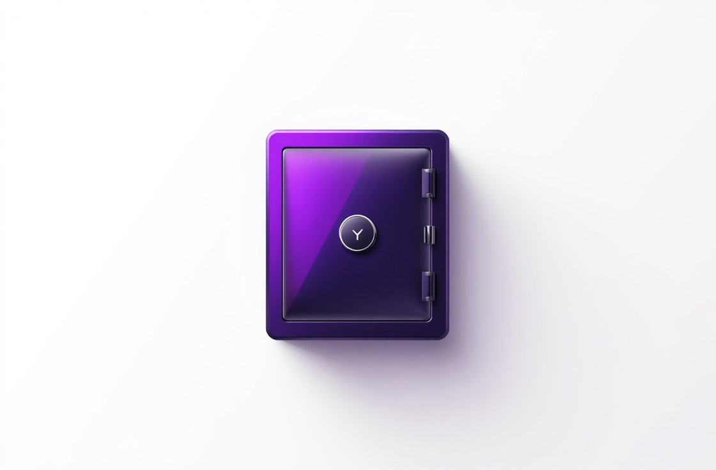
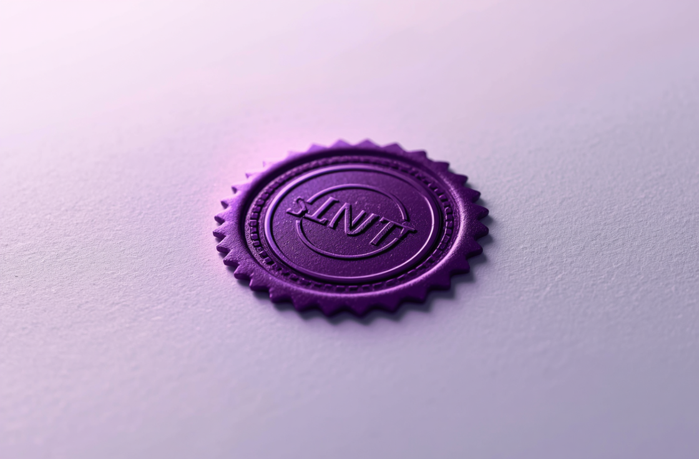

Key Features: A Living Legacy Ecosystem
NOTARIZATION
GROWTH
REWARDS
Prove document integrity with tamper-proof features.
Lock MON to benefit heirs with endowment yield.
Earn points through active participation and document protection.

Slide 6
WHY IT'S USEFUL
ESSENTIAL FEATURES
WillVault offers real impact powered by Monad's technology. Its benefits include:
Fast and near-free check-ins
Trustless operation without middlemen
Global accessibility for all wallet users
Peace of mind for secure document transfer
The platform provides critical advantages:
High throughput ensures instant claims
Eliminates traditional legal barriers
Works effectively in regions with weak legal systems
Guarantees that assets reach intended heirs as code ensures reliability

Slide 7


The Vision of WillVault
OUR MISSION
Every person deserves a secure way to pass on what matters.
THE PROMISE
Your legacy, secured on-chain — for good.
LIVE NOW
Running on Monad testnet today. Thank you.

